Slide 1
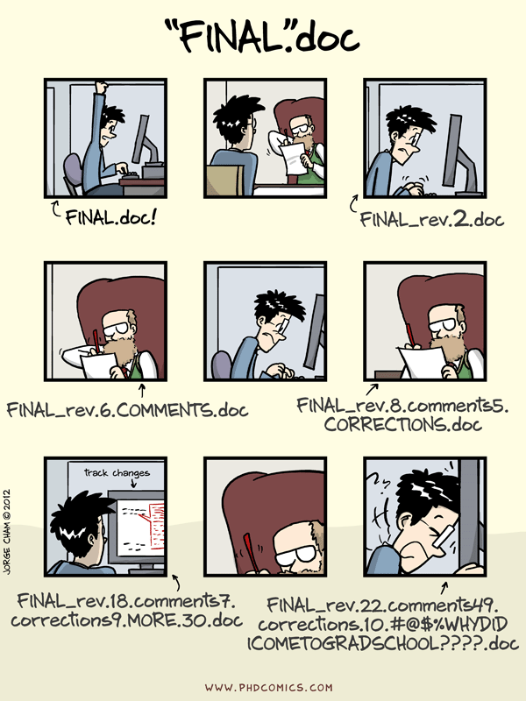
Version control
Reproducibility = key for credible, sharable science
Ensures data, code, & results can be verified
Builds trust and enables future use
“Final_Final.docx” problem
Data overwrites and lost changes
Hard to track collaborations

Slide 2
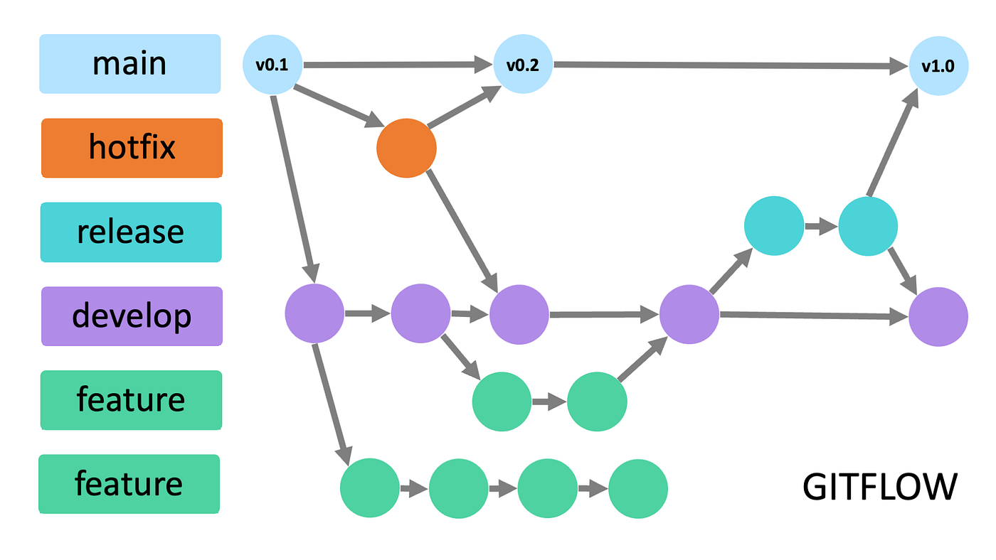
Git
A version control system
Tracks changes & history
Branching allows parallel work

Slide 3
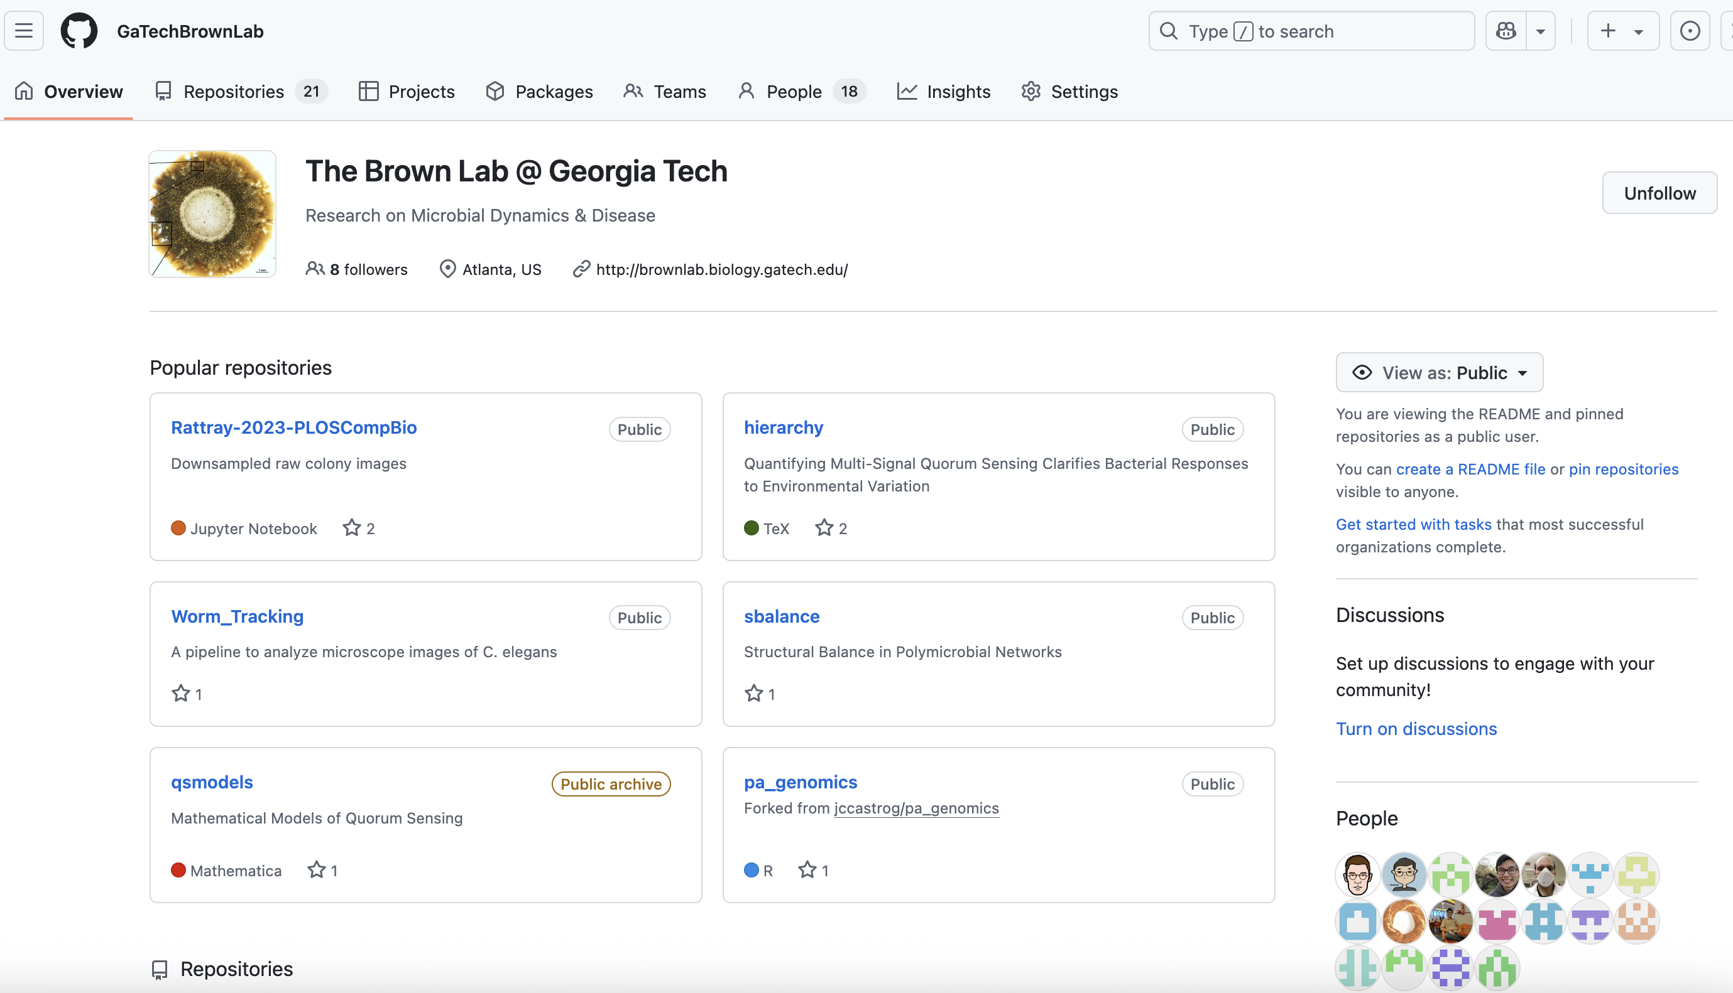
GitHub
Cloud platform to host Git repositories
Collaboration tools
(issues, pull requests)
Visibility and backup

Slide 4
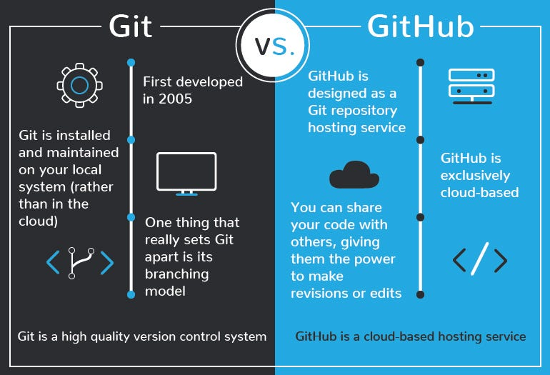

Slide 5
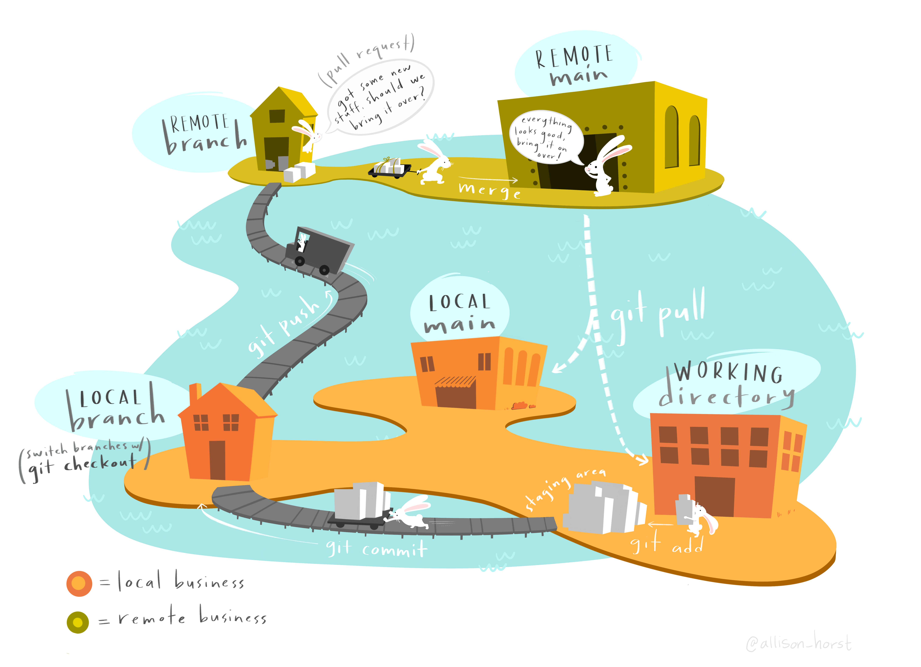

Slide 6
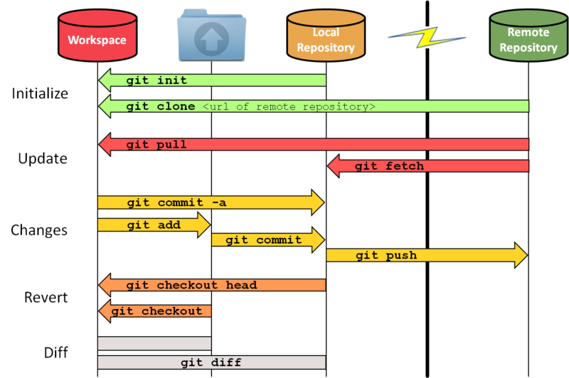

Slide 7
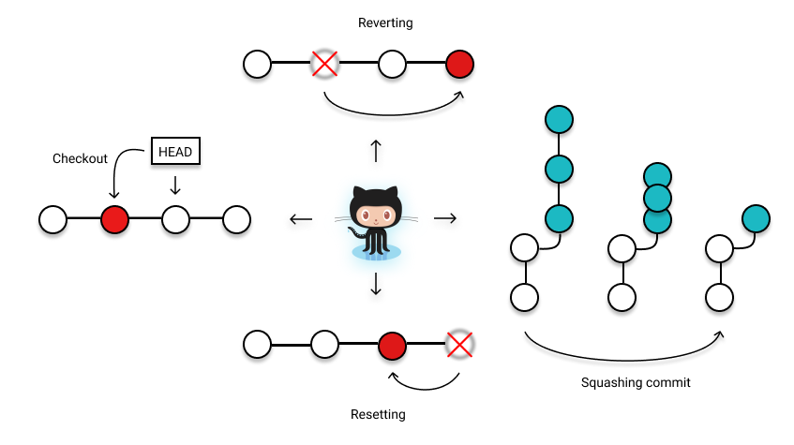

Slide 8
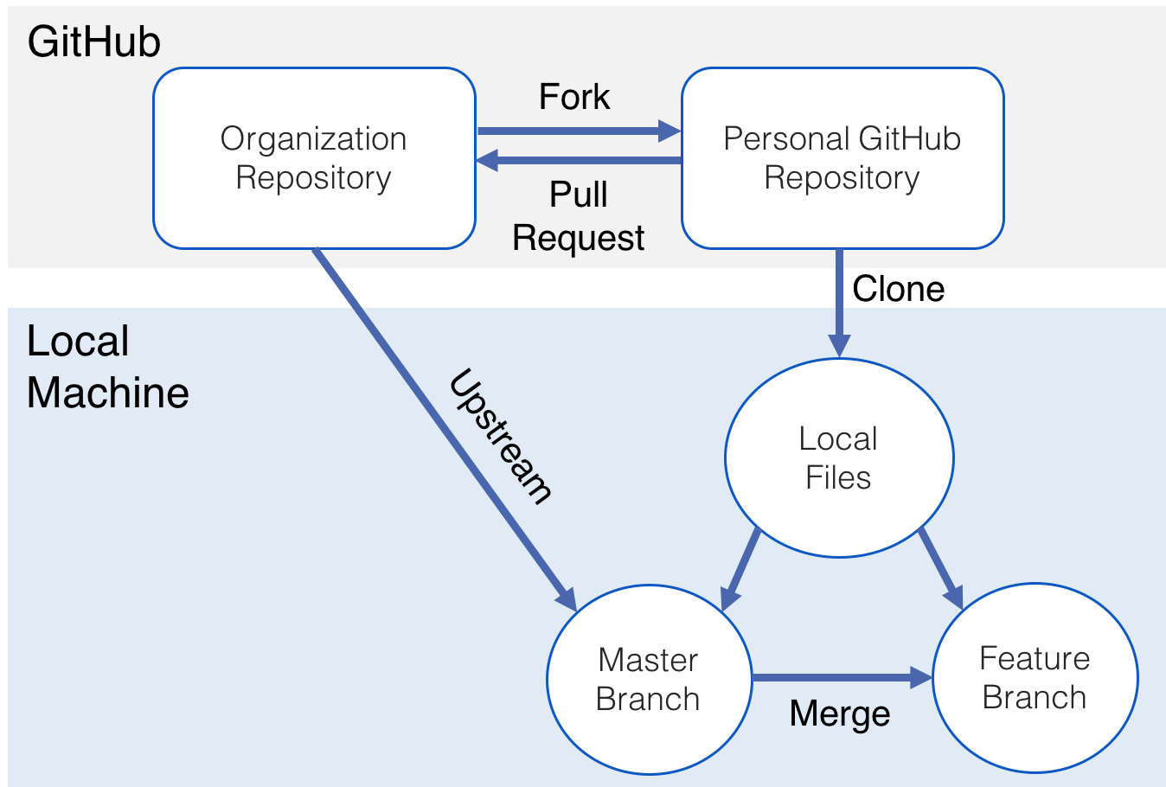

Slide 9
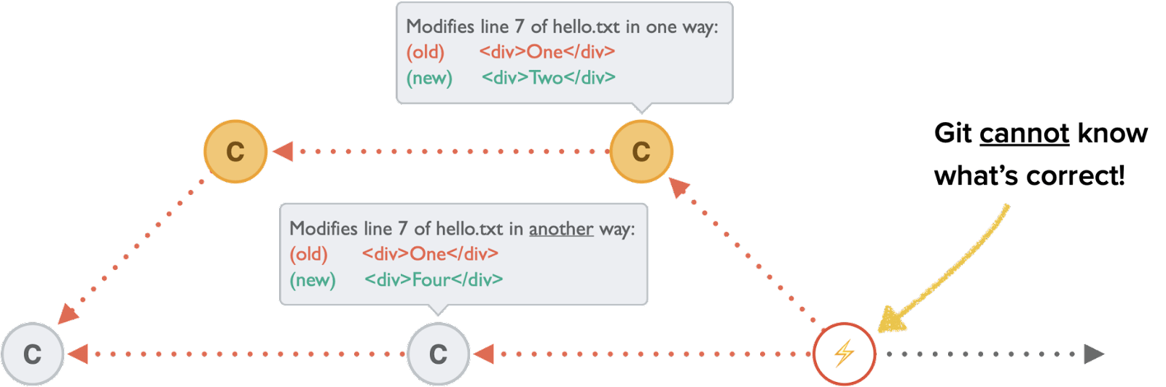

Slide 10
Basic flow
Create an account: https://github.com/ +2FO
Install git https://git-scm.com/downloads
Create a repo, clone, or fork an existing repo
Authenticate yourself, tokens, SSH
Global settings (git config --global), origin, and upstream (git remote add)
Git workflow (branch, add, commit, merge, pull, push)
Pull request

Slide 11
Some lab practices
Commit often, descriptive messages
Use .gitignore for large/unwanted files
Write clear README & document analyses
Create separate branches for each new feature or fix.
Use git pull upstream main to stay up-to-date with the lab’s central repo.
Never push directly to the lab’s main repo. Use pull requests to propose, review, and discuss changes.
CONFLICTS! Check that your changes run without errors and don’t break anything.
Communicate in pull requests and issues.
Raw data and key results should be backed up outside Git (e.g., lab server, cloud storage).

Slide 12
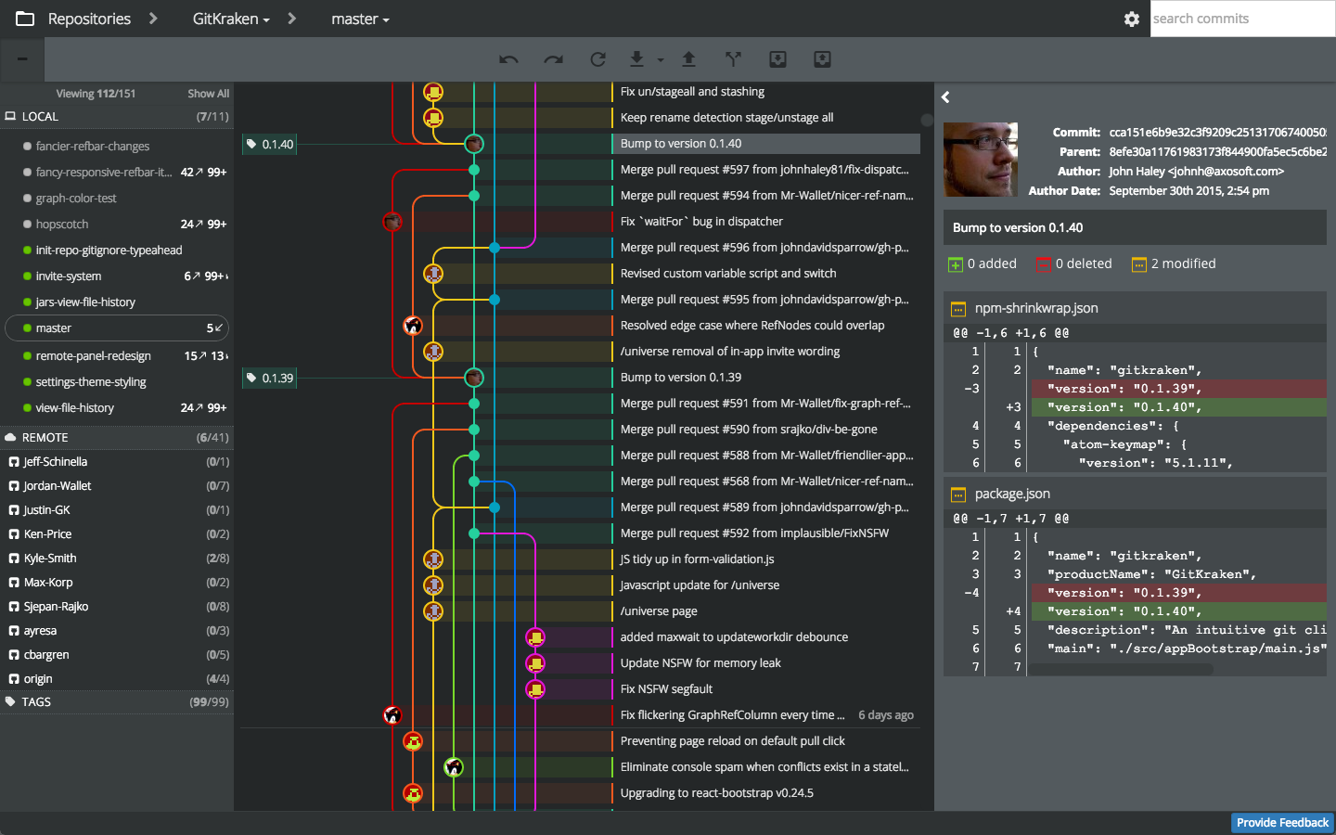

Slide 13
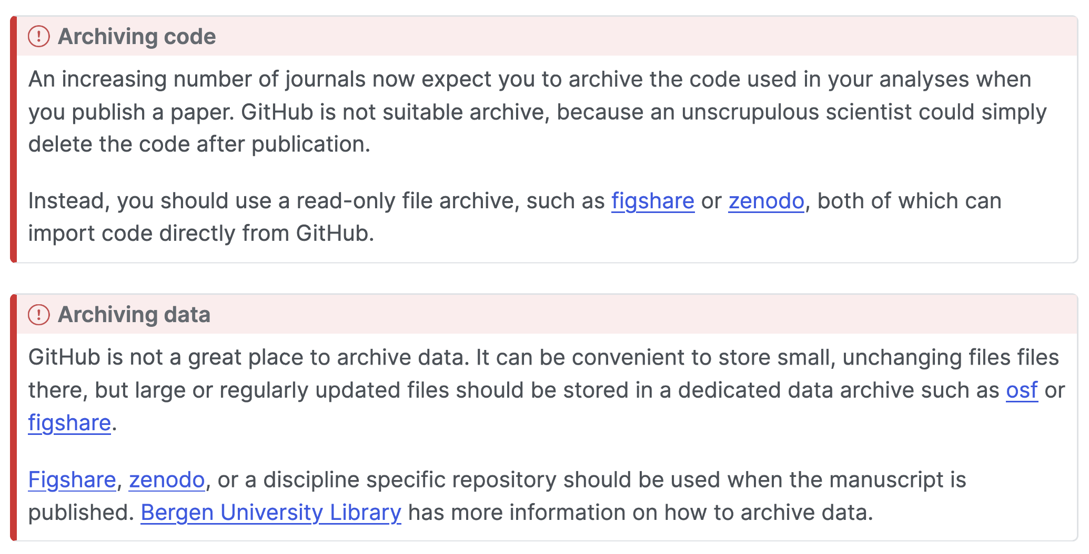

Slide 14
Info links
https://ohshitgit.com/
https://biostats-r.github.io/biostats/github/
https://happygitwithr.com/
https://github.com/bobbyiliev/introduction-to-git-and-github-ebook?tab=readme-ov-file

