Slide 1

Wine Production and Climate Change
An Analysis of the Impact of Rising Temperatures on Global Wine Production

Slide 2
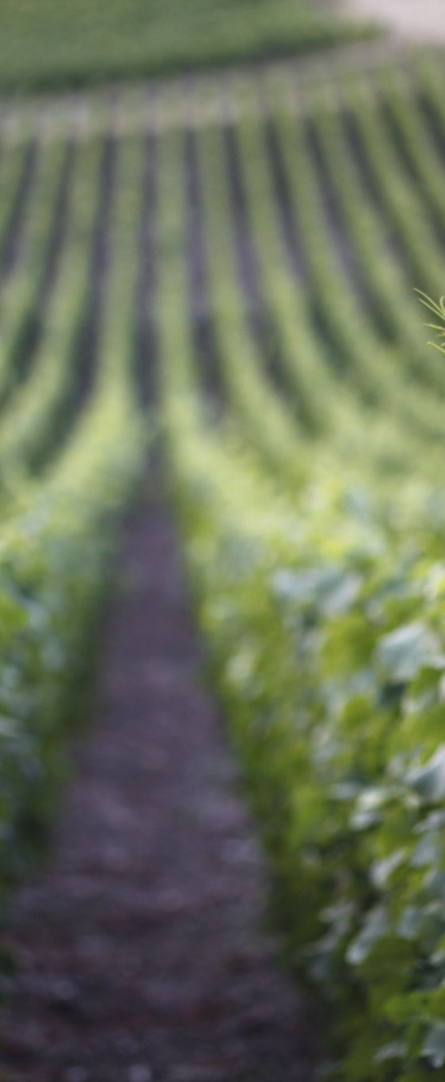
Research Question #3:
Which geographical regions can expect to see an increase in wine production and which regions can expect to see a decrease in wine production given the expected rise in temperature?
Hypothesis: There is statistically significant difference in the expected change in wine production between geographical regions as a result of the expected rise in temperature.
We expect to see geographical regions traditionally too cold to grow wine to see an increase in production due to rising temperatures, and those traditionally ideal to see a decrease in wine production.

Slide 3
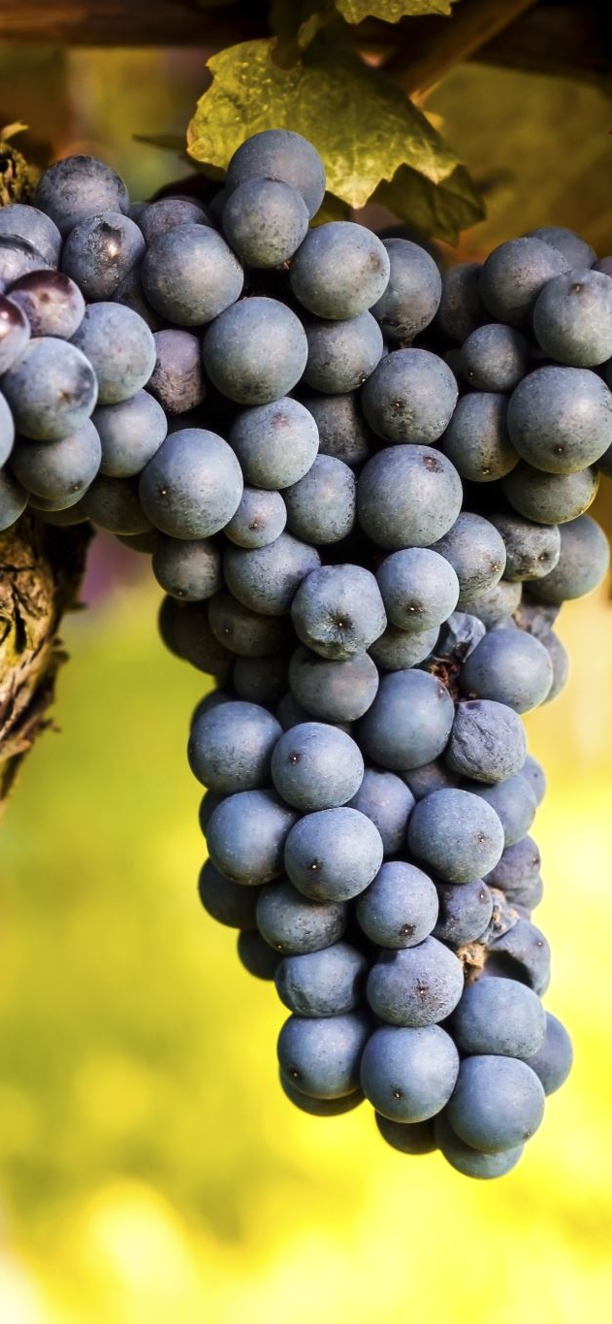
Analysis Methodology
To analyze which geographical regions can expect an increase or decrease in wine production given the expected rise in temperature, we need to:
Correlation Analysis between Temperature and Wine Production:
Analyze the relationship between temperature and wine production.
Trend Analysis of Average Temperature and Wine Production Over the Years:
Identify trends in temperature changes over the years.
Identification of Regions Potentially Affected by Climate Change:
Predict which regions might see an increase or decrease in wine production based on these trends.

Slide 4
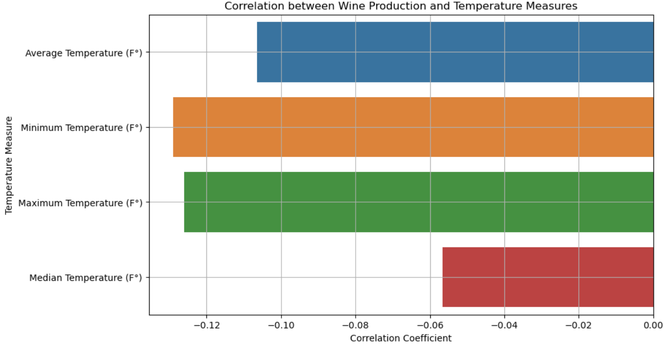
Correlation between Wine Production and Temperature Measures
+ 1 indicates a strong positive correlation.
- 1 indicates a strong negative correlation.

Slide 5
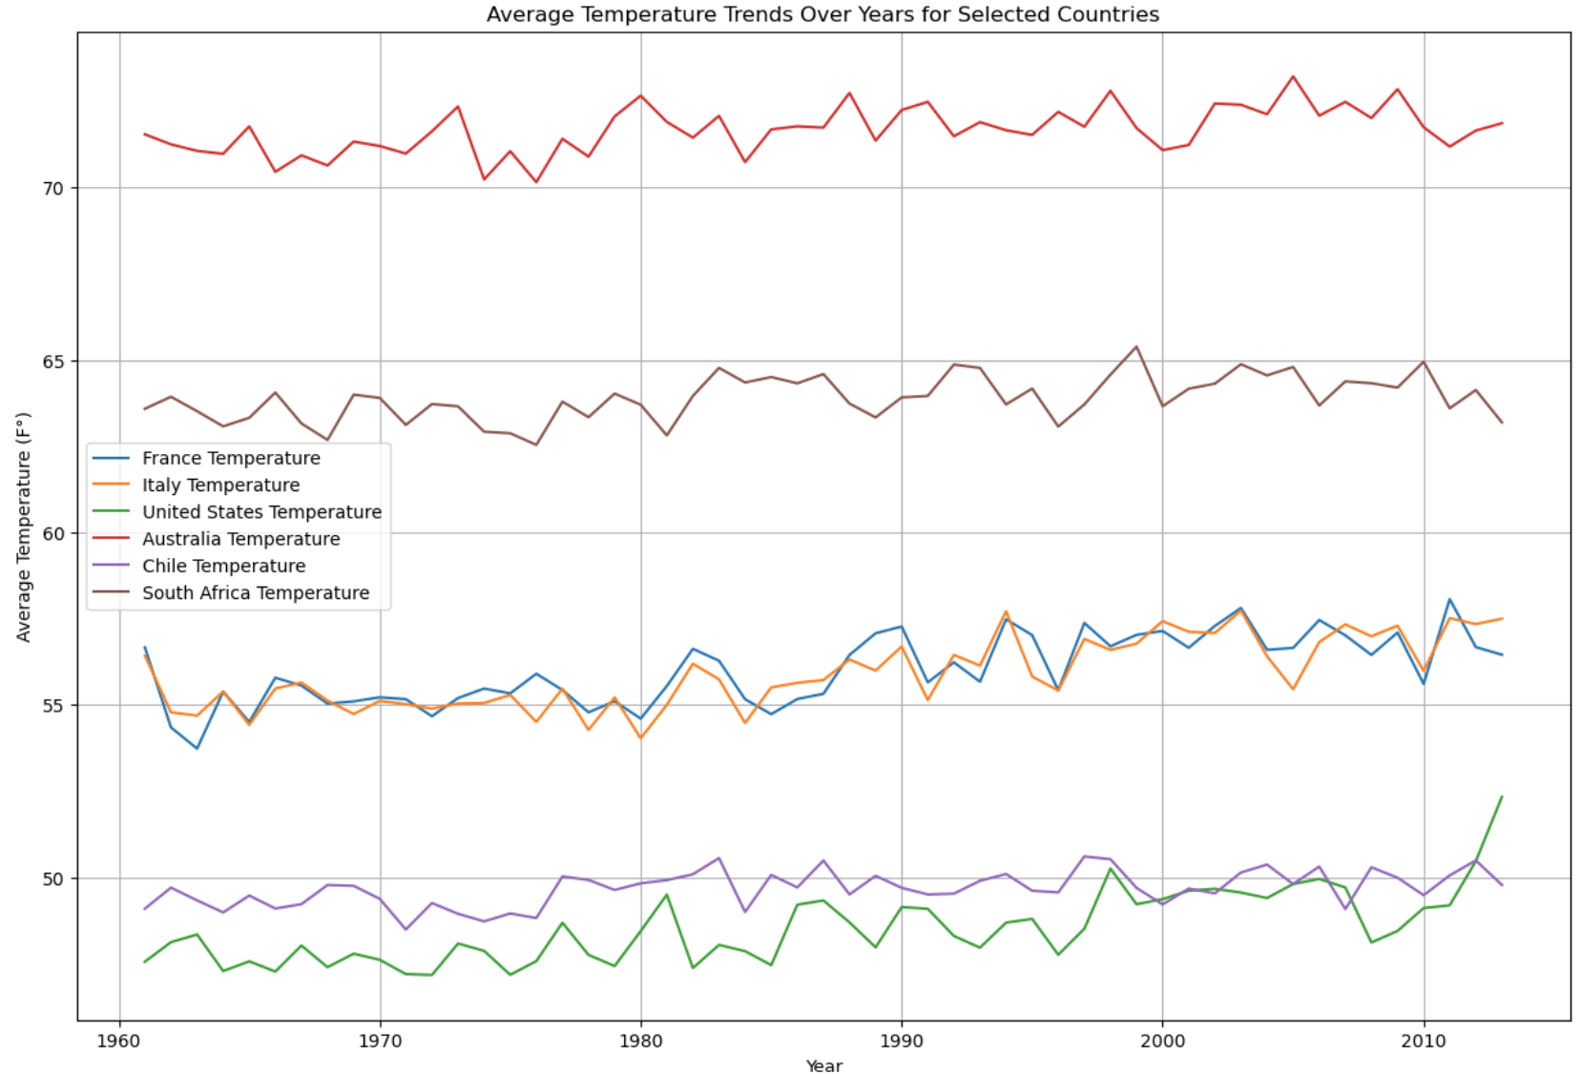
Average Temperature Trends Over Years for Selected Countries

Slide 6
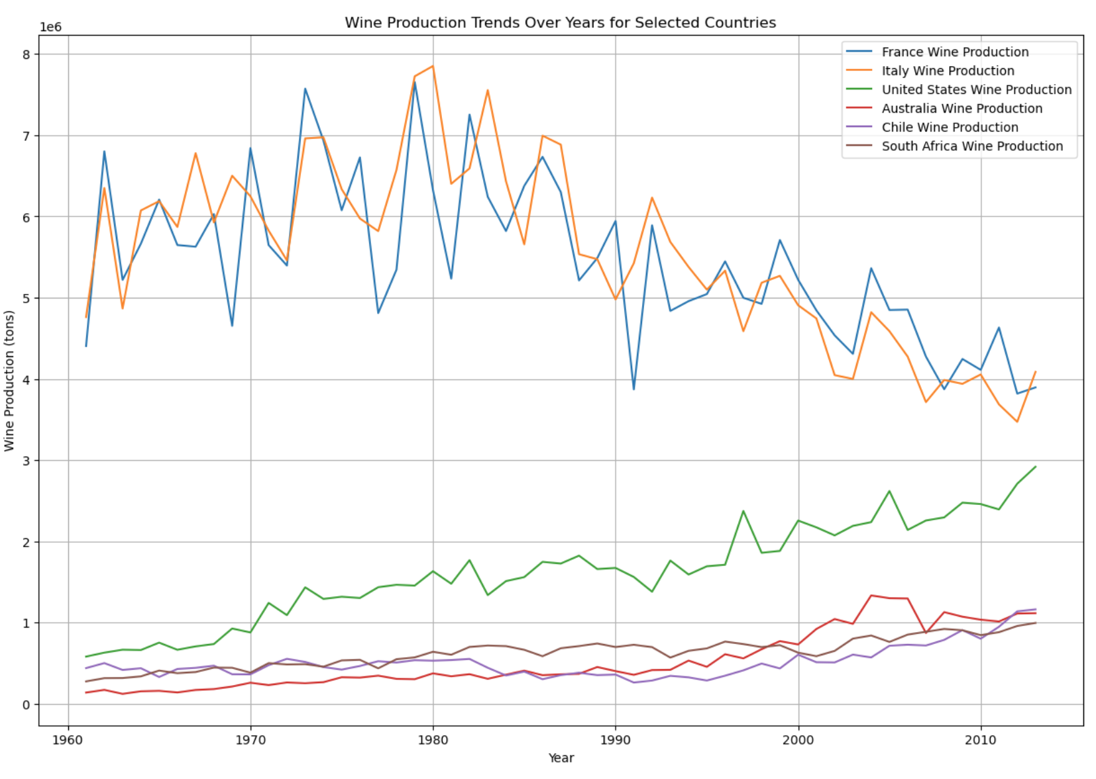
Wine Production Trends Over Years for Selected Countries

Slide 7
Results
Varied Impact Across Regions:
Climate change impact on wine production varies significantly across different regions. Countries like France, Italy, the United States, Australia, Chile, and South Africa show diverse trends in temperature changes and corresponding shifts in wine production.
Temperature-Wine Production Relationship:
Correlation analysis reveals that temperature fluctuations are related to changes in wine production, though the relationship's strength and direction vary by region. Some regions exhibit a positive correlation, suggesting increased wine production with rising temperatures, while others show a negative correlation, indicating a potential decrease in production.

