Slide 1
Recommendation Engines with CollobrativeFiltering, ALS & AutoEncoders
CS 556 – BIg Data AnalysIs
Canberk ASLAN

Slide 2

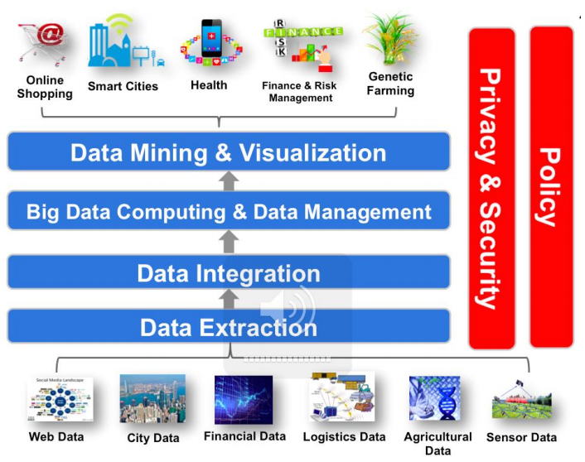
What is Big Data
Big data is a term that describes the large volume of data
Both structured and unstructured
Data Types
Activity Data (Simple activities like listen music, read book)
Conversation Data (Email, social media)
Photo and Image Data (Pictures from smartphones, Youtube Videos)
Sensor Data (Smart phone sensor data)
IOT Data (Smart Home, Smart TVs, Smart Watches)

Slide 3
Big Data Cont.
There are four components in the formation of large data.
These are
Volume. Storing Big Data was problem at past. Now Hadoop etc
Velocity. Driving the real time data.
Variety. Data comes in all types of formats – from structured/
Unstructured text documents, email, video, audio, stock ticker data and financial transactions.
Value. The most important component is value. The meaning and value of data after mining operations

Slide 4
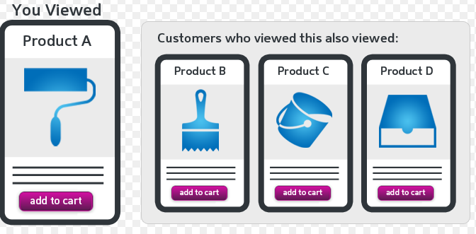
Recommendation Systems
The overall objective is to increase the sales or demonstration rates for companies.
The general logic of referral systems is as follows. The websites follow the scoring you give to movies, books, music, and make modeling through people who look like you. These products are also recommended to you through this modeling.

Slide 5
Recommendation System Challenges
Dimensionality
Reduction of dimensionality provides
Discover hidden correlations/topics (Words that occur commonly together)
Remove redundant and noisy features (Not all words are useful)
Easier storage and processing of the data
Data Sparsity
Cold Start Problem
New items have no ratings
New users have no history

Slide 6
Project Data ,Infra and System Informations
Software Environment
Hadoop 2.7 Environment
Spark 2.3.0 Framework
Implementation Lang: Python 3.7 fo SVD CF and ALS ,Python 3.6 for AutoEncoderss
Tensorflow Framework
O.S.
Windows 10, Ubuntu 18(Crashed)
Infra Structure
Processor : Intel i7 5500U and Intel i7 7780HQ
Ram : 8GB DDR3L and 16GB DDR4
GPU tried but had issues: Nvidia GTX960M and Nvidia 1050Ti
Data
Kaggle Netflix Data, Movie Lens 1M Data, 100K Data and 10M Data
Train Set : % 80 , Test Set : %20

Slide 7
Recommendation Methods
Collobrative Filtering with SVD
Alternate Least Squares
AutoEncoders

Slide 8
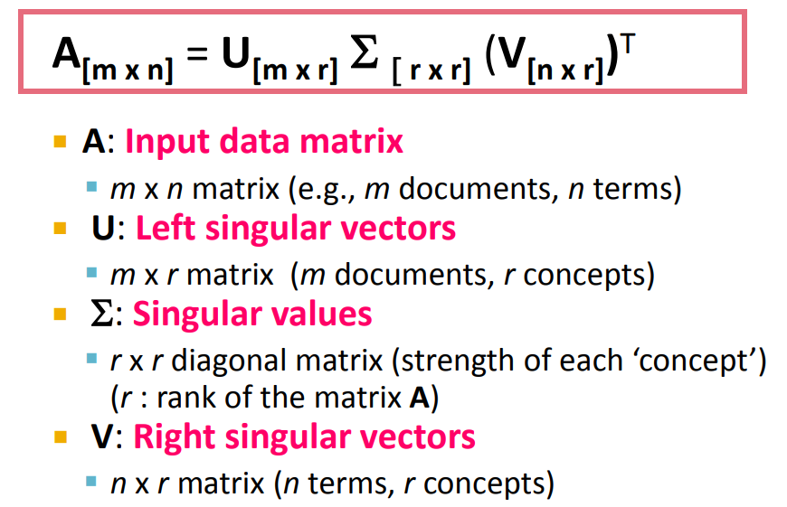

Collobrative Filtering with SVD
SVD is a matrix decomposition technique that has mathematically originated from
linear algebra. It decomposes any matrix into 3 matrices
Data Normalization for Sparse Matrix
Data must be linear
The Goal is minimize the sum of reconstruction errors
Drop the trend depends On Energy Matrix

Slide 9
Alternate Least Squares
ALS is a matrix factorization algorithm and runs in a parallel fashion.
ALS is implemented in Apache Spark ML
Good at a larges-scale collaborative filtering problems.
ALS is a good at solving scalability and sparseness of the Ratings data
Some high-level ideas behind ALS are:
Its objective function is slightly different than SVD: ALS uses L2 regularization while SVD uses L1 regularization
ALS minimizes two loss functions alternatively; It first holds user matrix fixed and runs gradient descent with item matrix; then it holds item matrix fixed and runs gradient descent with user matrix
Its scalability: ALS runs its gradient descent in parallel across multiple partitions of the underlying training data from a cluster of machines

Slide 10
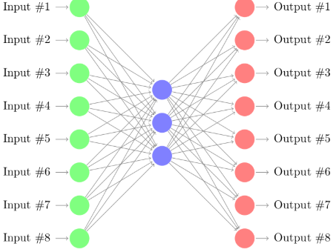
AutoEncoders
AutoEncoder is a kind of unsupervised Neural Network
Reconstruct multidimensional data in hidden space and then reconstruct (reconstruct) data from compressed hidden space.
The loss is the root mean squared error (RMSE).
It solves cold start problem.
2 different network model were used for Project.
Used for dimension reduction
Data Compression and Feature Extraction

Slide 11
Outputs &RMSE Values of 3 Methods
SVD Resuts
Please enter a Customer ID : 88
Movie_Id
110 Braveheart (1995)
168 First Knight (1995)
216 Billy Madison (1995)
260 Star Wars: Episode IV
356 Forrest Gump (1994)
673 Space Jam (1996)
780 Independence Day (a.k.a. ID4) (1996)
RMSE (Test set) 0.8752 RMSE (Train set) 0.8673
MSE (Test set)0.6792 MSE (Train set) 0.63

Slide 12
Outputs &RMSE Values of 3 Methods
ALS Results
Recommend Movie X to N counted User Like Below :
______________________________________________
Rating(user=58887, product=286, rating=5)
Rating(user=27297, product=286, rating=5)
Rating(user=33574, product=286, rating=5)
Rating(user=11139, product=286, rating=5)
Rating(user=22107, product=286, rating=5)
Rating(user=11491, product=286, rating=5)
Rating(user=43753, product=286, rating=5)
Rating(user=28707, product=286, rating=5)
Recommend Movies to User X Like Below :
_______________________________________________
Rating(user=222, product=7752, rating=5)
Rating(user=222, product=6674, rating=4.98)
Rating(user=222, product=8478, rating=4.90)
Rating(user=222, product=59339, rating=4.86)
Rating(user=222, product=6443, rating=4.81)
Rating(user=222, product=2604, rating=4.71)
Rating(user=222, product=2319, rating=4.7)
Rating(user=222, product=26106, rating=4.66)
Train MSE: 0.589
Train RMSE: 0.767
Test MSE: 0.623
Test RMSE: 0.814

Slide 13
Outputs &RMSE Values of 3 Methods
First NN AutoEncoder Outputs – 100 Epochs With Relu and Adam Optimizer
Encoder: (Moviesize x 500) * ( 500 x 100) => 2 Layers
Decoder: (100 x 500) * (500 x Moviesize) => 2 Layers
epoch:0 rmse(train):3.6543 rmse(test):3.6614
epoch:1 rmse(train):3.5380 rmse(test):3.5466
epoch:2 rmse(train):3.2796 rmse(test):3.2902
epoch:3 rmse(train):2.8622 rmse(test):2.8747
|||
|||
|||
|||
epoch:97 rmse(train):1.5155 rmse(test):1.5405
epoch:98 rmse(train):1.5356 rmse(test):1.5603
epoch:99 rmse(train):1.5434 rmse(test):1.5680

Slide 14
Outputs &RMSE Values of 3 Methods
Second NN AutoEncoder Outputs – 100 Epochs With Sigmoid and Adam Optimizer
Encoder: (Moviesize x 10) => 1Layers
Decoder: (10 x Moviesize) => 1 Layers
epoch:0 rmse(train):3.7122 rmse(test):3.7198
epoch:1 rmse(train):3.7024 rmse(test):3.7106
epoch:2 rmse(train):3.6964 rmse(test):3.7051
epoch:3 rmse(train):3.6921 rmse(test):3.7012
|||
|||
|||
|||
epoch:97 rmse(train):2.8615 rmse(test):2.8737
epoch:98 rmse(train):2.8510 rmse(test):2.8634
epoch:99 rmse(train):2.8403 rmse(test):2.8529

Slide 15
Comparison
 | CF with SVD | ALS | AutoEncoder 1st | AutoEncoder 2nd
Train RMSE | 0.8673 | 0.767 | 1.5434 | 2.8403
Test RMSE | 0.8752 | 0.814 | 1.5680 | 2.8529
Best results are from ALS.
sALS is the most effective Algoritm.

