Slide 1

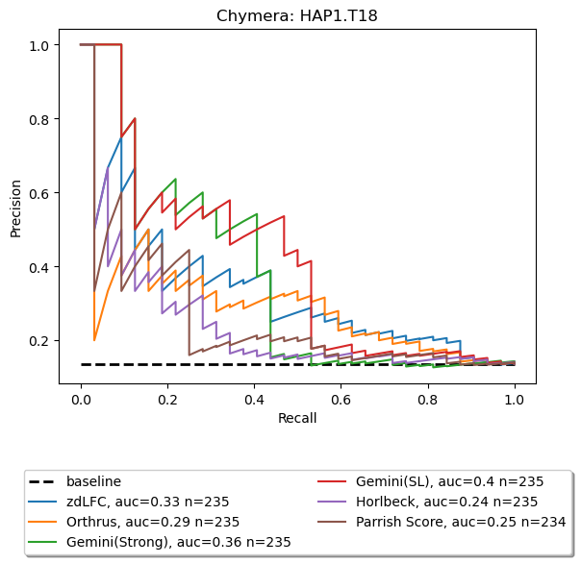
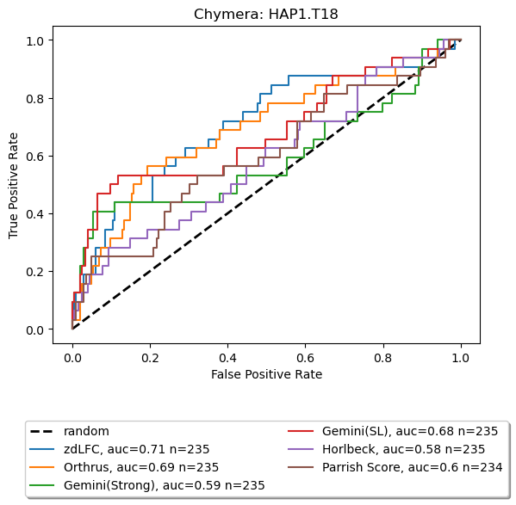
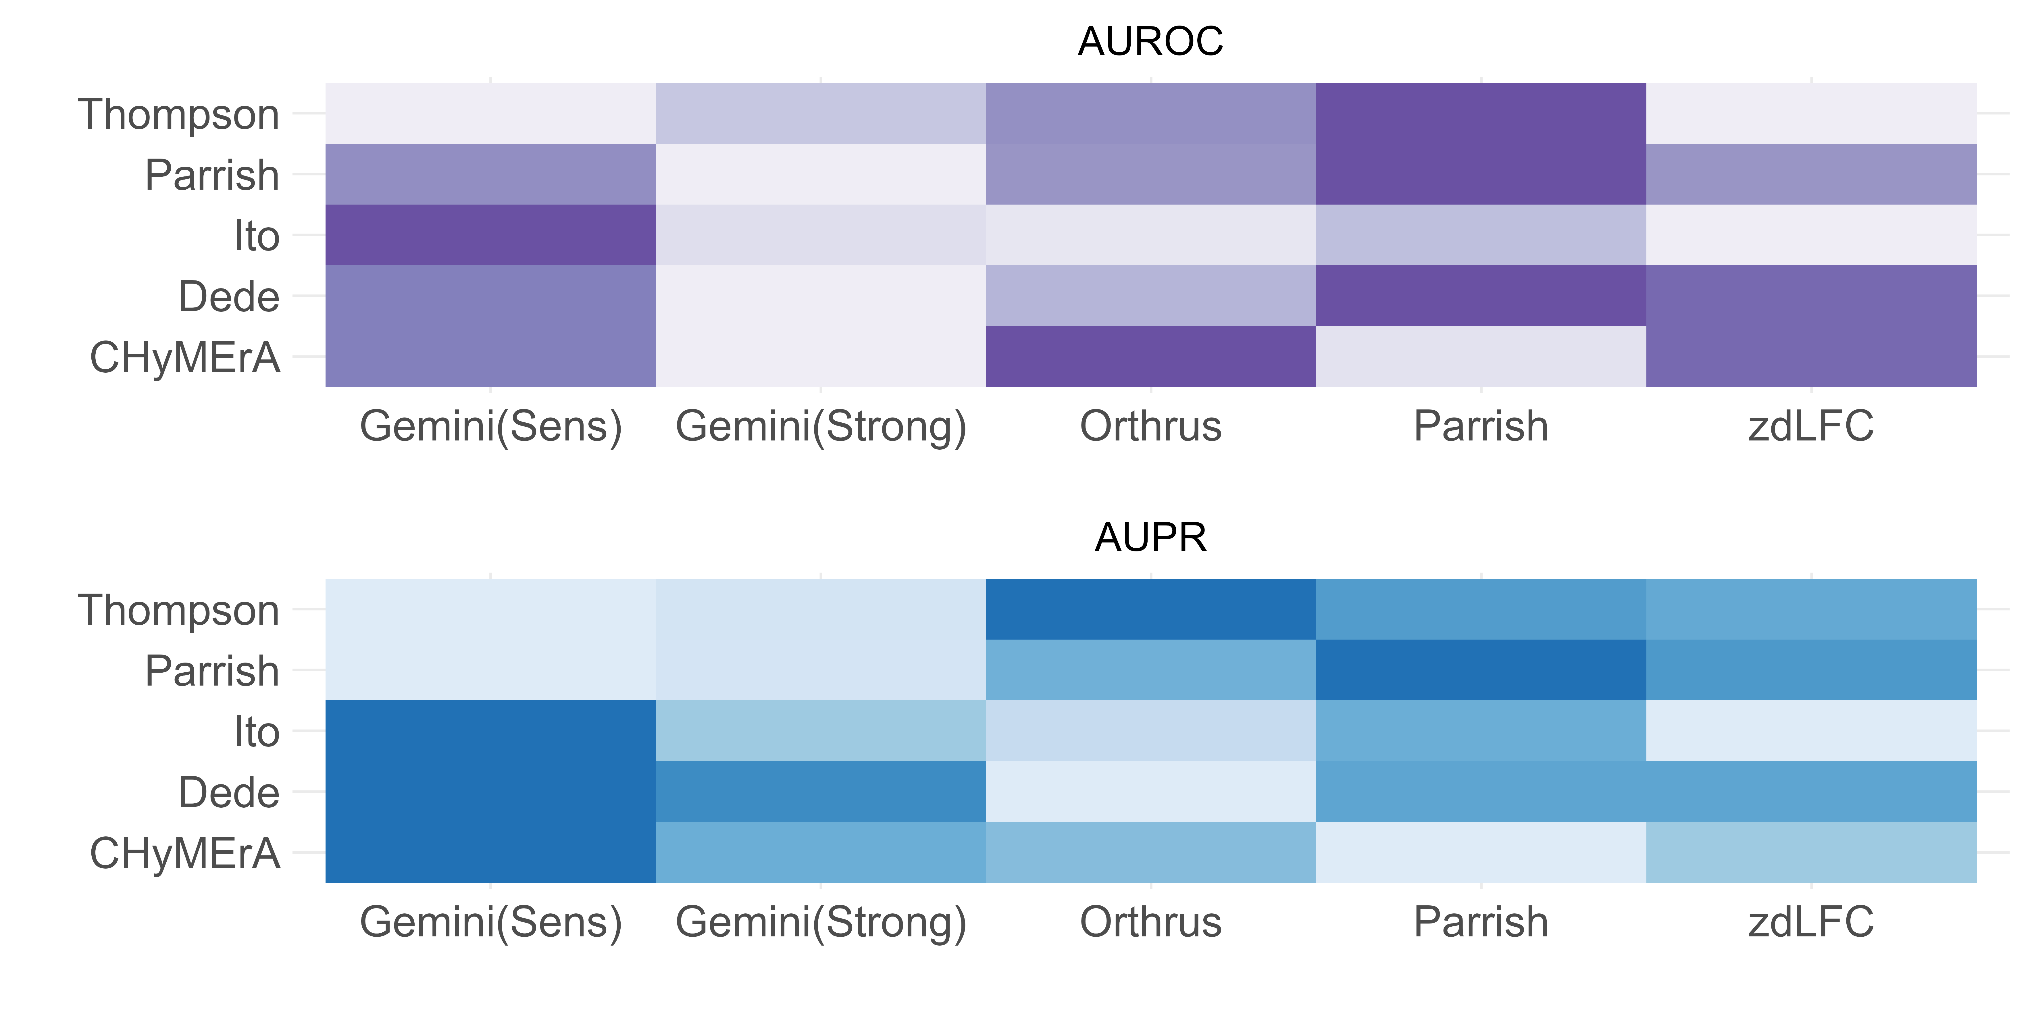
CRISPR DKO Screens
Dede Screen
Gene Pairs: 400
Cell Lines: 3
CRISPR Approach: enCas12a
CHyMErA Screen
Gene Pairs: 672
Cell Lines: 2
CRISPR Approach: Cas9/Cas12a
Ito Screen
Gene Pairs: 5,065
Cell Lines: 11
CRISPR Approach: Cas9
Parrish Screen
Gene Pairs: 1,030
Cell Lines: 2
CRISPR Approach: Cas9
Thompson Screen
Gene Pairs: 1,191
Cell Lines: 3
CRISPR Approach: Cas9
Calculated Scores
GI Scoring methods
zdLFC
Gemini
(Strong and Sensitive)
…
Gene Pair | Score
A1_A2 | 1.2
A1_A3 | 1.56
… | …
A2_A4 | 2.09
Parrish Score
Orthrus
Analysis
Benchmarks
De Kegel Benchmark
Gene Pair | isSL
A1_A2 | False
A1_A3 | True
… | …
A2_A4 | False
Köferle Benchmark
Gene Pair | IsSL
A1_A2 | True
A1_A3 | True
… | …
A2_A4 | False

