Slide 1
Vote DAO project
Vote for hackathon:
Admin、Judges、Projects
Auther by xinshengchen 2021.05.16 Beijing

Slide 2
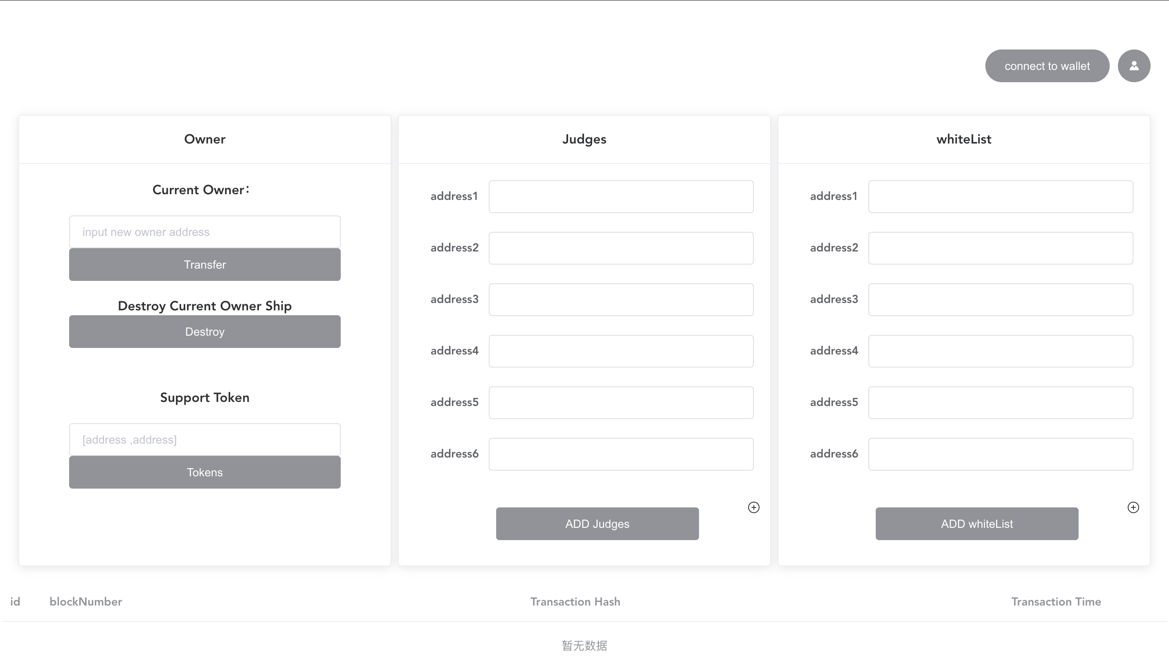
Owner page
Auther by xinshengchen 2021.05.16 Beijing

Slide 3
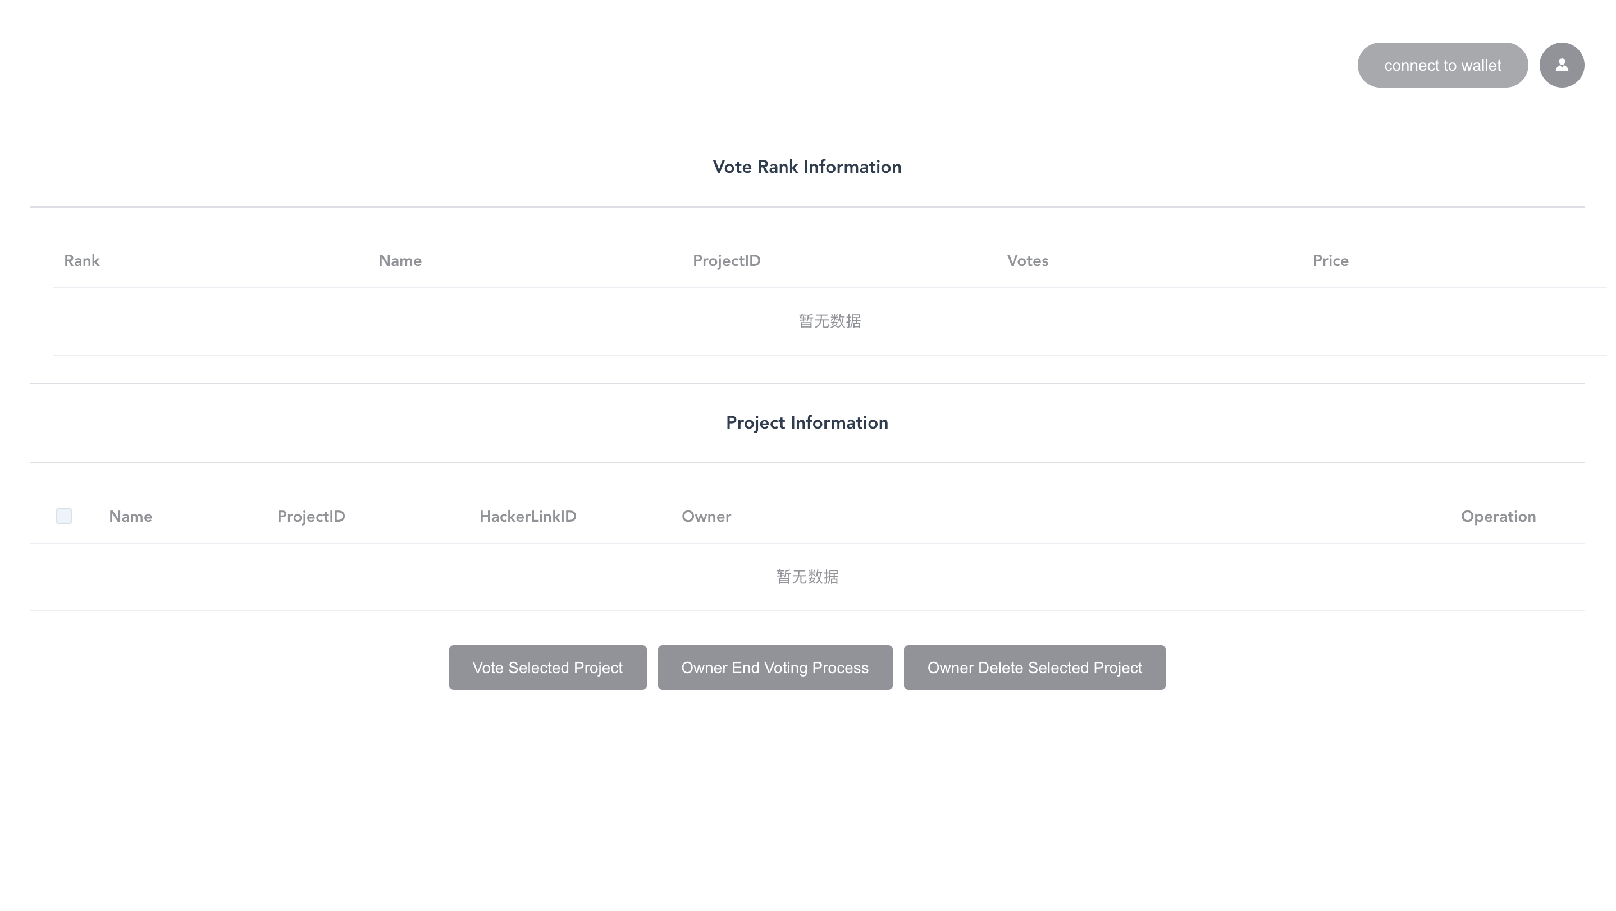
Vote page
Auther by xinshengchen 2021.05.16 Beijing

Slide 4
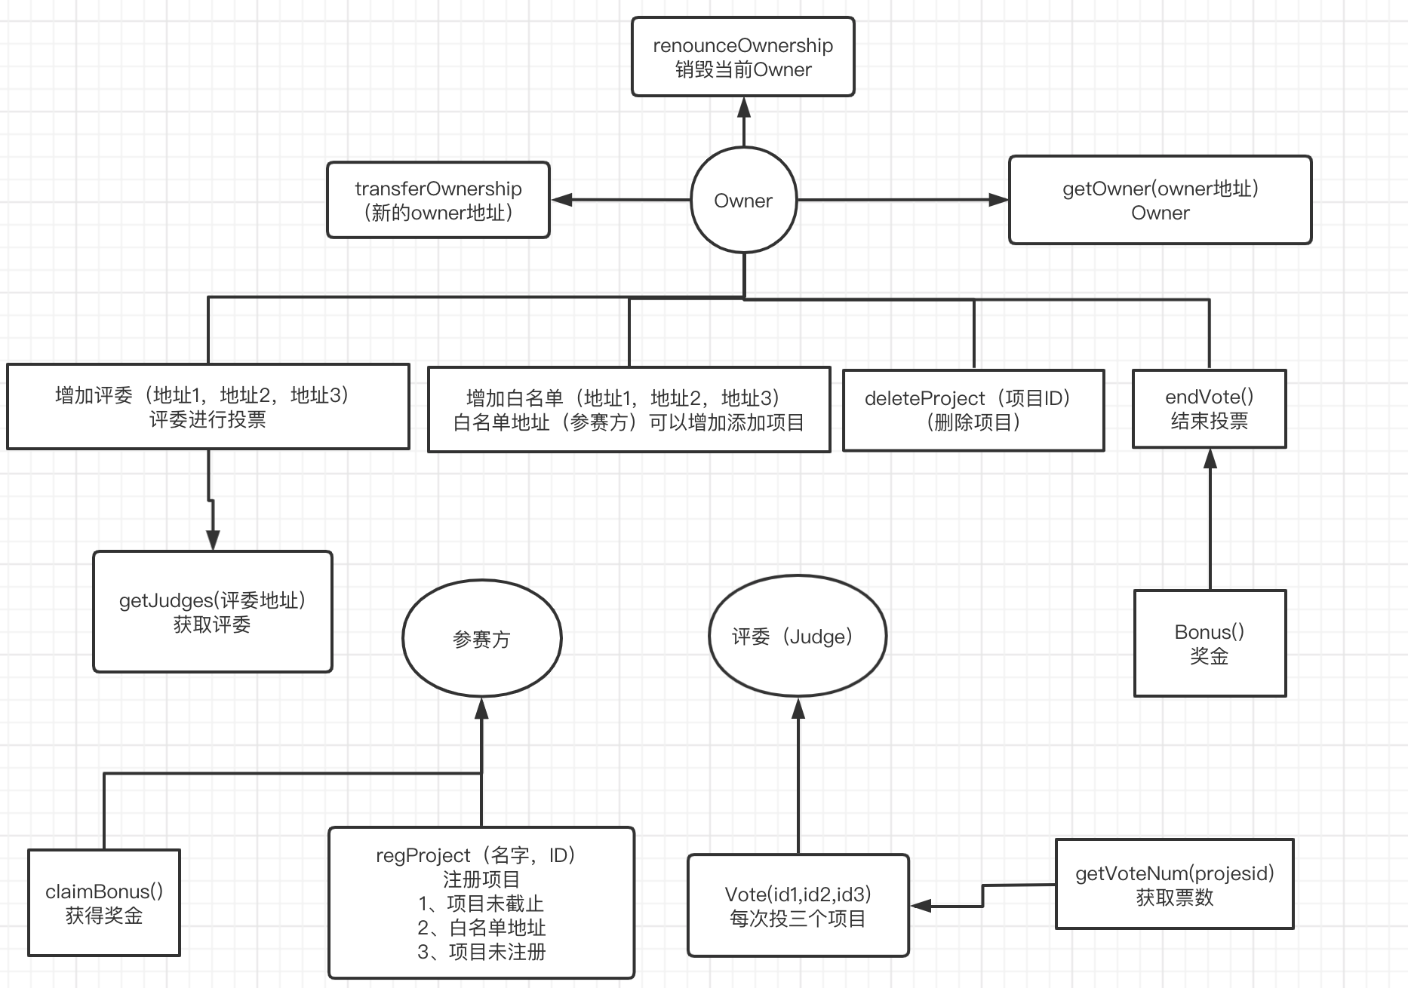
Vote Process

