Slide 1




Research Presentation
Patient Survival Analysis by Team Diabetes
Shanele Youngquist, Mary Doerries, Cristian Casado, Can Dai, Michael Goss

Slide 2

Introduction
Notes:
Introduce the topic not the dataset

Slide 3

Introduction
The health care system in the United States continues to be under heavy pressure (National Report Card on the State of Emergency Medicine, 2009).
It is important that we are able to understand patient profiles and generate models that allow for volume predictions and potentially reduce the number of fatal outcomes.
In this study, we are leveraging several multivariate data analysis techniques to understand several aspects related to patient survival in the United States.
©Pexels
Notes:
According to the 2009 National Report Card on the State of Emergency Medicine, the health care system in the United States continues to be under heavy pressure. The recent Covid-19 pandemic has been a huge stressor, in addition to long term situations related to hospital capacity, cost of technology, medicine costs, insurance coverage and efficiency of emergency services.
As visits to emergency departments in hospitals across the country increase, which is proven by the National hospital ambulatory survey that was conducted in 2006, it displayed that hospital visits increased with an average of 32% more visits from 1996 to 2006. As more data is being collected each year, it is important that we are able to understand patient profiles and generate models that allow for volume predictions and potentially reduce the number of fatal outcomes.
In this study, we are leveraging several multivariate data analysis techniques to understand several aspects related to patient survival in the United States.

Slide 4
Literature Review
Notes:
When conducting research, it is easy to go to one source: Wikipedia. However, you need to include a variety of sources in your research. Consider the following sources:
Who can I interview to get more information on the topic?
Is the topic current and will it be relevant to my audience?
What articles, blogs, and magazines may have something related to my topic?
Is there a YouTube video on the topic? If so, what is it about?
What images can I find related to the topic?

Slide 5
Annotated References
Safaei, N., Safaei, B., Seyedekrami, S., Talafidaryani, M., Masoud, A., Wang, S., Li, Q., & Moqri, M. (2022). E-CatBoost: An efficient machine learning framework for predicting ICU mortality using the eICU Collaborative Research Database. PloS one, 17(5), e0262895. https://doi.org/10.1371/journal.pone.0262895
The study proposes machine learning models for predicting ICU mortality status upon discharge. A novel contribution made is to produce different models for patients affected by each of 12 different disease groups.
Pang, K., Li, L., Ouyang, W., Liu, X., & Tang, Y. (2022). Establishment of ICU Mortality Risk Prediction Models with Machine Learning Algorithm Using MIMIC-IV Database. Diagnostics (2075-4418), 12(5), N.PAG. https://doi-org.ezproxy.depaul.edu/10.3390/diagnostics12051068.
The study proposes a machine learning model for predicting mortality risk of ICU patients based on the characteristics of the Acute Physiology and Chronic Health Evaluation Score III (APACHE III) and the Logistic Organ Dysfunction Score (LODS).
Epstein, S. K., Burstein, J. L., Case, R. B., Gardner, A. F., Herman, S. H., Hirshon, J. M., Jermyn, J. W., McKay, M. P., Mitchiner, J. C., Sullivan, W. P., Wagner, M. J., Beer, S., Tiberi, L., Price, C., Cunningham, R., Wilkerson, D., Bromley, M., Geist, M., Gore, L., Singh, C. A., … Schwalberg, R. H. (2009). The National Report Card on the State of Emergency Medicine: evaluating the emergency care environment state by state 2009 edition. Annals of emergency medicine, 53(1), 4–148. https://doi.org/10.1016/j.annemergmed.2008.10.028.
The report provides a snapshot on the state of the emergency care system in the United States, evaluating it on 5 categories: access to emergency care, quality and patient safety environment, medical liability environment, public health and injury prevention and disaster preparedness. It then provides an overall grade for the country and each of the states. According to the report, “The overall grade for the United States is C-”.
Notes:
For our literature review we included several annotated references. The first is a study on utilizing machine learning for predicting ICU mortality status upon patient discharge, using information available during the first 24 hours of admission. It produces different models for patients affected by each of the 12 different disease groups. Based on their findings – age, heart rate, respiratory rate, blood urine nitrogen and creatinine levels were the most critical features in mortality predictions.
The second study proposes a machine learning model to predict mortality risk of ICU patients based on characteristics of A.P.A.C.H.E III and L.O.D.S. Researchers discovered that mortality risk of ICU patients can be better predicted using both of these tools and would be helpful in assisting medical personnel in judging the outcome of critically ill patients, especially those with a survival outcome that appears uncertain.
The third study is from the National Report Card on the State of Emergency Medicine which provides a snapshot on the emergency care system in the United States. The report provides rankings in five different categories and provides an grade for the country overall and individually for each state. The categories assessed are access to emergency care, quality and patient safety environment, medical liability environment, public health and injury prevention and disaster preparedness. In 2009, the overall grade for the United States was a C-.
Safaei, N., Safaei, B., Seyedekrami, S., Talafidaryani, M., Masoud, A., Wang, S., Li, Q., & Moqri, M. (2022). E-CatBoost: An efficient machine learning framework for predicting ICU mortality using the eICU Collaborative Research Database. PLoS ONE, 17(5), 1–33. https://doi-org.ezproxy.depaul.edu/10.1371/journal.pone.0262895
Benediktsson, S., Hansen, C., Frigyesi, A., & Kander, T. (2020). Coagulation tests on admission correlate with mortality and morbidity in general ICU patients: An observational study. Acta Anaesthesiologica Scandinavica, 64(5), 628–634. https://doi-org.ezproxy.depaul.edu/10.1111/aas.13545
Pang, K., Li, L., Ouyang, W., Liu, X., & Tang, Y. (2022). Establishment of ICU Mortality Risk Prediction Models with Machine Learning Algorithm Using MIMIC-IV Database. Diagnostics (2075-4418), 12(5), N.PAG. https://doi-org.ezproxy.depaul.edu/10.3390/diagnostics12051068

Slide 6
Research Questions/ Methods
Notes:
After consulting a variety of sources, you will need to narrow your topic. For example, the topic of internet safety is huge, but you could narrow that topic to include internet safety in regards to social media apps that teenagers are using heavily. A topic like that is more specific and will be relevant to your peers. Some questions to think about to help you narrow your topic:
What topics of the research interest me the most?
What topics of the research will interest my audience the most?
What topics will the audience find more engaging? Shocking? Inspiring?

Slide 7
Research Questions/ Methods
Question 1 (Regression): Are there certain attributes of hospital/ICU patients that have a higher risk of death?
Question 2 (PCA): Which sets of attributes capture the most information about the ICU patients?
Question 3 (FA): What are the underlying trends in the attributes of hospital patients?
Methods utilized
Principal Component Analysis
Factor Analysis
Linear Regression, Ridge Regression, LASSO regression

Slide 8
Research Questions/ Methods
Q4: What is the relationship between vitals and demographic info (including patient mortality)?
Q5: What types of disease groups are more common to Hispanic patients?
Methods utilized
Canonical Correlation Analysis
Correspondence Analysis was utilized to identify types of diagnosis most related to Hispanic patients.

Slide 9
Results / Discussion

Slide 10
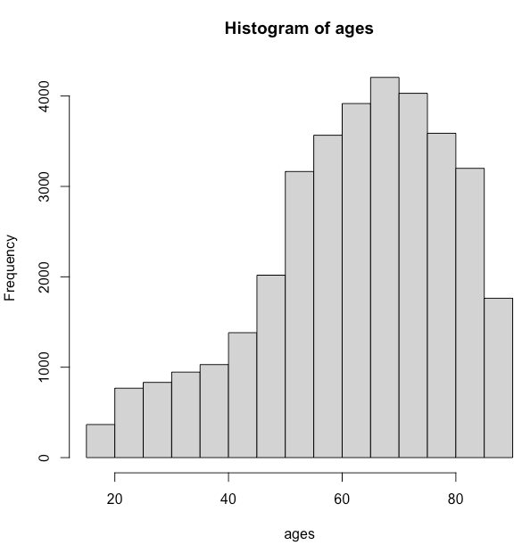
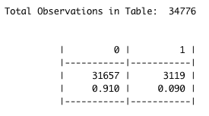
Research Question 1
Are there certain attributes of hospital / ICU patients that have a higher risk of death?
Mostly older patients going to the hospital.
Number of deaths are actually quite small.
91% of patients survived.
There are 5 variables marked as significant.
Age; high heart rate; low oxygen; low blood pressure, low body temp
Blood pressure was also flagged and that is positively linked to a patient's BMI.
Both age and blood pressure variables are flagged in our literature review sources as significant in predicting patient deaths.
Notes:
The first research question that was posed allows us to broadly look at the overall data set. The question being, "Are there certain attributes of hospital / ICU patients that have a higher risk of death?". Based on our findings, as displayed by the chart on the right hand side, we can see that mostly older patients are the ones going to the hospital. However, the number of deaths from a hospital visit are actually quite small, we can see that out of over 31,000 patients, there is a 91% survival rate. Out of all the data that was collected, there were five variables that were marked as significant – this included age, heart rate, oxygen levels, blood pressure levels and body temperature. It is significant that blood pressure was flagged because we know that is positively linked to a patient's BMI. In addition, based on our literary review, both age and blood pressure variables were flagged as significant in predicting patient death.

Slide 11
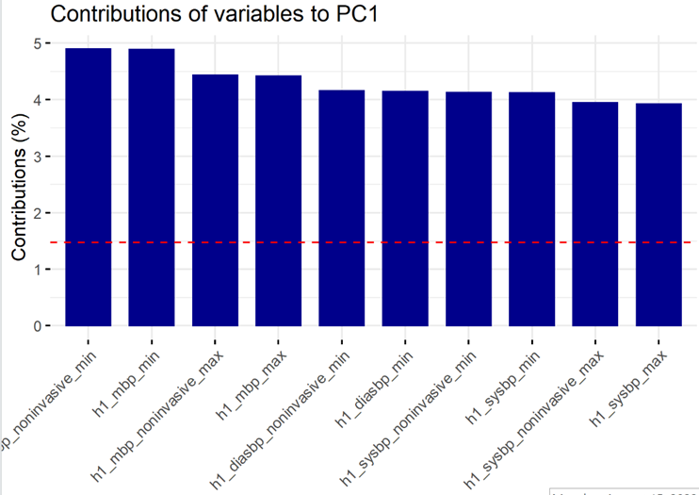
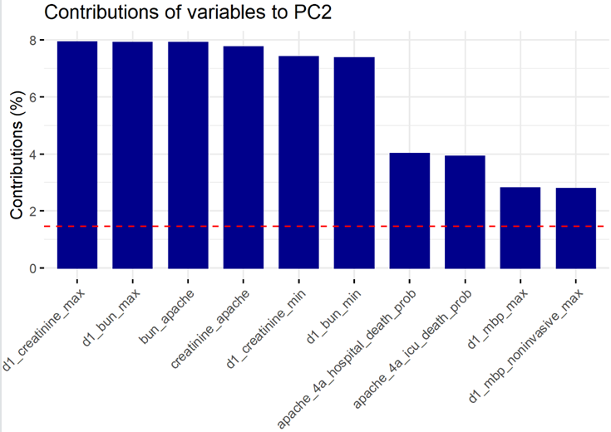
Research Question 2
Which sets of attributes capture the most information about the ICU patients?
After performing a log transformation on non-normal variables:
KMO MSE was 0.82
The p-value from Bartlett's test of sphericity was close to 0
Cronbach's alpha was 0.86
2 components from using the scree plot and knee method, cross-loadings at 3 components
Component 1:
Captures 22% of the variance in the dataset
The loadings and the variable contributions show that most of the variables are related to the patient's maximum and minimum blood pressure readings after an hour and after one day
Component 2:
Captures 10% of the variance in the dataset
The loadings and variable contributions show that most of the variables are related to the patient's blood urea nitrogen and creatinine concentrations in their plasma or serum during their first day

Slide 12
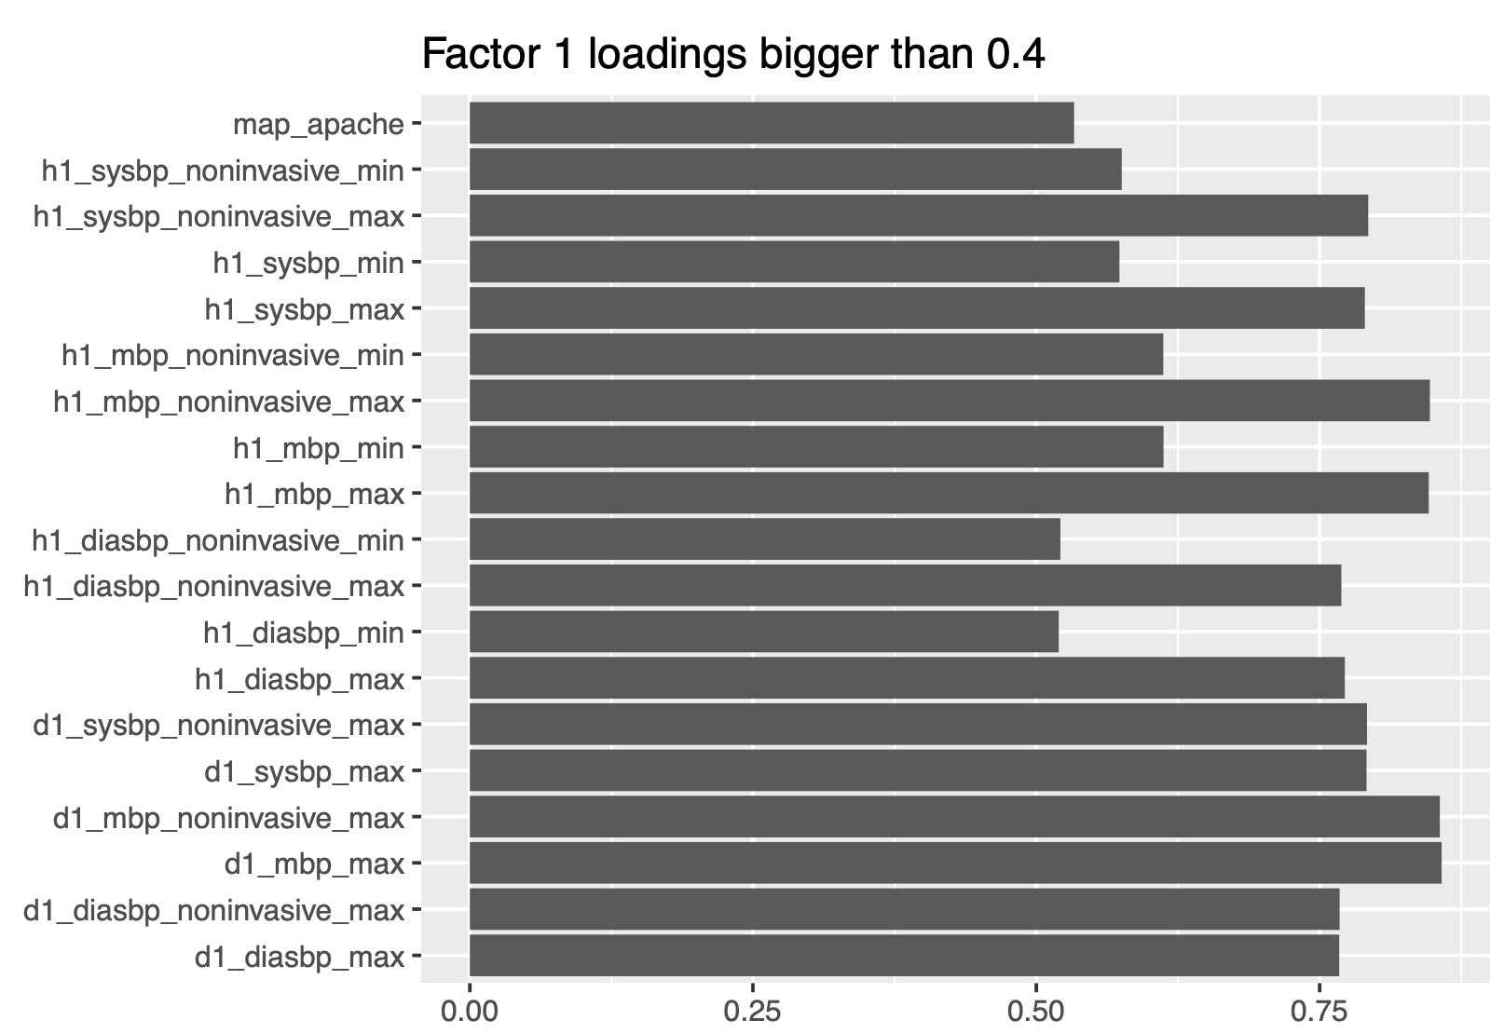
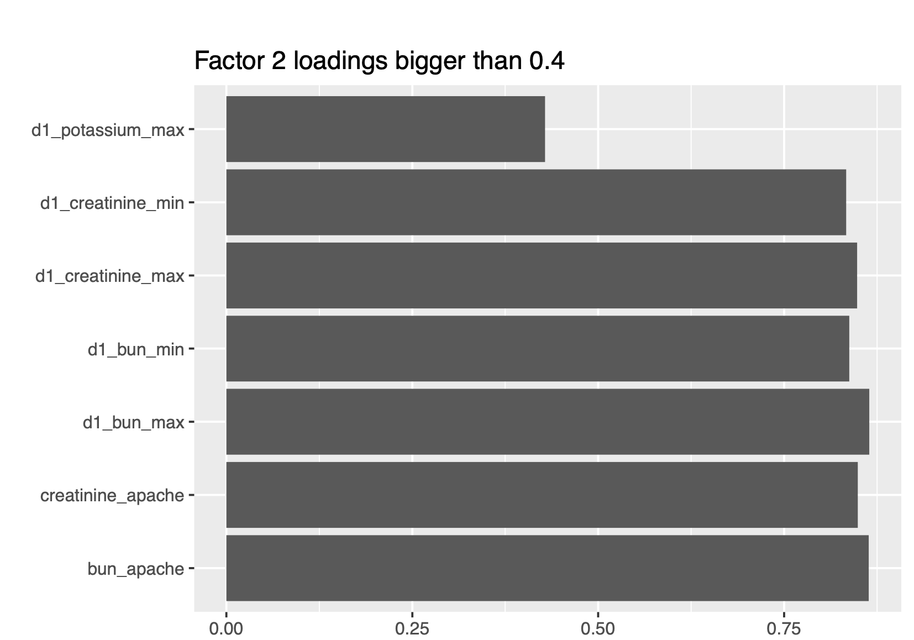
Research Question 3
What are the underlying trends in the attributes of hospital patients?
5 factors using Scree plot (knee method)
KMO (MSE = 0.81) , Bartlett's Test of Sphericity (p-value < 2.22e-16), Cronbach's Alpha (raw_alpha = 0.82)
Cumulative variance = 0.424, RMSA = 0.08
Factor 1: Loadings show that this factor is about a patient’s highest blood pressure during their unit stay (during their first hour or during their first 24 hours).
Factor 2: Loading shows that this factor is about a patient's blood urea nitrogen, creatinine, potassium concentrations.
Notes:
Loadings in x axis, the variables in y axis
Explain how all the variables how positive loadings
What are the underlying trends in the attributes of ICU patients?

Slide 13
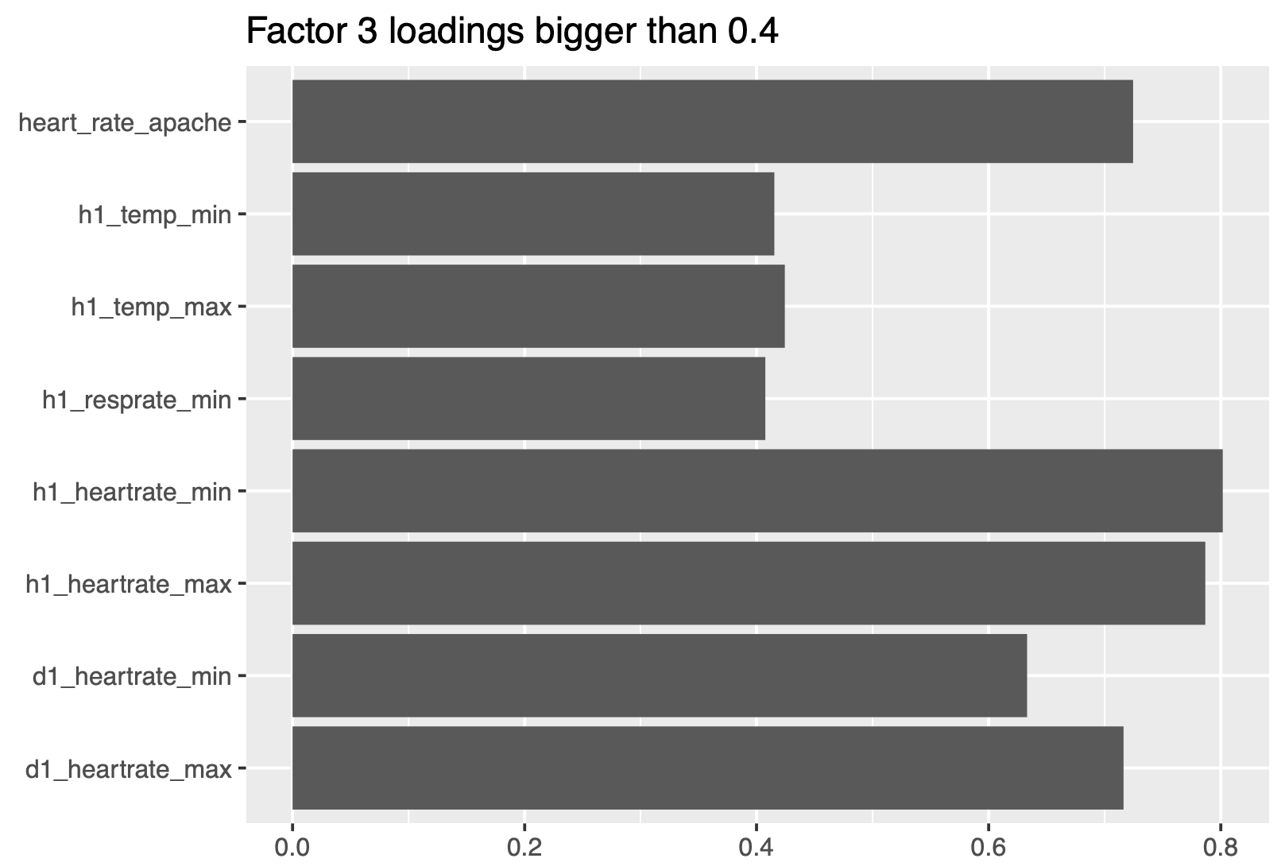
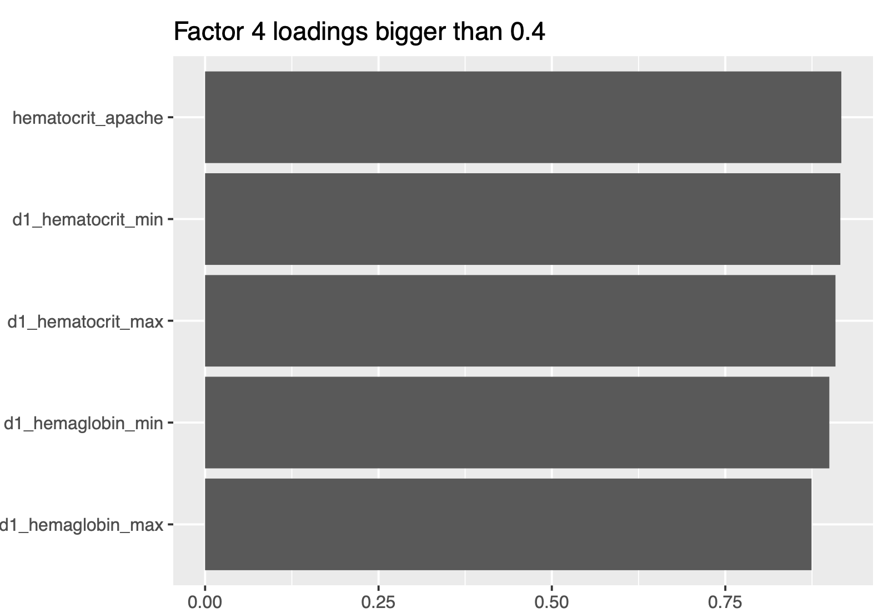
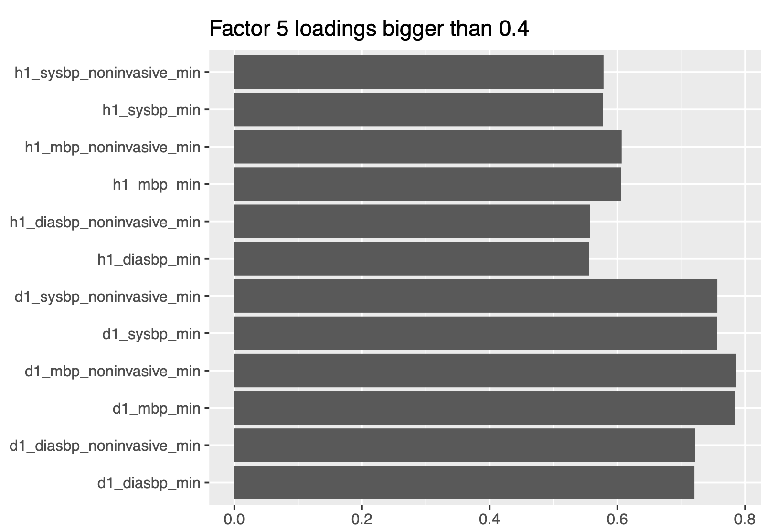
Research Question 3
Factor 3: Loadings indicate that this factor is about a patient's heart-rate, respiration and body-temperature during their first hour or first 24 hours of the stay. These variables are vitals. ​
Factor 4: Loadings indicate that this factor is about a patient's red blood cells proportion and hemoglobin levels during their first 24 hours of stay.
Factor 5: Factor five is about a patient’s lowest blood pressures during their unit stay (during their first hour or during their first 24 hours).

Slide 14
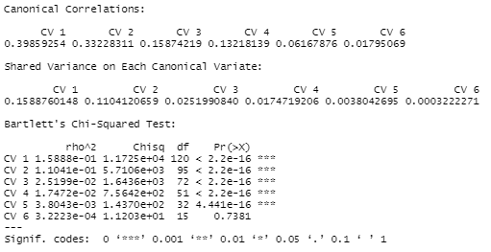
Research Question 4
What is the relationship between vitals and demographic info (including patient mortality)?
Some of the variables are not normal so the Bartlett's Chi-Squared test is used to determine significant variates
5 variates were identified as significant
99% of overlapping variance between vitals and demographic variables

Slide 15
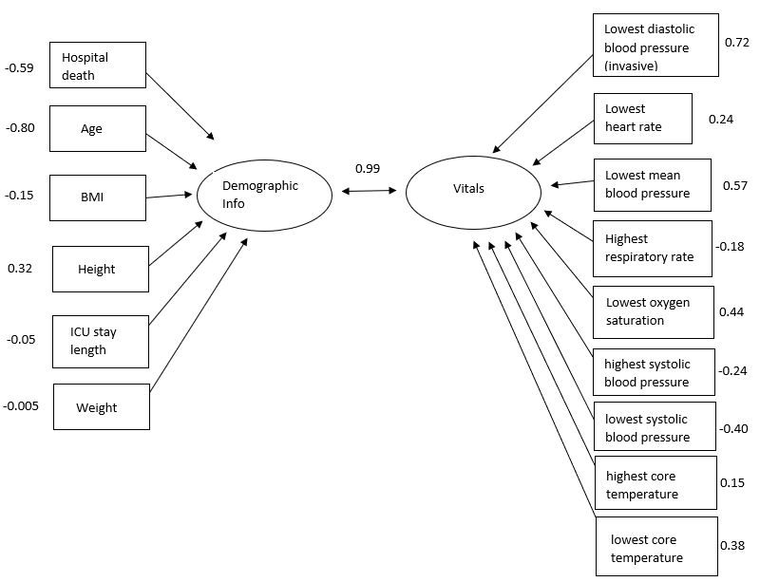
Research Question 4
The strongest positive correlations from vitals are low blood pressure measured both invasively and non-invasively.
The strongest negative correlation from the demographic variables is age.
Both age and blood pressure also flagged in literature review sources as significant in predicting patient mortality in the ICU.

Slide 16
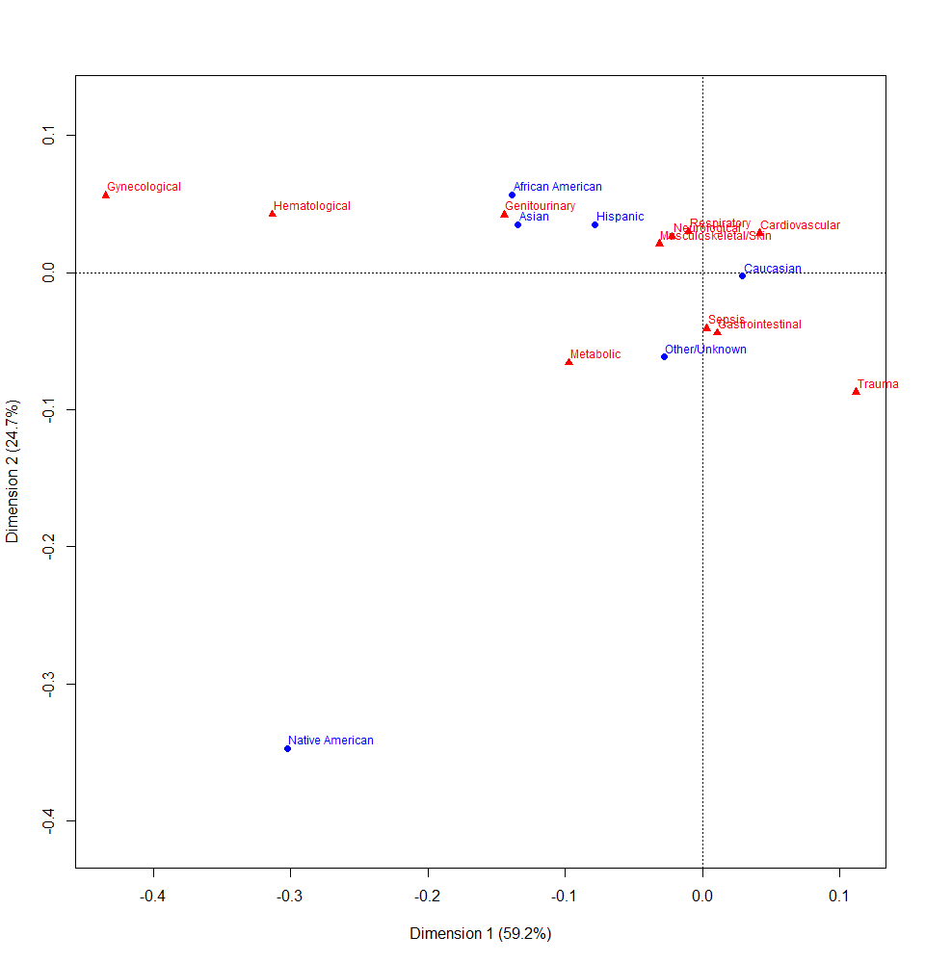
Research Question 5
What types of diagnosis are more common in Hispanic patients?
The 2 dimensions represent 83% of the variance between ethnicity and diagnosis group.
At hospital admission time, Hispanic patients are more associated with the following diagnosis groups: respiratory, neurological, musculoskeletal, genitourinary, hematological, and gynecological.
They are also less likely to be admitted because of trauma.
Figure 1. Correspondence analysis solution for Hispanic patients

Slide 17
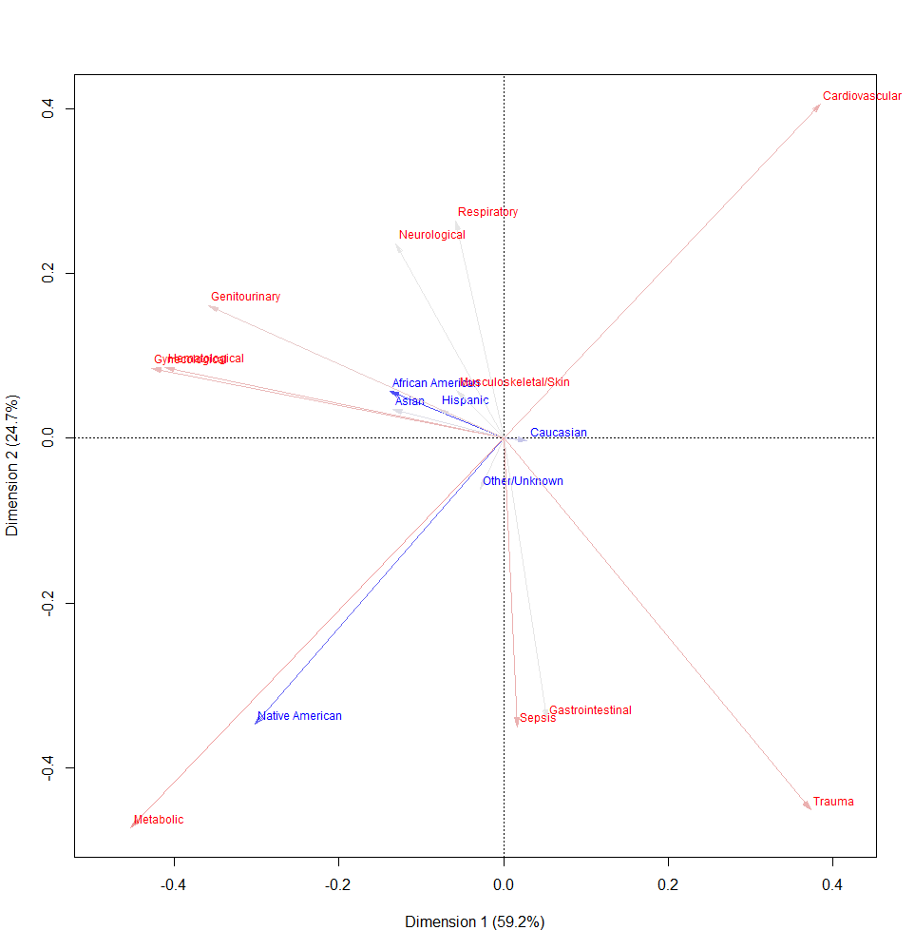
Research Question 5
But amongst the previously identified groups, which type of diagnosis is more closely associated with the Hispanic patients?
In order, these are the top 3 diagnosis for Hispanics:
Musculoskeletal
Neurological
Respiratory
It is worth mentioning that Native-American patients are more likely to be admitted to a hospital due to metabolic disorders than by any other reason.
Figure 1. Correspondence analysis solution for Hispanic patients (with arrows)

Slide 18

Limitations
A lot of missing data, potentially relevant independent variables had to be removed.
Inability to consult with subject matter experts
Removal of categorical variables, could have been important.
Could have extended our analysis with additional time to analyze the dataset.
Potentially inconsistent data due to data collection timing.
Notes:
Data collection timing:
Most of the lab tests conducted to collect data were not administered either in the first hour or in the first 24 hours of a patients stay. The exact or a consistent timing of the data collection is unknown except the invertal they were conducted. This limitation may cause inconsistent data, noise or even outliers. This limitation can be fixed by introducing a consistent schedule to collect tests from patients in future work.

Slide 19

Future Work
Include categorical variables into our analysis
Further studies focusing on age, weight, BMI and blood pressure
Be strict on data collection timing to be within the first 24 hours of hospital admittance.
Explore additional types of clustering techniques due to the large dataset size requiring more computing resources.
©Pexels
Notes:
Data collection timing: Most of the lab tests conducted to collect data were not administered either in the first hour or in the first 24 hours of a patients stay. The exact or a consistent timing of the data collection is unknown expect the invertal they were conducted. This limitation may cause inconsistent data, noise or even outliers. This limitation can be fixed by introducing a consistent schedule to collect tests from patients in future work.

Slide 20

Conclusions
Age and blood pressure are important predictors of survivability. It is good advice to attend routine medical checks as we grow older to proactively identify any situations.
More exposure to nature seems to be related to a healthier life. Native Americans are considerably further apart from known disease groups such as cardiovascular issues.
Mortality rate at the hospitals in the United States is low when looking at overall percentages (9%). We recognize even a 1% rate for loss of life could be a dramatic event depending on the scale.

Slide 21
References
Patient Survival Prediction Dataset. https://www.kaggle.com/datasets/sadiaanzum/patient-survival-prediction-dataset?select=Dataset.csv
Boyle, J., Jessup, M., Crilly, J., Green, D., Lind, J., Wallis, M., Miller, P., & Fitzgerald, G. (2012). Predicting emergency department admissions. Emergency medicine journal : EMJ, 29(5), 358–365. https://doi.org/10.1136/emj.2010.103531
Benediktsson, S., Hansen, C., Frigyesi, A., & Kander, T. (2020). Coagulation tests on admission correlate with mortality and morbidity in general ICU patients: An observational study. Acta Anaesthesiologica Scandinavica, 64(5), 628–634. https://doi-org.ezproxy.depaul.edu/10.1111/aas.13545
Epstein, S. K., Burstein, J. L., Case, R. B., Gardner, A. F., Herman, S. H., Hirshon, J. M., Jermyn, J. W., McKay, M. P., Mitchiner, J. C., Sullivan, W. P., Wagner, M. J., Beer, S., Tiberi, L., Price, C., Cunningham, R., Wilkerson, D., Bromley, M., Geist, M., Gore, L., Singh, C. A., … Schwalberg, R. H. (2009). The National Report Card on the State of Emergency Medicine: evaluating the emergency care environment state by state 2009 edition. Annals of emergency medicine, 53(1), 4–148. https://doi.org/10.1016/j.annemergmed.2008.10.028
Pang, K., Li, L., Ouyang, W., Liu, X., & Tang, Y. (2022). Establishment of ICU Mortality Risk Prediction Models with Machine Learning Algorithm Using MIMIC-IV Database. Diagnostics (2075-4418), 12(5), N.PAG. https://doi-org.ezproxy.depaul.edu/10.3390/diagnostics12051068
Safaei, N., Safaei, B., Seyedekrami, S., Talafidaryani, M., Masoud, A., Wang, S., Li, Q., & Moqri, M. (2022). E-CatBoost: An efficient machine learning framework for predicting ICU mortality using the eICU Collaborative Research Database. PLoS ONE, 17(5), 1–33. https://doi-org.ezproxy.depaul.edu/10.1371/journal.pone.0262895
Notes:
Alphabetize

Slide 22
Q & A

