Slide 1


Americas
Americas
Americas
Americas
Americas
Americas
Americas
Americas

Slide 2

1
1
1
1
1 Scholastic RP
1 Scholastic RP
1 Scholastic RP
1 Scholastic RP
1
1
1
1
1 Scholastic RP
1 Scholastic RP
1 Scholastic RP
1 Scholastic RP

Slide 3
Americas
Americas
Americas
Americas
Americas
Americas
Americas
Americas

Slide 4

1
1
1
1
1 Field RP
1 Field RP
1 Field RP
1 Field RP
1
1
1
1
1 Field RP
1 Field RP
1 Field RP
1 Field RP

Slide 5
Americas
Americas
Americas
Americas
Americas
Americas
Americas
Americas

Slide 6

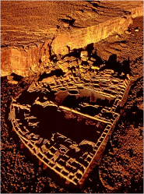
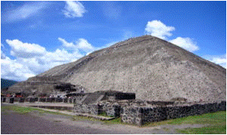
1
1
FIND!
Chaco
Canyon
1
2
1 Support RP
1 Support RP
1 Support RP
1
1
FIND!
Pyramid of the Sun
1
2
1 Support RP
1 Support RP
1 Support RP

Slide 7
Americas
Americas
Americas
Americas
Americas
Americas
Americas
Americas

Slide 8
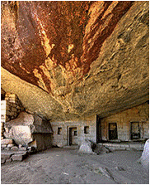
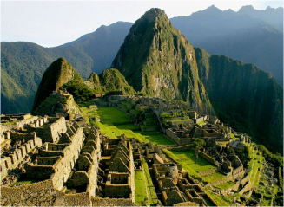
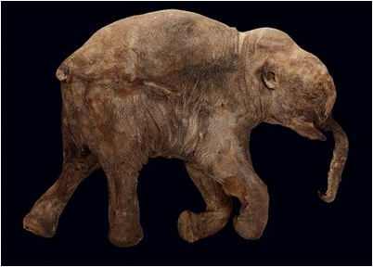
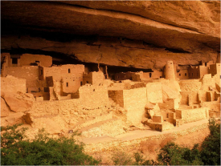
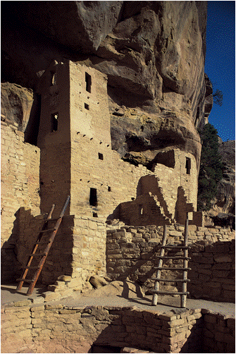
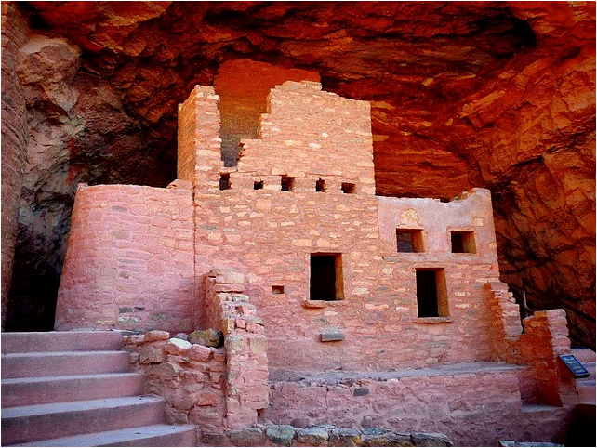
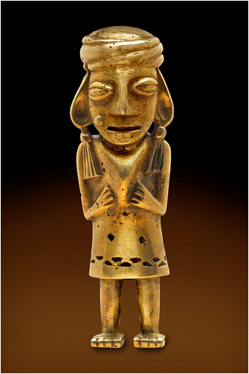
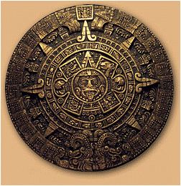
2
2
2
2
FIND!
Temple of the Moon
FIND!
Machu Picchu
FIND!
Intact Mammoth
FIND!
Anasazi
Ruins
2
2
2
2
FIND!
Mesa Verde
FIND!
Manitou Cliff Dwellings
FIND!
Incan Gold
FIND!
Aztec Sun Stone

Slide 9
Americas
Americas
Americas
Americas
Americas
Americas
Americas
Americas

Slide 10
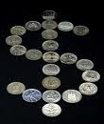

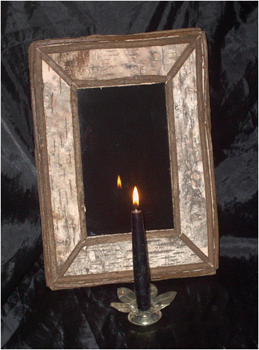


Enhancement
Stipend
Collect $2 at the beginning of each turn
Enhancement
Field Workshop
Requires 1 less Field or Scholastic RP when on a dig
Enhancement
Scrying
Stone
Can peek at 1 Hazard per turn prior to paying Hazard Pay
Enhancement
Bullwhip
Adds 2 dice to dice pool during combat
Enhancement
Talisman
Player achieves successes on a roll of 4, 5 or 6

