Slide 1



Eurasia
Eurasia
Eurasia
Eurasia
Eurasia
Eurasia
Eurasia
Eurasia

Slide 2


2
2
2
2
2 Scholastic RP
2 Scholastic RP
2 Scholastic RP
2 Scholastic RP
2
2
2
2
2 Field RP
2 Field RP
2 Field RP
2 Field RP

Slide 3
Eurasia
Eurasia
Eurasia
Eurasia
Eurasia
Eurasia
Eurasia
Eurasia

Slide 4

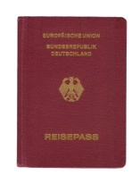
2
2
2
2
2 Support RP
2 Support RP
2 Support RP
2 Support RP
2
2
2
2
1 Permit RP
1 Permit RP
1 Permit RP
1 Permit RP

Slide 5
Eurasia
Eurasia
Eurasia
Eurasia
Eurasia
Eurasia
Eurasia
Eurasia

Slide 6

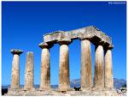
2
2
FIND!
Terracotta Army
2
4
OR
OR
OR
2 Scholastic RP
OR 1 Permit
2 Scholastic RP
OR 1 Permit
2 Scholastic RP
OR 1 Permit
2
2
FIND!
Temple of Apollo
1
4
OR
OR
OR
2 Field RP
OR 1 Permit
2 Field RP
OR 1 Permit
2 Field RP
OR 1 Permit

Slide 7
Eurasia
Eurasia
Eurasia
Eurasia
Eurasia
Eurasia
Eurasia
Eurasia

Slide 8


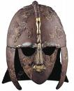

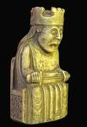
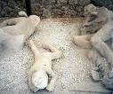

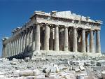
4
4
4
4
FIND!
Cave Paintings at Lascaux
FIND!
Theater of Delphi
FIND!
Chiang Mai Temples
FIND!
Sutton Hoo Ship
4
4
4
4
FIND!
Isle of Lewis Chess Set
FIND!
Lost City of Pompeii
FIND!
Ruins of Carthage
FIND!
Acropolis of Athens

Slide 9
Eurasia
Eurasia
Eurasia
Eurasia
Eurasia
Eurasia
Eurasia
Eurasia

Slide 10
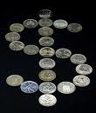




Enhancement
Stipend
Collect $3 at the beginning of each turn
Enhancement
Field Workshop
Requires 1 less Support RP when on a dig
Enhancement
Crystal Ball
Can peek at take top 2 Explore Cards; discard 1 and keep 1
Enhancement
Bullwhip
Adds 2 dice to dice pool during combat
Enhancement
Talisman
Player achieves successes on a roll of 4, 5 or 6

