Slide 1

Elephant: A Wellness Trunk
Demo 2
Medhashree Adhikari, Hyeyun Jung, Gabby Pruneda Turcios, Candice Lu
Notes:
Hi! We are Team Elephant! *Names*

Slide 2
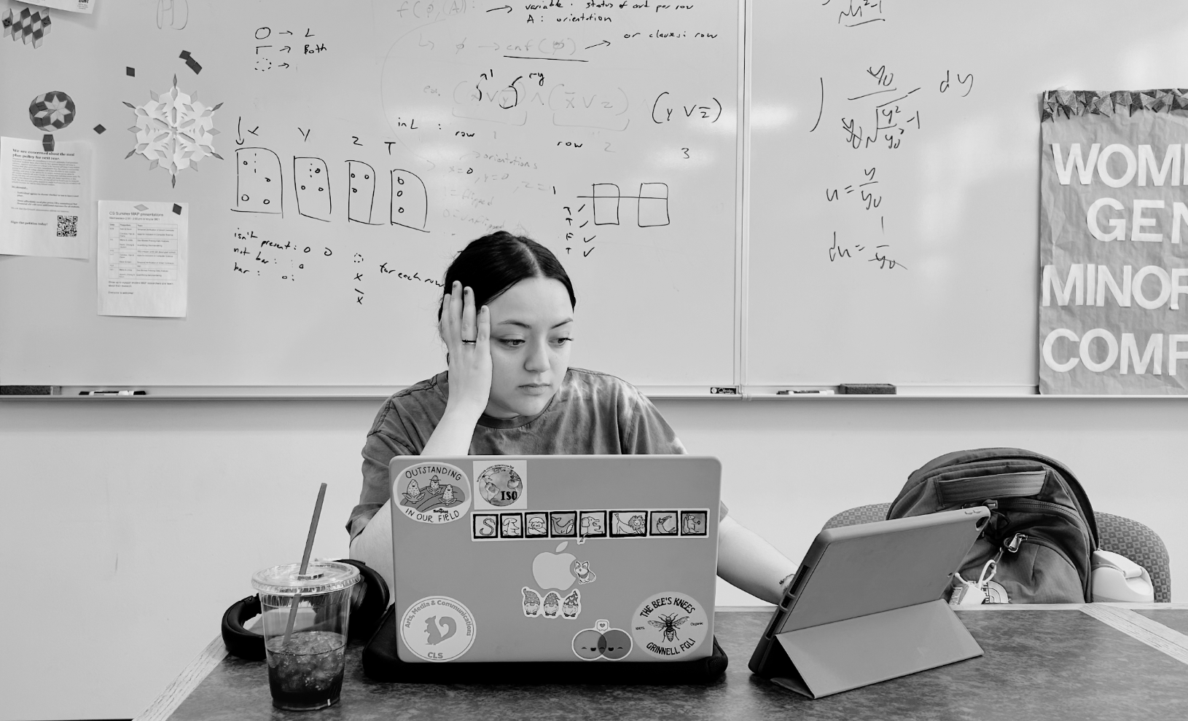
Introduction
Meet Sam, a typical, burnt out Grinnellian - they've been working for hours in front of a computer, maybe been procrastinating and then cramming against deadlines—all while striving to stay "productive". This “grind” culture, especially infamous at Grinnell, is normalized, but it's taking a toll on our mental and physical well-being, and we can attest.
Notes:
Candice – standard user that you met last time, grinnell specific, example of type of student that would use elephant and why

Slide 3
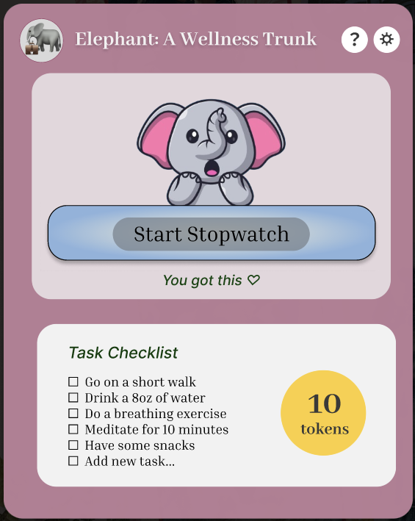
Meet Elephant: A Wellness Trunk, a user-friendly app designed to integrate wellness into your busy work routine—seamlessly and thoughtfully.
Notes:
Gabby – (intro to elephant) Please meet Elephant: A Wellness Trunk, a user-friendly app designed to integrate wellness and mindfulness breaks into your daily routine, with tools to keep you on task and productive on your own terms with working environment tools like Pomodoro and stopwatch timers. In addition to this great addition to your daily scheduling/organizing, users can customize their widget to their own likes by collecting our sets of widgets avatars aesthetically made from commissioned local artists.
New notes: Our app turns wellness into a shared, achievable journey—one goal at a time.

Slide 4
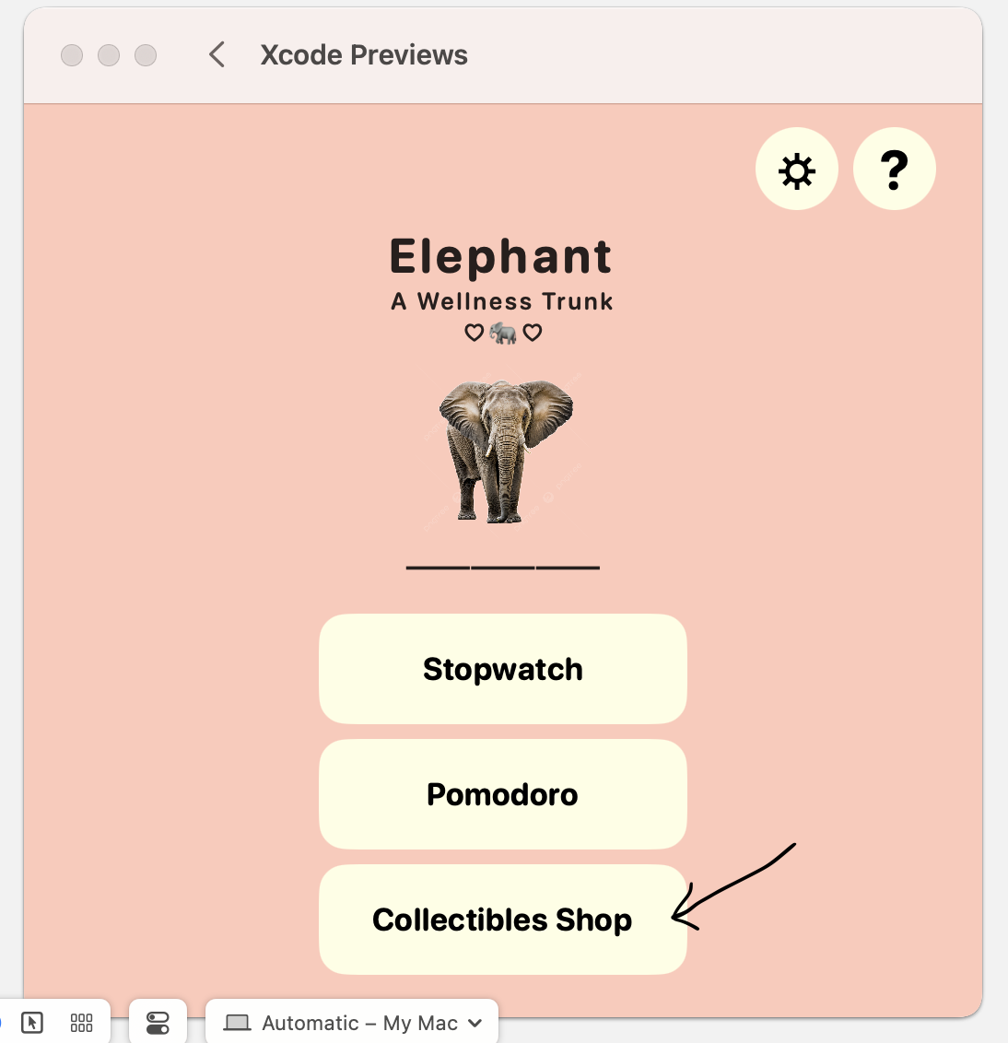
What is Elephant?
MacOS widget that incorporates:
Wellness to-do list
Pomodoro timer/stopwatch
Token reward system
Goals:
Incorporate wellness habits into working routines
Gamified mechanisms to incentivize users
Two components:
Main app: settings, token store, user manual
Widget: to-do list view, timer view with customizable avatar
Notes:
Gabby - A little more in-depth overview, what is it on, why use it, how to use it

Slide 5

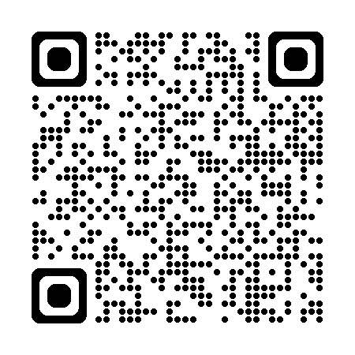
Let’s see how this gets done
with a quick demo…
prototype:
https://tinyurl.com/elephant-app25
Notes:
Mae – general demo + widget
Gabby – show settings

Slide 6
Progress
Xcode Challenges
Issues in accessing files recently added and pushed (.xcodeproj file)
Feature Development
Widget creation
Widget User Interface
Updated App User Interface
Checklist bone structure
Data Management & Storage
Learning firebase & PostgreSQL
Delayed due to stock image purchase
Notes:
Candice: current stage of development
Gabby: As for settings, I have been working on getting a working custom checklist within settings and having mode and theme changes change across main app pagesbut this is still in progress

Slide 7
Code Sample
https://github.com/junghyey/grinnell-elephant/blob/main/ElephantMacApp/ManualView.swift
Notes:
Hyeyun: The code sample we think it is good to share is the code for creating our 4 or more pages manual.
We could have hard code each page, but since each page shared similar logic (such as content, home button, back button), we decided to create a template page that can be used for each page. ManualTemplateView is a true reusable. ManualTemplateView<Content: View> which accepts a custom content view as a closure, supports optional navigation targes like backbutton. And it encapsulates the layout logic (header, bodym etc)
This allows each manual page only needs to define what it displays. So it is reusable!

Slide 8
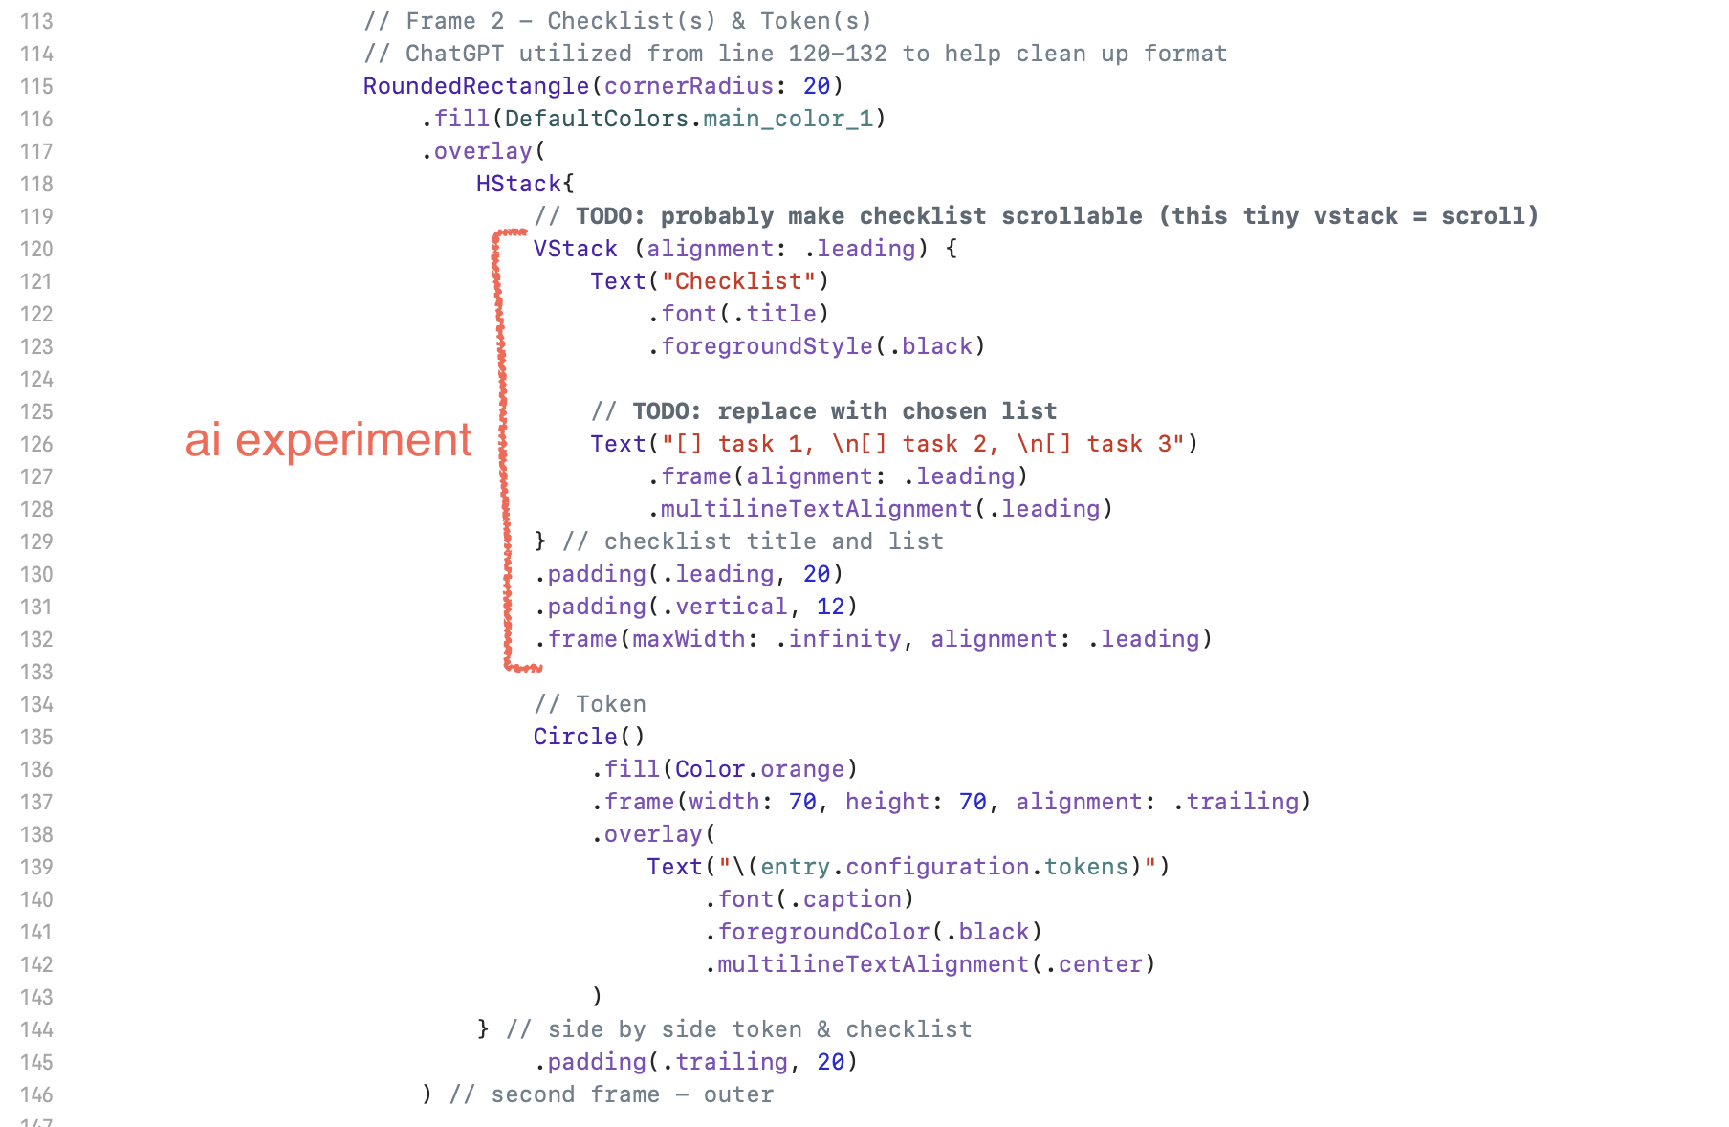
AI Experiment
Support
Supplemental, minimal questions
Language has minimal resources
Hinder
Start code
Over-reliance
Ethics
Environmental damage
Developer ethics
Notes:
Candice - this is what we think about ai use,
Mae – this is an instance of use in our code

Slide 9
Thank you! Questions?
Team Elephant: Medhashree Adhikari, Hyeyun Jung, Candice Lu, Gabby Pruneda Turcios
Notes:
Thank you! Do we have any questions from our peers?

