Slide 1
Finding the Most Powerful Person
Algorithm & Data Structure Program
Qiaoyi He

Slide 2
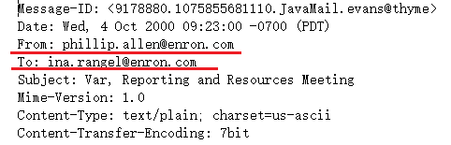
Extracting Info From Data Set
Use Tokenize Method to Extract Froms, Tos, CCs from each email. We ignore the email if it is not the Enron email(@enron.com).

Slide 3
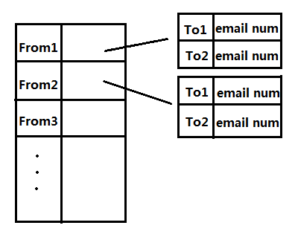
Creating Relation Graph
When we get information, we store them in a relation graph.

Slide 4
Graph Analysis-Degree
Degree : The number of nodes that a given node is connected to. Despite the direction of edges.
This parameter will show how many people this person know. it just likes the all contacts of this person. The more people this person know, the more central this person is.

Slide 5
Graph Analysis-Email Number
Sent Email & Received Email: Sent Email is the total number this person sent to others. On the other hand, Received Email is the total number this person received.
Email number is a very important parameter in analysis. It will show whether this person is active in company. Perhaps, one person has lots of degree, but he or she never communicate with them. Thus, we use email number stands for communication frequency with others.

Slide 6
Graph Analysis-Closeness
Closeness: Total shortest distance to all other nodes in the network.
Farness: reciprocal of closeness.
This part involve those nodes which are not directly connected to this node. Perhaps, some people do not have many contacts, but he or she may have a friend who has a lot of friends. Thus, this person is closed to the centre of graph. In my analysis, shortest path is that passing least people to reach other nodes.

Slide 7
Graph Analysis-Betweenness
Betweeness: The number of “Times” that any node needs go through a given node to reach any other node by the shortest path.
In this part, we find all shortest path from all nodes to any other nodes, and calculate the times of going through each node. It will show who is the most important person to connect other people.

Slide 8
Graph Analysis-Cutpoint
Cutpoint: A vertex whose removal from the graph increases the number of components. It makes some points unreachable from some others.
It is similar with betweenness, but cutpoint is used to connect two subgraph. If we remove cutpoint, there are more subgraph. People in one subgraph cannot contact with people who are in another subgraph.

Slide 9
Graph Analysis-Transitivity
Transitivity: A given node can reach undirected connected nodes through directed connected nodes.
This parameter will show how broad of one person’s friend circle. This person can know how many friends through friends.

Slide 10
Result of Analysis
Powerful Ratio= degree*20%+
SentEmail*14%+
ReceivedEmail*6%+
Farness*20%+
Betweenness*20%+
Transitivity*20%

