Slide 1
Data Mining:
Concepts and Techniques
Additional Theme: Collaborative Filtering & Data Mining
Jiawei Han and Micheline Kamber
Department of Computer Science
University of Illinois at Urbana-Champaign
www.cs.uiuc.edu/~hanj
© Jiawei Han and Micheline Kamber. All rights reserved
Data Mining: Principles and Algorithms

Slide 2
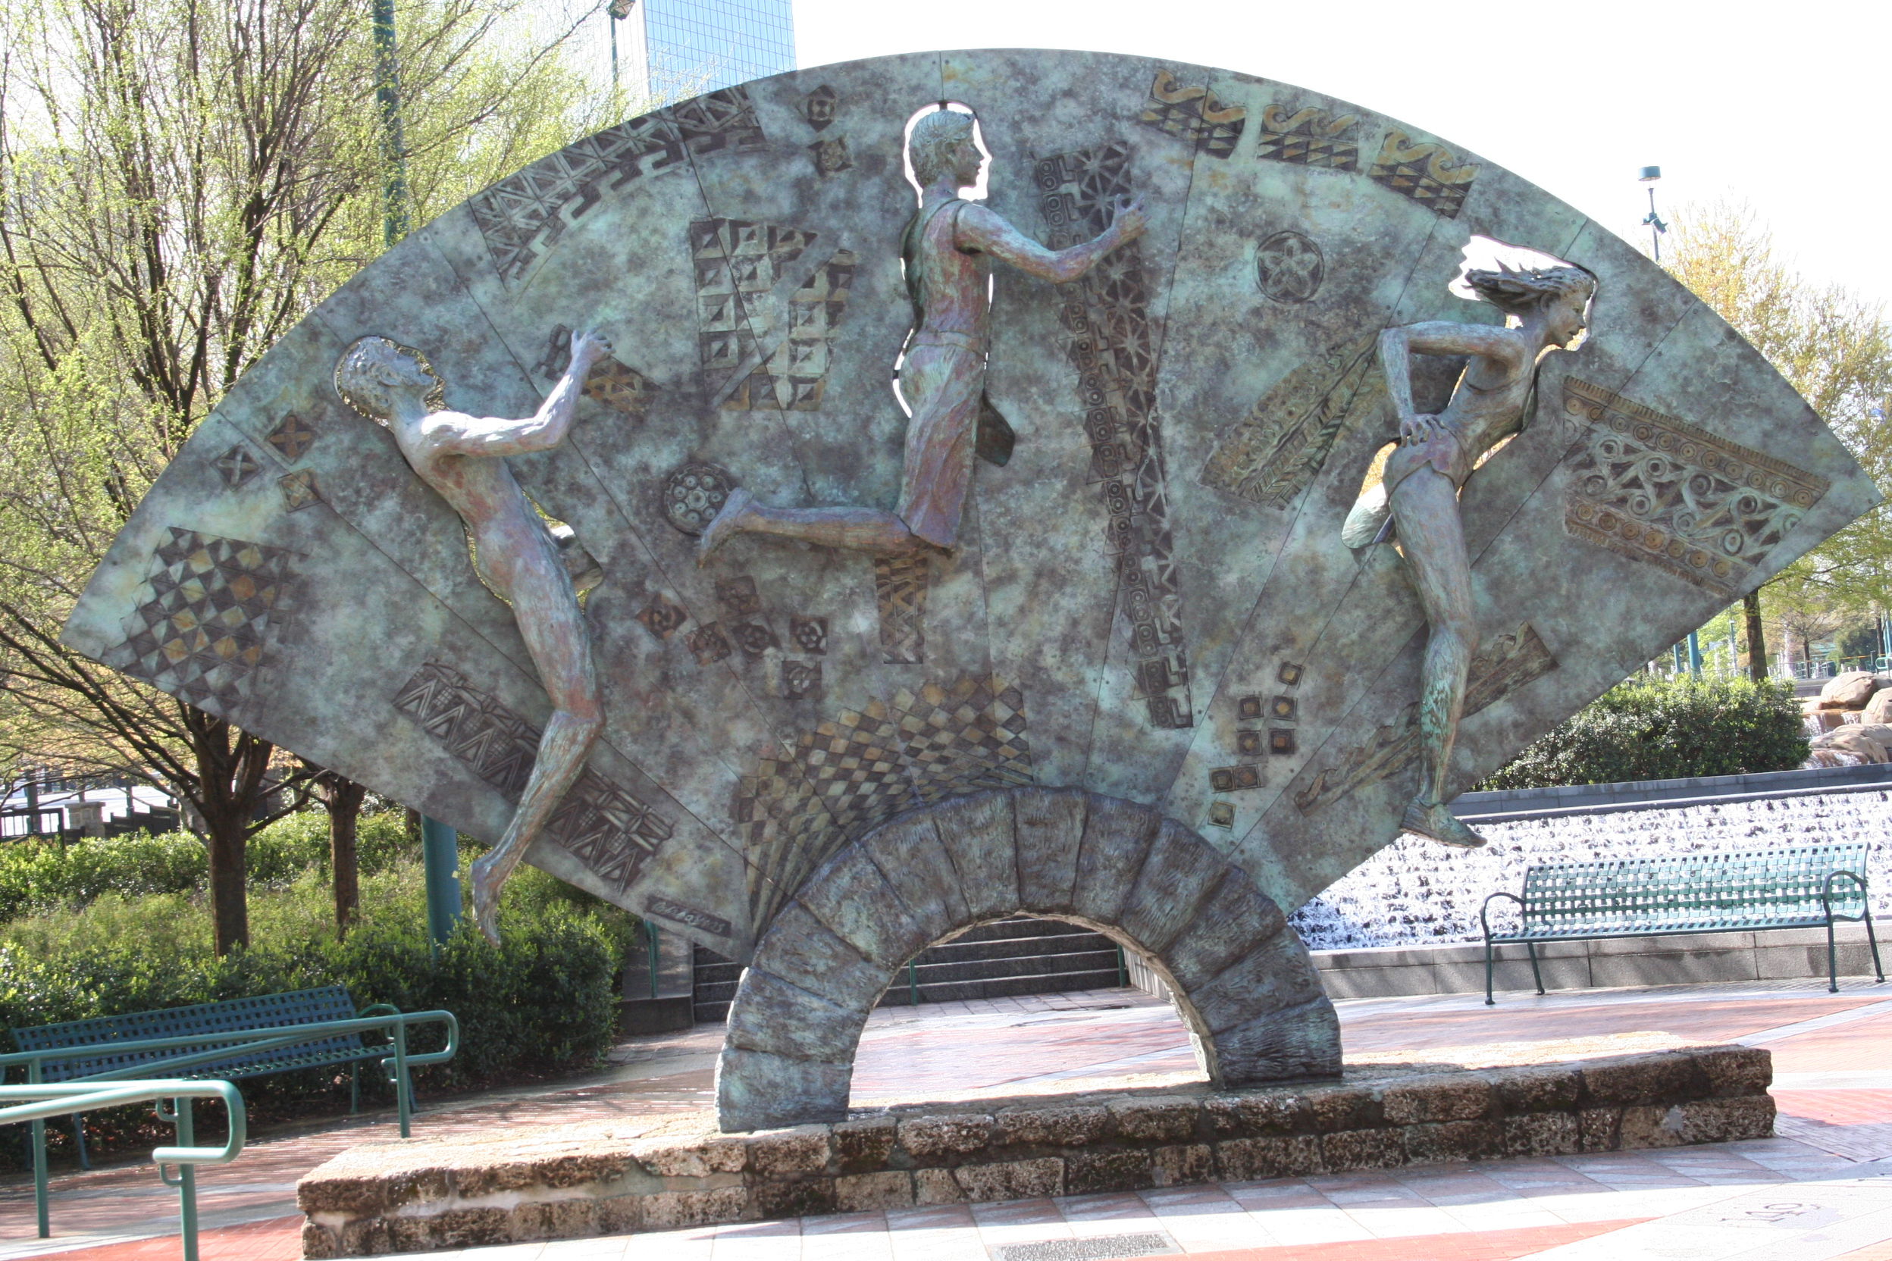
Data Mining: Principles and Algorithms

Slide 3
Outline
Motivation
Systems in Action
A Conceptual Framework
User-User Methods
Item-Item Methods
Recent Advances and Open Problems
Data Mining: Principles and Algorithms

Slide 4
Motivation
User Perspective
  Lots of online products, books, movies, etc.
  Reduce my choices…please…
Manager Perspective
  “ if I have 3 million customers on the web, I should have 3 million stores on the web.”
CEO of Amazon.com [SCH01]
Data Mining: Principles and Algorithms

Slide 5
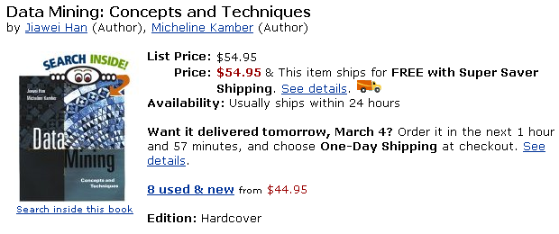
Example: Recommendation
Customers who bought this book also bought:
Data Preparation for Data Mining: by Dorian Pyle (Author)
The Elements of Statistical Learning: by T. Hastie, et al
Data Mining: Introductory and Advanced Topics: by Margaret H. Dunham
Mining the Web: Analysis of Hypertext and Semi Structured Data
Data Mining: Principles and Algorithms

Slide 6
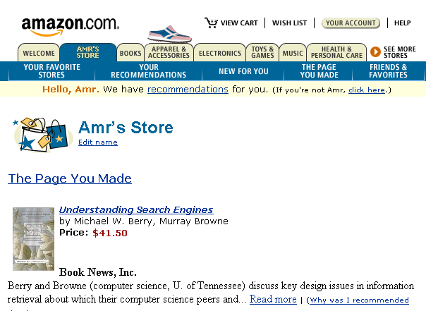
Example: Personalization
Data Mining: Principles and Algorithms

Slide 7
Other Examples
Movielens: movies
Moviecritic: movies again
My launch: music
Gustos starrater: web pages
Jester: Jokes
TV Recommender: TV shows
Suggest 1.0 : different products
And much more…
Data Mining: Principles and Algorithms

Slide 8
How it Works?
Each user has a profile
Users rate items
  Explicitly: score from 1..5
  Implicitly: web usage mining
    Time spent in viewing the item
    Navigation path
    Etc…
System does the rest, How?
  This is what we will show today
Data Mining: Principles and Algorithms

Slide 9
Basic Approaches
Collaborative Filtering (CF)
  Look at users collective behavior
  Look at the active user history
  Combine!
Content-based Filtering
  Recommend items based on key-words
  More appropriate for information retrieval
Today’s
Focus
Data Mining: Principles and Algorithms

Slide 10
Collaborative Filtering: A Framework
Items: I
i₁ i₂ … i_{j} … i_{n}
3 1.5 …. … 2
₂
₁
₃
u₁
u₂
…
u_{i}
...
u_{m}
The task:
Q1: Find Unknown ratings?
Q2: Which items should we recommend to this user?
.
.
.
r_{ij}=?
Users: U
Unknown function
f: U x I→ R
Data Mining: Principles and Algorithms

Slide 11
Collaborative Filtering Road Map
User-User Methods
  Identify like-minded users
  Memory-based: K-NN
  Model-based: Clustering
Item-Item Method
  Identify buying patterns
  Correlation Analysis
  Linear Regression
  Belief Network
  Association Rule Mining
Data Mining: Principles and Algorithms

Slide 12





User-User Similarity: Intuition
Target
Customer
3
Q3: How to combine?
Q1: How to measure similarity?
Q2: How to select neighbors?
Data Mining: Principles and Algorithms

Slide 13
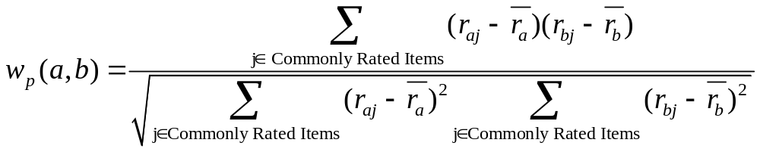
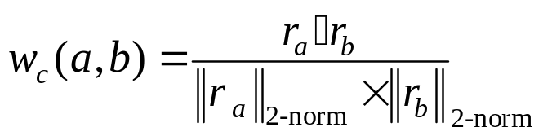
How to Measure Similarity?
i₁ i_{n}
Pearson correlation coefficient
Cosine measure
  Users are vectors in product-dimension space
u_{a}
u_{b}
Data Mining: Principles and Algorithms

Slide 14
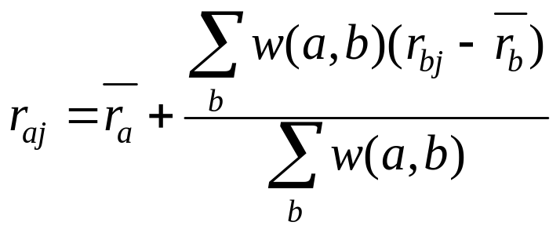
Nearest Neighbor Approaches [SAR00a]
Offline phase:
  Do nothing…just store transactions
Online phase:
  Identify highly similar users to the active one
    Best K ones
    All with a measure greater than a threshold
Prediction
User b’s deviation
User a’s neutral
User a’s estimated deviation
Data Mining: Principles and Algorithms

Slide 15
Clustering [BRE98]
Offline phase:
  Build clusters: k-mean, k-medoid, etc.
Online phase:
  Identify the nearest cluster to the active user
  Prediction:
    Use the center of the cluster
    Weighted average between cluster members
      Weights depend on the active user
Faster
Slower but a little more accurate
Data Mining: Principles and Algorithms

Slide 16
Clustering vs. k-NN Approaches
K-NN using Pearson measure is slower but more accurate
Clustering is more scalable
Active user
Bad recommendations
We can use soft clustering but will lose computational edge
Data Mining: Principles and Algorithms

Slide 17
Did We Answer the Questions?
Target
Customer
3
Q3: How to combine?
Q1: How to measure similarity?
Q2: How to select neighbors?
Data Mining: Principles and Algorithms

Slide 18
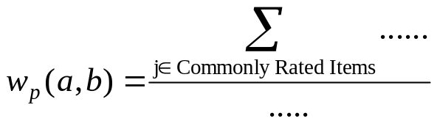
Are We Done?
Q1:How to measure similarity?
Done...
Really??
Sparsity results from the poor representation!
  U1 rates recycled letter pads High
  U2 rates recycled memo pads High
Both of them like Recycled office products
They are similar but the math won’t work for that
Example from [SAR00P]
What about Sparsity?
Not enough common Items
implies spurious neighbors
and hence bad recommendations
By working at the right level of abstraction we can eliminate sparsity
Data Mining: Principles and Algorithms

Slide 19
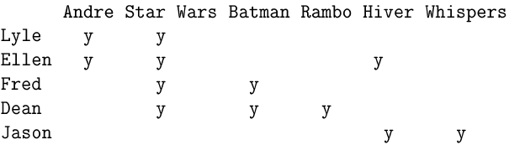
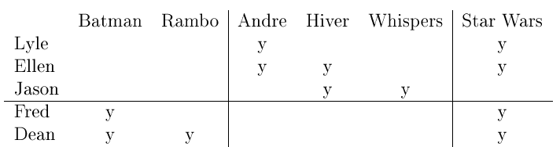
The Power of Representation [UNG98]
Action
Foreign
Classic
Q1-B: How can we formalize this intuition?
Data Mining: Principles and Algorithms

Slide 20
How to Abstract?
Semi-manual Methods
  Use product features
  Cluster products first, then cluster users
  Works only if we have descriptive features
Automatic Methods
  Adjusted Product Taxonomy
  Latent Semantic Indexing
Data Mining: Principles and Algorithms

Slide 21
Latent Semantic Indexing [SAR00b]
=
I’
S
I_{k}’
R
U_{k}
S_{k}
R_{k}
U
k X n
m X k
r X n
m X r
r X r
m X n
k X k
The reconstructed matrix R_{k} = U_{k}.S_{k}.I_{k}’ is the closest
rank-k matrix to the original matrix R.
  Captures latent associations
  Reduced space is less-noisy
Data Mining: Principles and Algorithms

Slide 22
Are We Done? (2)
Not adequately answered
Q2:How to Select Neighbors?
We don’t expect to use the same neighbors for all products
  Neighbors should be product-category specific
Data Mining: Principles and Algorithms

Slide 23
Are We Done? (3)
Q3:How to combine?
Weighted average
Discover association rules in neighbors’ transactions [LEE01, WAN04]
  For every x in this group:
  like(x, Item1) ^ like(x, Item2)→ like(x, Item3)
  Use confidence and support to judge the quality of the prediction
  Prediction is done on the binary level (like, dislike)
  Costly to run online
Data Mining: Principles and Algorithms

Slide 24
User-User Methods Evaluation
Achieve good quality in practice
The more processing we push offline, the better the method scale
However:
  User preference is dynamic
    High update frequency of offline-calculated information
  No recommendation for new users
    We don’t know much about them yet
Data Mining: Principles and Algorithms

Slide 25
Collaborative Filtering Road Map
User-User Methods
  Identify like-minded users
  Memory-based: K-NN
  Model-based: Clustering
Item-Item Method
  Identify buying patterns
  Correlation Analysis
  Linear Regression
  Association Rule Mining
Data Mining: Principles and Algorithms

Slide 26
Item-Item Similarity: The Intuition
Search for similarities among items
All computations can be done offline
Item-Item similarity is more stable that user-user similarity
  No need for frequent updates
First Order Models
  Correlation Analysis
  Linear Regression
Data Mining: Principles and Algorithms

Slide 27
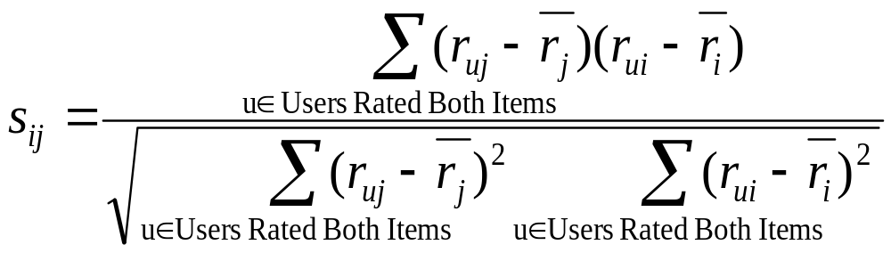
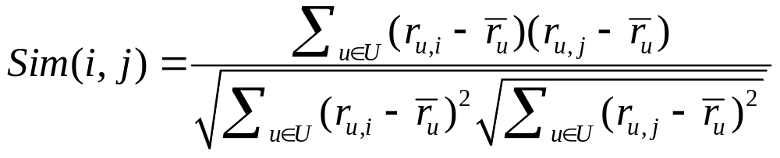
Correlation-based Methods [SAR01]
Same as in user-user similarity but on item vectors
Pearson correlation coefficient
  Look for users who rated both items
Adjusted Cosine
i₁ i_{i} i_{j} i_{n}
u₁
u_{m}
Data Mining: Principles and Algorithms

Slide 28
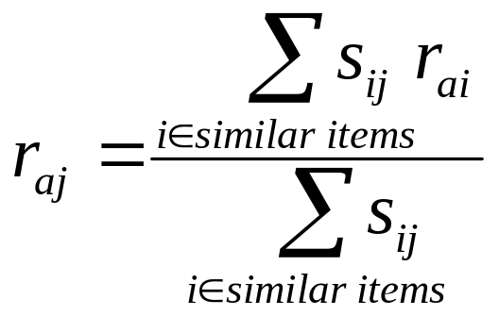
Correlation-based Methods (2)
Offline phase:
  Calculate n(n-1) similarity measures
  For each item
    Determine its k-most similar items
Online phase:
  Predict rating for a given user-item pair as a weighted sum over similar items that he rated
U_{a}
2
3
?
4
j
Data Mining: Principles and Algorithms

Slide 29
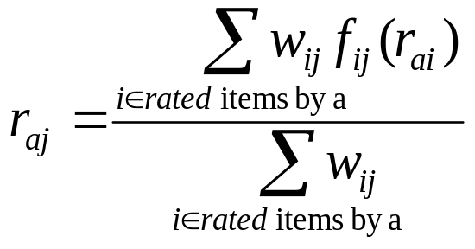
Regression Based Methods [VUC00]
Offline phase:
  Fit n(n-1) linear regressions
  F_{ij}(x) is a linear transformation of a user rating on item i to his rating on item j
Online phase
  Same as previous method
  The weights are inversely proportional to the regression error rates
Data Mining: Principles and Algorithms

Slide 30
Association Rule Mining
Offline processing
  Work on the binary level (like, dislike)
  View user as market basket containing items liked by user
  Discover association rules between items
Online processing:
  Match items that the active user like with rules left hand side
  Recommend rules’ consequent based on support and confidence
Data Mining: Principles and Algorithms

