Slide 1
Data Mining:
Concepts and Techniques
(3rd ed.)
— Chapter 11 —
Jiawei Han, Micheline Kamber, and Jian Pei
University of Illinois at Urbana-Champaign &
Simon Fraser University
©2011 Han, Kamber & Pei. All rights reserved.

Slide 2
Model-Based Clustering
What is model-based clustering?
  Attempt to optimize the fit between the given data and some mathematical model
  Based on the assumption: Data are generated by a mixture of underlying probability distribution
Typical methods
  Statistical approach
    EM (Expectation maximization), AutoClass
  Machine learning approach
    COBWEB, CLASSIT
  Neural network approach
    SOM (Self-Organizing Feature Map)
Data Mining: Concepts and Techniques

Slide 3
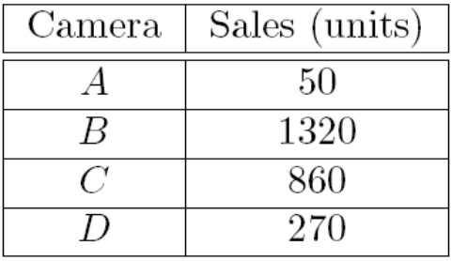
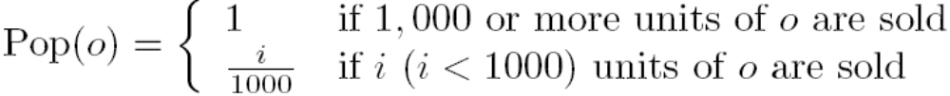
Fuzzy Set and Fuzzy Cluster
Clustering methods discussed so far
  Every data object is assigned to exactly one cluster
Some applications may need for fuzzy or soft cluster assignment
  Ex. An e-game could belong to both entertainment and software
Methods: fuzzy clusters and probabilistic model-based clusters
Fuzzy cluster: A fuzzy set S: F_{S} : X → [0, 1] (value between 0 and 1)
Example: Popularity of cameras is defined as a fuzzy mapping
Then, A(0.05), B(1), C(0.86), D(0.27)

Slide 4
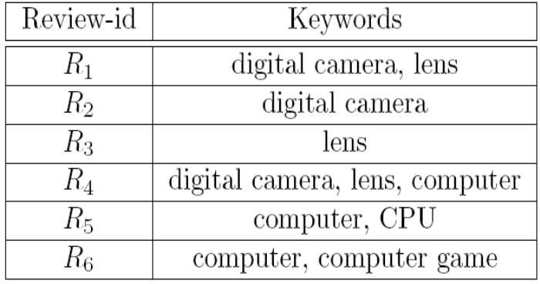
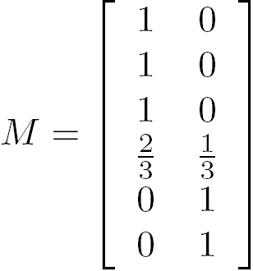


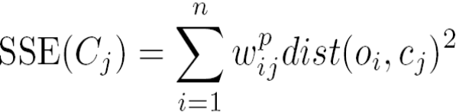
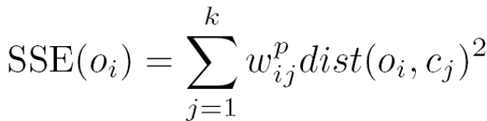
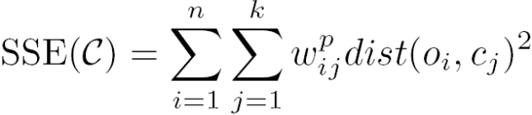
Fuzzy (Soft) Clustering
Example: Let cluster features be
  C₁ :“digital camera” and “lens”
  C₂: “computer“
Fuzzy clustering
  k fuzzy clusters C₁, …,C_{k} ,represented as a partition matrix M = [w_{ij}]
  P1: for each object o_{i} and cluster C_{j}, 0 ≤ w_{ij} ≤ 1 (fuzzy set)
  P2: for each object o_{i}, , equal participation in the clustering
  P3: for each cluster C_{j} , ensures there is no empty cluster
Let c₁, …, c_{k} as the center of the k clusters
For an object o_{i}, sum of the squared error (SSE), p is a parameter:
For a cluster C_{i}, SSE:
Measure how well a clustering fits the data:

Slide 5
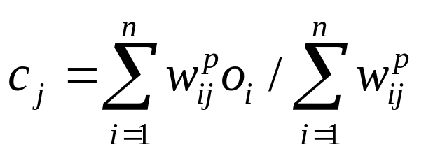
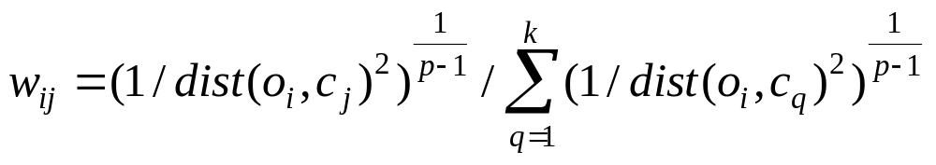
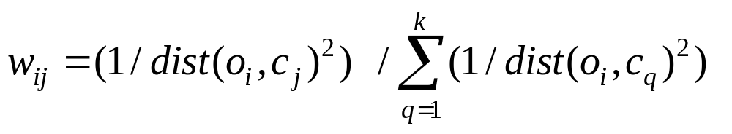
Initialization: random initialization
Computing centroids
p approaches 1; membership weight goes to 1 for the closest cluster and to 0 for all other clusters (k means)

Slide 6
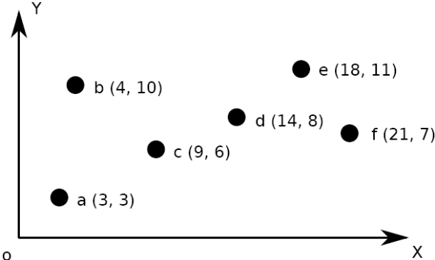
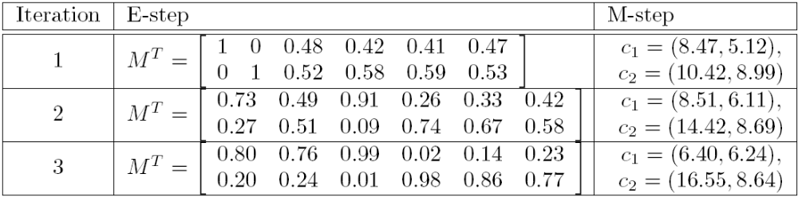
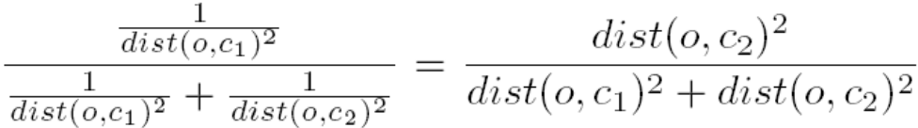

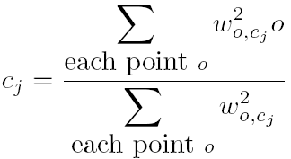
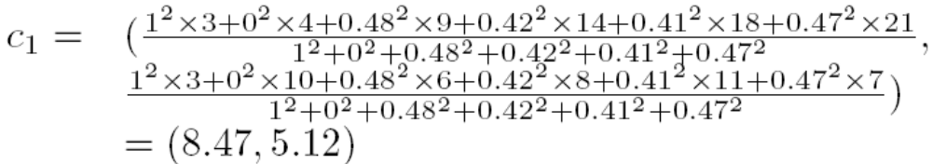
Fuzzy Clustering Using the EM Algorithm
Initially, let c₁ = a and c₂ = b
1st E-step: assign o to c₁,w. wt =
1st M-step: recalculate the centroids according to the partition matrix, minimizing the sum of squared error (SSE)
Iteratively calculate this until the cluster centers converge or the change is small enough

Slide 7
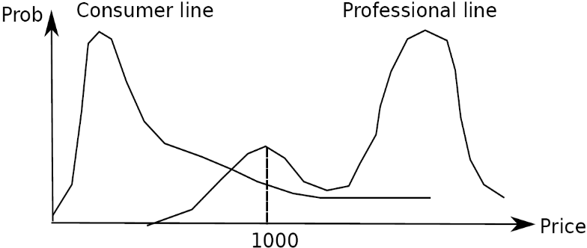
Probabilistic Model-Based Clustering
Cluster analysis is to find hidden categories.
A hidden category (i.e., probabilistic cluster) is a distribution over the data space, which can be mathematically represented using a probability density function (or distribution function).
Ex. 2 categories for digital cameras sold
  consumer line vs. professional line
  density functions f₁, f₂ for C₁, C₂
  obtained by probabilistic clustering
A mixture model assumes that a set of observed objects is a mixture of instances from multiple probabilistic clusters, and conceptually each observed object is generated independently
Out task: infer a set of k probabilistic clusters that is mostly likely to generate D using the above data generation process

Slide 8

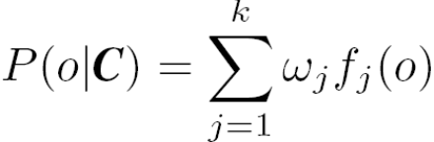
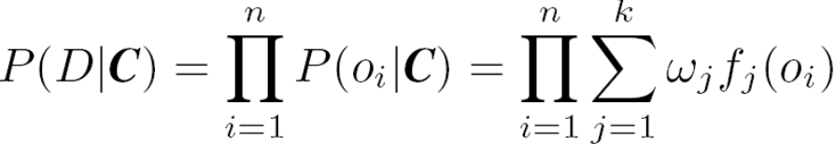
Model-Based Clustering
A set C of k probabilistic clusters C₁, …,C_{k} with probability density functions f₁, …, f_{k}, respectively, and their probabilities ω₁, …, ω_{k}.
Probability of an object o generated by cluster C_{j} is
Probability of o generated by the set of cluster C is
Since objects are assumed to be generated independently, for a data set D = {o₁, …, o_{n}}, we have,
Task: Find a set C of k probabilistic clusters s.t. P(D|C) is maximized
However, maximizing P(D|C) is often intractable since the probability density function of a cluster can take an arbitrarily complicated form
To make it computationally feasible (as a compromise), assume the probability density functions being some parameterized distributions

Slide 9
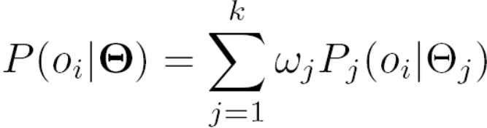
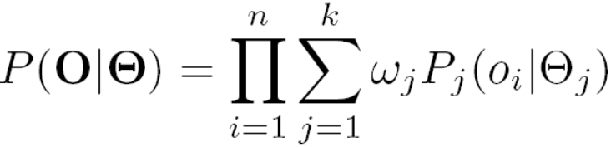
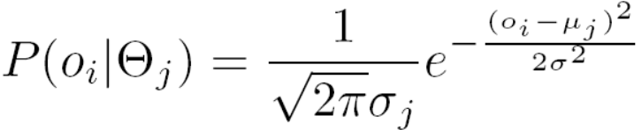
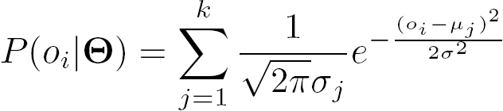
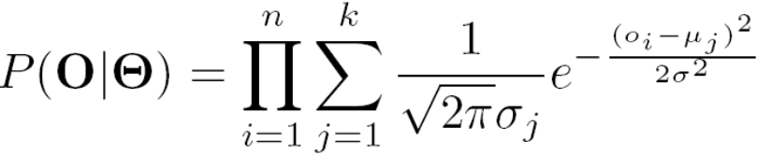
Univariate Gaussian Mixture Model
O = {o₁, …, o_{n}} (n observed objects), Θ = {θ₁, …, θ_{k}} (parameters of the k distributions), and P_{j}(o_{i}| θ_{j}) is the probability that o_{i} is generated from the j-th distribution using parameter θ_{j}, we have the probability of oi
Wj : the probability that θj is chosen to generate an object
Univariate Gaussian mixture model
  Assume the p.d.f of each cluster follows a 1-d Gaussian distribution
  The probability density function of each cluster are centered at μ_{j} with standard deviation σ_{j}, θ_{j}, = (μ_{j}, σ_{j}), we have

Slide 10
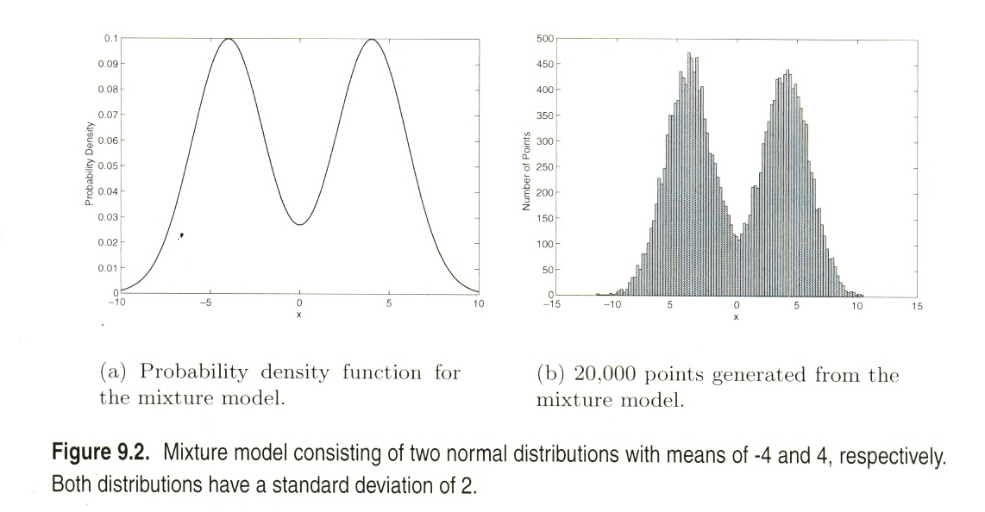

Slide 11
The EM (Expectation Maximization) Algorithm
The k-means algorithm has two steps at each iteration:
  Expectation Step (E-step): Given the current cluster centers, each object is assigned to the cluster whose center is closest to the object: An object is expected to belong to the closest cluster
  Maximization Step (M-step): Given the cluster assignment, for each cluster, the algorithm adjusts the center so that the sum of distance from the objects assigned to this cluster and the new center is minimized
The (EM) algorithm: A framework to approach maximum likelihood or maximum a posteriori estimates of parameters in statistical models.
  E-step assigns objects to clusters according to the current fuzzy clustering or parameters of probabilistic clusters
  M-step finds the new clustering or parameters that minimize the sum of squared error (SSE) or maximize the expected likelihood

Slide 12
EM — Expectation Maximization
EM — A popular iterative refinement algorithm
An extension to k-means
  Assign each object to a cluster according to a weight (prob. distribution)
  New means are computed based on weighted measures
General idea
  Starts with an initial estimate of the parameter vector
  Iteratively rescores the patterns against the mixture density produced by the parameter vector
  The rescored patterns are used to update the parameter updates
  Patterns belonging to the same cluster, if they are placed by their scores in a particular component
Algorithm converges fast but may not be in global optima
Data Mining: Concepts and Techniques

Slide 13
Expectation Maximization (EM)
Select an initial set of model parameters
repeat
Expectation Step: For each object, calculate the
probability that each object belongs to each
distribution, i.e., calcuate prob(Cj | oi, Θ).
Maximization Step: Given the probabilities from
the expectation step, find the new estimates of
the parameters that maximize the expected likelihood.
5. until The parameters do not change or the change is
below a specified threshold
Data Mining: Concepts and Techniques

Slide 14
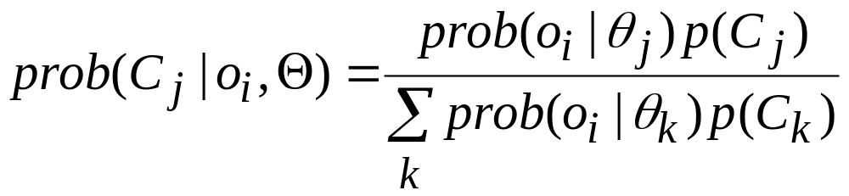
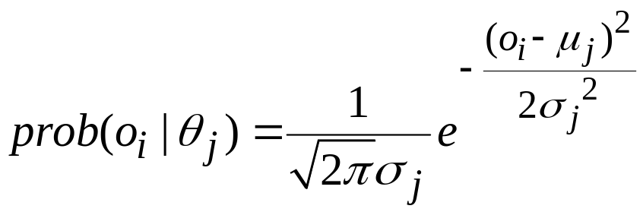
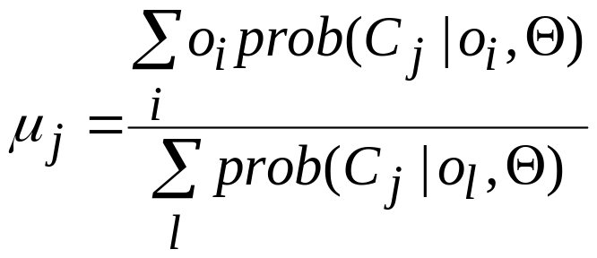
The EM (Expectation Maximization) Algorithm
Initially, randomly assign k cluster centers
Iteratively refine the clusters based on two steps
  Expectation step: assign each data point o_{i} to cluster C_{j} (θj)
  Maximization step: Estimation of model parameters
Data Mining: Concepts and Techniques

Slide 15
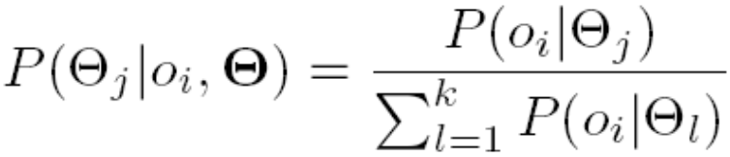
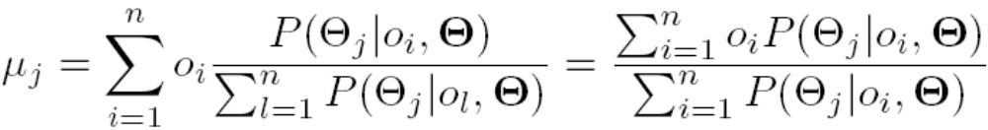
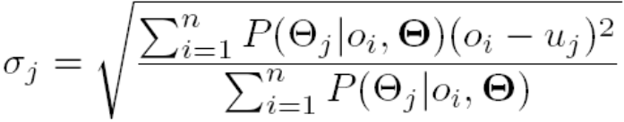
Computing Mixture Models with EM
Given n objects O = {o₁, …, o_{n}}, we want to mine a set of parameters Θ = {θ₁, …, θ_{k}} s.t.,P(O|Θ) is maximized, where θ_{j} = (μ_{j}, σ_{j}) are the mean and standard deviation of the j-th univariate Gaussian distribution
We initially assign random values to parameters θ_{j}, then iteratively conduct the E- and M- steps until converge or sufficiently small change
At the E-step, for each object o_{i}, calculate the probability that o_{i} belongs to each distribution,
At the M-step, adjust the parameters θ_{j} = (μ_{j}, σ_{j}) so that the expected likelihood P(O|Θ) is maximized

Slide 16
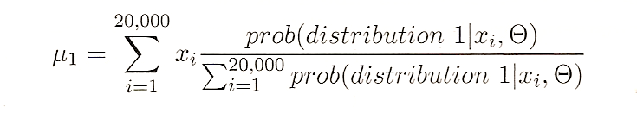
Prob(0|θ1)=0.12; Prob(0|θ2)=0.06
Prob(dist1|0,Θ)=0.12/(0.12+0.06)=0.66; Prob(dist2|0,Θ)=0.06/(0.12+0.06)=0.33;

Slide 17
Neural Network Approach
Neural network approaches
  Represent each cluster as an exemplar, acting as a “prototype” of the cluster
  New objects are distributed to the cluster whose exemplar is the most similar according to some distance measure
Typical methods
  SOM (Soft-Organizing feature Map)
  Competitive learning
    Involves a hierarchical architecture of several units (neurons)
    Neurons compete in a “winner-takes-all” fashion for the object currently being presented
Data Mining: Concepts and Techniques

Slide 18
Self-Organizing Feature Map (SOM)
SOMs, also called topological ordered maps, or Kohonen Self-Organizing Feature Map (KSOMs)
It maps all the points in a high-dimensional source space into a 2 to 3-d target space, s.t., the distance and proximity relationship (i.e., topology) are preserved as much as possible
Similar to k-means: cluster centers tend to lie in a low-dimensional manifold in the feature space
Clustering is performed by having several units competing for the current object
  The unit whose weight vector is closest to the current object wins
  The winner and its neighbors learn by having their weights adjusted
SOMs are believed to resemble processing that can occur in the brain
Useful for visualizing high-dimensional data in 2- or 3-D space
Data Mining: Concepts and Techniques

Slide 19
Self-Organizing Maps (SOM)
Initialize the centroids
Repeat
  Select the next object
  Determine the closest centroid to the object
  Update the centroid and the centroids that are close, i.e., in a specified neighborhood
Until The centroids don’t change much or a threshold is exceeded.
Assign each object to its closet centroid and clusters
Data Mining: Concepts and Techniques

Slide 20
(0,0)
(0,1)
(0,2)
(1,0)
(1,1)
(1,2)
(2,0)
(2,1)
(2,2)
Data Mining: Concepts and Techniques

Slide 21
SOM
p(t) current object; mk the closest centroid
Update the jth centroid
  mj(t+1) = mj(t) + hj(t) (p(t) – mj(t))
hj(t) = α(t) exp(-dist(rj, rk)²/ (2σ²(t)) (Gaussian fun)
rj/rk : grid locations of the centroids
hj(t) = α(t) if dist(rj, rk) ≤ threshold, 0 otherwise
α(t) : learning rate parameter; 0 < α(t) < 1
Data Mining: Concepts and Techniques

Slide 22
Clustering Graphs and Network Data
Applications
  Bi-partite graphs, e.g., customers and products, authors and conferences
  Web search engines, e.g., click through graphs and Web graphs
  Social networks, friendship/coauthor graphs
Similarity measures
  Geodesic distances
  Distance based on random walk (SimRank)
Graph clustering methods
  Minimum cuts: FastModularity (Clauset, Newman & Moore, 2004)
  Density-based clustering: SCAN (Xu et al., KDD’2007)

Slide 23
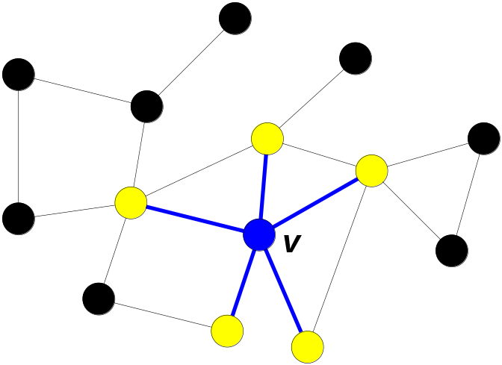
A Social Network Model
Cliques, hubs and outliers
  Individuals in a tight social group, or clique, know many of the same people, regardless of the size of the group
  Individuals who are hubs know many people in different groups but belong to no single group. Politicians, for example bridge multiple groups
  Individuals who are outliers reside at the margins of society. Hermits, for example, know few people and belong to no group
The Neighborhood of a Vertex
  Define Γ(ν) as the immediate neighborhood of a vertex (i.e. the set of people that an individual knows )

Slide 24
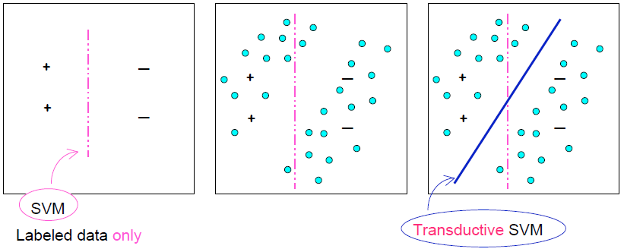
Why Semi-Supervised Learning?
Sparsity in data: training examples cannot cover the data space well
unlabeled data can help to address sparsity

Slide 25
Semi-Supervised Learning Methods
Many methods exist: EM with generative mixture models, self-training, co-training, data-based methods, transductive SVM, graph-based methods, …
Inductive methods and Transductive methods
  Transductive methods: only label the available unlabeled data – not generating a classifier
  Inductive methods: not only produce labels for unlabeled data, but also generate a classifier
Algorithmic methods
  Classifier-based methods: start from an initial classifier, and iteratively enhance it
  Data-based methods: find an inherent geometry in the data, and use the geometry to find a good classifier

Slide 26
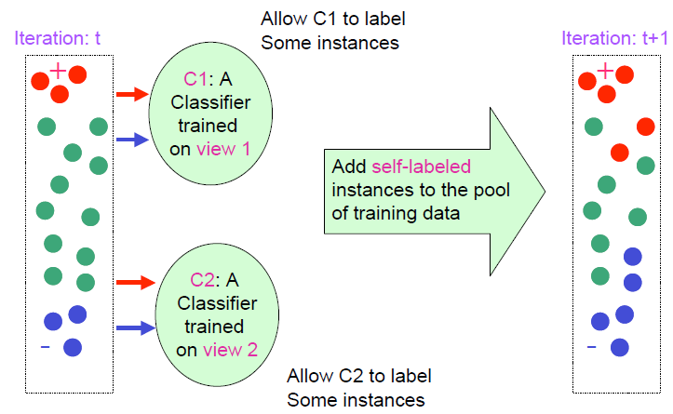
Co-Training

