Slide 1
Link Analysis
Ontology Network Analysis
HITS
Page Rank

Slide 2
Identifying
Communities of Practice through
Ontology Network Analysis
Harith Alani, Srinandan Dasmahapatra,
Kieron O’Hara, and Nigel Shadbott,
University of Southampton
2003 IEEE Intelligent Systems

Slide 3
Introduction
Ontology
In computer or information sciences, ontology is a data model that represents a set of concepts.
Individuals: instances or objects
Classes: sets, concepts, types of objects
Attributes: properties, features
Relations
Notes:
http://blog.roodo.com/myroodo/archives/2817405.html
http://en.wikipedia.org/wiki/Ontology_(computer_science)

Slide 4
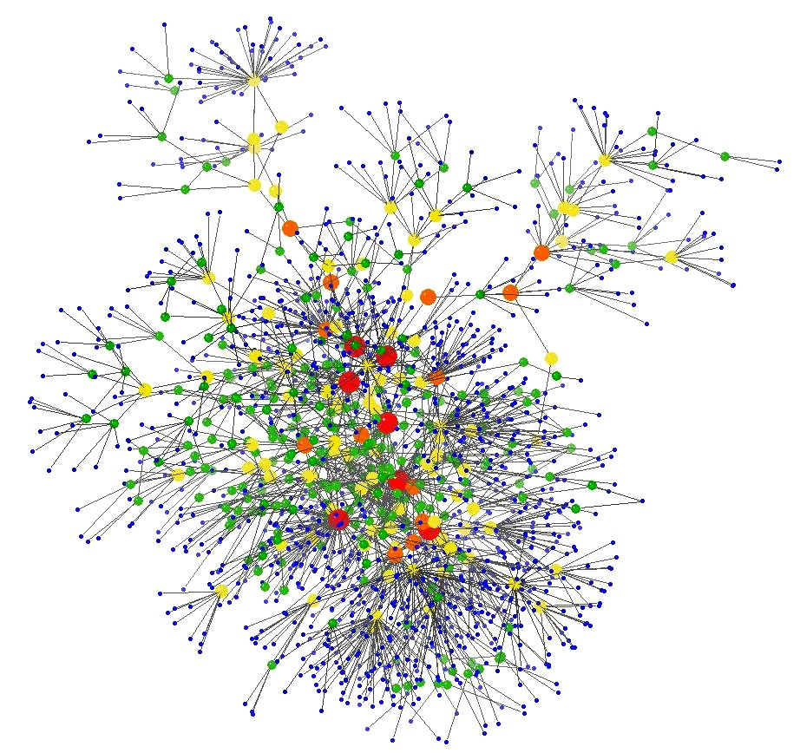
Ontology - Visualization

Slide 5
Communities of Practice & Ontocopi
Communities of Practice
The process of social learning that occurs when people have common goals.
--> Informal Self-organising group
Ontocopi (tool)
It uncovers Communities of Practice by analysing the connectivity of instances.
--> ONTOCOPI makes an explicit assumption that (some)
informal relations can be inferred from formal ones.
Notes:
http://zh.wikipedia.org/wiki/%E5%AF%A6%E8%B8%90%E7%A4%BE%E7%BE%A4
More recently, Community of Practice has become associated with knowledge management as people have begun to see them as ways of developing social capital, nurturing new knowledge, stimulating innovation, or sharing existing tacit knowledge within an organization.
Ontocopi uses ontological relations to discover connections between objects that the ontology only implicitly represents.
Ontocopi provides an algorithmic instantiation of the general ONA method. It plugs into the Protégé-2000 ontology and knowledge base editor.

Slide 6
Algorithm-ONA
Breadth-first, spreading-activation search
Link threshold
  lets COPs have different ranges
    Narrow COP
    Wider COP

Slide 7
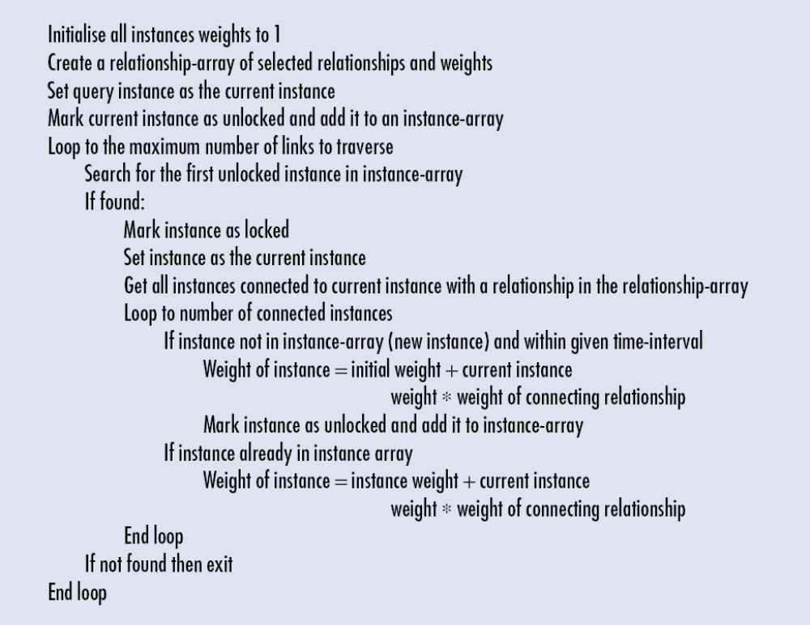
Pseudo code (for the COP calculation algorithm)

Slide 8
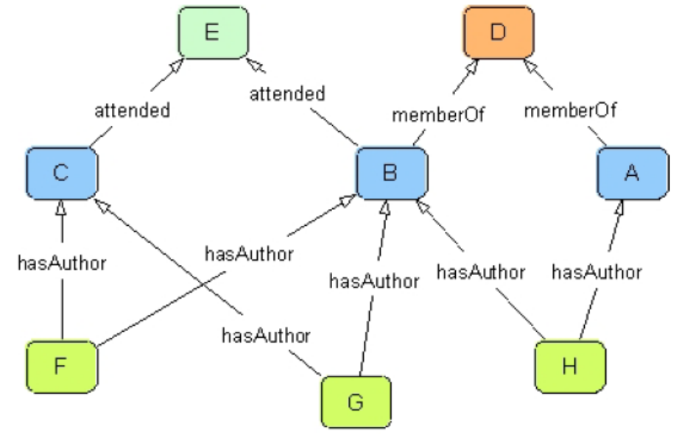
The algorithm- Example
Initial weight: 1
A passes 1*0.6 to D ;
1*1 to H.
D w = 1+1*0.6
H w = 1+1*1
D passes total weight
(1+1*0.6)*0.6 to B and A
Expansion stopped when link path is exhausted or link threshold is reached.
Selected relations:
hasAuthor (weights 1.0)
memberOf (weights 0.6)
attended (weights 0.3)

Slide 9
Distance
  Power 1/n
    n is the minimum number of links traversed to reach the instance starting from the query instance
Hub
  One-Step-Backwards

Slide 10
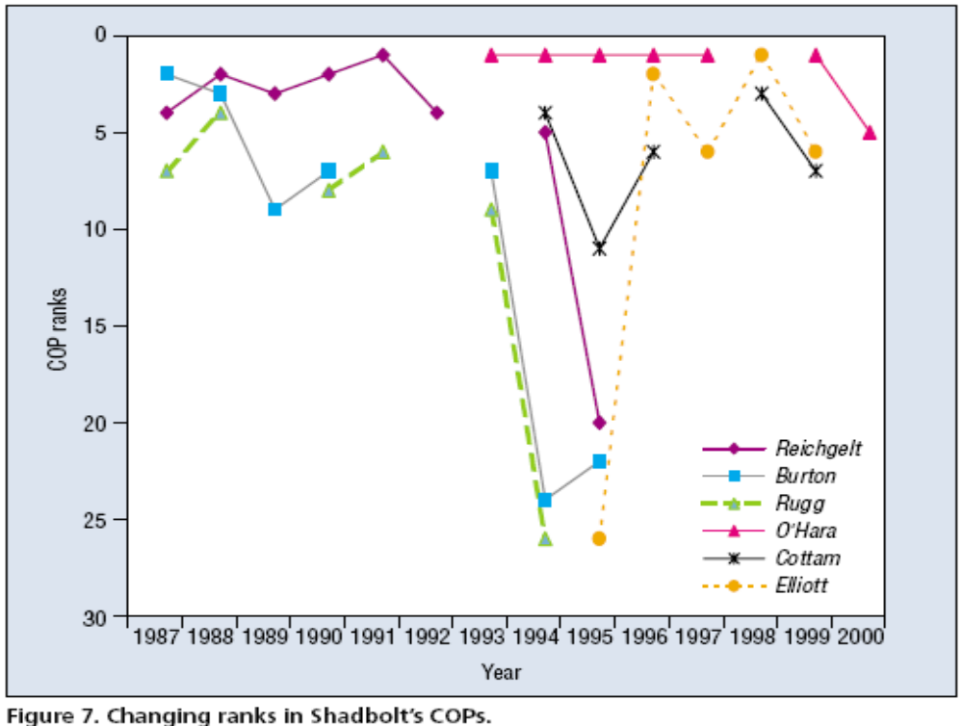
Temporarily-based COP identification

Slide 11
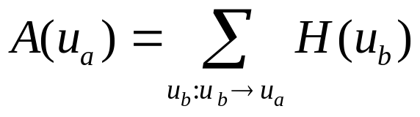
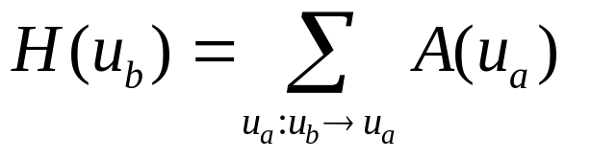
HITS
Authority Update: Update each node's Authority score to be equal to the sum of the Hub Scores of each node that points to it. That is, a node is given a high authority score by being linked to by pages that are recognized as Hubs for information.
Hub Update: Update each node's Hub Score to be equal to the sum of the Authority Scores of each node that it points to. That is, a node is given a high hub score by linking to nodes that are considered to be authorities on the subject.

Slide 12
Start with each node having a hub score and authority score of 1.
Run the Authority Update Rule
Run the Hub Update Rule
Normalize the values by dividing each Hub score by the sum of the squares of all Hub scores, and dividing each Authority score by the sum of the squares of all Authority scores.
Repeat from the second step as necessary

Slide 13
1 G := set of pages
2 for each page p in G do
3 p.auth = 1 // p.auth is the authority score of the page p
4 p.hub = 1 // p.hub is the hub score of the page p
5 function HubsAndAuthorities(G)
6 for step from 1 to k do // run the algorithm for k steps
7 norm = 0
8 for each page p in G do // update all authority values first
9 p.auth = 0
10 for each page q in p.incomingNeighbors do // the set of pages that link to p
11 p.auth += q.hub
12 norm += square(p.auth) // calculate the sum of the squared auth values to normalise
13 norm = sqrt(norm)
14 for each page p in G do // update the auth scores
15 p.auth = p.auth / norm // normalise the auth values
16 norm = 0
17 for each page p in G do // then update all hub values
18 p.hub = 0
19 for each page r in p.outgoingNeighbors do // the set of pages that p links to
20 p.hub += r.auth
21 norm += square(p.hub) // calculate the sum of the squared hub values to normalise
22 norm = sqrt(norm)
23 for each page p in G do // then update all hub values
24 p.hub = p.hub / norm // normalise the hub values

Slide 14
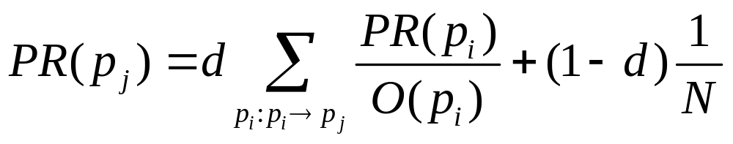
Page Rank
O (p_{i}) denotes p_{i}’s outdegree
The formula uses a model of a random surfer who gets bored after several clicks and switches to a random page.
The probability, at any step, that the person will continue is a damping factor d. d is usually set at 0.85
N is the total number of pages

Slide 15
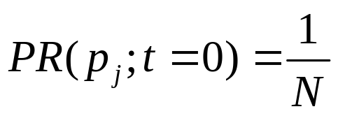
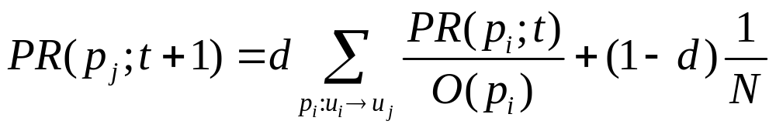
Iterative Computation
In the former case, at t = 0, an initial probability distribution is assumed, usually
At each time step, the computation, as detailed above, yields

