Slide 1
Data Mining:
Concepts and Techniques
— Mining Text and Web Data —
Jiawei Han and Micheline Kamber
Department of Computer Science
University of Illinois at Urbana-Champaign
www.cs.uiuc.edu/~hanj
©2006 Jiawei Han and Micheline Kamber. All rights reserved.
Data Mining: Principles and Algorithms

Slide 2
Mining Text and Web Data
Text mining, natural language processing and information extraction: An Introduction
Text categorization methods
Mining Web linkage structures
Summary
Data Mining: Principles and Algorithms

Slide 3




Mining Text Data: An Introduction
Data Mining / Knowledge Discovery
Structured Data Multimedia Free Text Hypertext
HomeLoan (
Loanee: Frank Rizzo
Lender: MWF
Agency: Lake View
Amount: $200,000
Term: 15 years
)
Frank Rizzo bought
his home from Lake
View Real Estate in
1992.
He paid $200,000
under a15-year loan
from MW Financial.
<a href>Frank Rizzo
</a> Bought
<a hef>this home</a>
from <a href>Lake
View Real Estate</a>
In <b>1992</b>.
<p>...
Loans($200K,[map],...)
Data Mining: Principles and Algorithms
Notes:
Throughout this course we have been discussing Data Mining over a variety of data types.
Two former types we covered were Structured Data (relational) and multimedia data.
Today and in the last class we have been discussing Data Mining over free text,
and our next section will cover hypertext, such as web pages.
Text mining is well motivated, due to the fact that much of the world’s data can be
found in free text form (newspaper articles, emails, literature, etc.). There is a
lot of information available to mine.
While mining free text has the same goals as data mining in general
(extracting useful knowledge/stats/trends), text mining must overcome
a major difficulty – there is no explicit structure.
Machines can reason will relational data well since schemas are explicitly available.
Free text, however, encodes all semantic information within natural language. Our
text mining algorithms, then, must make some sense out of this natural language
representation. Humans are great at doing this, but this has proved to be a problem for machines.

Slide 4
Bag-of-Tokens Approaches
Documents
Token Sets
Four score and seven years ago our fathers brought forth on this continent, a new nation, conceived in Liberty, and dedicated to the proposition that all men are created equal.
Now we are engaged in a great civil war, testing whether that nation, or …
nation – 5
civil - 1
war – 2
men – 2
died – 4
people – 5
Liberty – 1
God – 1
…
Feature
Extraction
Loses all order-specific information!
Severely limits context!
Data Mining: Principles and Algorithms
Notes:
The previous text mining presentations “made sense” out of free text by
viewing text as a bag-of-tokens (words, n-grams). This is the same approach as IR.
Under that model we can already summarize, classify, cluster, and compute co-occurrence stats over free text.
These are quite useful for mining and managing large volumes of free text.
However, there is a potential to do much more. The BOT approach loses a LOT of information
contained in text, such as word order, sentence structure, and context. These are precisely the
features that humans use to interpret text.
Thus the natural question is can we do better?

Slide 5

Natural Language Processing
A dog is chasing a boy on the playground
Lexical
analysis
(part-of-speech
tagging)
Det
Noun
Aux
Verb
Det
Noun
Prep
Det
Noun
Noun Phrase
Noun Phrase
Complex Verb
Noun Phrase
Prep Phrase
Semantic analysis
Verb Phrase
Syntactic analysis
(Parsing)
Dog(d1).
Boy(b1).
Playground(p1).
Chasing(d1,b1,p1).
Verb Phrase
+
Sentence
Scared(x) if Chasing(_,x,_).
A person saying this may
be reminding another person to
get the dog back…
Scared(b1)
Inference
Pragmatic analysis
(speech act)
Data Mining: Principles and Algorithms
(Taken from ChengXiang Zhai, CS 397cxz – Fall 2003)
Notes:
NLP, or Computational Linguistics, is an entire field dedicated to the study
of automatically understanding free text. This field has been active since the 50’s.
General NLP attempts to understand document completely (at the level of a human reader).
There are several steps involved in NLP.
…Blah…

Slide 6
General NLP—Too Difficult!
Word-level ambiguity
  “design” can be a noun or a verb (Ambiguous POS)
  “root” has multiple meanings (Ambiguous sense)
Syntactic ambiguity
  “natural language processing” (Modification)
  “A man saw a boy with a telescope.” (PP Attachment)
Anaphora resolution
  “John persuaded Bill to buy a TV for himself.”
  (himself = John or Bill?)
Presupposition
  “He has quit smoking.” implies that he smoked before.
Humans rely on context to interpret (when possible).
This context may extend beyond a given document!
Data Mining: Principles and Algorithms
(Taken from ChengXiang Zhai, CS 397cxz – Fall 2003)
Notes:
General NLP has proven to be too difficult. It is dubbed “AI-Complete”, meaning that such a
program would basically have to have near-human intelligence (i.e. solve AI).
The reason NLP in general is so difficult is that text is highly ambiguous. NL is meant for
human consumption and often contains ambiguities under the assumption that humans
will be able to develop context and interpret the intended meaning.
For instance [rewind], in this example the sentence could mean that either the dog, or the boy, or both
are on the playground. As a human we know that it is probably both, but that is due to our
knowledge that a dog is probably chasing close behind the boy, playgrounds are large,
they are probably playing, and a playground is a place to play. This background knowledge
probably is not contained in a document containing this sentence.
Despite such obstacles, computational linguists have made great progress on several subproblems.
We will now talk about four of these subproblems.

Slide 7
Shallow Linguistics
Progress on Useful Sub-Goals:
  English Lexicon
  Part-of-Speech Tagging
  Word Sense Disambiguation
  Phrase Detection / Parsing
Data Mining: Principles and Algorithms
Notes:
Several subgoals to NLP have been addressed to derive more info than just bag-of-tokens view.
English lexicon, POS Tagging, WSD, Parsing
Even with imperfect performance, these solutions already open the door for more intelligent text processing.

Slide 8
WordNet
An extensive lexical network for the English language
Contains over 138,838 words.
Several graphs, one for each part-of-speech.
Synsets (synonym sets), each defining a semantic sense.
Relationship information (antonym, hyponym, meronym …)
Downloadable for free (UNIX, Windows)
Expanding to other languages (Global WordNet Association)
Funded >$3 million, mainly government (translation interest)
Founder George Miller, National Medal of Science, 1991.
watery
parched
moist
wet
dry
arid
synonym
antonym
Data Mining: Principles and Algorithms
damp
anhydrous
Notes:
WordNet is an extensive lexical network for the human language.
Consists of a graph of synsets for each part of speech. Contains synonym and antonym relationships.
(hyponym=isa/subset, maple is a tree -> maple is a hyponym of tree)
(meronym=hasa, tree has a leaf -> leaf is a meronym of tree)
As will see, this is useful throughout NLP/ShallowLinguistics.
This encodes some of the lexicon that humans carry with them when interpreting text.

Slide 9
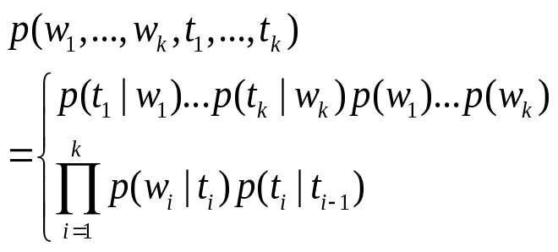
Part-of-Speech Tagging
Training data (Annotated text)
This sentence serves as an example of annotated text…
Det N V1 P Det N P V2 N
“This is a new sentence.”
POS Tagger
This is a new sentence.
Det Aux Det Adj N
Pick the most likely tag sequence.
Independent assignment
Most common tag
Partial dependency
(HMM)
Data Mining: Principles and Algorithms
(Adapted from ChengXiang Zhai, CS 397cxz – Fall 2003)
Notes:
POS Tagging attempts to label each word with the appropriate part of speech.
Past approaches were rule-based (manual, then learned). Current trend, however, is toward statistical approaches (HMM).
This shift is common throughout NLP, due to the ability of statistical approaches to robustly handle noise and/or unexpected events.
Conceptually statistical approaches are more fitting due to the fact that uncertainty is sometimes unavoidable (ambiguity).
Current algorithms (Brill’s Tagger, CLAWS taggers) report accuracy in the 97% range.

Slide 10
Word Sense Disambiguation
?
“The difficulties of computational linguistics are rooted in ambiguity.”
N Aux V P N
Supervised Learning
Features:
  Neighboring POS tags (N Aux V P N)
  Neighboring words (linguistics are rooted in ambiguity)
  Stemmed form (root)
  Dictionary/Thesaurus entries of neighboring words
  High co-occurrence words (plant, tree, origin,…)
  Other senses of word within discourse
Algorithms:
  Rule-based Learning (e.g. IG guided)
  Statistical Learning (i.e. Naïve Bayes)
  Unsupervised Learning (i.e. Nearest Neighbor)
Data Mining: Principles and Algorithms
Notes:
WSD attempts to resolve ambiguity by labeling each word with a precise sense, as intended in the document.
This is typically performed after POS tagging, since POS tags are quite useful for WSD.
Current approaches address this as a supervised learning problem.
Features include neighboring words w/ POS tags, stemmed form of word, high co-occurrence words (with stem).
Quite a few supervised learning algorithms have been applied (rule-lists, bayesian, NN).
Performance depends heavily upon the particular text, but from what I’ve read 90%+ accuracy is common.

Slide 11
Parsing
Choose most likely parse tree…
S
Probability of this tree=0.000015
Probabilistic CFG
NP
VP
S→ NP VP
NP → Det BNP
NP → BNP
NP→ NP PP
BNP→ N
VP → V
VP → Aux V NP
VP → VP PP
PP → P NP
V → chasing
Aux→ is
N → dog
N → boy
N→ playground
Det→ the
Det→ a
P → on
Det
1.0
BNP
VP
PP
0.3
0.4
0.3
A
N
Aux
V
NP
P
NP
Grammar
dog
is
chasing
on
…
a boy
.
the playground
.
…
.
S
Probability of this tree=0.000011
1.0
NP
VP
0.01
Det
BNP
Aux
V
NP
PP
0.003
A
N
is
chasing
NP
Lexicon
P
NP
…
dog
a boy
on
…
Data Mining: Principles and Algorithms
the playground
(Adapted from ChengXiang Zhai, CS 397cxz – Fall 2003)
Notes:
Parsing attempts to infer the precise grammatical relationships between different words in a given sentence.
For example, POS are grouped into phrases and phrases are combined into sentences.
Approaches include parsing with probabilistic CFG’s, “link dictionaries”, and tree adjoining techniques (super-tagging).
Current techniques can only parse at the sentence level, in some cases reporting accuracy in the 90% range.
Again, the performance heavily depends upon the grammatical correctness and the degree of ambiguity of the text.

Slide 12
Obstacles
Ambiguity
“A man saw a boy with a telescope.”
Computational Intensity
Imposes a context horizon.
Text Mining NLP Approach:
  Locate promising fragments using fast IR methods (bag-of-tokens).
  Only apply slow NLP techniques to promising fragments.
Data Mining: Principles and Algorithms
Notes:
The biggest obstacle to sophisticated NLP is ambiguity. Humans are quite skilled at inferring context and meaning.
NLP is expensive and can currently only be performed on the small scale (per-sentence, selective sentences).
This restriction further limits our ability to derive context (from across the document).
Current approach is to use fast IR techniques (bag-of-tokens) to determine promising text fragments and then apply more expensive NLP techniques on those fragments. (same idea is in multimedia mining)

Slide 13
Summary: Shallow NLP
However, shallow NLP techniques are feasible and useful:
Lexicon – machine understandable linguistic knowledge
  possible senses, definitions, synonyms, antonyms, typeof, etc.
POS Tagging – limit ambiguity (word/POS), entity extraction
  “...research interests include text mining as well as bioinformatics.”
    NP N
WSD – stem/synonym/hyponym matches (doc and query)
  Query: “Foreign cars” Document: “I’m selling a 1976 Jaguar…”
Parsing – logical view of information (inference?, translation?)
  “A man saw a boy with a telescope.”
Even without complete NLP, any additional knowledge extracted from text data can only be beneficial.
Ingenuity will determine the applications.
Data Mining: Principles and Algorithms
Notes:
Even though general NLP is elusive, the subgoals presented here already provide opportunity for more intelligent text processing/analysis.
POS Tagging can provide a basis for extracting relations/facts (IE – HMM approach example).
WSD can resolve semantic ambiguities at the word-level. Even interpret synonyms as related. (laptop, notebook) (in document and query)
Parsing can translate free text into a logical, machine-understandable representation of the stated “knowledge”. (MT?, Inference?)
Rest is up to ingenuity, but it seems clear that as more of the knowledge encoded in text can be machine-understood we will be able to build systems to more intelligently work/reason with textual data.

Slide 14
Mining Text and Web Data
Text mining, natural language processing and information extraction: An Introduction
Text information system and information retrieval
Text categorization methods
Mining Web linkage structures
Summary
Data Mining: Principles and Algorithms

Slide 15
Text Databases and IR
Text databases (document databases)
  Large collections of documents from various sources: news articles, research papers, books, digital libraries, e-mail messages, and Web pages, library database, etc.
  Data stored is usually semi-structured
  Traditional information retrieval techniques become inadequate for the increasingly vast amounts of text data
Information retrieval
  A field developed in parallel with database systems
  Information is organized into (a large number of) documents
  Information retrieval problem: locating relevant documents based on user input, such as keywords or example documents
Data Mining: Principles and Algorithms

Slide 16
Information Retrieval
Typical IR systems
  Online library catalogs
  Online document management systems
Information retrieval vs. database systems
  Some DB problems are not present in IR, e.g., update, transaction management, complex objects
  Some IR problems are not addressed well in DBMS, e.g., unstructured documents, approximate search using keywords and relevance
Data Mining: Principles and Algorithms

Slide 17
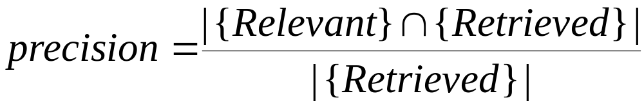
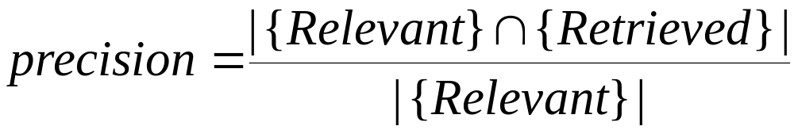
Basic Measures for Text Retrieval
Relevant
Relevant & Retrieved
Retrieved
All Documents
Precision: the percentage of retrieved documents that are in fact relevant to the query (i.e., “correct” responses)
Recall: the percentage of documents that are relevant to the query and were, in fact, retrieved
Data Mining: Principles and Algorithms

Slide 18
Information Retrieval Techniques
Basic Concepts
  A document can be described by a set of representative keywords called index terms.
  Different index terms have varying relevance when used to describe document contents.
  This effect is captured through the assignment of numerical weights to each index term of a document. (e.g.: frequency, tf-idf)
DBMS Analogy
  Index Terms → Attributes
  Weights → Attribute Values
Data Mining: Principles and Algorithms

Slide 19
Information Retrieval Techniques
Index Terms (Attribute) Selection:
  Stop list
  Word stem
  Index terms weighting methods
Terms  Documents Frequency Matrices
Information Retrieval Models:
  Boolean Model
  Vector Model
  Probabilistic Model
Data Mining: Principles and Algorithms

Slide 20
Boolean Model
Consider that index terms are either present or absent in a document
As a result, the index term weights are assumed to be all binaries
A query is composed of index terms linked by three connectives: not, and, and or
  e.g.: car and repair, plane or airplane
The Boolean model predicts that each document is either relevant or non-relevant based on the match of a document to the query
Data Mining: Principles and Algorithms

Slide 21
Keyword-Based Retrieval
A document is represented by a string, which can be identified by a set of keywords
Queries may use expressions of keywords
  E.g., car and repair shop, tea or coffee, DBMS but not Oracle
  Queries and retrieval should consider synonyms, e.g., repair and maintenance
Major difficulties of the model
  Synonymy: A keyword T does not appear anywhere in the document, even though the document is closely related to T, e.g., data mining
  Polysemy: The same keyword may mean different things in different contexts, e.g., mining
Data Mining: Principles and Algorithms

Slide 22
Similarity-Based Retrieval in Text Data
Finds similar documents based on a set of common keywords
Answer should be based on the degree of relevance based on the nearness of the keywords, relative frequency of the keywords, etc.
Basic techniques
Stop list
    Set of words that are deemed “irrelevant”, even though they may appear frequently
    E.g., a, the, of, for, to, with, etc.
    Stop lists may vary when document set varies
Data Mining: Principles and Algorithms

Slide 23
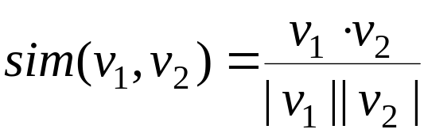
Similarity-Based Retrieval in Text Data
  Word stem
    Several words are small syntactic variants of each other since they share a common word stem
    E.g., drug, drugs, drugged
  A term frequency table
    Each entry frequent_table(i, j) = # of occurrences of the word t_{i} in document d_{i}
    Usually, the ratio instead of the absolute number of occurrences is used
  Similarity metrics: measure the closeness of a document to a query (a set of keywords)
    Relative term occurrences
    Cosine distance:
Data Mining: Principles and Algorithms

Slide 24
Indexing Techniques
Inverted index
  Maintains two hash- or B+-tree indexed tables:
    document_table: a set of document records <doc_id, postings_list>
    term_table: a set of term records, <term, postings_list>
  Answer query: Find all docs associated with one or a set of terms
  + easy to implement
  – do not handle well synonymy and polysemy, and posting lists could be too long (storage could be very large)
Signature file
  Associate a signature with each document
  A signature is a representation of an ordered list of terms that describe the document
  Order is obtained by frequency analysis, stemming and stop lists
Data Mining: Principles and Algorithms

Slide 25
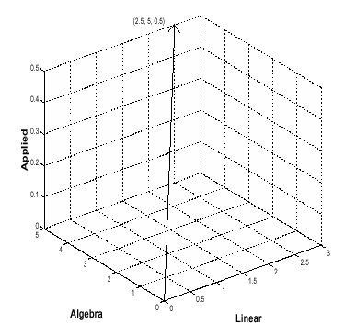
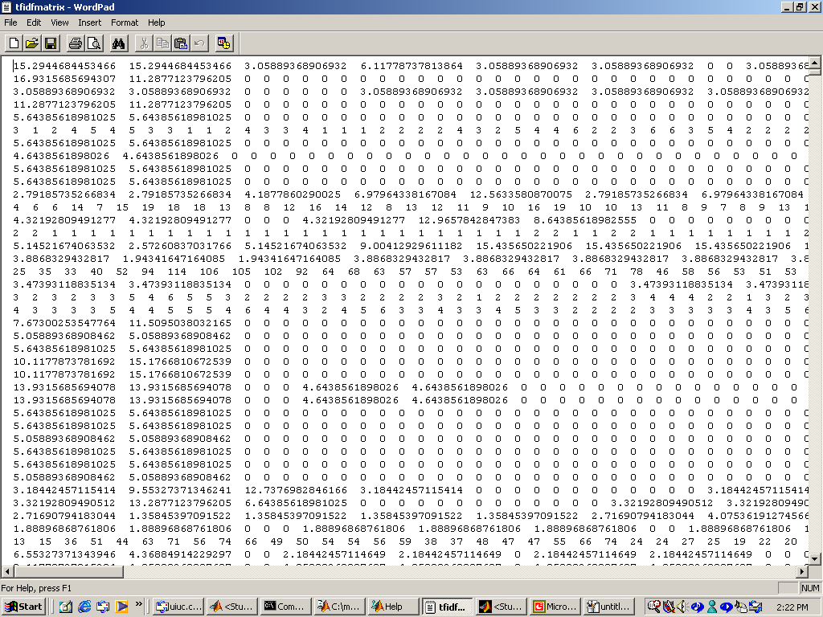
Vector Space Model
Documents and user queries are represented as m-dimensional vectors, where m is the total number of index terms in the document collection.
The degree of similarity of the document d with regard to the query q is calculated as the correlation between the vectors that represent them, using measures such as the Euclidian distance or the cosine of the angle between these two vectors.
Data Mining: Principles and Algorithms

Slide 26
Vector Space Model
Represent a doc by a term vector
  Term: basic concept, e.g., word or phrase
  Each term defines one dimension
  N terms define a N-dimensional space
  Element of vector corresponds to term weight
  E.g., d = (x₁,…,x_{N}), x_{i} is “importance” of term i
New document is assigned to the most likely category based on vector similarity.
Data Mining: Principles and Algorithms

Slide 27
VS Model: Illustration
Starbucks
C₂
Category 2
Category 3
C₃
Java
new doc
Microsoft
C₁
Category 1
Data Mining: Principles and Algorithms

Slide 28
What VS Model Does Not Specify
How to select terms to capture “basic concepts”
  Word stopping
    e.g. “a”, “the”, “always”, “along”
  Word stemming
    e.g. “computer”, “computing”, “computerize” => “compute”
  Latent semantic indexing
How to assign weights
  Not all words are equally important: Some are more indicative than others
    e.g. “algebra” vs. “science”
How to measure the similarity
Data Mining: Principles and Algorithms

Slide 29
How to Assign Weights
Two-fold heuristics based on frequency
  TF (Term frequency)
    More frequent within a document → more relevant to semantics
    e.g., “query” vs. “commercial”
  IDF (Inverse document frequency)
    Less frequent among documents → more discriminative
    e.g. “algebra” vs. “science”
Data Mining: Principles and Algorithms

Slide 30

TF Weighting
Weighting:
  More frequent => more relevant to topic
    e.g. “query” vs. “commercial”
    Raw TF= f(t,d): how many times term t appears in doc d
Normalization:
  Document length varies => relative frequency preferred
    e.g., Maximum frequency normalization
Data Mining: Principles and Algorithms

Slide 31

IDF Weighting
Ideas:
  Less frequent among documents → more discriminative
Formula:
n — total number of docs k — # docs with term t appearing
(the DF document frequency)
Data Mining: Principles and Algorithms

Slide 32
TF-IDF Weighting
TF-IDF weighting : weight(t, d) = TF(t, d) * IDF(t)
  Freqent within doc → high tf → high weight
  Selective among docs → high idf → high weight
Recall VS model
  Each selected term represents one dimension
  Each doc is represented by a feature vector
  Its t-term coordinate of document d is the TF-IDF weight
  This is more reasonable
Just for illustration …
  Many complex and more effective weighting variants exist in practice
Data Mining: Principles and Algorithms

Slide 33



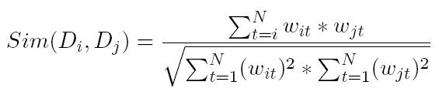
How to Measure Similarity?
Given two document
Similarity definition
  dot product
  normalized dot product (or cosine)
Data Mining: Principles and Algorithms

Slide 34
Illustrative Example
text
mining
search
engine
text
doc1
Sim(newdoc,doc1)=4.8*2.4+4.5*4.5
Sim(newdoc,doc2)=2.4*2.4
Sim(newdoc,doc3)=0
To whom is newdoc more similar?
travel
text
map
travel
doc2
text mining travel map search engine govern president congress
IDF(faked) 2.4 4.5 2.8 3.3 2.1 5.4 2.2 3.2 4.3
doc1 2(4.8) 1(4.5) 1(2.1) 1(5.4)
doc2 1(2.4 ) 2 (5.6) 1(3.3)
doc3 1 (2.2) 1(3.2) 1(4.3)
newdoc 1(2.4) 1(4.5)
government
president
congress
doc3
……
Data Mining: Principles and Algorithms

Slide 35
VS Model-Based Classifiers
What do we have so far?
  A feature space with similarity measure
  This is a classic supervised learning problem
    Search for an approximation to classification hyper plane
VS model based classifiers
  K-NN
  Decision tree based
  Neural networks
  Support vector machine
Data Mining: Principles and Algorithms

Slide 36
Latent Semantic Indexing
Basic idea
  Similar documents have similar word frequencies
  Difficulty: the size of the term frequency matrix is very large
  Use a singular value decomposition (SVD) techniques to reduce the size of frequency table
  Retain the K most significant rows of the frequency table
Method
  Create a term x document weighted frequency matrix A
  SVD construction: A = U * S * V’
  Define K and obtain U_{k} ,, S_{k} , and V_{k}.
  Create query vector q’ .
  Project q’ into the term-document space: Dq = q’ * U_{k} * S_{k}⁻¹
  Calculate similarities: cos α = Dq . D / ||Dq|| * ||D||
Data Mining: Principles and Algorithms

Slide 37
Text Classification
Motivation
  Automatic classification for the large number of on-line text documents (Web pages, e-mails, corporate intranets, etc.)
Classification Process
  Data preprocessing
  Definition of training set and test sets
  Creation of the classification model using the selected classification algorithm
  Classification model validation
  Classification of new/unknown text documents
Text document classification differs from the classification of relational data
  Document databases are not structured according to attribute-value pairs
Data Mining: Principles and Algorithms

Slide 38
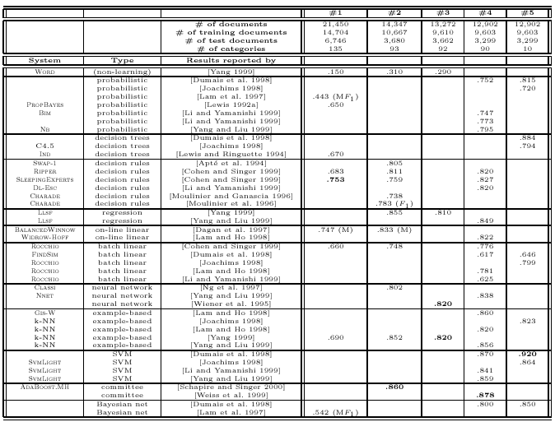
Text Classification(2)
Classification Algorithms:
  Support Vector Machines
  K-Nearest Neighbors
  Naïve Bayes
  Neural Networks
  Decision Trees
  Association rule-based
  Boosting
Data Mining: Principles and Algorithms

Slide 39
Document Clustering
Motivation
  Automatically group related documents based on their contents
  No predetermined training sets or taxonomies
  Generate a taxonomy at runtime
Clustering Process
  Data preprocessing: remove stop words, stem, feature extraction, lexical analysis, etc.
  Hierarchical clustering: compute similarities applying clustering algorithms.
  Model-Based clustering (Neural Network Approach): clusters are represented by “exemplars”. (e.g.: SOM)
Data Mining: Principles and Algorithms

Slide 40
Text Categorization
Pre-given categories and labeled document examples (Categories may form hierarchy)
Classify new documents
A standard classification (supervised learning ) problem
Sports
Business
Education
Science
Categorization
System
…
…
Sports
Business
Education
Data Mining: Principles and Algorithms

Slide 41
Applications
News article classification
Automatic email filtering
Webpage classification
Word sense disambiguation
… …
Data Mining: Principles and Algorithms

Slide 42
Categorization Methods
Manual: Typically rule-based
  Does not scale up (labor-intensive, rule inconsistency)
  May be appropriate for special data on a particular domain
Automatic: Typically exploiting machine learning techniques
  Vector space model based
    Prototype-based (Rocchio)
    K-nearest neighbor (KNN)
    Decision-tree (learn rules)
    Neural Networks (learn non-linear classifier)
    Support Vector Machines (SVM)
  Probabilistic or generative model based
    Naïve Bayes classifier
Data Mining: Principles and Algorithms

Slide 43
Probabilistic Model
Main ideas
  Category C is modeled as a probability distribution of pre-defined random events
  Random events model the process of generating documents
  Therefore, how likely a document d belongs to category C is measured through the probability for category C to generate d.
Data Mining: Principles and Algorithms

Slide 44
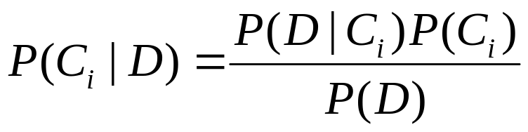
Quick Revisit of Bayes’ Rule
Category Hypothesis space: H = {C₁ , …, C_{n}}
One document: D
As we want to pick the most likely category C*, we can drop p(D)
Posterior probability of C_{i}
Document model for category C
Data Mining: Principles and Algorithms

Slide 45
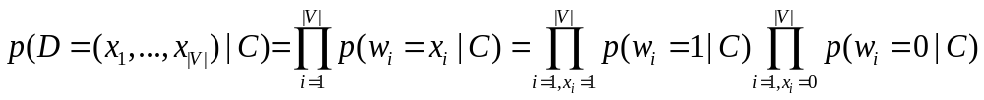
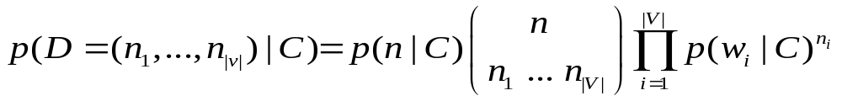
Probabilistic Model
Multi-Bernoulli
  Event: word presence or absence
  D = (x₁, …, x_{|V|}), x_{i} =1 for presence of word w_{i}; x_{i} =0 for absence
  Parameters: {p(w_{i}=1|C), p(w_{i}=0|C)}, p(w_{i}=1|C)+ p(w_{i}=0|C)=1
Multinomial (Language Model)
  Event: word selection/sampling
  D = (n₁, …, n_{|V|}), n_{i}: frequency of word w_{i} n=n₁,+…+ n_{|V|}
  Parameters: {p(w_{i}|C)} p(w₁|C)+… p(w_{|v|}|C) = 1
Data Mining: Principles and Algorithms

Slide 46
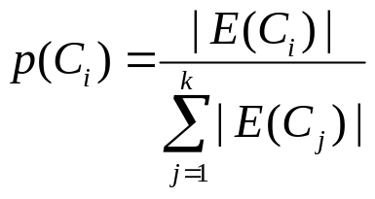
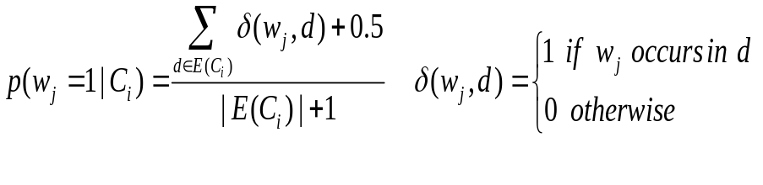
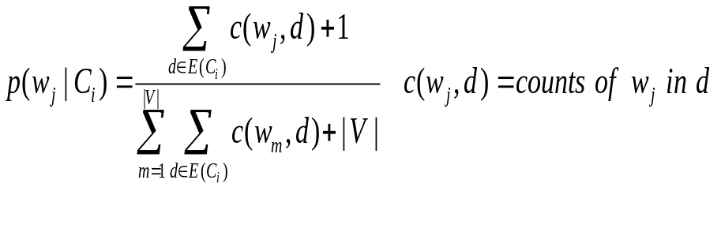
Parameter Estimation
Training examples:
Category prior
Multi-Bernoulli Doc model
Multinomial doc model
E(C₁)
E(C₂)
C₁
C₂
C_{k}
E(C_{k})
Vocabulary: V = {w₁, …, w_{|V|}}
Data Mining: Principles and Algorithms

Slide 47
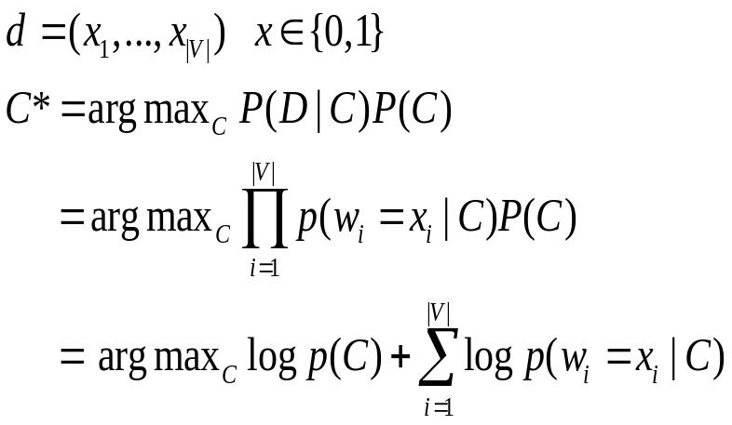
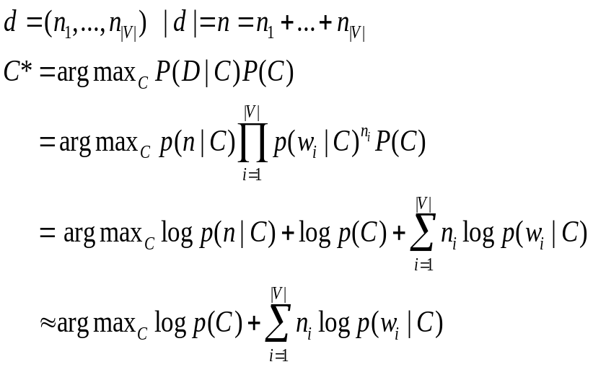
Classification of New Document
Multi-Bernoulli
Multinomial
Data Mining: Principles and Algorithms

Slide 48
Categorization Methods
Vector space model
  K-NN
  Decision tree
  Neural network
  Support vector machine
Probabilistic model
  Naïve Bayes classifier
Many, many others and variants exist [F.S. 02]
  e.g. Bim, Nb, Ind, Swap-1, LLSF, Widrow-Hoff, Rocchio, Gis-W, … …
Data Mining: Principles and Algorithms

Slide 49
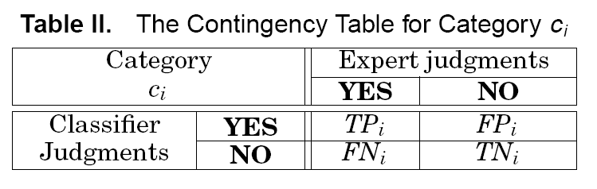


Evaluations
Effectiveness measure
  Classic: Precision & Recall
    Precision
    Recall
Data Mining: Principles and Algorithms

Slide 50
CS276A
Text Retrieval and Mining
Lecture 12
[Borrows slides from Viktor Lavrenko and Chengxiang Zhai]

Slide 51
Today
The Language Model Approach to IR
  Basic query generation model
  Alternative models

Slide 52





IR based on Language Model (LM)
Information need
d1
generation
d2
query
…
…
A common search heuristic is to use words that you expect to find in matching documents as your query – why, I saw Sergey Brin advocating that strategy on late night TV one night in my hotel room, so it must be good!
The LM approach directly exploits that idea!
dn
document collection

Slide 53
Formal Language (Model)
Traditional generative model: generates strings
  Finite state machines or regular grammars, etc.
Example:
I wish
I wish I wish
I wish I wish I wish
I
wish
I wish I wish I wish I wish
…
*wish I wish

Slide 54
Stochastic Language Models
Models probability of generating strings in the language (commonly all strings over alphabet ∑)
Model M
0.2 the
0.1 a
0.01 man
0.01 woman
0.03 said
0.02 likes
…
the
man
likes
the
woman
0.2
0.01
0.02
0.2
0.01
multiply
P(s | M) = 0.00000008

Slide 55
Stochastic Language Models
Model probability of generating any string
Model M1
Model M2
0.2 the
0.0001 class
0.03 sayst
0.02 pleaseth
0.1 yon
0.01 maiden
0.0001 woman
0.2 the
0.01 class
0.0001 sayst
0.0001 pleaseth
0.0001 yon
0.0005 maiden
0.01 woman
the
class
pleaseth
yon
maiden
0.2
0.01
0.0001
0.0001
0.0005
0.2
0.0001
0.02
0.1
0.01
P(s|M2) > P(s|M1)

Slide 56
Stochastic Language Models
A statistical model for generating text
  Probability distribution over strings in a given language
M
P ( | M )
= P ( | M )
P ( | M, )
P ( | M, )
P ( | M, )

Slide 57
Unigram and higher-order models
Unigram Language Models
Bigram (generally, n-gram) Language Models
Other Language Models
  Grammar-based models (PCFGs), etc.
    Probably not the first thing to try in IR
P ( )
= P ( )
P ( | )
P ( | )
P ( | )
Easy.
Effective!
P ( ) P ( ) P ( ) P ( )
P ( ) P ( | ) P ( | ) P ( | )

Slide 58
Using Language Models in IR
Treat each document as the basis for a model (e.g., unigram sufficient statistics)
Rank document d based on P(d | q)
P(d | q) = P(q | d) x P(d) / P(q)
  P(q) is the same for all documents, so ignore
  P(d) [the prior] is often treated as the same for all d
    But we could use criteria like authority, length, genre
  P(q | d) is the probability of q given d’s model
Very general formal approach

Slide 59
The fundamental problem of LMs
Usually we don’t know the model M
  But have a sample of text representative of that model
Estimate a language model from a sample
Then compute the observation probability
P ( | M ( ) )
M

Slide 60
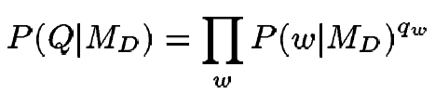
Language Models for IR
Language Modeling Approaches
  Attempt to model query generation process
  Documents are ranked by the probability that a query would be observed as a random sample from the respective document model
    Multinomial approach

Slide 61
Retrieval based on probabilistic LM
Treat the generation of queries as a random process.
Approach
  Infer a language model for each document.
  Estimate the probability of generating the query according to each of these models.
  Rank the documents according to these probabilities.
  Usually a unigram estimate of words is used
    Some work on bigrams, paralleling van Rijsbergen

Slide 62
Retrieval based on probabilistic LM
Intuition
  Users …
    Have a reasonable idea of terms that are likely to occur in documents of interest.
    They will choose query terms that distinguish these documents from others in the collection.
Collection statistics …
  Are integral parts of the language model.
  Are not used heuristically as in many other approaches.
    In theory. In practice, there’s usually some wiggle room for empirically set parameters

Slide 63
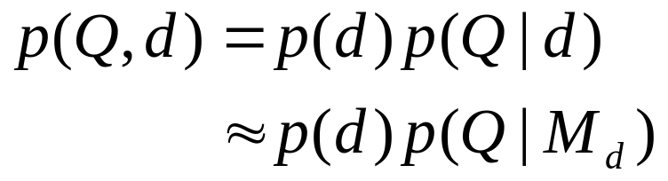
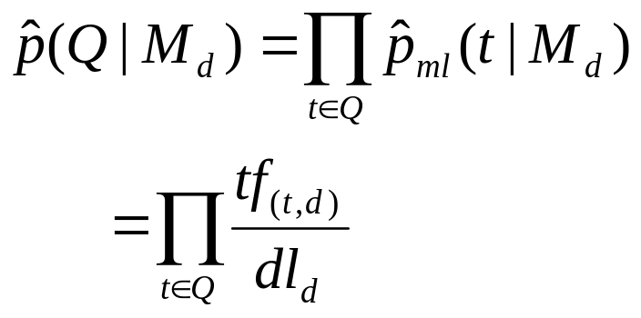



Query generation probability (1)
Ranking formula
The probability of producing the query given the language model of document d using MLE is:
Unigram assumption:
Given a particular language model, the query terms occur independently
: language model of document d
: raw tf of term t in document d
: total number of tokens in document d

Slide 64

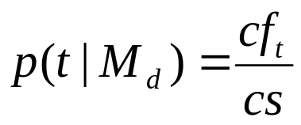
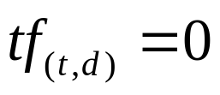


Insufficient data
Zero probability
  May not wish to assign a probability of zero to a document that is missing one or more of the query terms [gives conjunction semantics]
General approach
  A non-occurring term is possible, but no more likely than would be expected by chance in the collection.
  If ,
: raw count of term t in the collection
: raw collection size(total number of tokens in the collection)

Slide 65
Insufficient data
Zero probabilities spell disaster
  We need to smooth probabilities
    Discount nonzero probabilities
    Give some probability mass to unseen things
There’s a wide space of approaches to smoothing probability distributions to deal with this problem, such as adding 1, ½ or ε to counts, Dirichlet priors, discounting, and interpolation
  [See FSNLP ch. 6 or CS224N if you want more]
A simple idea that works well in practice is to use a mixture between the document multinomial and the collection multinomial distribution

Slide 66
Mixture model
P(w|d) = λP_{mle}(w|M_{d}) + (1 – λ)P_{mle}(w|M_{c})
Mixes the probability from the document with the general collection frequency of the word.
Correctly setting λ is very important
A high value of lambda makes the search “conjunctive-like” – suitable for short queries
A low value is more suitable for long queries
Can tune λ to optimize performance
  Perhaps make it dependent on document size (cf. Dirichlet prior or Witten-Bell smoothing)

Slide 67
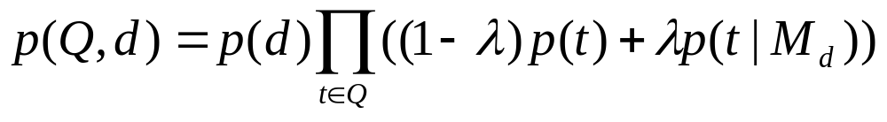
Basic mixture model summary
General formulation of the LM for IR
  The user has a document in mind, and generates the query from this document.
  The equation represents the probability that the document that the user had in mind was in fact this one.
general language model
individual-document model

Slide 68
Example
Document collection (2 documents)
  d₁: Xerox reports a profit but revenue is down
  d₂: Lucent narrows quarter loss but revenue decreases further
Model: MLE unigram from documents; λ = ½
Query: revenue down
  P(Q|d₁) = [(1/8 + 2/16)/2] x [(1/8 + 1/16)/2]
  = 1/8 x 3/32 = 3/256
  P(Q|d₂) = [(1/8 + 2/16)/2] x [(0 + 1/16)/2]
  = 1/8 x 1/32 = 1/256
Ranking: d₁ > d₂

Slide 69


Extension: 3-level model
3-level model
  Whole collection model ( )
  Specific-topic model; relevant-documents model ( )
  Individual-document model ( )
Relevance hypothesis
  A request(query; topic) is generated from a specific-topic model { , }.
  Iff a document is relevant to the topic, the same model will apply to the document.
    It will replace part of the individual-document model in explaining the document.
  The probability of relevance of a document
    The probability that this model explains part of the document
    The probability that the { , , } combination is better than the { , } combination

Slide 70





3-level model
Information need
d1
d2
generation
query
…
…
…
dn
document collection

