Slide 1
RA multi-omics evidence map
Genetic association, macrophage states
and the limits of evidence in public datasets
Xia Wu
PhD student, University of Iowa
xwu76@uiowa.edu
Open data · Reproducible workflow · Nature-style data figures
Exploratory RA integration with an NSCLC extension
GeNeDis 2026 | Xia Wu · University of Iowa | Individual submission
1

Slide 2
The scores used in this study
S1 · 15 discovery genes
From sorted active/remission macrophages. Used for exploratory transfer and anti-TNF change.
S2 · 10 predefined IFN genes
Associations in spatial tissue and across bulk disease stages. Only 2 genes overlap with S1.
Hallmark IFN-gamma
Pathway and protein evidence. Specificity is supported in lining, not in sublining.
M-6 / Tph · 30 genes each
Programmes from atlas states, transferred to the fluid and lung cohorts.
GeNeDis 2026 | Xia Wu · University of Iowa | Score definitions
2

Slide 3
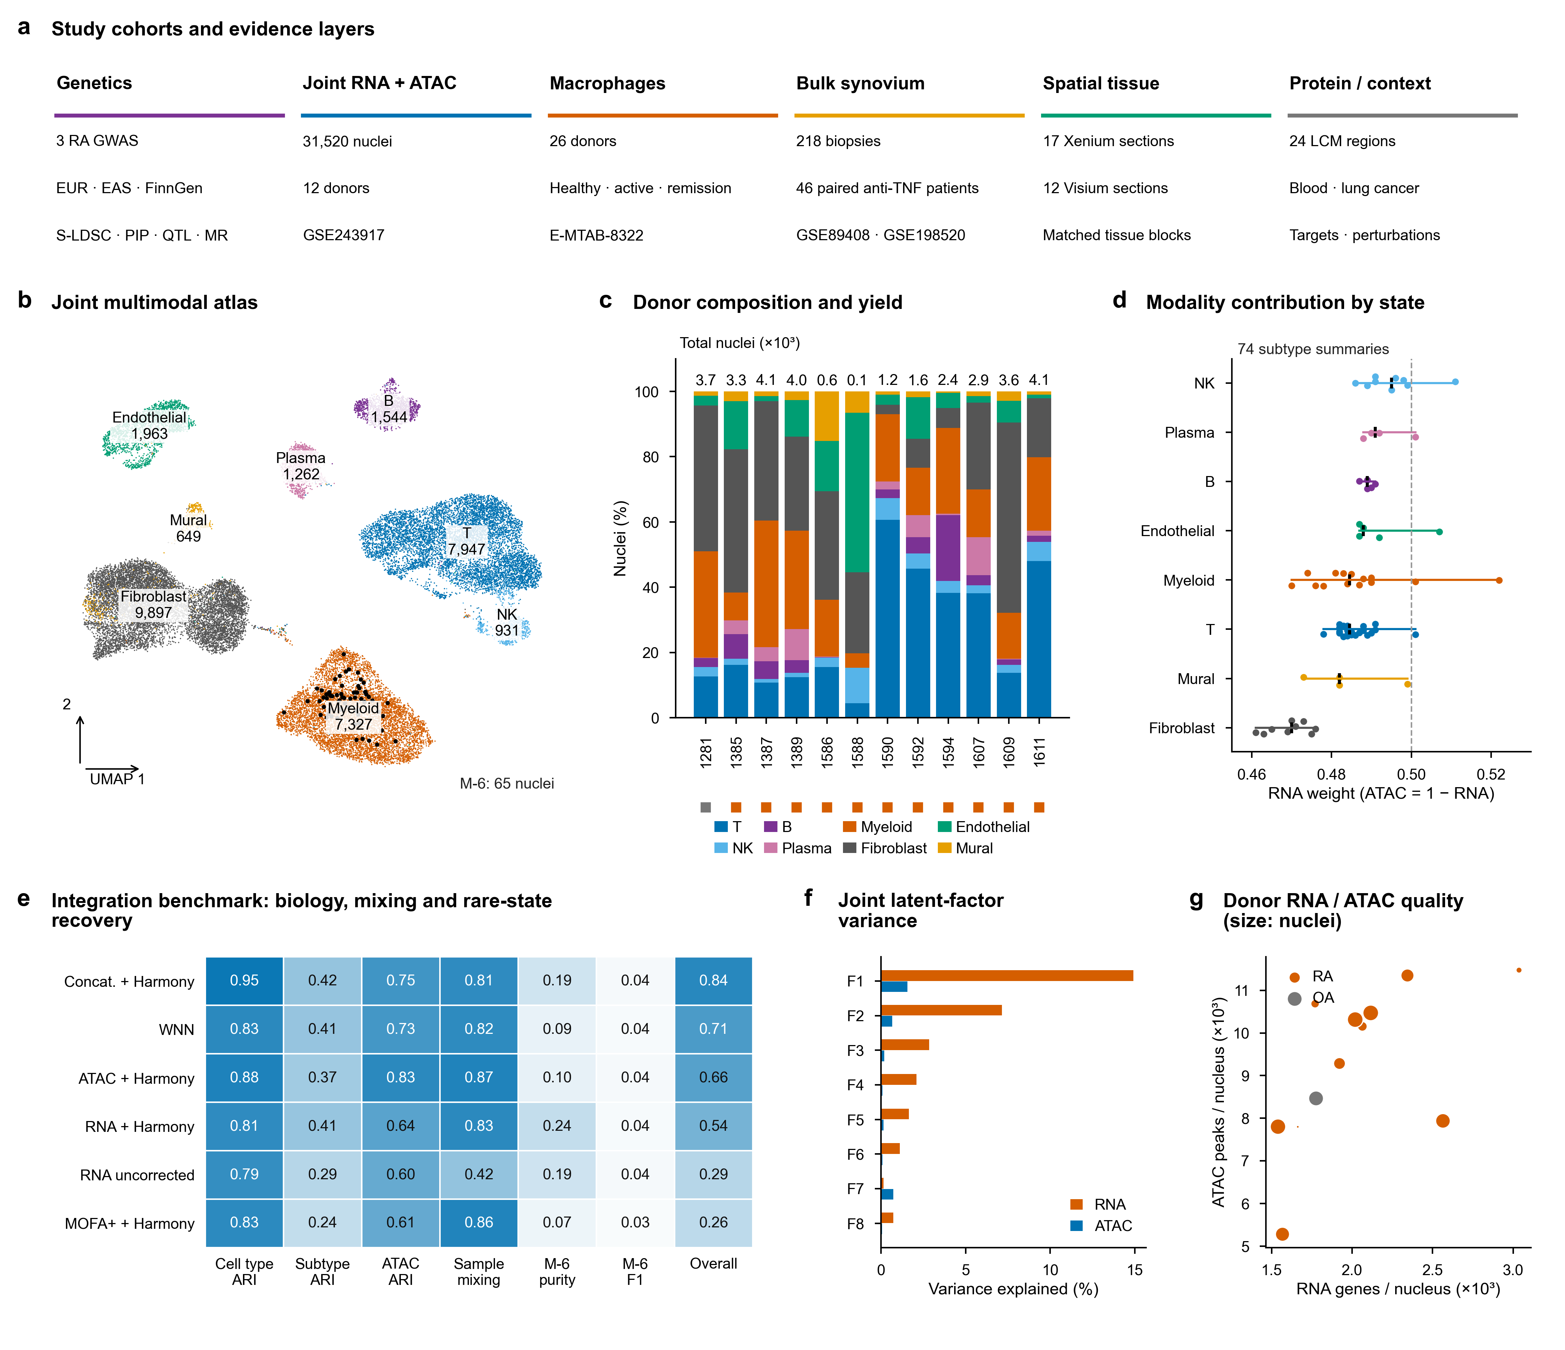
Published atlas states and tested integration baselines
31,520 nuclei from 12 donors. RNA and ATAC are measured in the same nuclei.
Fine-state labels, including the 65-nucleus M-6, are taken from Gupta et al.
Concatenation and WNN rank highest in this benchmark. Rare M-6 neighbourhoods favour RNA alone.
GeNeDis 2026 | Xia Wu · University of Iowa | Fig1
3

Slide 4
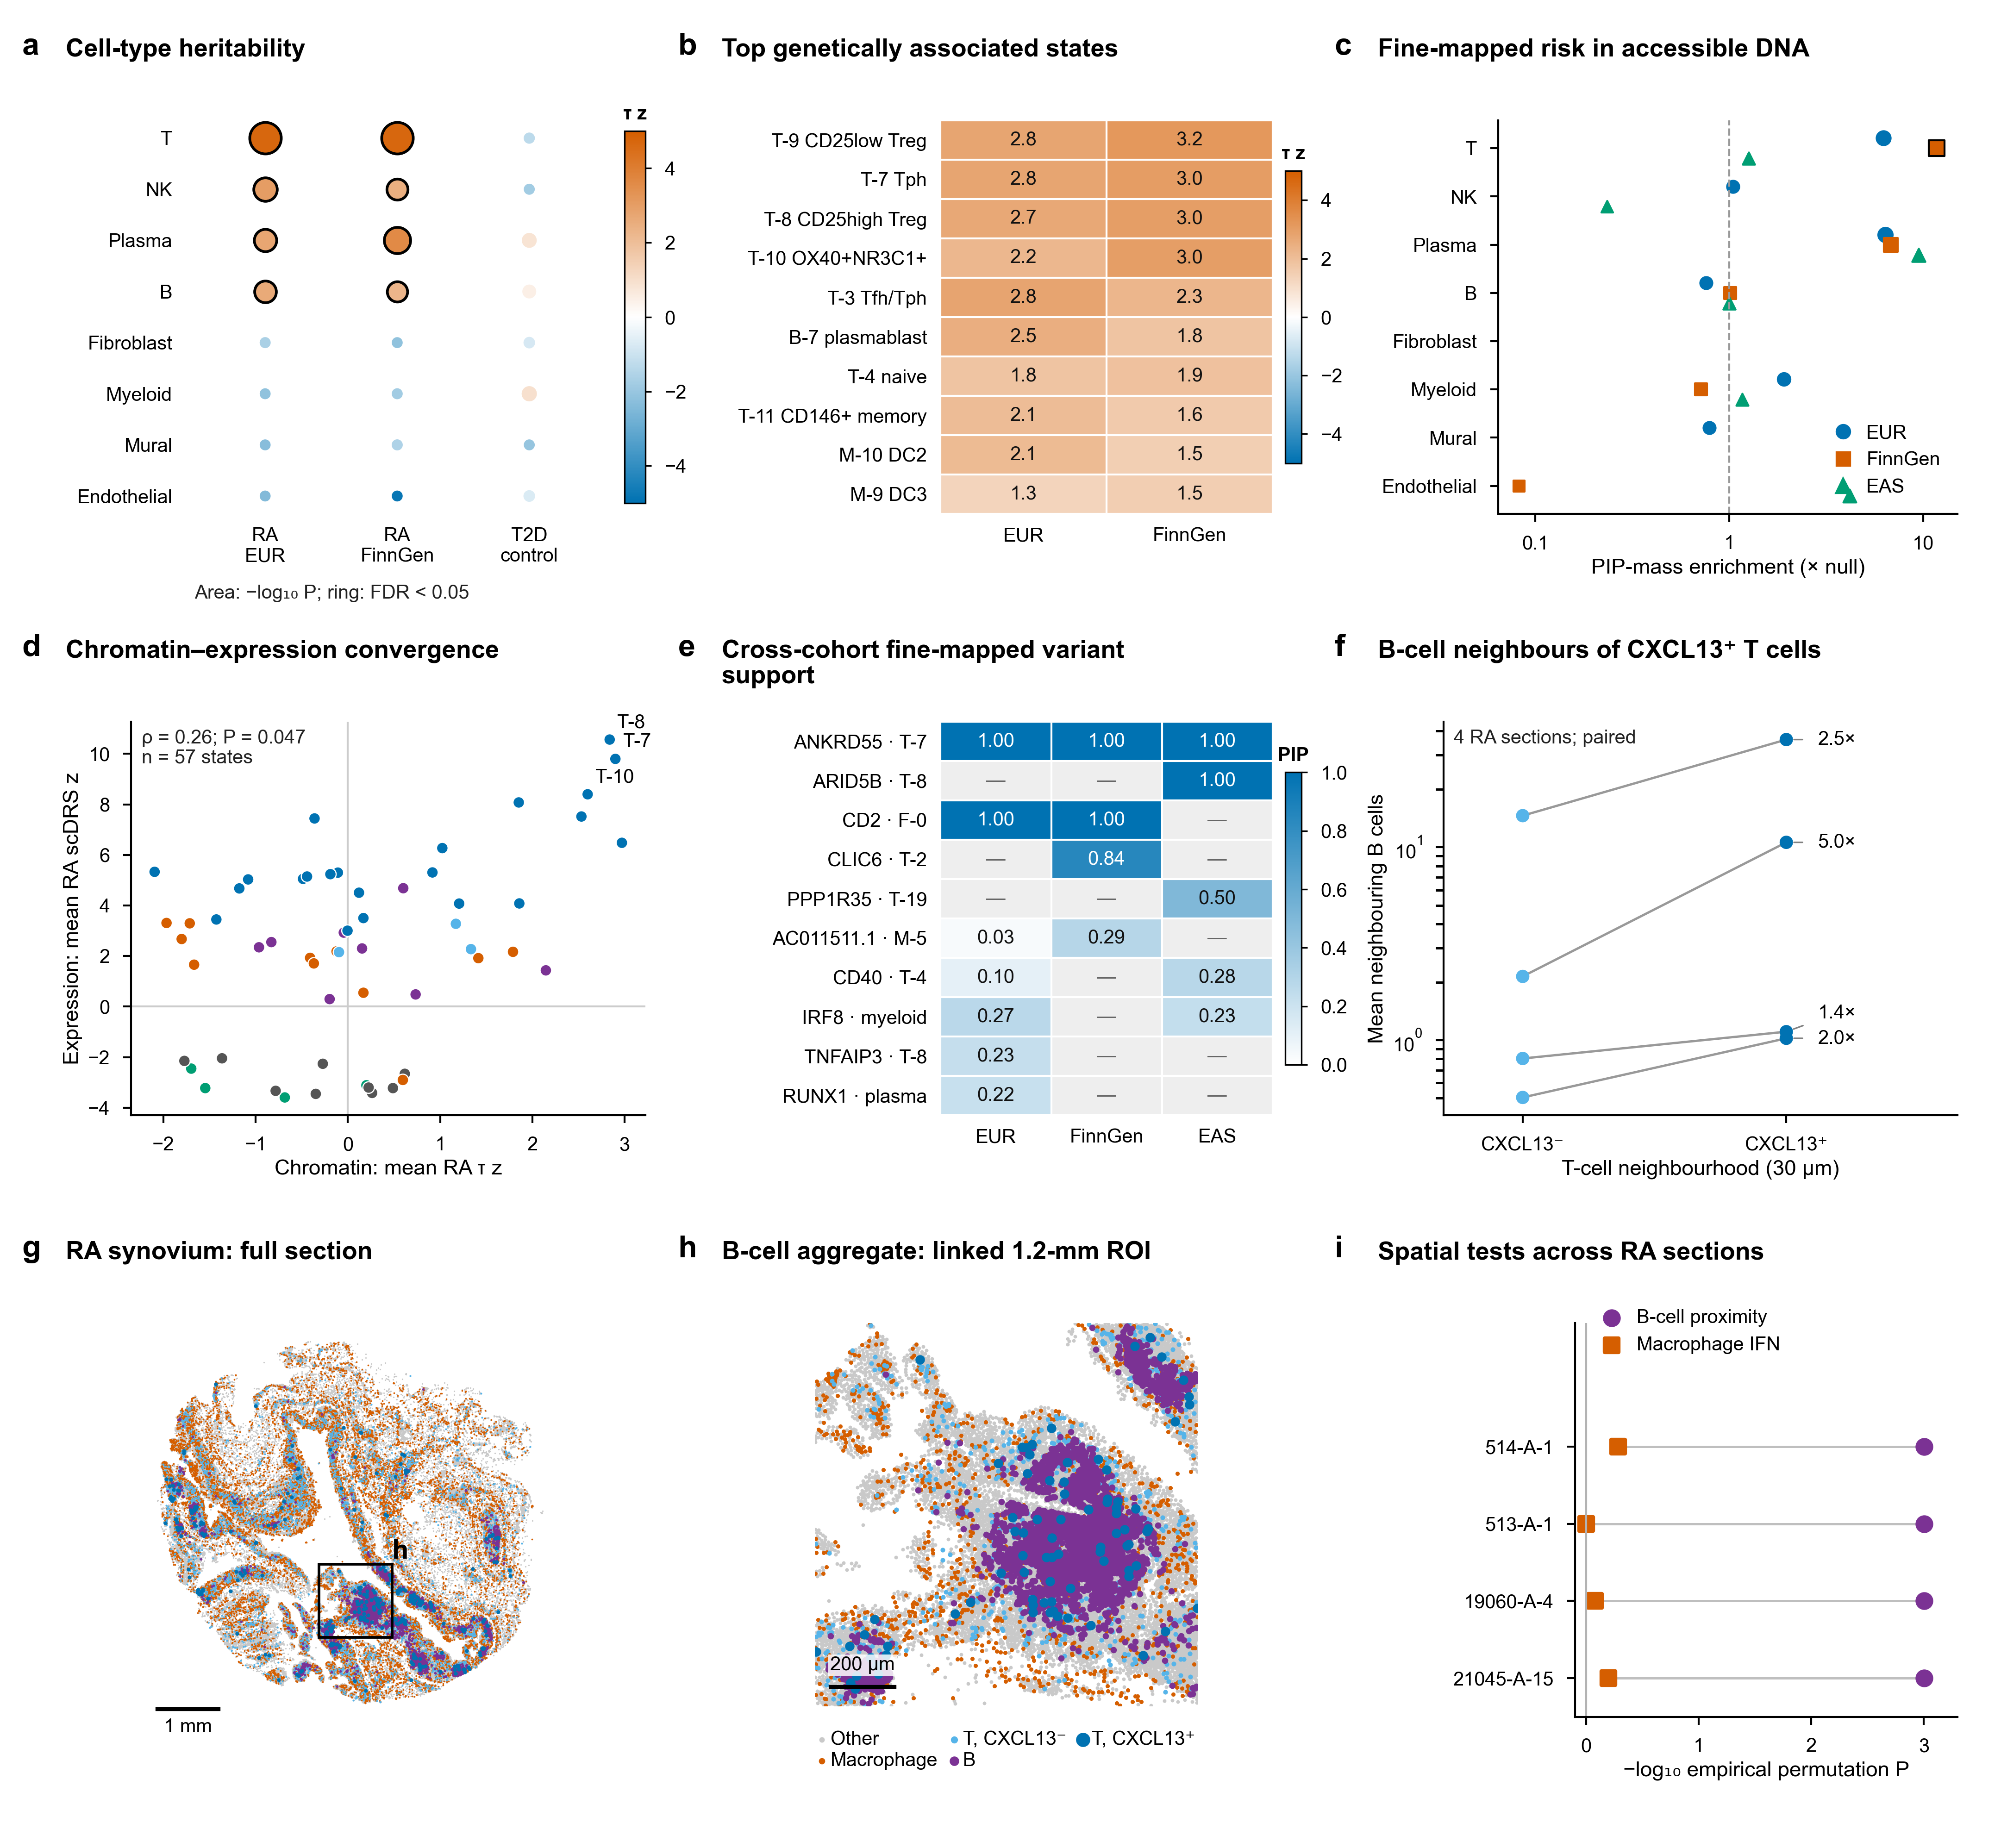
Genetic enrichment and spatial neighbourhood associations
Tph/Treg-associated chromatin is enriched for RA heritability.
S-LDSC and scDRS are complementary methods that use the same GWAS traits.
More B cells sit near CXCL13-positive T cells in 4/4 sections.
The empirical global-permutation P does not account for label clustering or tissue compartments.
GeNeDis 2026 | Xia Wu · University of Iowa | Fig2
4

Slide 5
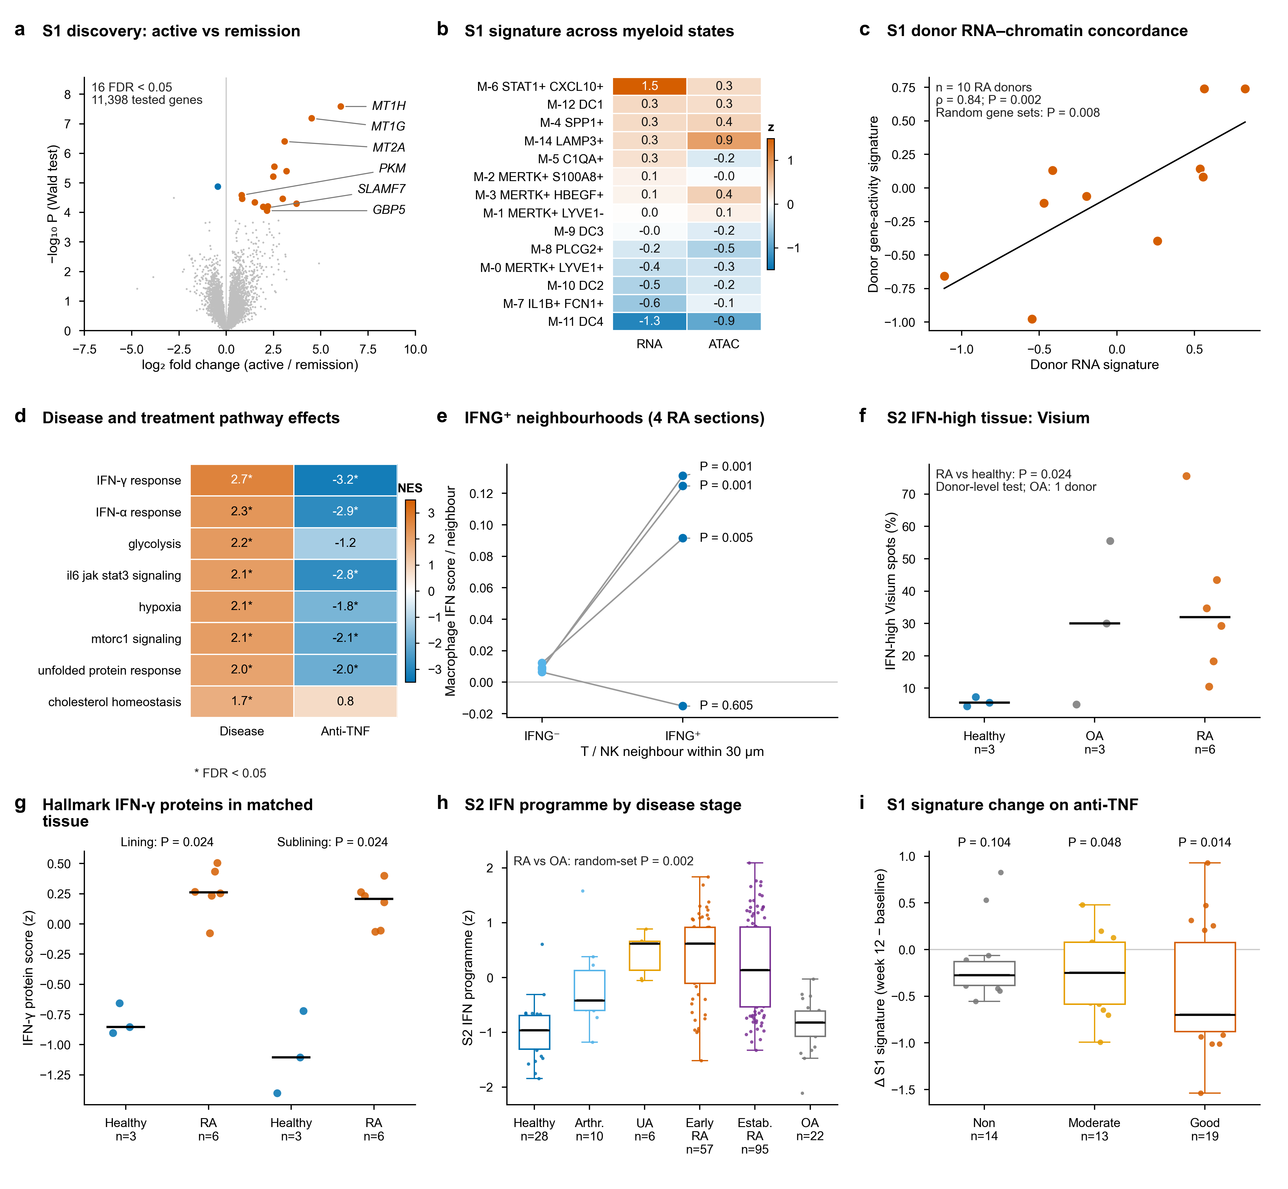
Separate discovery, tissue and treatment evidence
S1 maps to M-6. Its donor inflammation and bulk RA/OA validation tests are negative.
S2 shows spatial and bulk disease-stage associations.
Protein points and test use the same donor averages: 6 RA versus 3 healthy.
S1 falls in good responders, but the change is not significantly different from nonresponders.
GeNeDis 2026 | Xia Wu · University of Iowa | Fig3
5

Slide 6
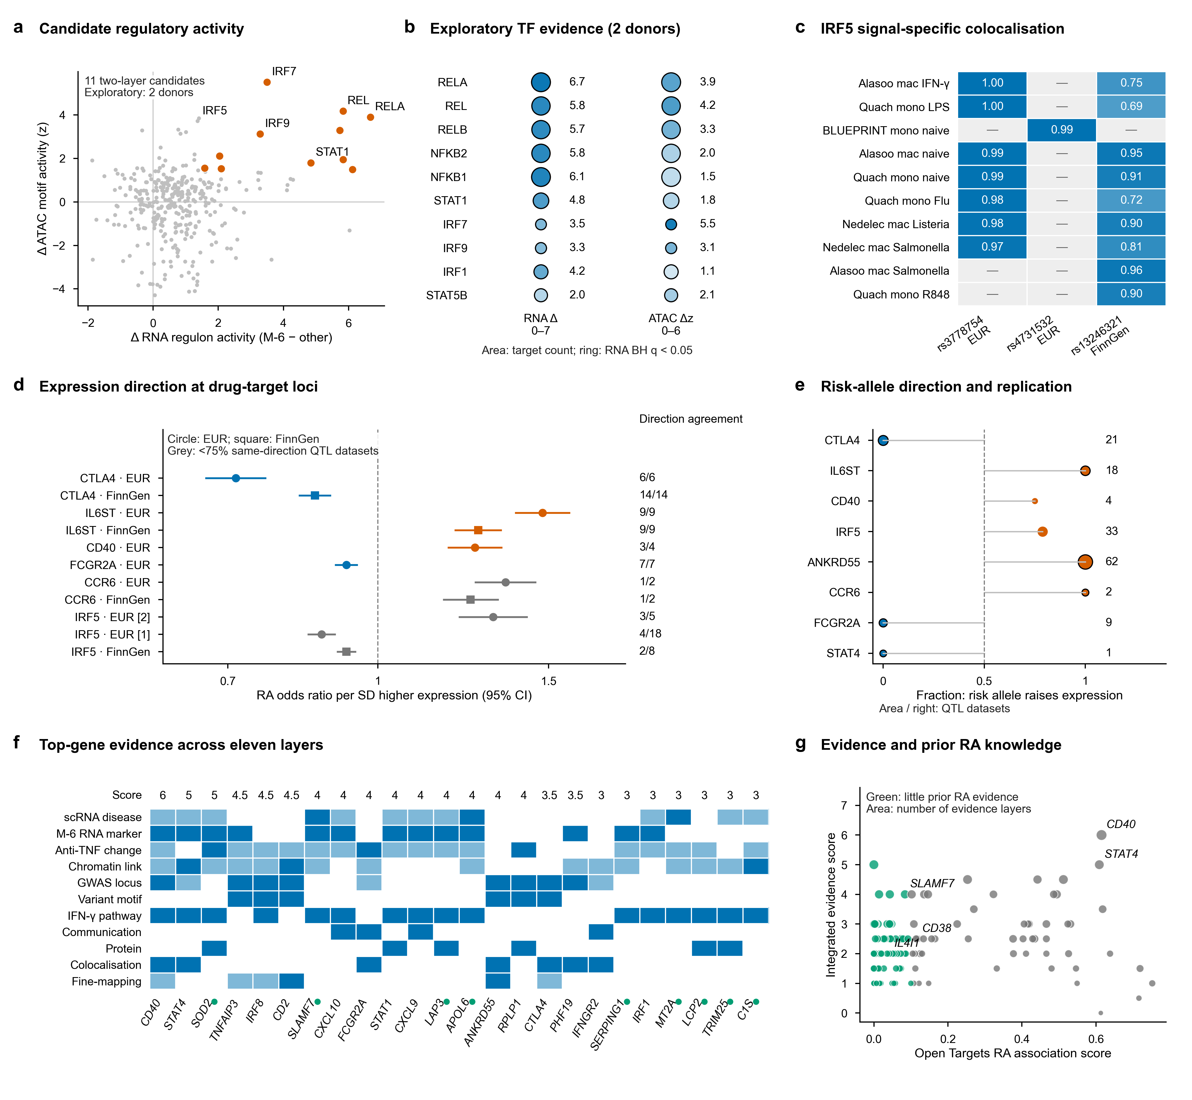
Candidate regulators and expression-associated genetic estimates
TF screen: two donors with M-6 and BH-adjusted gene-label permutations. Two-donor uncertainty remains.
IRF5 colocalisation supports a shared association signal.
Wald ratios cannot estimate drug efficacy or rule out pleiotropy.
Abatacept binds CD80/CD86. IL6ST is not IL6R, the target of tocilizumab.
GeNeDis 2026 | Xia Wu · University of Iowa | Fig4
6

Slide 7
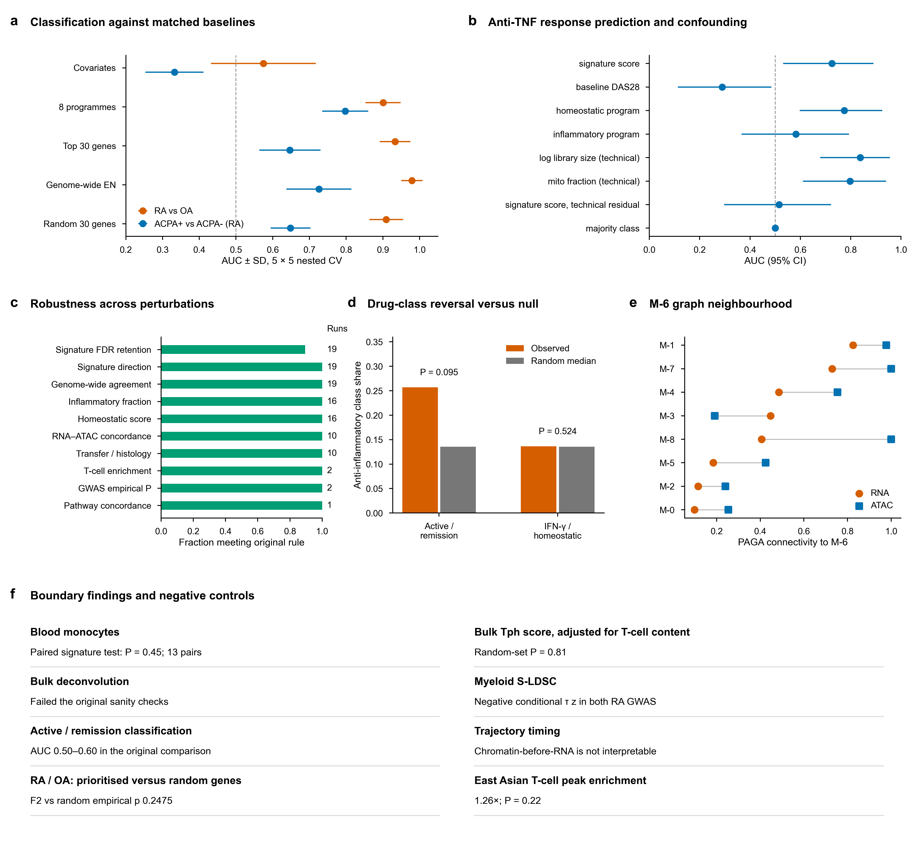
Baselines and boundary findings
Classifiers fit all preprocessing on training data only and use repeated nested CV.
199 label permutations repeat the same tuning and resampling as the observed model.
Random controls match the number of retained prioritised genes in each training fold.
Limits in blood transfer, response prediction, deconvolution and trajectory are all reported.
GeNeDis 2026 | Xia Wu · University of Iowa | ExtData_Fig1
7

Slide 8
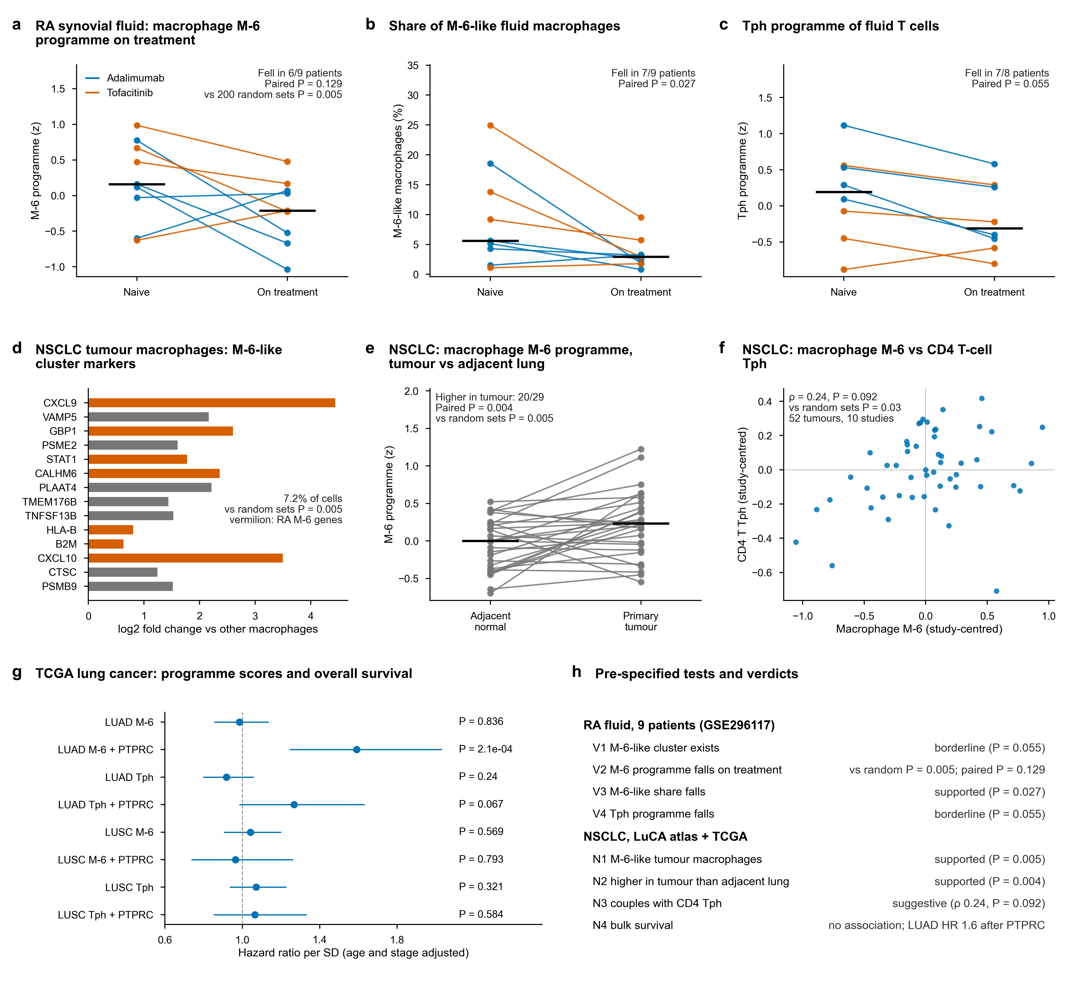
Exploratory transfer to synovial fluid and NSCLC
Fluid: 9 paired patients, two therapies pooled. No response labels are available.
The M-6-like fraction falls in 7/9 patients, but the paired pseudobulk-score test is not significant.
LuCA: the M-6 score is higher in tumour in 20/29 paired donors.
Tph coupling P = 0.092. The primary TCGA survival tests are negative.
GeNeDis 2026 | Xia Wu · University of Iowa | ExtData_Fig2
8

Slide 9
Internal classifiers: final held-out performance
Mean AUC across 25 outer folds. All fitted transformations stay inside the training folds.
F0 covariates · F1 programmes · F2 prioritised genes · F3 genome-wide
RA vs OA
ACPA+ vs ACPA- (RA)
F0 0.574 ± 0.143
F0 0.332 ± 0.079
F1 0.900 ± 0.048
F1 0.797 ± 0.062
F2 0.933 ± 0.042
F2 0.647 ± 0.083
F3 0.979 ± 0.029
F3 0.726 ± 0.089
F1 permutation p 0.005
F2 vs random empirical p 0.2475
F1 permutation p 0.005
F2 vs random empirical p 0.5149
SD across correlated folds is not a confidence interval. No external clinical validation.
GeNeDis 2026 | Xia Wu · University of Iowa | Nested CV
9

Slide 10
What the data support
A reproducible map of complementary RA associations and candidate targets for follow-up.
Score definitions, cohort independence and strength of evidence are kept separate.
Published states and original discoveries are clearly credited to their sources.
Causal regulation, therapeutic efficacy and clinical prediction need further validation.
GeNeDis 2026 | Xia Wu · University of Iowa | Interpretation
10

Slide 11
Reproducibility and submission contents
The full pipeline was rerun from raw inputs in a separate project. Run logs and a comparison report come with the submission.
Saved copies of the API/GMT/eQTL inputs keep the reference version, including Open Targets 26.09.
A quick check verifies hashes, reruns three small analyses and draws six figures without the large raw/interim data.
README · Sources · Code · Processed tables · QC report · Limits · Presentation · Manifest
GeNeDis 2026 | Xia Wu · University of Iowa | Validation
11

Slide 12
Sources and contact
Gupta et al., Nature Genetics 2023: GSE243917 atlas and author-defined states.
Alivernini et al., Nature Medicine 2020: E-MTAB-8322 discovery cohort.
GSE198520 / GSE89408: independent bulk cohorts.
GSE347958 / GSE347797 / PXD062696: shared spatial/protein cohort.
GSE296117 / LuCA / TCGA: exploratory extensions.
All accessions and licences: docs/sources.tsv
Xia Wu · PhD student, University of Iowa · xwu76@uiowa.edu
GeNeDis 2026 | Xia Wu · University of Iowa | Provenance
12

