Slide 1
VIDEO GAME
RATING ANALYSIS
Max Atherton
Candida Miranda
Chris Winn
Rachel Novak
Notes:
Chris

Slide 2
Our Process
Picked a topic &
Selected an API
Writing the Code
Data Visualization & Analysis
Our topic: Video games
We were curious to see if the length of game play have any effect on the popular rating score.
RAWG is the largest video game database and game discovery service. And we are gladly sharing our 500,000+ games, search, and machine learning recommendations with the world.
Wrote loops upon loops to retrieve the data points we wanted to compare.
RAWG has multiple pages full of information based on the category. We had to loop through several pages and retrieve the information in order to get a large enough data set.
We created different sets of visualizations to compare between each other to analyze where there were trends.
We found several good correlations from our data displays.
Notes:
Chris

Slide 3
Picked a Topic &
Selected an API
We shuffled through several options, and eventually landed on:
“Does the playtime duration of video games have an effect on ratings?”
Which evolved into this secondary thought of:
“Does what critics say really matter when it comes to what games are played the most?”
API Selection there are tons of databases to select from; we looked at the general steam api, thought about Playstation, we researched tons of options until we found one with enough data and the data points we were looking for.
Notes:
Chris

Slide 4
Writing the Code
We set up our URL information for our API call. The base url for the Rawg API is 'https://api.rawg.io/api' To pull information, users also need an API Key.
One of the challenges we faced with this particular API was that game information of over 800K lines of data was returned in pages. The default result was 20 games per page, which, obviously, would not provide a meaningful number of games for analysis. Our group utilized a for loop to create multiple urls to retrieve data from multiple pages. We received data from 51 pages, which gave us 1,000 games to analyze. The following attributes were then printed to a dataframe:
Game name
Metacritic rating
Release Date
Recommendation (Rating)
Recommendation Count
Playtime; in hours
Latest Update
Users Added
Game Owned (#)
To reduce the number of outliers, we created a new dataframe based on playtime hours being <= 60 hours.
We then created several plots to analyze the data and address our questions.
Notes:
Candida

Slide 5
Data Set & Dependencies
## Dataset used
RAWG API (https://rawg.io/apidocs)
## Rough Breakdown of Tasks
Python code bones
API information-data_set research
Visualizations
Written Analysis
Presentation outline
## Data Pull (Python)
Pandas
Requests
JSON
Matplotlib
Scipy.stats
Pprint
Notes:
Candida

Slide 6
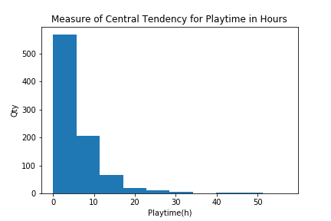
Data Visualization & Analysis
## Impact of Various Metrics on Playtime
We created a histogram to show the average playtime, defined as Steam average playtime in hours. The mean playtime for our sample of games was 4 hours. The distribution was right skewed significantly.
Playtime_mean: 6.172686230248307
Playtime_median: 4.0
Playtime_mode: 3
Notes:
Chris

Slide 7
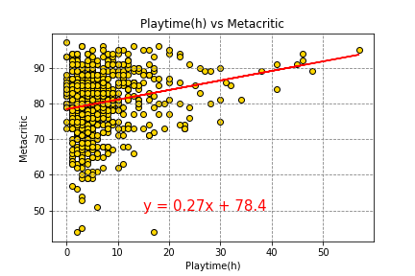
Data Visualization & Analysis ## Impact of Various Metrics on Playtime
Impact of Various Metrics on Playtime
We created a scatter plot measuring Metacritic Rating and Playtime, in hours to determine if there was a correlation. The vast majority of games had playtime less than 20 hours.
All of the games that were played 30 or more hours had a Metacritic rating of at least 75, and all games that had 40 or more hours played had a Metacritic rating above 80.
The r-squared is: 0.04489498083749605
Notes:
Rachel
higher the R-squared, the better the model fits your data

Slide 8
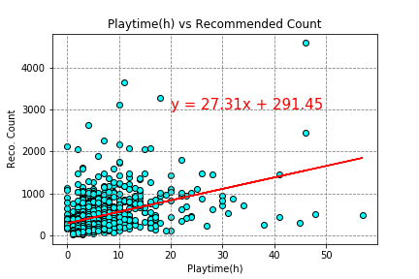
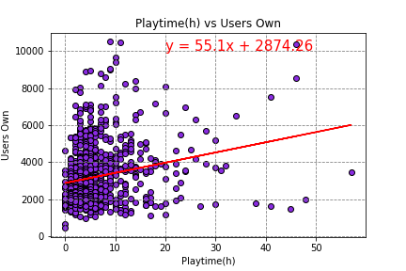
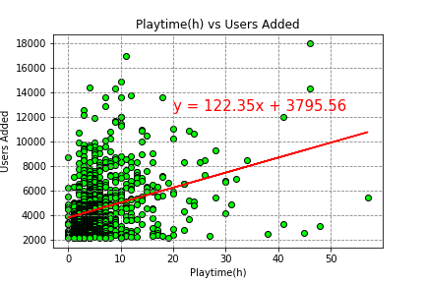
Data Visualization & Analysis ## Impact of Various Metrics on Playtime
Our next scatter plot measured Recommendation Count and Playtime, in hours. The r-squared is: 0.1625495862179935
We then created a scatterplot to measure the Number of Users who owned the game vs Playtime.The r-squared is: 0.04847573267778598
The final scatter plot involving playtime measured Users Added and Playtime, in hours. The r-squared is: 0.10349947555522913
The regression lines on the scatterplot diagrams can be somewhat misleading, due to the scale. Of all the metrics we measured against playtime, the slope of the Recommend count rating was closest to 1, suggesting the strongest relationship.
Notes:
Rachel

Slide 9
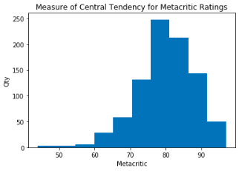
Data Visualization & Analysis
## Impact of Various Metrics on Playtime
We created a histogram to show the average Metacritic rating.
The mean rating for our sample of games was 80. The distribution was left skewed significantly.
Metacritic_mean: 80.04853273137698
Metacritic_median: 81.0
Metacritic_mode: 83.0
Notes:
Chris

Slide 10
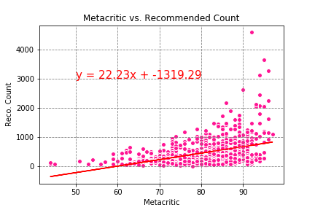
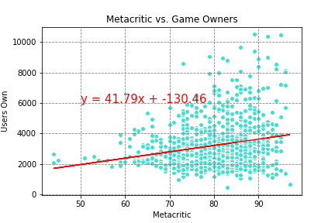
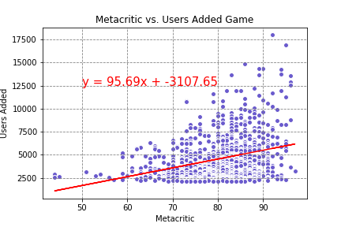
Data Visualization & Analysis
## Impact of Various Metrics on Metacritic
We then examined metacritic rating against metrics to determine if there were any relationships there.
The first scatterplot was Recommendation Count against Metacritic Rating. The r-squared is: 0.1710758184699138
Next, we examined the Number of Users who owned the game against Metacritic. The r-squared is: 0.04417437917723503
The final scatterplot was Users Added against Metacritic Rating.
The r-squared is: 0.10034841044427029
Our findings: Of these three metrics, the strongest relationship appears again to be between Recommendation Count and Metacritic Rating.
Notes:
[[being a factor of professional critics and users rating]]
Rachel

Slide 11
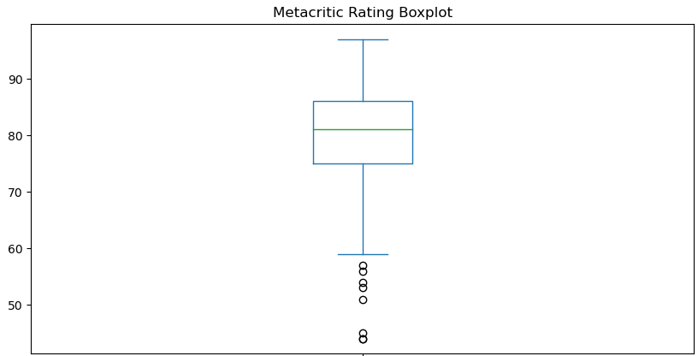
Box Plot Metacritic Rating
count 886.000000
mean 80.048533
std 8.054399
min 44.000000
25% 75.000000
50% 81.000000
75% 86.000000
max 97.000000
Notes:
Left-Skewed Distribution: Metacritic Score
The distribution of Metacritic Scores is left-skewed, with most Metacritic scores ranging between 75 and 86, with fewer and fewer scores less than these scores.

Slide 12
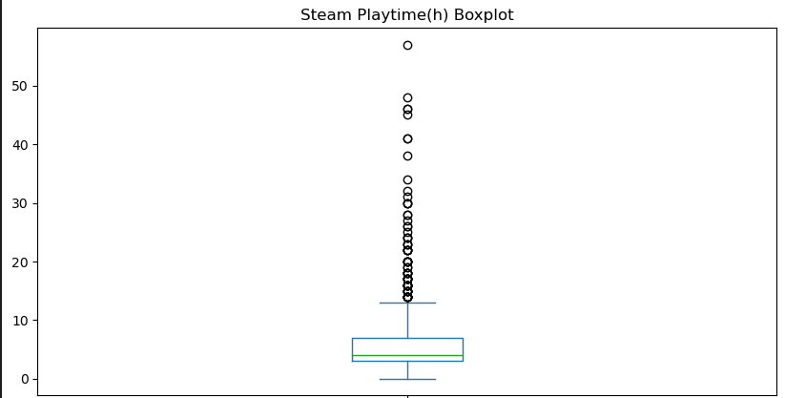
Box Plot Steam Playtime
count 886.000000
mean 6.172686
std 6.389661
min 0.000000
25% 3.000000
50% 4.000000
75% 7.000000
max 57.000000
Notes:
Right-Skewed Distribution: Steam Playtime (h)
The distribution of Steam Playtime (h) is right-skewed, with most hours played between 4 and 7 but with a long right tail of users that play for a longer period of time. We can infer users can show restraint by limiting themselves to 6 hours of gameplay or game developers need to focus for more on developing games that are more engaging.

Slide 13
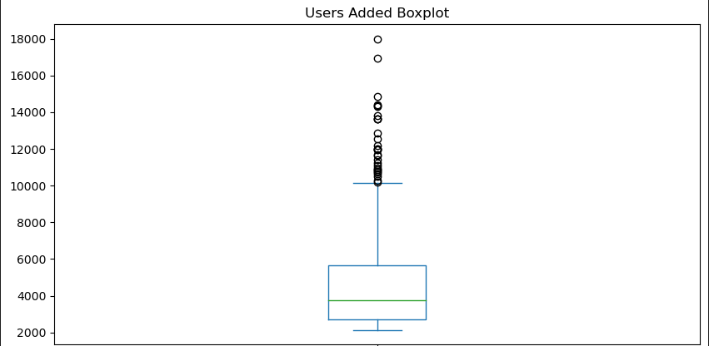
Box Plot Users Added Game
count 886.000000
mean 4550.808126
std 2430.129030
min 2136.000000
25% 2713.500000
50% 3776.000000
75% 5679.500000
max 17991.000000
Notes:
Right-Skewed Distribution: Users Added
The distribution of Users Added is right-skewed, with most users added to a game between 2713 and 5679 but with a long right tail of users adding a game.

Slide 14
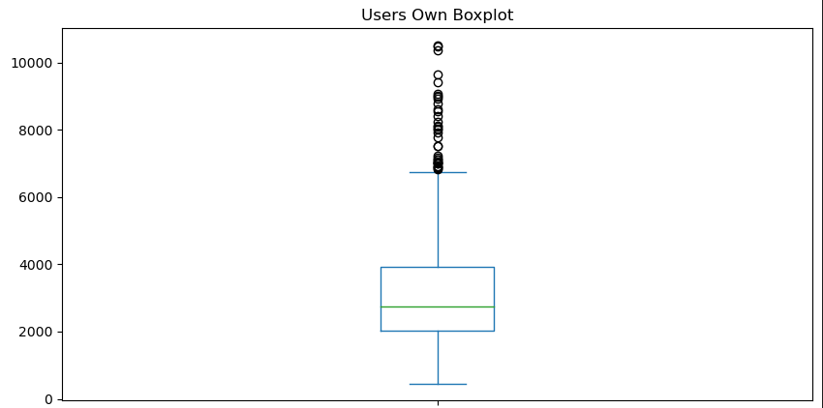
Box Plot Users Own Game
count 886.000000
mean 3214.378104
std 1599.102635
min 452.000000
25% 2019.500000
50% 2745.000000
75% 3912.000000
max 10511.000000
Notes:
Right-Skewed Distribution: Users Own
The distribution of Users Owning a particular game is right-skewed, with most users owned between 2019 and 3912 but with a long right tail of users owned.

Slide 15
Additional Data Points & Limitations
We selected the front 50 pages of data results in 8,010 lines of available data.
Top 10 Games with Exceptional Recommendations
1 Grand Theft Auto V
2 The Witcher 3: Wild Hunt
3 Portal 2
4 Portal
5 The Elder Scrolls V: Skyrim
6 BioShock Infinite
7 Life is Strange
8 Red Dead Redemption 2
9 Half-Life 2
10 BioShock
Games with the oldest & latest updates
Oldest: Puzzle Agent – 2022-09-22T15:57:02
Newest: Assassin's Creed 2 Deluxe Edition – 2023-02-14T22:44:34
The highest number of users that added a video game is 18,869.
The lowest number of users that added a video game is 2,136.
The highest number of users that own a video game 11,134.
The lowest number of users that own a video game 452.
Limitations:
First 50 pages of a massive data frame
Data is only from the Steam platform
We picked Metacritic over other ratings; there are several outlets of ratings
Notes:
Rachel
Next step would have been looking at various rating provided; reddit, youtube, other channel outlets and
weighing the rating for comparison.

Slide 16
Analysis and Conclusion
TAKE AWAY 1
TAKE AWAY 2
TAKE AWAY 3
Our hypothesis null was true. “Does the playtime duration of video games have an effect on ratings?” There is not a strong enough correlation to make this true statement for the population.
Of all the metrics we measured against playtime, the slope of the Recommend count rating was closest to 1, suggesting the strongest relationship.
Our findings: Of these three metrics measured against Metacritic rating, the strongest relationship appears again to be between Recommendation Count and Metacritic Rating.
Notes:
Rachel
all of our graphs hold a positive coefficient which indicates that as the value of the independent variable increases, the mean of the dependent variable also tends to increase. For example as metacritic score increase the recommended count increases as well.
The playtime average (in hours) is 6.55, and the average of users that own a videogame is 3228.65.
We can determine by this data that the average of users that own a videogame is higher compared to the average of playtime.

Slide 17
THANK YOU
GROUP 3: Max Atherton, Candida Miranda, Rachel Novak and Chris Winn
Notes:
Chris

