Slide 1

.crash course
Christina Protopapadaki, Filip Jorissen & Bram van der Heijde
Christina.Protopapadaki@bwk.kuleuven.be Filip.Jorissen@mech.kuleuven.be,
Bram.vanderHeijde@kuleuven.be
October 20, 2017

Slide 2
Modelica crash course
What is Modelica ?
Syntax, language concepts and model structuring
Modelica tools
Use of IDEAS library
Getting started (tutorials, reference docs, libraries, software implementations, ...)
➔ To get you started with Modelica!

Slide 3
What is Modelica?

Slide 4

What is Modelica
Modelica is a language for modeling of physical systems
open source
object oriented
Acausal modeling (equation based)
multi-domain
primarily for simulation, but usable for optimization
small and large models (> 100 000 equations)
many model libraries (free and commercial)
textual and graphical modeling

Slide 5
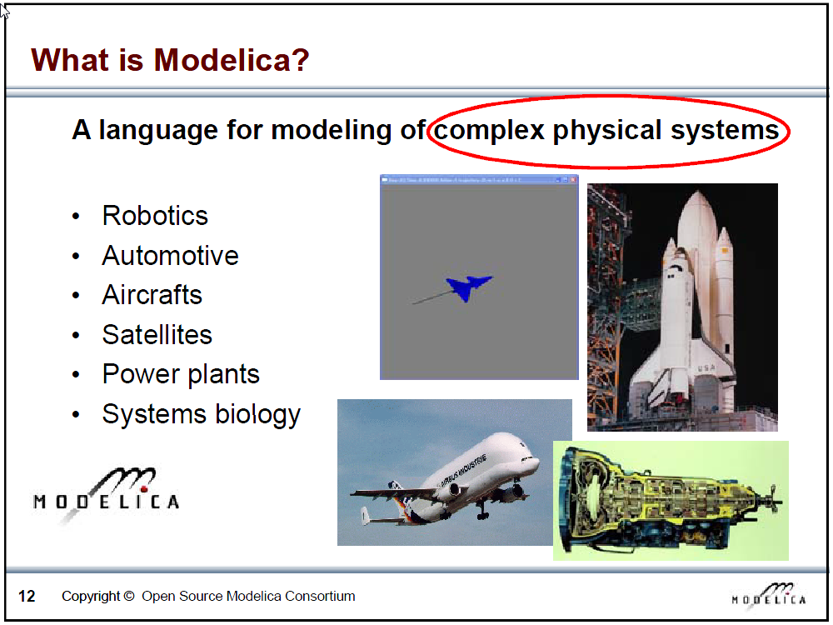
Slide from Peter Fritzson, Introduction to Object-Oriented Modeling, Simulation and Control with Modelica, Tutorial for Modelica Conference 2011, Dresden

Slide 6
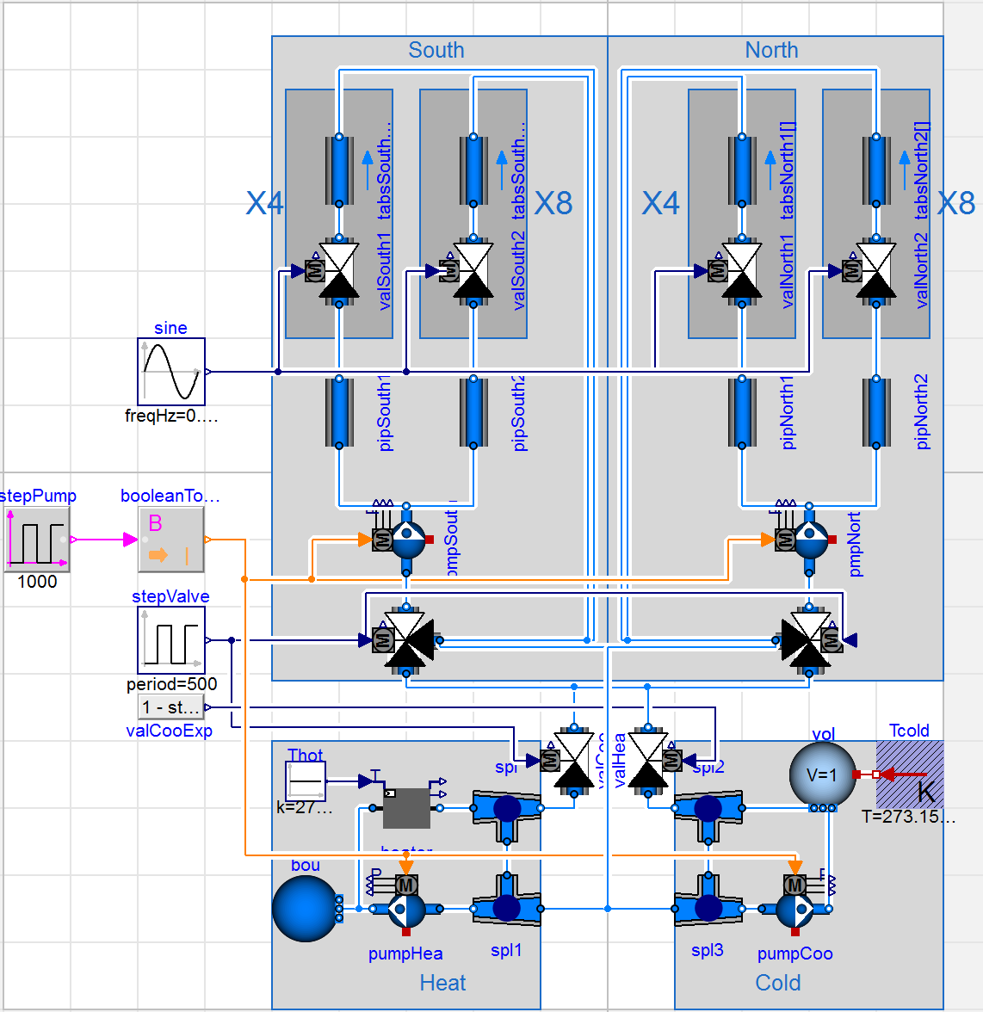
What is Modelica?
Modeling and simulation of complex physical systems
But optimization is possible
JModelica

Slide 7
What is Modelica?
Language, not a tool
Tools:
Dymola
OpenModelica
JModelica
Different tools
➔ Different functions
➔ Possibly slightly different results
Check www.modelica.org for more information

Slide 8
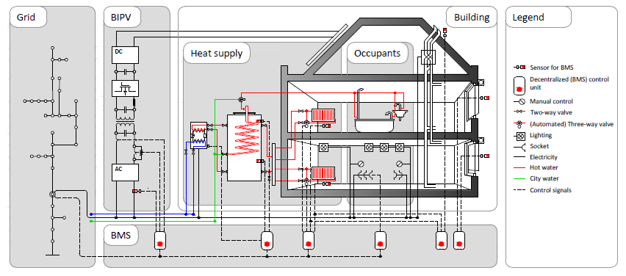
Multi-physics environment

Slide 9
Modelica vs. Simulink-style
Slide from Michael Wetter and Thierry Nouidui, Introduction to Modelica (2015), see http://simulationresearch.lbl.gov/modelica/downloads/workshops/2015-06-22-lbnl/slides/modelica-intro.pdf
Notes:
Slide Michael wetter

Slide 10
Modelica vs. Simulink-style
What if we want to change heat injection to here?
Slide from Michael Wetter and Thierry Nouidui, Introduction to Modelica (2015), see http://simulationresearch.lbl.gov/modelica/downloads/workshops/2015-06-22-lbnl/slides/modelica-intro.pdf
Notes:
Slide Michael wetter

Slide 11
Modelica vs. Simulink-style
Slide from Michael Wetter and Thierry Nouidui, Introduction to Modelica (2015), see http://simulationresearch.lbl.gov/modelica/downloads/workshops/2015-06-22-lbnl/slides/modelica-intro.pdf
Notes:
Slide Michael wetter

Slide 12
How does Dymola work?

Slide 13
Modelica environments
Commercial software tool
Dymola (Dassault Systèmes, Sweden)
Free and open source tools
OpenModelica (Open Source Modelica Consortium, Sweden and other countries)
JModelica (Modelon, Sweden)

Slide 14
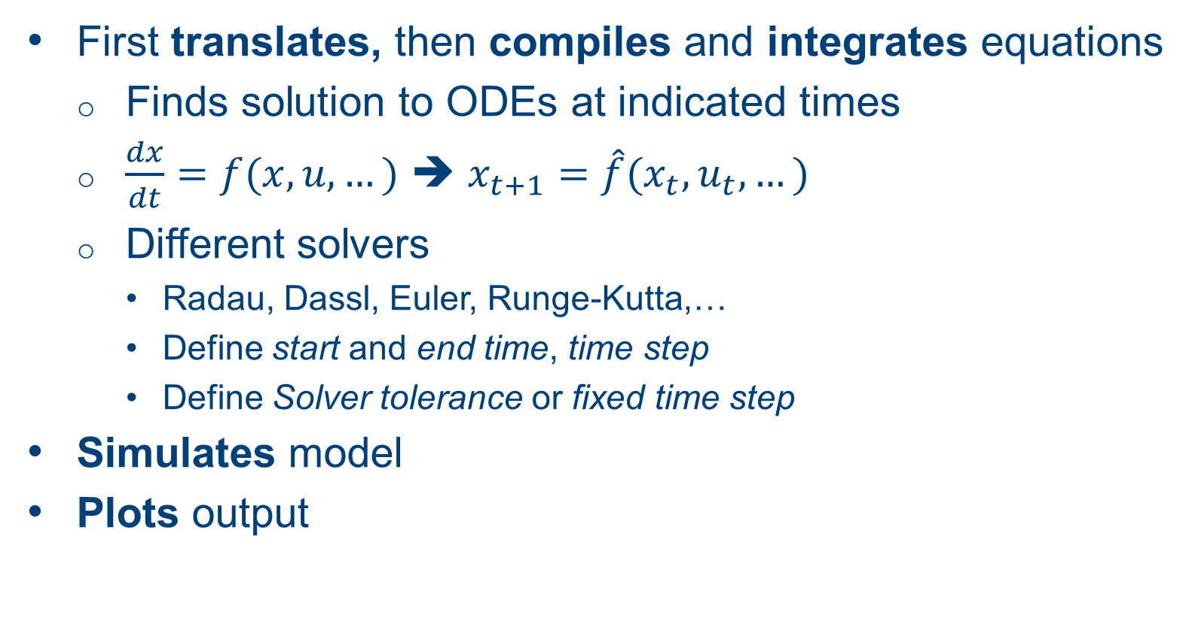
What does Dymola do?
First translates, then compiles and integrates equations
Finds solution to ODEs at indicated times
$\frac{dx}{dt}=f(x,u,…)$ ➔ $x_{t+1}=\hat{f}(x_{t},u_{t},…)$
Different solvers
Radau, Dassl, Euler, Runge-Kutta,…
Define start and end time, time step
Define Solver tolerance or fixed time step
Simulates model
Plots output

Slide 15
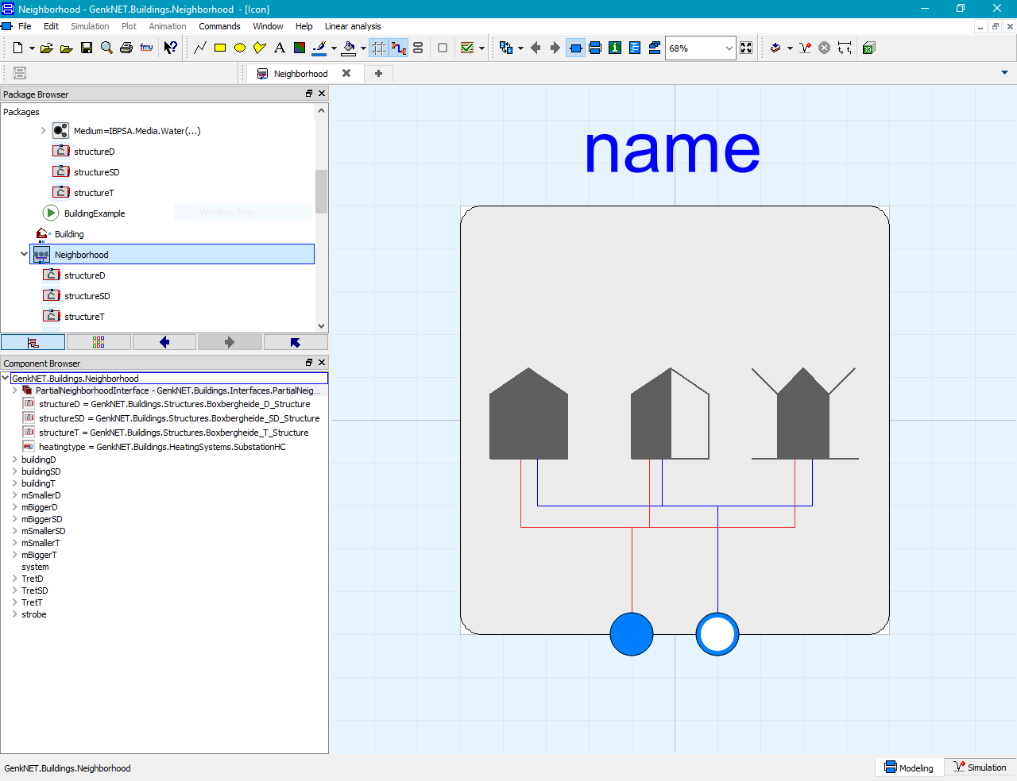
Graphical user interface
Icon view

Slide 16
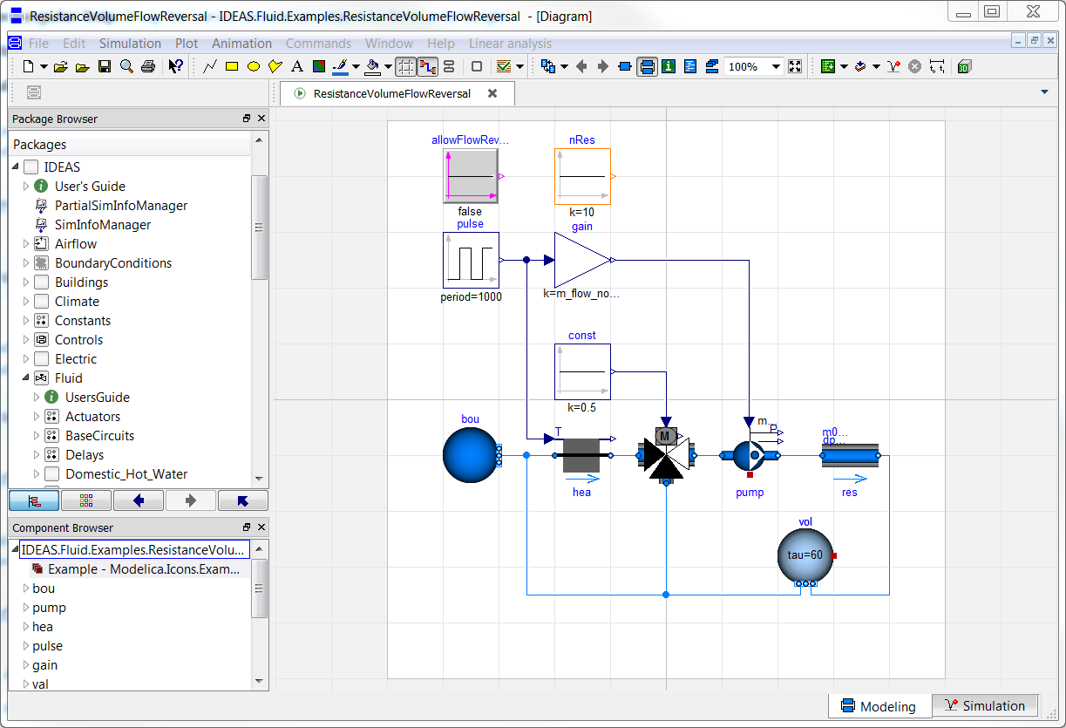
Graphical user interface
Diagram view

Slide 17
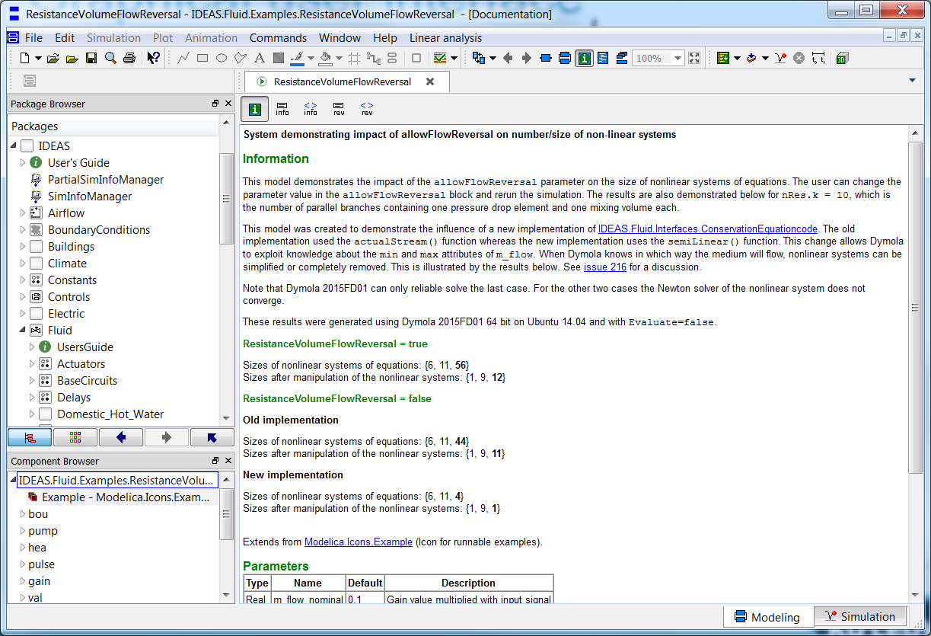
Graphical user interface
Documentation view

Slide 18
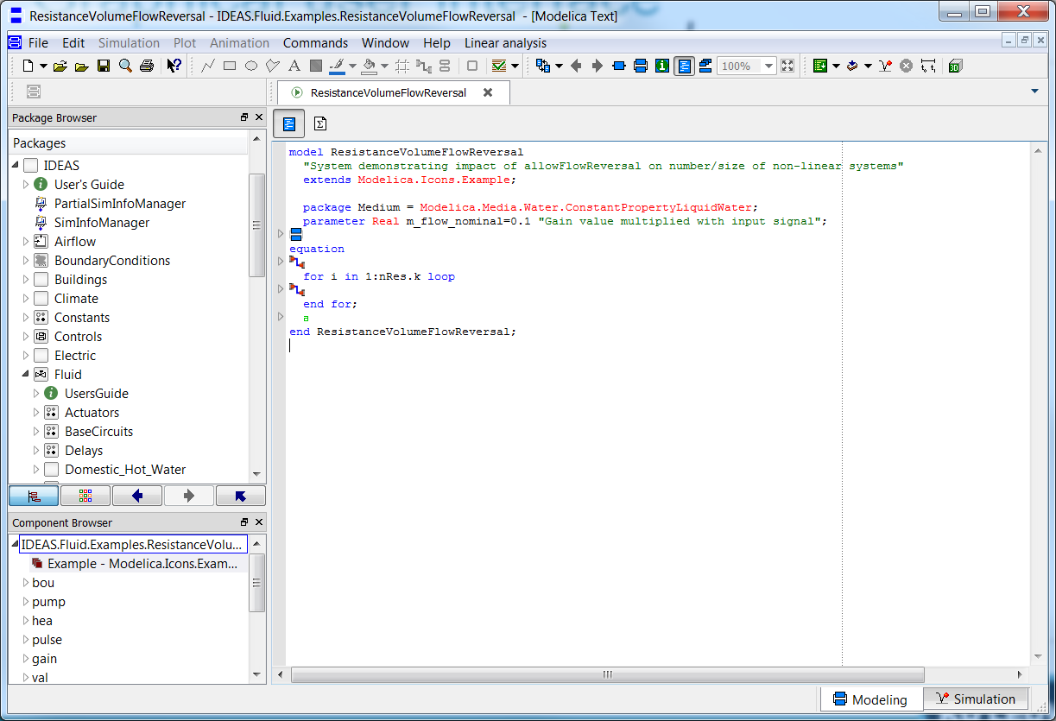
Graphical user interface
Modelica Text view
Notes:
icon toevoegen

Slide 19
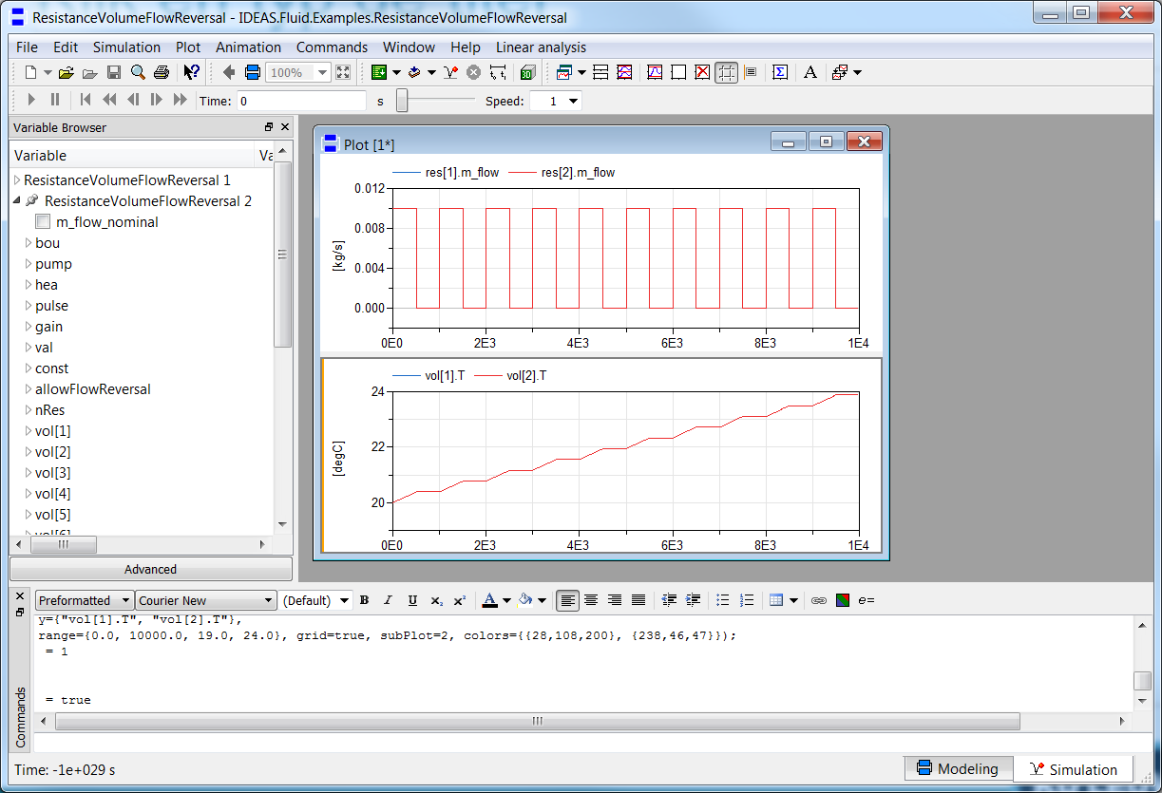
Graphical user interface
Simulation tab

Slide 20
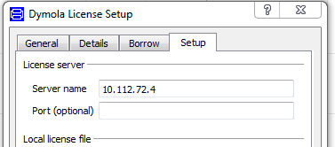
Use of Dymola with KULeuven license
Access to a floating licence (on the building physics server).
Connect to WiFi
Open Dymola and go to Help > License…
Enter 10.112.72.4 and follow instructions

Slide 21
Modelica syntax and concepts

Slide 22
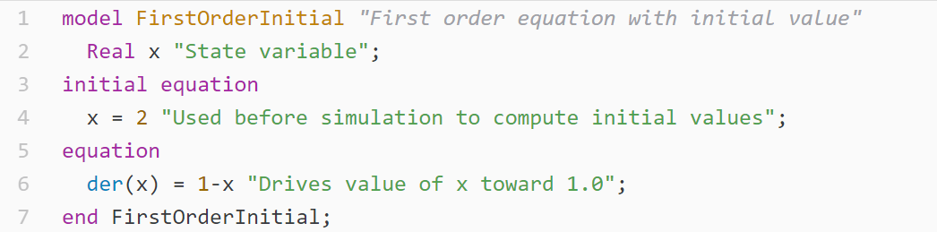
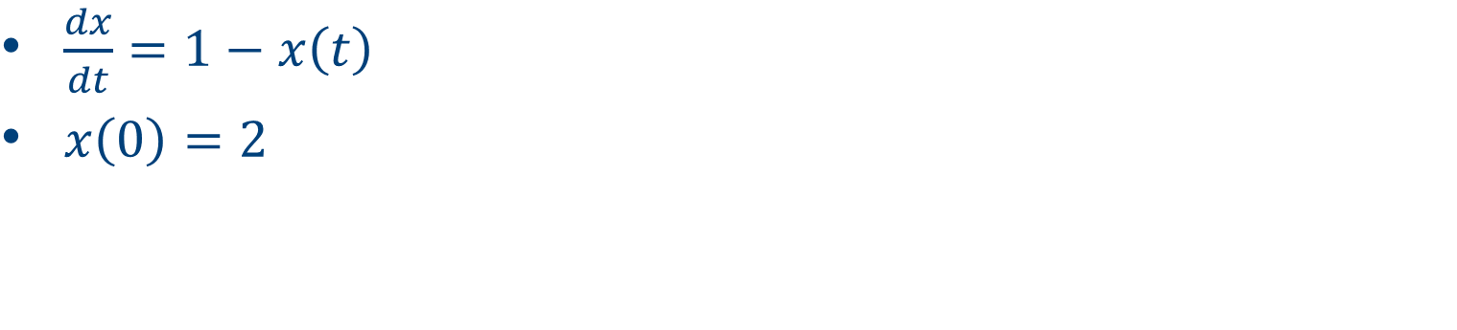
Your first model
$\frac{dx}{dt}=1−x\left(t\right)$
$x\left(0\right)=2$
Notes:
Define variable, define equation, define initial state

Slide 23
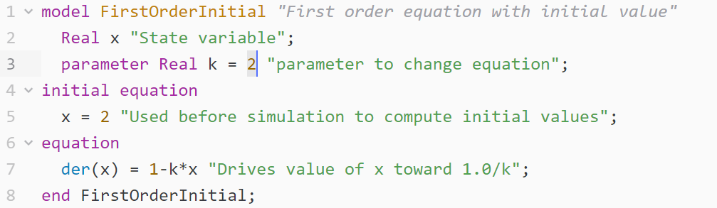
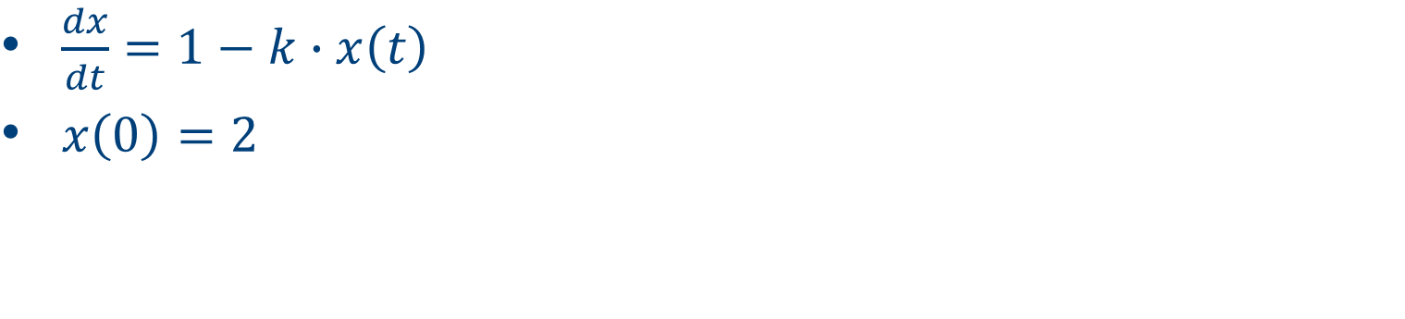
Your second model
$\frac{dx}{dt}=1−k∙x\left(t\right)$
$x\left(0\right)=2$
Notes:
Possible to define parameters: variables of which the value is known before, but can be changed by the user
Constants are used for parameters that are not likely to change

Slide 24
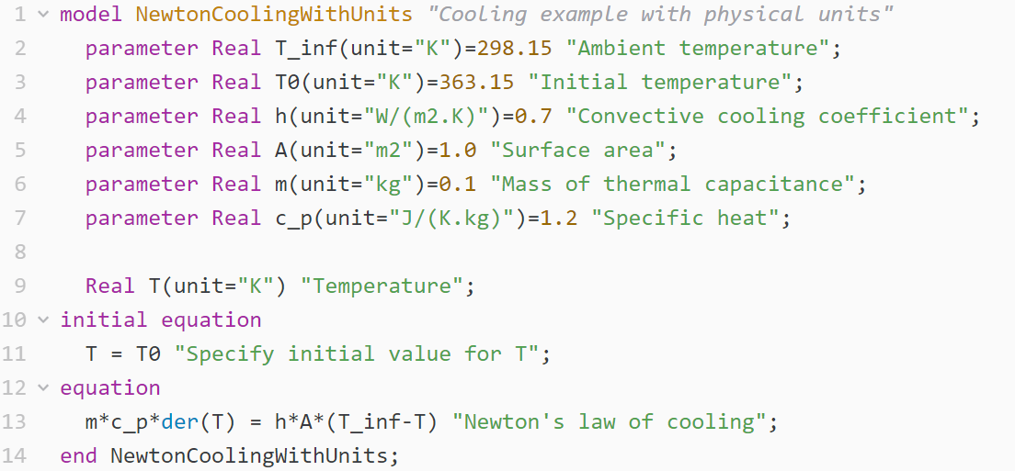
Assigning units

Slide 25
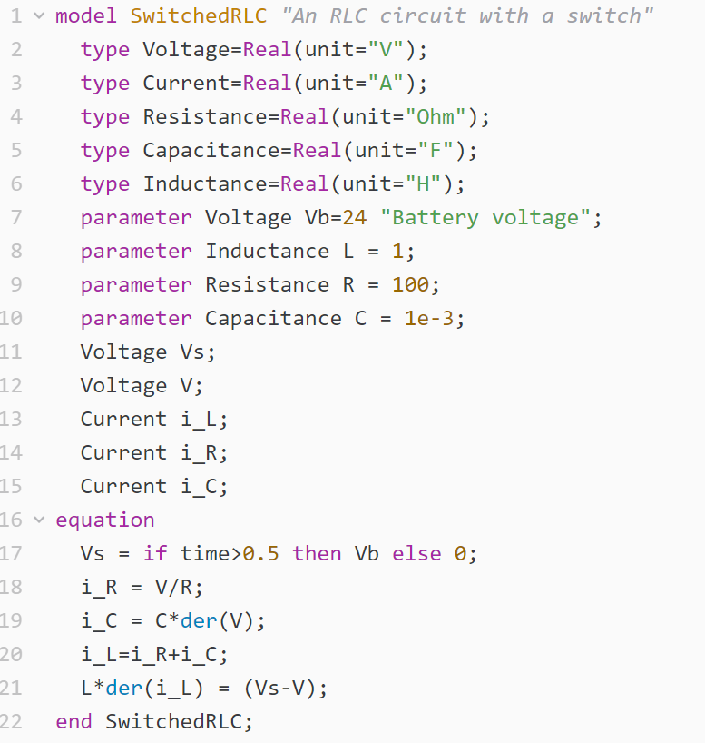
Physical types
Define own types
Use predefined SI units
e.g. Modelica.SIunits.Voltage

Slide 26
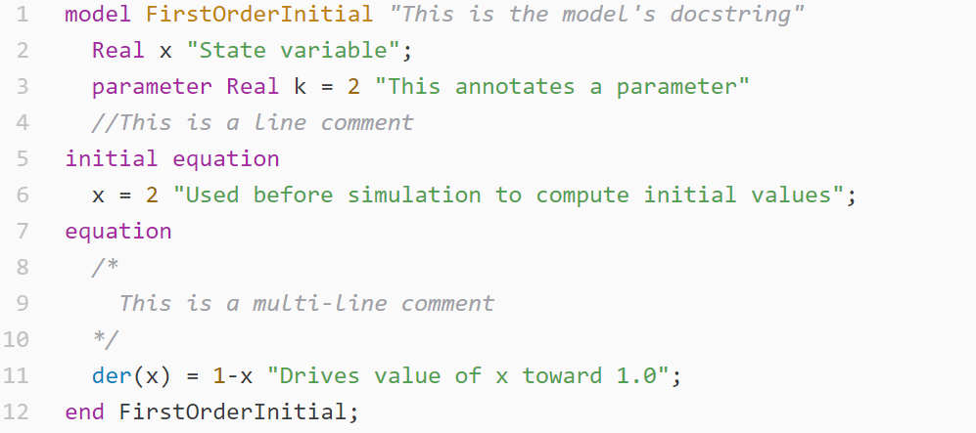
Documentation
Provide info to make code readable!
Notes:
types: assign unit to for example real, Boolean,…

Slide 27
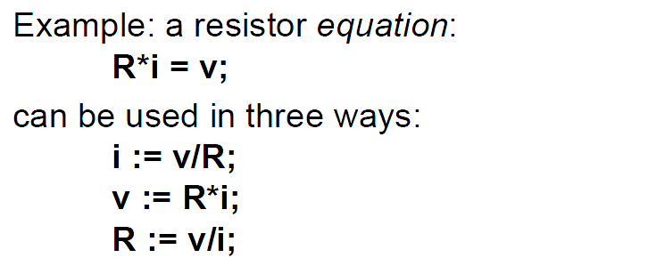
Equations
Arithmetic operators
* / + - ^ (use . for element-wise)
Time derivatives
der(x) = x ~
PDEs only after discretization or using specialized functions
Acausality
Slide from Peter Fritzson, Introduction to Object-Oriented Modeling, Simulation and Control with Modelica, Tutorial for Modelica Conference 2011, Dresden
Notes:
Modelica is a programming language. Overview of the most important parts of the syntax

Slide 28
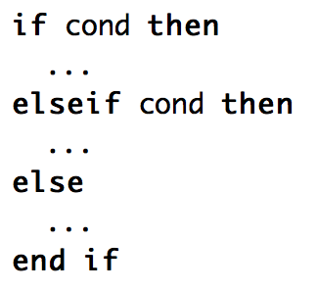

Logical operators, control flow
Logical
and or not … (see modelica specification for more)
Conditional
if elseif else
Loops
for
Comparing numbers
> < <> >= …
Check syntax!

Slide 29
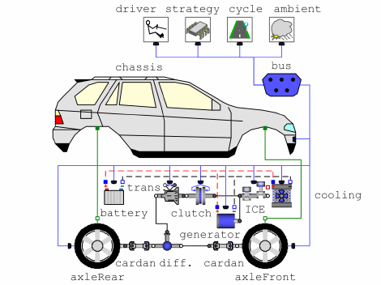
Let’s connect
Make two or more models interact
Electrical circuit
Building
Car
…
Need connectors
Source DOI: 10.4271/2007-01-0541, Simic et al.

Slide 30
Connectors
Usually
Signal in out
Fluid flow (mass flow rate, pressure, enthalpy)
Heat flow (heat flow rate, temperature)
Refer to one or more types
Allow only connections between equal connectors
Notes:
Types uitleggen => enkel juiste connecties maken

Slide 31
Connectors
Three examples:
Variables with and without “flow”
Flow variables
Potential variables
Stream variables
Fluid flow
Pressure
Mass flow
Specific enthalpy flow
Heat transfer
Temperature
Heat flow
Electricity
Voltage
Current
Slide from Peter Fritzson, Introduction to Object-Oriented Modeling, Simulation and Control with Modelica, Tutorial for Modelica Conference 2011, Dresden
Notes:
eerst flow uitleggen

Slide 32
Inheritance
Model inherits from other model
Variables, parameters, equations
partial model (➔ extends)
Code can be managed more easily
Example

Slide 33
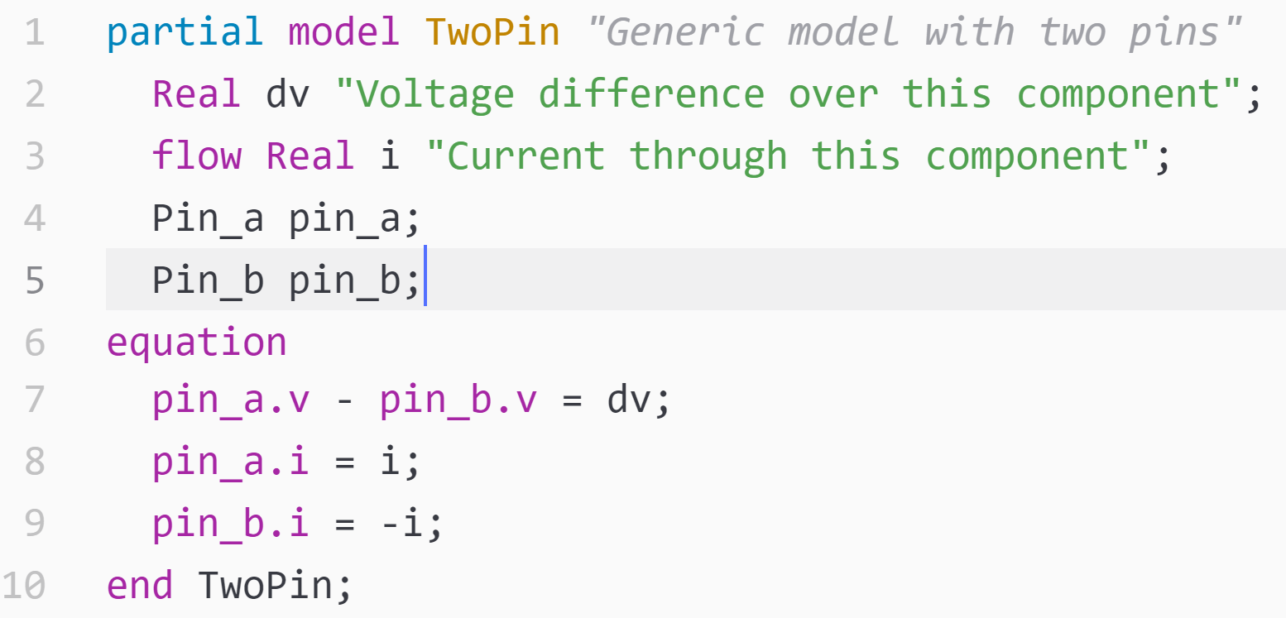
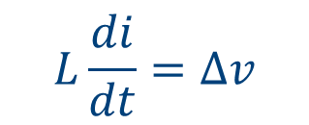
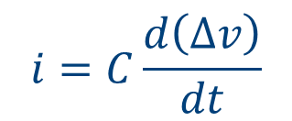


Inheritance
Resistance
extends TwoPort
$$Ri=∆v$$
Partial
TwoPort
Capacitance
extends TwoPort
$$i, ∆v$$
$$i=C\frac{d\left(∆v\right)}{dt}$$
Inductance
extends TwoPort
$$L\frac{di}{dt}=∆v$$
Notes:
Ander voorbeeld zoeken?

Slide 34
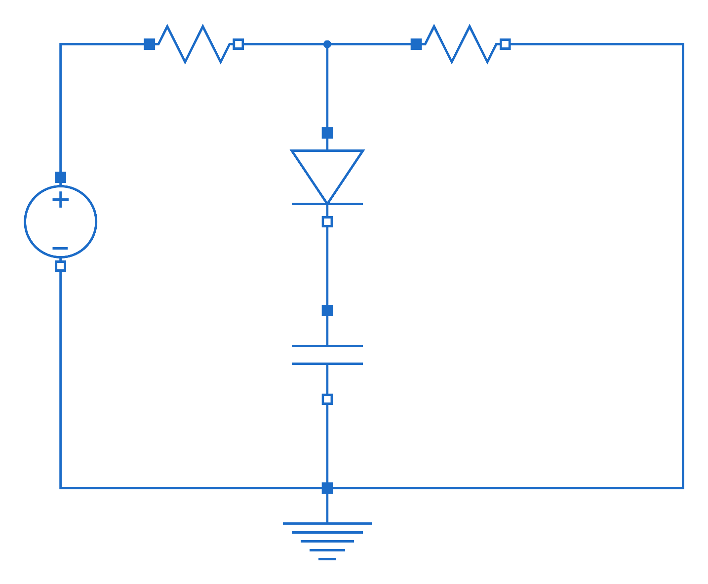
Homework exercise

Slide 35
Websites
General
www.modelica.org
www.openmodelica.org
www.jmodelica.org
http://www.claytex.com/tech-blog/
Modelica language
http://modref.xogeny.com/
http://book.xogeny.com/ !!!
Libraries:
https://github.com/open-ideas --> IDEAS + Crash Course
https://simulationresearch.lbl.gov/modelica --> look at Buildings.Examples.Tutorial
IBPSA Project 1: https://github.com/ibpsa/modelica-ibpsa
Dymola user guide
Volume 1 & 2: C:\Program Files (x86)\Dymola 2017\Documentation\Dymola User Manual Volume 1 or via Dymola > help.

Slide 36
Forums
http://www.openmodelica.org/index.php/forum
http://www.jmodelica.org/forum
www.stackoverflow.com (tag Modelica)

Slide 37
Interface with other programs
Scripting
Parameter variation
Parallel simulations
Optimal control
Python scripts
Nice for plotting
BuildingsPy (http://simulationresearch.lbl.gov/modelica/buildingspy/)
Built-in interface
MATLAB
Built-in with Dymola

Slide 38
Components
Instances of a model
model name usually Capitalized, instance not
Wall innerWall(res = 200, A = 10);
public variables and parameters can be accessed with dot notation, e.g.:
heatPort.Qflow
wall.res
Protected variables/params cannot be accessed
Don’t show up in simulation results
Notes:
Naar deel libraries? ➔ Filip

