Slide 1
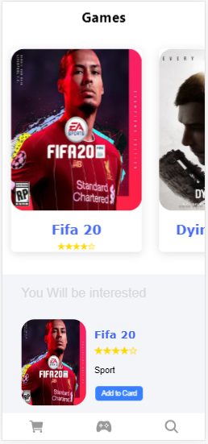
Playstation4 Store apps
Candra Wijaya MJ
3311811055

Slide 2
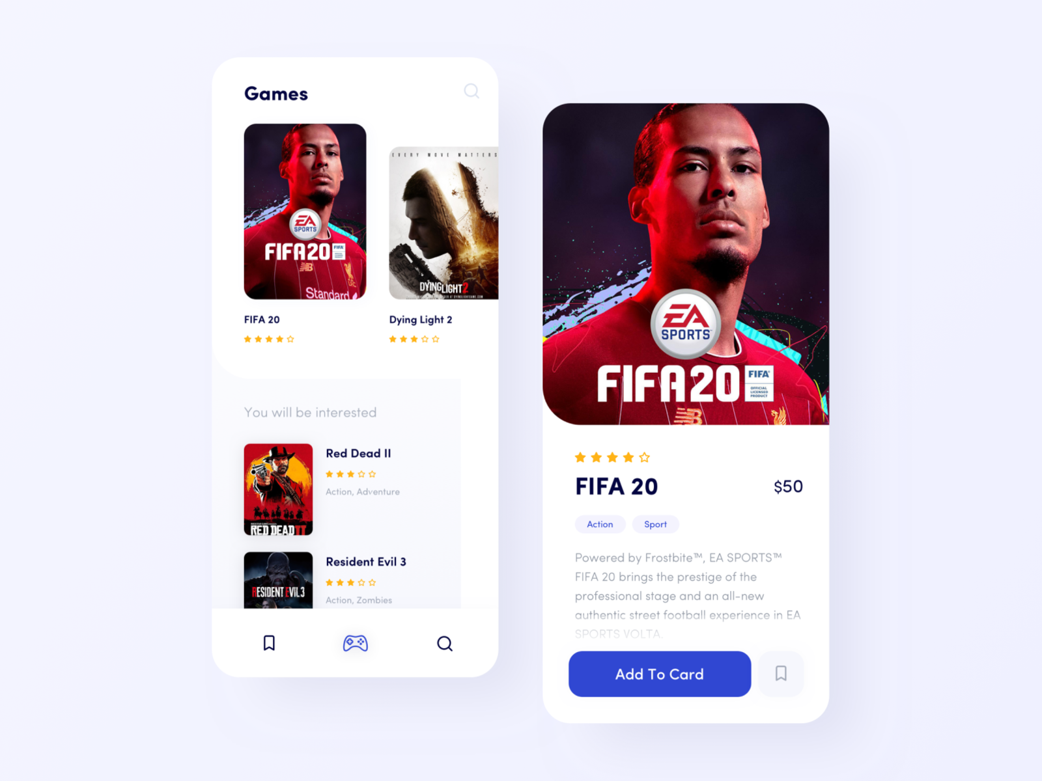
Link Acuan https://dribbble.com/shots/9347415-PS4-Game-store-concept

Slide 3
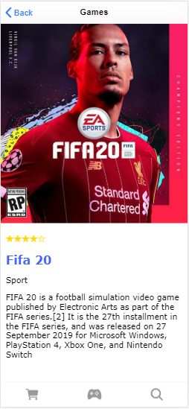
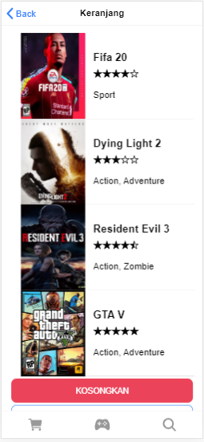
Playstation4 Store apps

Slide 4
Homepage.html
Homepage.ts
<ion-app>
<ion-toolbar color="#f4f5f8">
<ion-title><h1><b>Games</b></h1></ion-title>
</ion-toolbar>
<ion-content>
<ion-slides [options]='slidebaru'>
<ion-slide *ngFor ="let item of konten">
<ion-card [routerLink]="['/konten',item.id]">
<img src="assets/img/{{ item.image }}">
<h2><b>{{ item.name }}</b></h2>
<ion-icon name="{{ item.icon1 }}" ></ion-icon>
<ion-icon name="{{ item.icon2 }}" ></ion-icon>
<ion-icon name="{{ item.icon3 }}"></ion-icon>
<ion-icon name="{{ item.icon4 }}"></ion-icon>
<ion-icon name="{{ item.icon5 }}"></ion-icon>
</ion-card>
</ion-slide>
</ion-slides>
<div class="con-bawah">
<h2>You Will be interested</h2>
<ion-grid class="pad" *ngFor ="let item of konten">
<ion-row >
<img style="width: 120px; height: 160px;" src="assets/img/{{ item.image }}">
<div class="kotak">
<h4 [routerLink]="['/konten',item.id]"> <b>{{ item.name}}</b></h4>
<ion-icon name="{{ item.icon1 }}" ></ion-icon>
<ion-icon name="{{ item.icon2 }}" ></ion-icon>
<ion-icon name="{{ item.icon3 }}"></ion-icon>
<ion-icon name="{{ item.icon4 }}"></ion-icon>
<ion-icon name="{{ item.icon5 }}"></ion-icon>
<p>{{ item.kategori}}</p>
<ion-button size="small" (click)="beli(item)">
Add to Card
</ion-button>
</div>
</ion-row>
</ion-grid>
</div>
</ion-content>
</ion-app>
import { Component } from '@angular/core';
import { Storage } from '@ionic/storage';
import { KontenService } from '../services/konten.service';
import { CartService } from '../services/cart.service';
import { UtilsService } from '../services/utils.service';
@Component({
selector: 'app-home',
templateUrl: 'home.page.html',
styleUrls: ['home.page.scss'],
})
export class HomePage {
slidebaru = {
slidesPerView: 1.5
}
konten: any= [];
listkonten = [];
constructor(KontenService: KontenService, private cart: CartService, private utils: UtilsService, private storage: Storage ) {
this.listkonten = this.konten;
console.log(this.konten);
console.log(this.listkonten);
this.konten = KontenService.getkonten();
}
beli(data) {
console.log('Anda melakukan klik pada ' + data.name);
this.utils.showToast('Anda membeli ' + data.name);
this.cart.addToCart(data);
}
}

Slide 5
Konten.html
Konten.ts
<ion-header translucent>
<ion-toolbar>
<ion-buttons slot="start">
<ion-back-button defaultHref="/"></ion-back-button>
</ion-buttons>
<ion-title>Games</ion-title>
</ion-toolbar>
</ion-header>
<ion-content fullscreen >
<div>
<img src="assets/img/{{ konten.image }}">
<div class="kotak" >
<ion-icon name="{{ konten.icon1 }}" ></ion-icon>
<ion-icon name="{{ konten.icon2 }}" ></ion-icon>
<ion-icon name="{{ konten.icon3 }}"></ion-icon>
<ion-icon name="{{ konten.icon4 }}"></ion-icon>
<ion-icon name="{{ konten.icon5 }}"></ion-icon>
<h2><b>{{ konten.name }}</b></h2>
<p> {{konten.kategori}}</p>
<p>
{{konten.sub}}
</p>
</div>
</div>
</ion-content>
import { Component, OnInit } from '@angular/core';
import { KontenService } from '../services/konten.service';
import { ActivatedRoute } from '@angular/router';
@Component({
selector: 'app-konten',
templateUrl: './konten.page.html',
styleUrls: ['./konten.page.scss'],
})
export class KontenPage implements OnInit {
konten: any={};
id:any=[];
constructor(KontenService: KontenService,private route: ActivatedRoute) {
this.id = this.route.snapshot.paramMap.get("id");
console.log(this.id);
this.konten = KontenService.getkonten().find(konten => konten.id === this.id);
console.log(this.konten)
}
ngOnInit() {
}
}

Slide 6
Cart.html
Cart.ts
<ion-header>
<ion-toolbar>
<ion-buttons slot="start">
<ion-back-button defaultHref="home"></ion-back-button>
</ion-buttons>
<ion-title>{{title}}</ion-title>
</ion-toolbar>
</ion-header>
<ion-content class="ion-padding">
<ion-list *ngFor="let item of items">
<ion-item>
<img style="width: 120px; height: 160px;" src="assets/img/{{ item.image }}">
<div class="kotak">
<h4> <b>{{ item.name}}</b></h4>
<ion-icon name="{{ item.icon1 }}" ></ion-icon>
<ion-icon name="{{ item.icon2 }}" ></ion-icon>
<ion-icon name="{{ item.icon3 }}"></ion-icon>
<ion-icon name="{{ item.icon4 }}"></ion-icon>
<ion-icon name="{{ item.icon5 }}"></ion-icon>
<p>{{ item.kategori}}</p>
</div>
</ion-item>
</ion-list>
<ion-button (click)="kosongkan()" expand="block" color="danger"> KOSONGKAN </ion-button>
<ion-button (click)="beli()" fill="outline" expand="block">PEMBELIAN</ion-button>
</ion-content>
import { Component, OnInit } from '@angular/core';
import { CartService } from '../services/cart.service';
import { Router } from '@angular/router';
@Component({
selector: 'app-cart',
templateUrl: './cart.page.html',
styleUrls: ['./cart.page.scss'],
})
export class CartPage implements OnInit {
title = "Keranjang";
items = []; constructor(private cart: CartService, private router:Router) { } ngOnInit() {
this.ambildata();
console.log(this.items);
}
ambildata() {
this.items = this.cart.getItems();
}
beli() {
console.log('lanjut pembelian');
this.router.navigate(['/pembelian']);
}
kosongkan() {
this.cart.clearCart();
this.ambildata();
}
}

Slide 7
Service.konten.ts
Service.cart.ts
import { Injectable } from '@angular/core';
@Injectable({
providedIn: 'root'
})
export class KontenService {
konten = [
{
id:'1' ,
name: 'Fifa 20',
image:'fifa.jpg',
icon1:'star',
icon2:'star',
icon3:'star',
icon4:'star',
icon5:'star-outline',
kategori: 'Sport',
sub:'FIFA 20 is a football simulation video game published by Electronic Arts as part of the FIFA series.[2] It is the 27th installment in the FIFA series, and was released on 27 September 2019 for Microsoft Windows, PlayStation 4, Xbox One, and Nintendo Switch'
}
]
getkonten() { return this.konten; }
detail: any;
getDetail(id: any) {
this.detail = this.konten;
const data = this.detail.find(konten => konten.id === id);
}
constructor() { }
}
import { Injectable } from '@angular/core';
import { Storage } from '@ionic/storage';
import { KontenService } from '../services/konten.service';
const KEY_CART = "cart"
@Injectable({
providedIn: 'root'
})
export class CartService {
konten: any= [];
items = [];
constructor(KontenService: KontenService, private storage: Storage) {
this.getItems();
}
addToCart(product) {
console.log(product);
this.items.push(product);
this.storage.set(KEY_CART, JSON.stringify(this.items))
;
}
getItems() {
this.storage.get(KEY_CART).then((hasil) => {
if (hasil != null) {
this.items = JSON.parse(hasil);
console.log(this.items);
} else {
this.items = [];
console.log('empty');
}
});
return this.items;
}
clearCart() {
this.items = [];
this.storage.remove(KEY_CART);
return this.items;
}
}

Slide 8
Playstation4 Store apps

Slide 9
Done.

