Slide 1
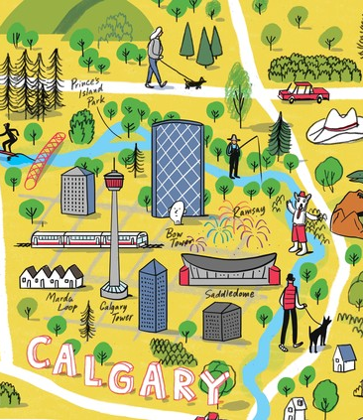
Navigating Calgary's 311 Service Data
Carolyn Andrews
Image Credit: Kyle METCALF /Swerve

Slide 2


AGENDA
Background
The Data
Analysis & Observations
Dashboards

Slide 3
Background

Slide 4

What is 311?
311 is a three-digit, non-emergency telephone number
for City information and non-emergency and non-law enforcement related services
(e.g. bylaw-related issues, potholes, street cleaning, tax account inquiries)
The 311 Service Request database tracks service request tickets
from the public for a City of Calgary information or service

Slide 5
The Data

Slide 6
Open Calgary
The City of Calgary’s Open Data Portal
311 Service Requests Dataset
Time Period: 2012 – Present
> 6 million rows
Updated: Daily
Data Provided By: The City
One row per service request
See more: https://data.calgary.ca/Services-and-Amenities/311-Service-Requests/iahh-g8bj/about_data

Slide 7
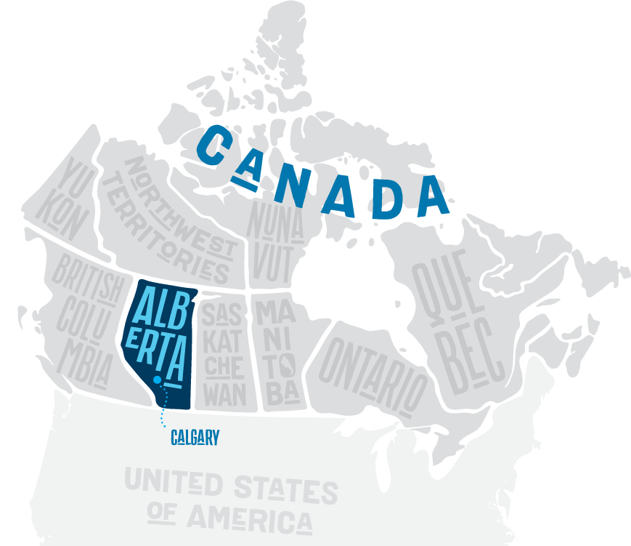
550,725
service requests were made in 2023
That’s over 1500 per day!
Credit: Mount Royal University

Slide 8
ANALYSIS & observations

Slide 9
Initial Questions
Quantity: How many requests are submitted yearly/monthly?
Frequency: What type of service is most frequently submitted?
Source: How are requests being submitted?
Response Time: How long does it take various requests to be closed?
Location: Are there areas (communities) of the city where services are requested more frequently?

Slide 10
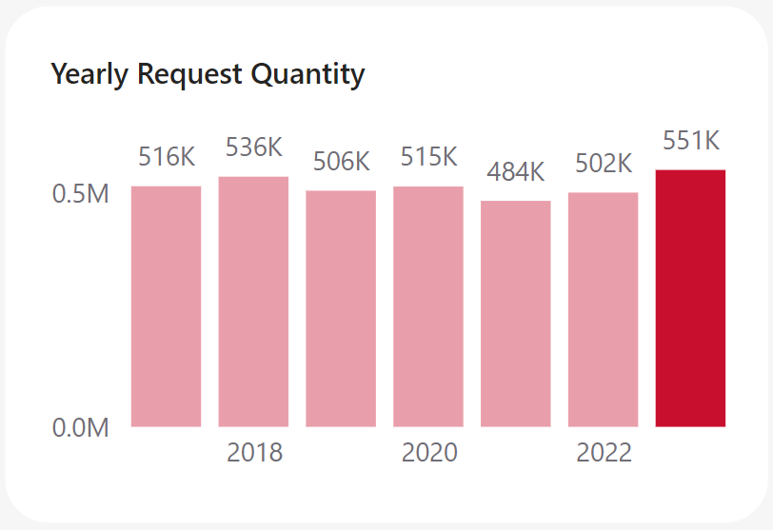
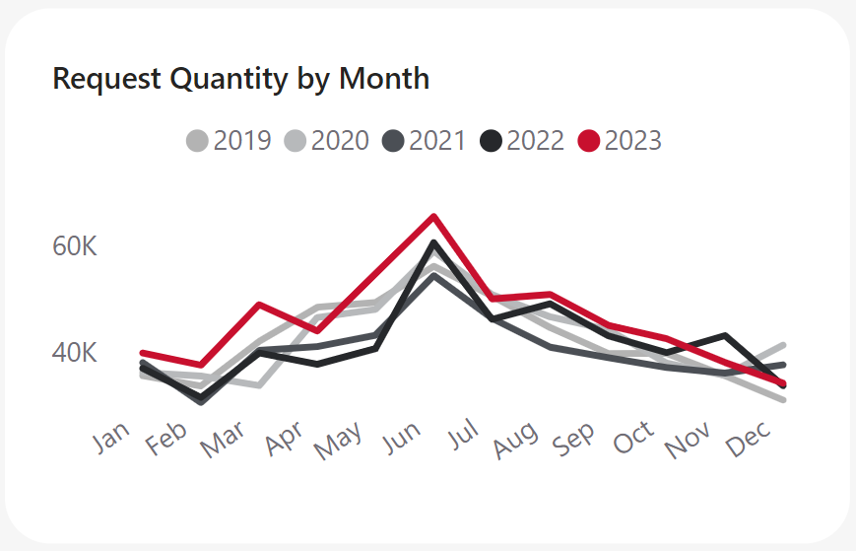
Analysis: quantity
At over 550k, 2023 saw a new high of the total number of service requests received
Before then, the city often saw between 500k-535k requests each year
A peak surge of requests happens in the summer months of June/July

Slide 11
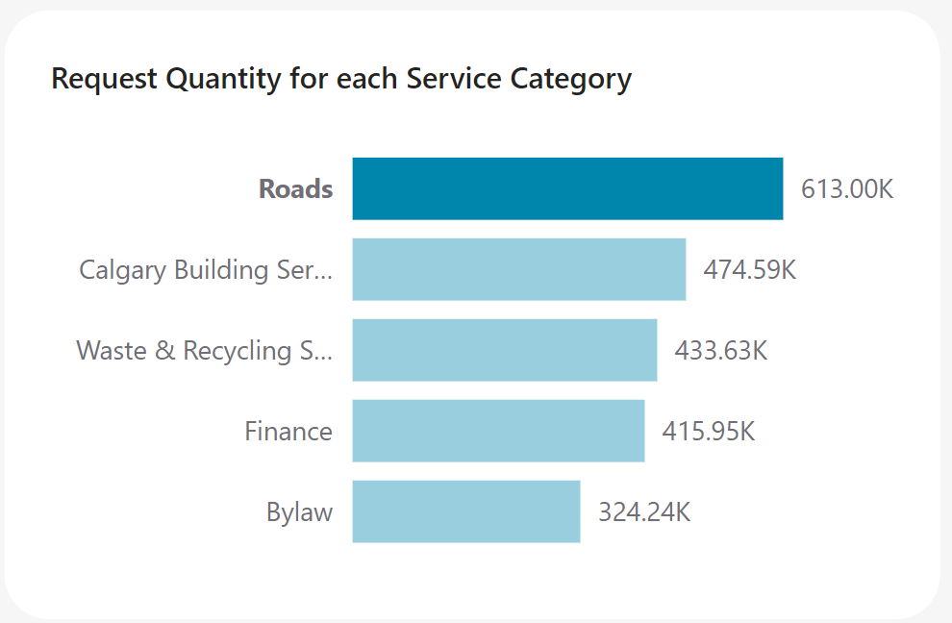
Analysis: frequency
Most years requests most frequently come in related to roads
From 2017 through Jan 2024 over 600k requests were in the Roads service category

Slide 12
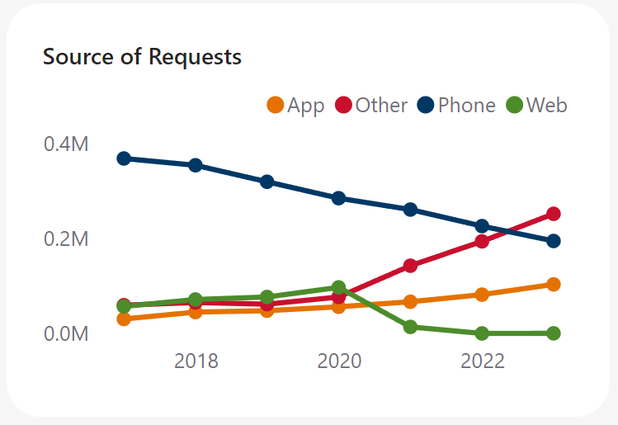
Analysis: source
The number of actual phone calls to 311 have been declining for years
But this is met with a rise in the use of other ways of contacting the service

Slide 13
Observation: open requests
Is the Number of Requests
from 2017 – 2023
still Open (as of late Jan 2024)
51,696
Of these pertain to:
Road Signs -
Parking or Traffic & Roadmarking
10,986

Slide 14
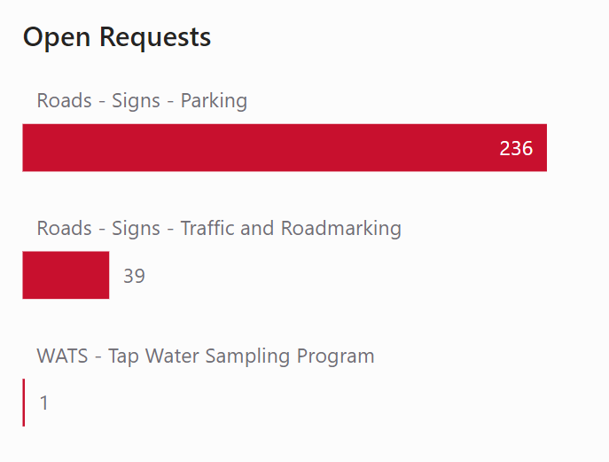
Observation: open Road sign requests
276 Open
requests originate
in 2017
Example:
Request #: 17-00633300
For: Roads - Signs - Traffic and Roadmarking
Date Requested: Tue, 27 Jun 2017
Last Update: Fri, 29 Sep 2023
Days Open: 6.6 years (and counting)
While some of these have update dates within the last year or two,
it is unknown why they are still open despite their age.

Slide 15
Dashboards

Slide 16
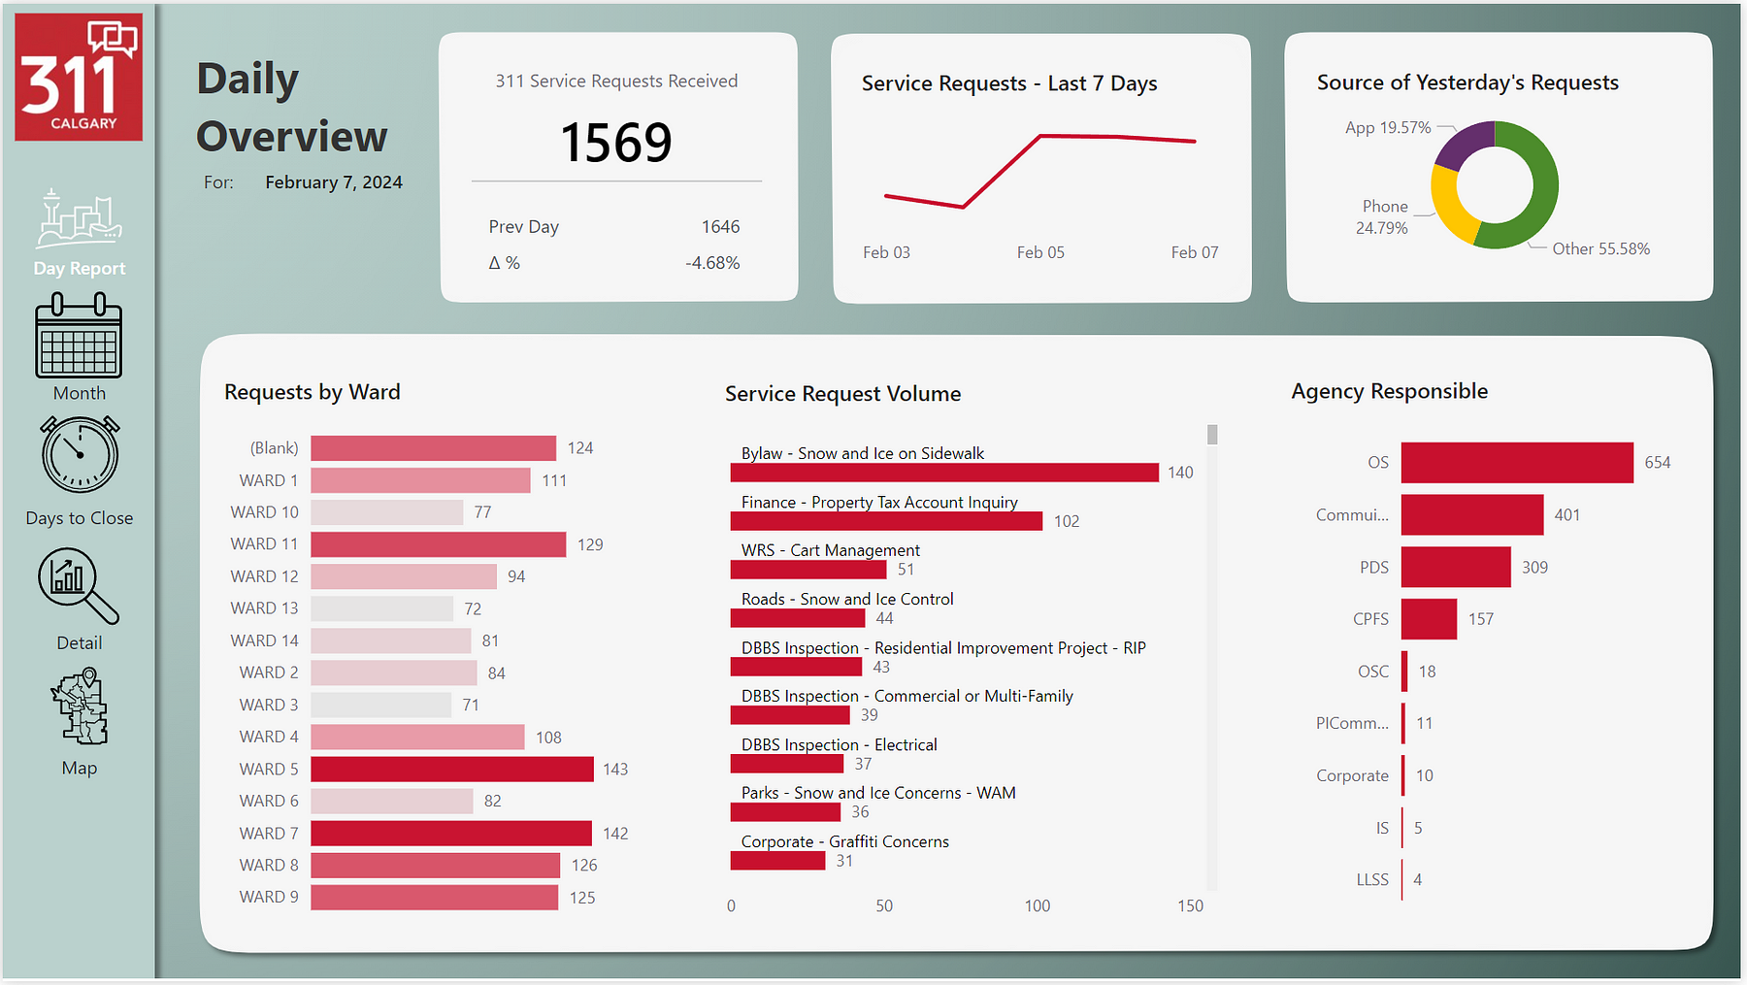
A dashboard to review the previous day’s requests

Slide 17
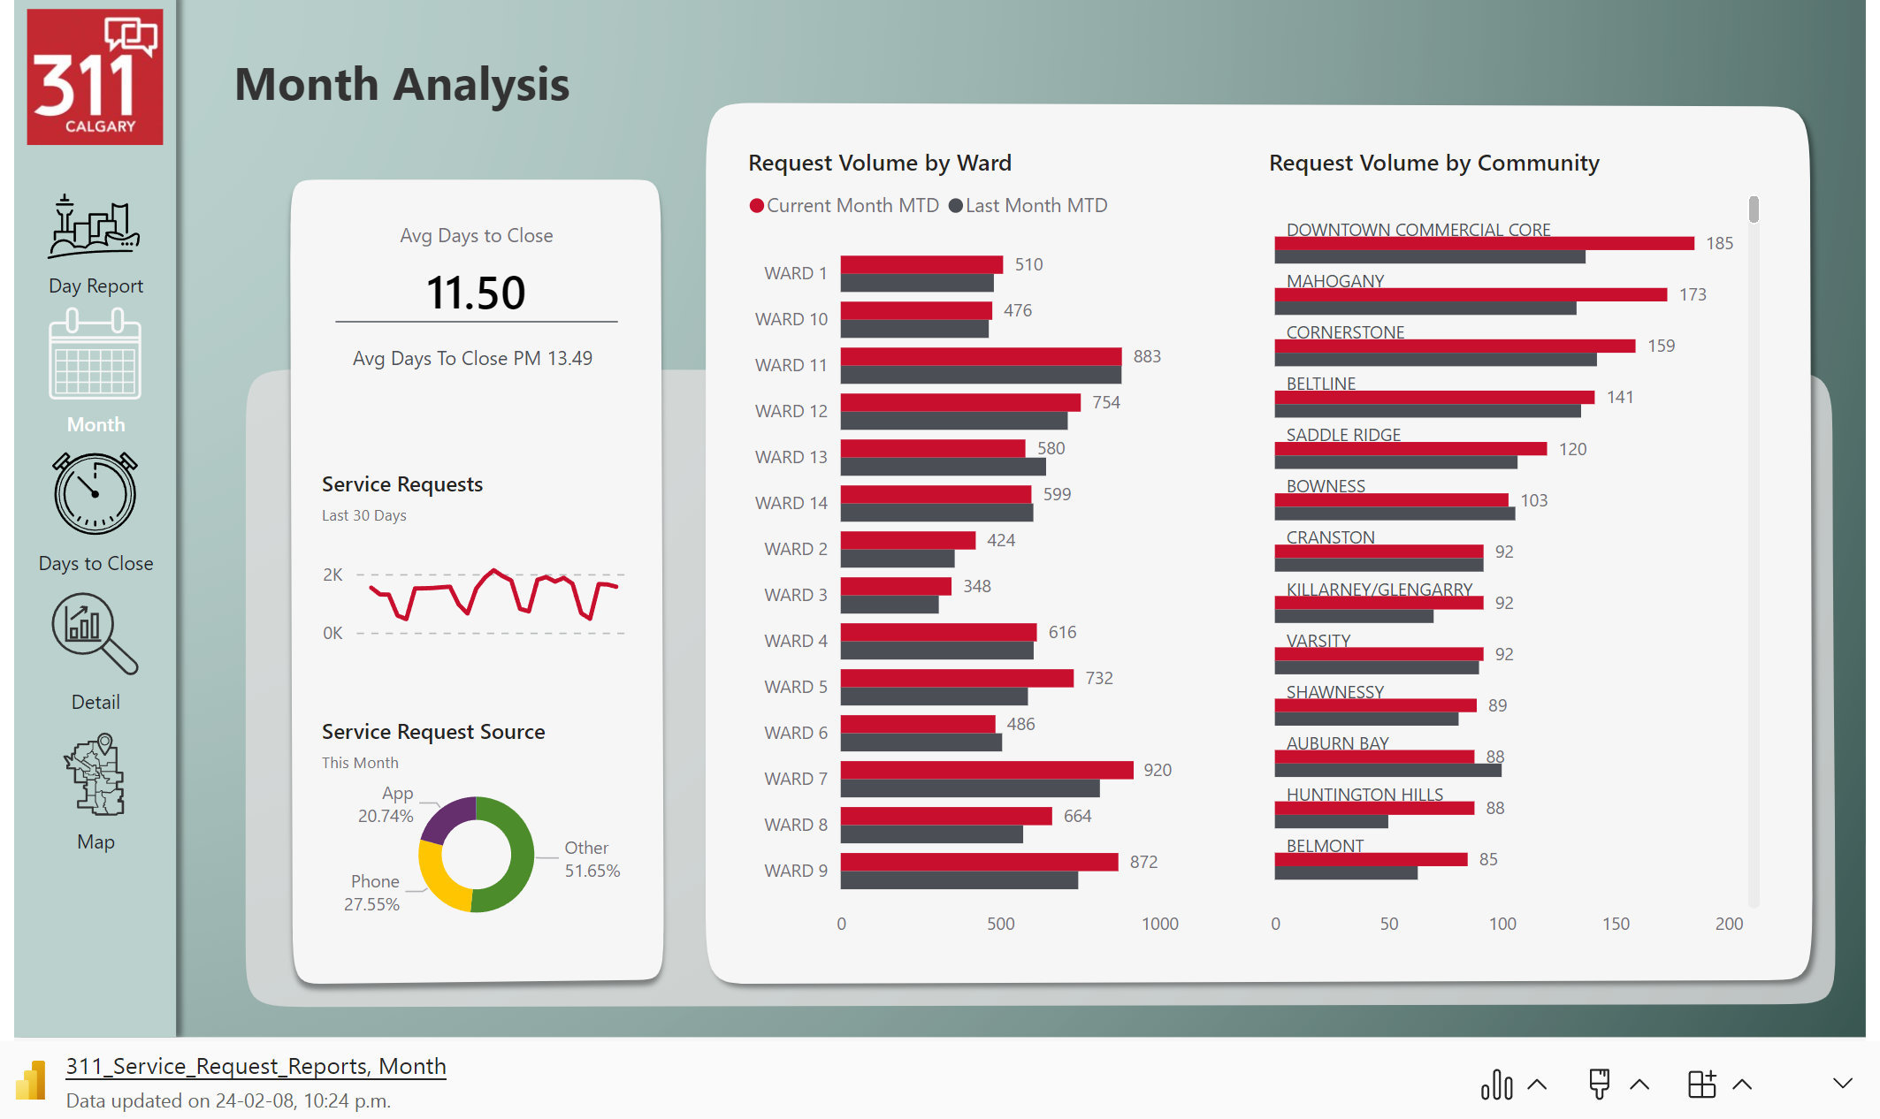
An analysis of the current month’s requests,
With comparison to the previous month

Slide 18
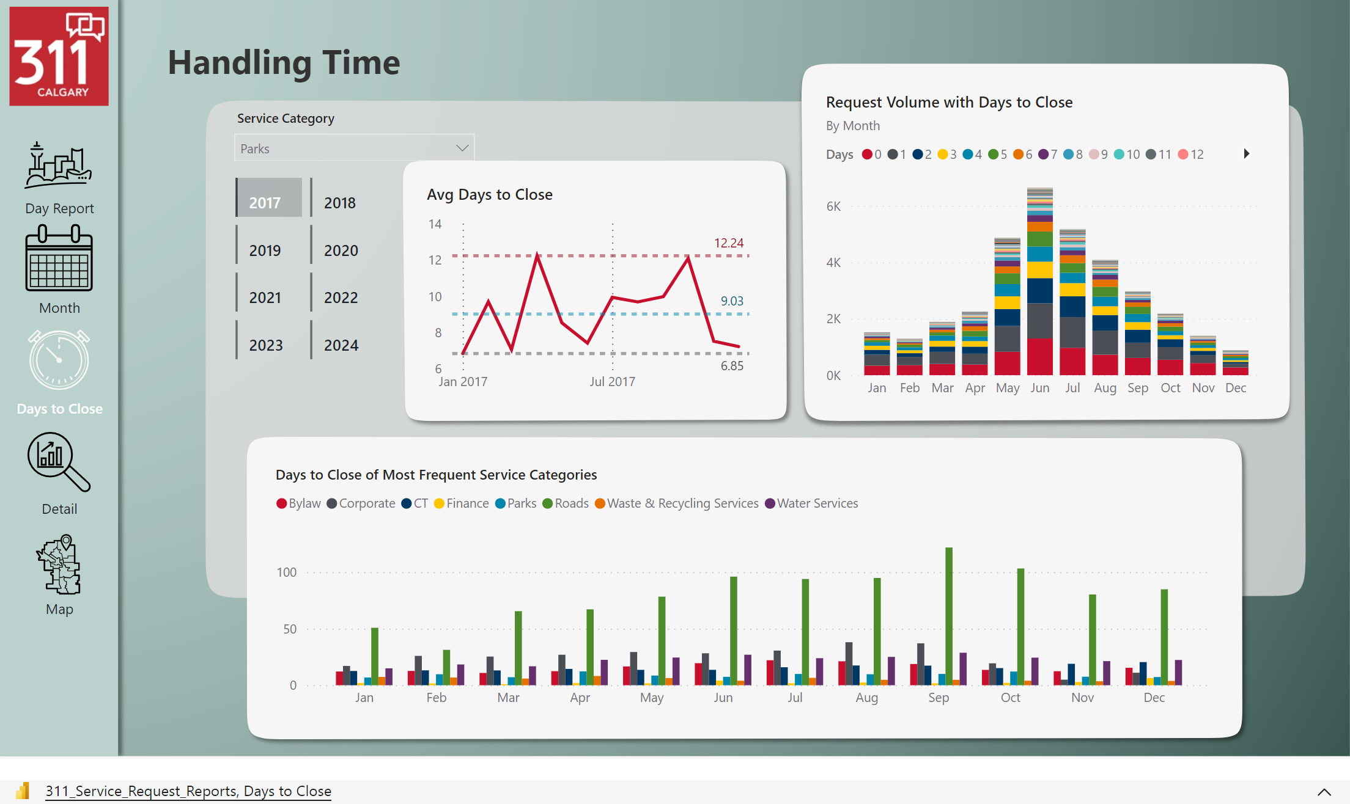
For analyzing how long requests take to close
Grouped by month and/or service category

Slide 19
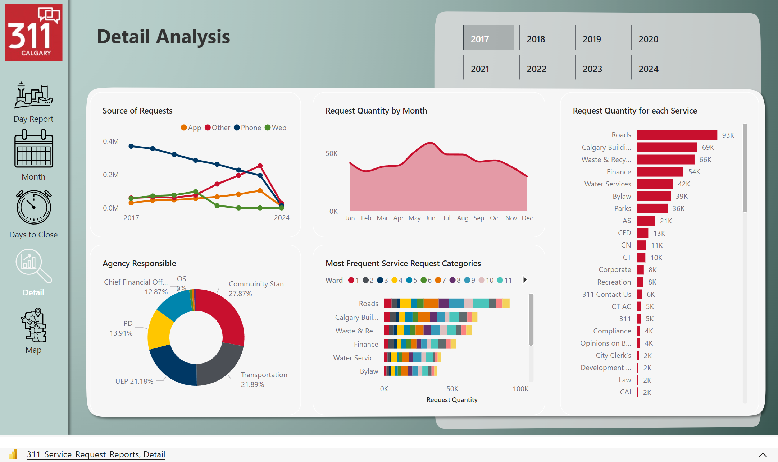
For a more detailed analysis of various elements of the dataset

Slide 20
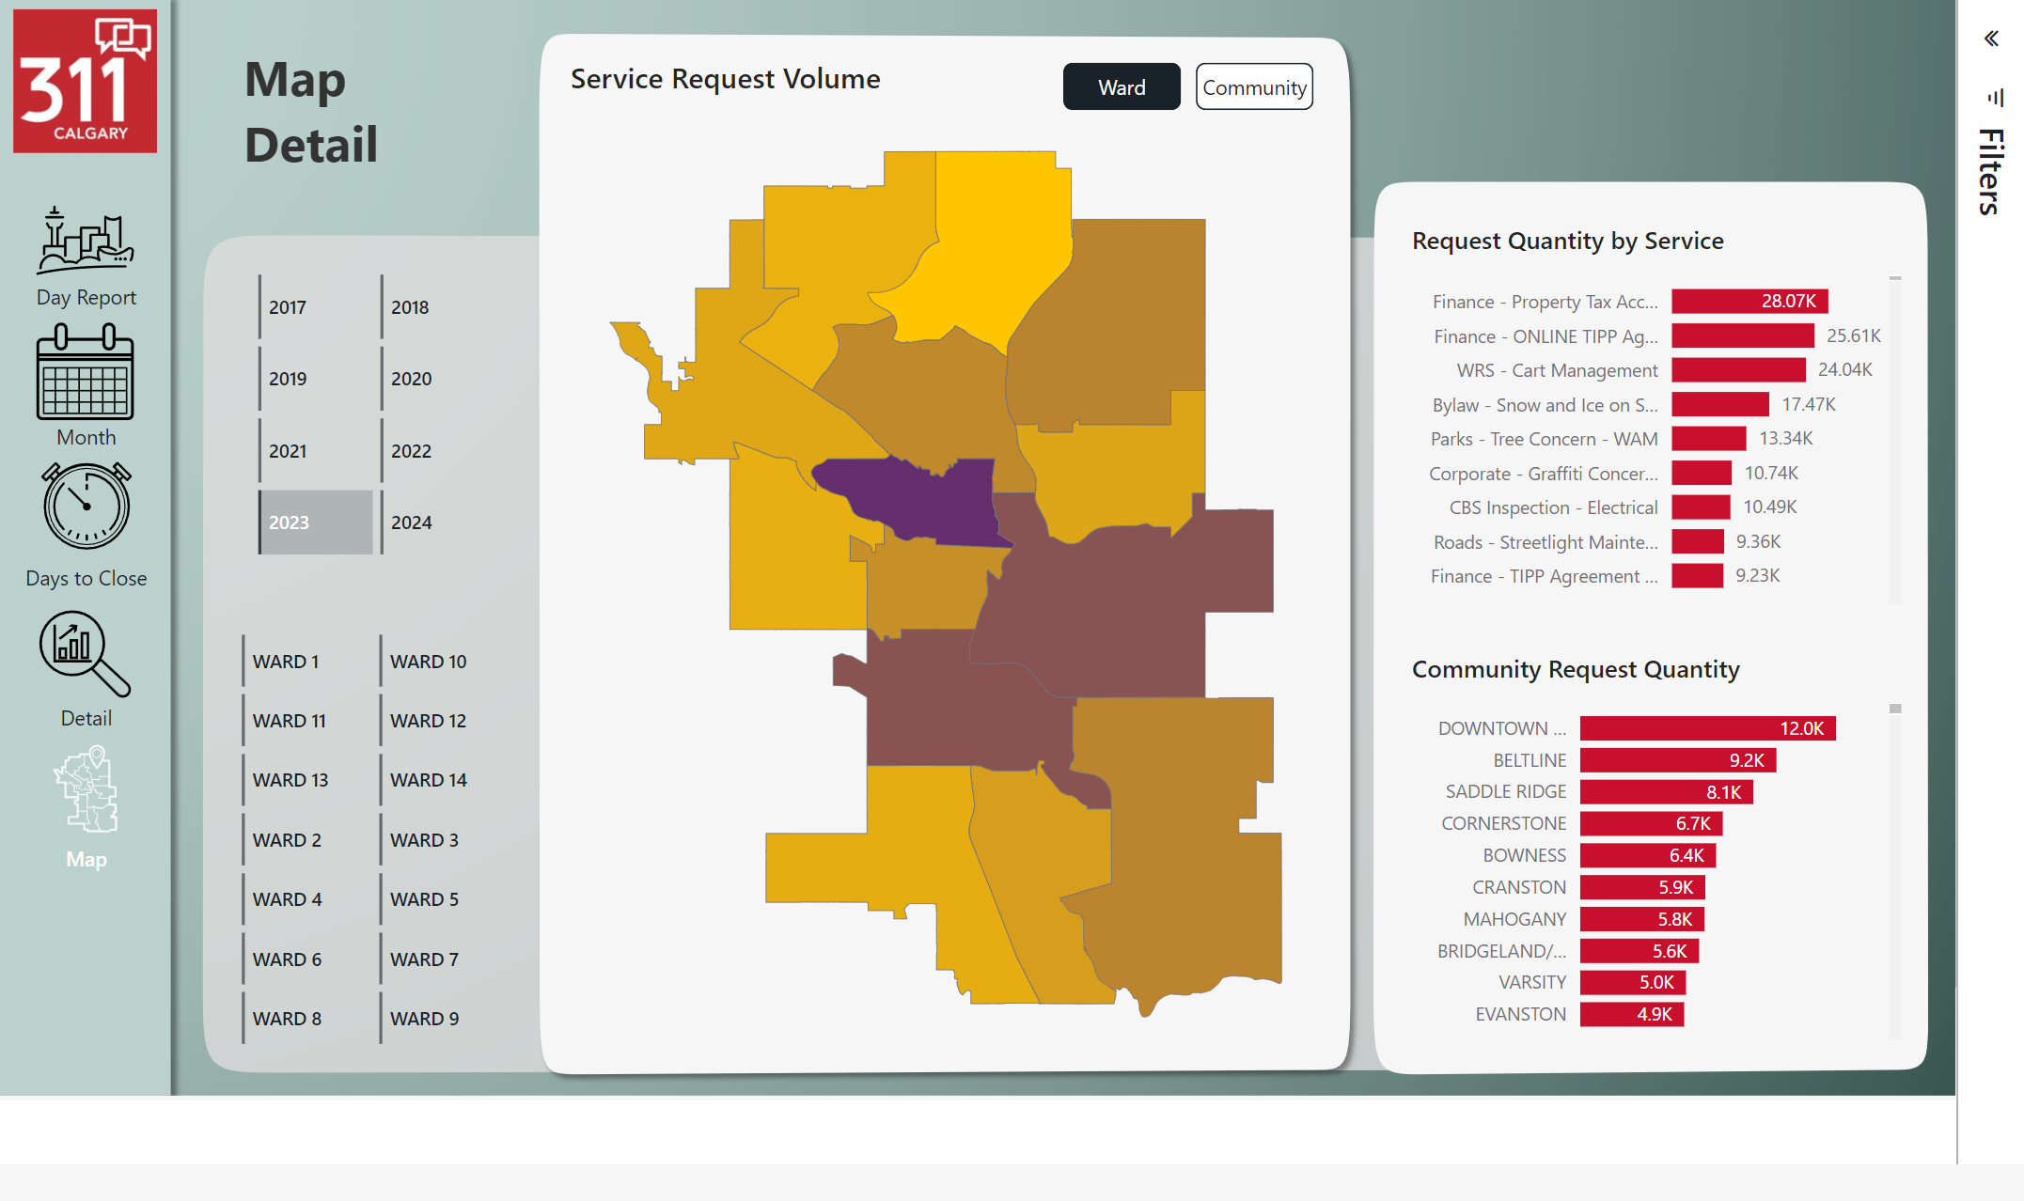
Mapping the request volume – by Ward and Community

Slide 21


THANK YOU
Carolyn Andrews

Slide 22
references
Data Source: https://data.calgary.ca/
Contains information licensed under the Open Government Licence – City of Calgary
License URL: https://data.calgary.ca/stories/s/Open-Calgary-Terms-of-Use/u45n-7awa

