Slide 1
Clinical Decision Making and Pattern Recognition in Health Care
Candy Arce

Slide 2
Why is it Important?
Patient care
Electronic health records
Diagnosis
Prevention

Slide 3
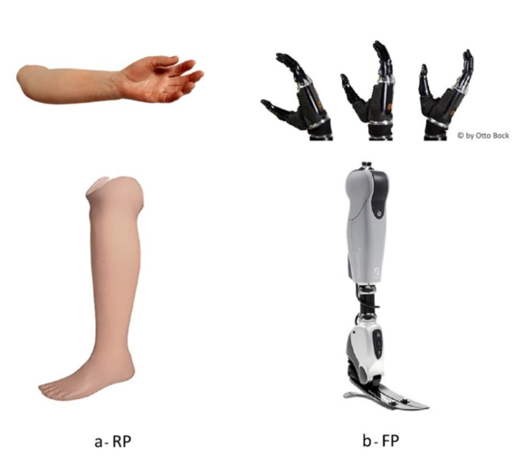
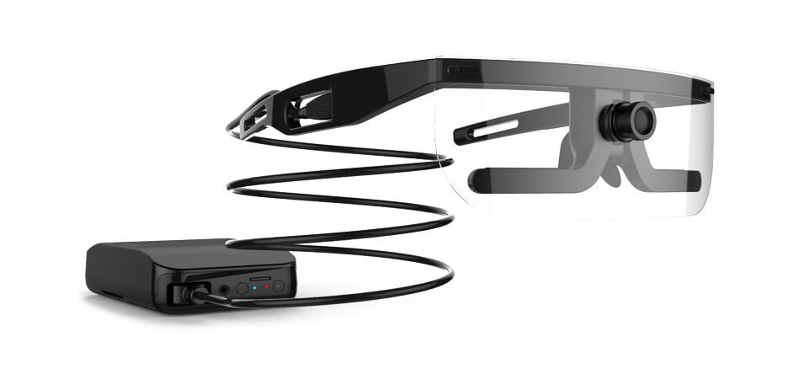
About the Report
Some technologies and devices used to improve healthcare include:
MRIs
Eye trackers
Prosthetic limbs
Motion analysis camera
Database systems

Slide 4
My focus
Autism Spectrum Disorder Detection Prototype
I wanted to create a prototype that used pattern recognition to detect Autism Spectrum Disorder (ASD). According to CDC, symptoms of the disorder include failure to initiate or respond to conversations, absence of interest in peers, abnormalities in eye contact and body language, stereotyped and motor movements, insistence on sameness, and intelligence impairment.

Slide 5
Explaining the POC
The software chosen to demonstrate this was Teachable Machine which recognizes images, and the code came from Scratch. My porotype has two main purposes, one is to imitate a conversation as if it were a person conversing with an individual with ASD. In my prototype, I have the machine asking questions to the user. Ideally, the user would respond verbally but as a demonstration, the user is typing their responses. When there is or there is no verbal response, I expect to track that information. Another feature I plan to obtain is to measure facial expressions. My prototype shows a dinosaur character changing colors and the model detects how the individual reacts to it. This is due to insistence on sameness.

Slide 6
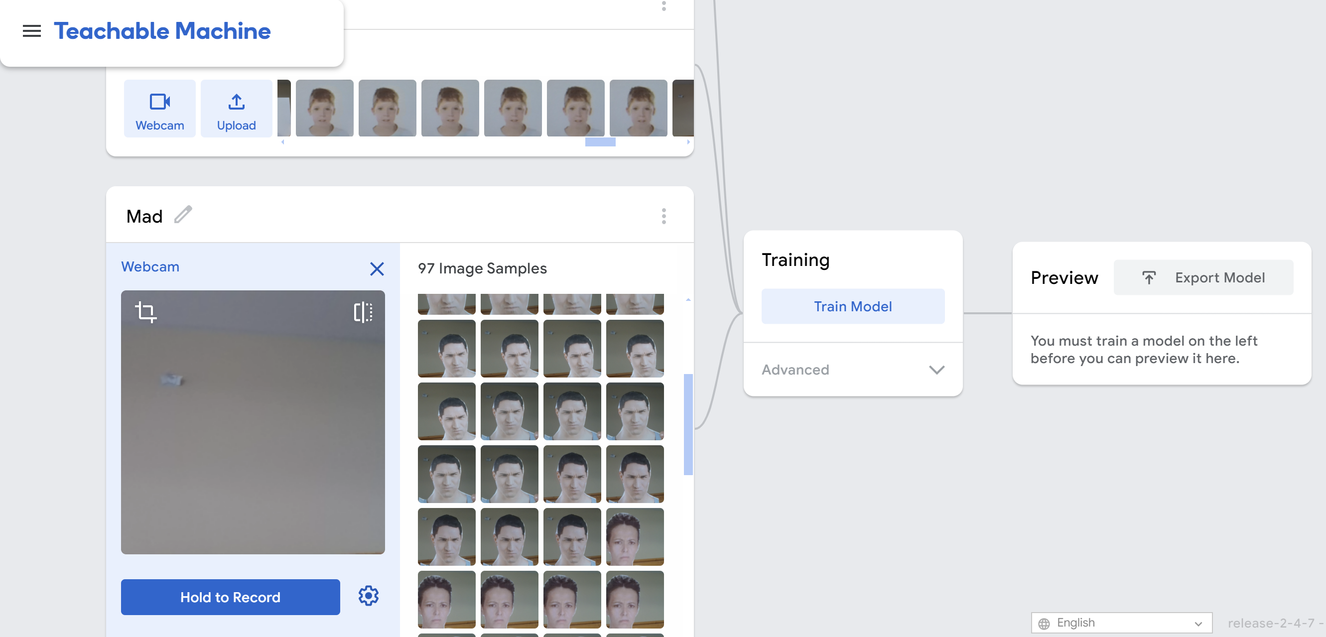
Teachable Machine
This online software allows for webcam captures. For my model, I made 3 classes for facial expression including happy, mad, and neutral.
https://teachablemachine.withgoogle.com/train/

Slide 7
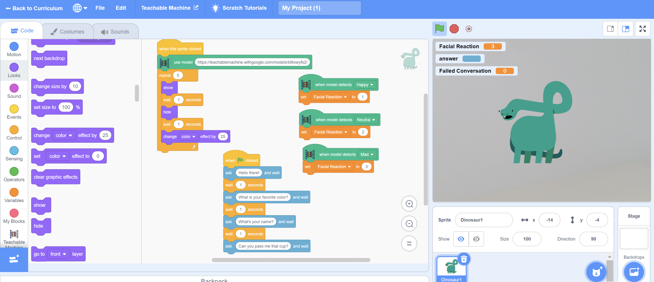
Scratch
The software used for basic coding was scratch because it allows an extension for Teachable Machine. Here, the image recognition would show up on the right as the individual interacts with the screen.
https://playground.raise.mit.edu/create/

Slide 8

Personal Impact
I chose to research ASD detection more in depth because I am passionate about integrating computing in health care. Additionally, I have firsthand experience with individuals affected with ASD, including family members and friends. Noticing common stereotyped behavior, I wanted to learn more about detection/diagnosis and become a part of improvement in health care.

Slide 9
Thank you
Candy Arce
575-652-0366
Candy.12vln@gmail.com

