Slide 1
Real-Time Depth Buffer Based Ambient Occlusion
Miguel Sainz
Slide <number>

Slide 2
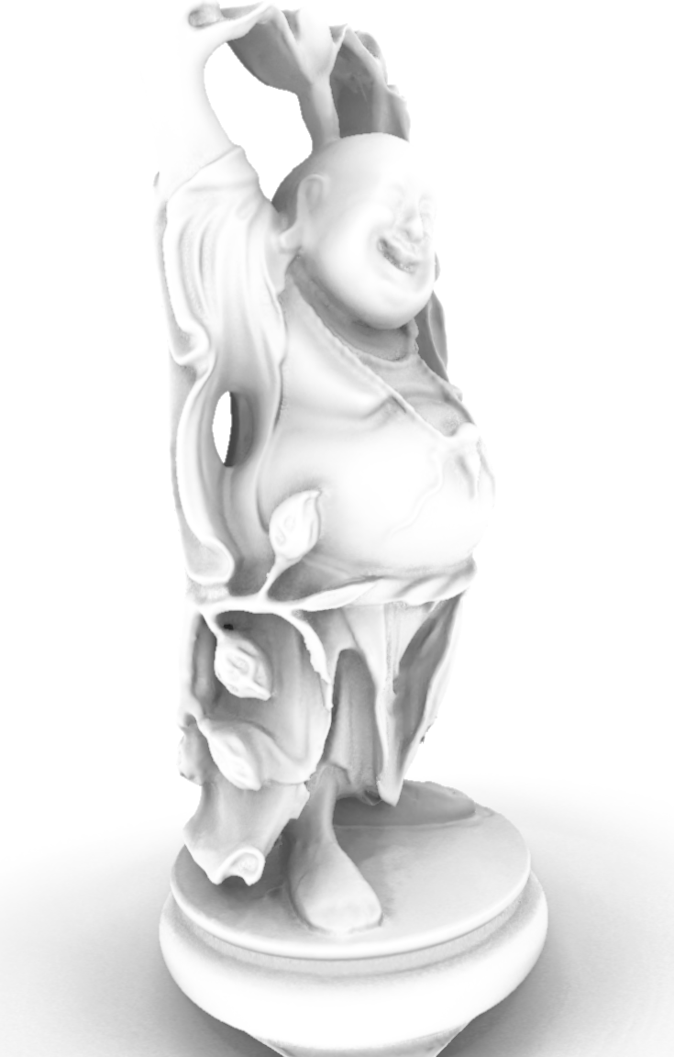
Motivation
Ambient occlusion approximates soft outdoor lighting (sky light)
It gives perceptual clues of depth, curvature, and spatial proximity
Traditional methods require pre-processing (bad for dynamic scenes)
It can be done as a full screen pass
Slide <number>
Notes:
It provides a GI look

Slide 3



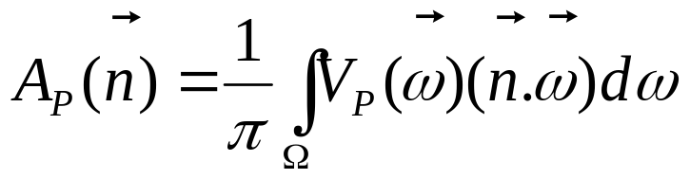

Ambient occlusion
P
Integral over the hemisphere Ω
  Weighted by cosine term for diffuse shading
  V( ) typically attenuated with distance to P

Slide 4
Why screen space?
eye
Depth buffer contains an approximate representation of the scene (micro patches)
No dependence on scene complexity
No pre-calculation (dynamic scenes are OK)
Needs to work in world space or eye space (AO is a world space phenomenon)
May also require a normal buffer
z
Notes:
(Sampling of surfaces visible from the camera)
Add Figure with: frustum, eye-space sphere with radius R, rays from eye to sphere

Slide 5
Related work -
I3D 07
[Shanmugam and Okan 07]
Approximate eye-space pixels by micro spheres
Accumulate occlusion of spheres in a kernel
Over-occlusion artifacts
  Because spheres don’t occlude one another
z
p
Notes:
Redo figs on pp
Cite [] as caption of figure
Uses normal + depth buffers

Slide 6
Horizon Split Ambient Occlusion (HSAO)
eye
Trace rays in screen space
Sampling based (stochastic)
Treat depth buffer as a height field
No preprocessing required
High quality (compared to a raytracer)
z

Slide 7
HSAO - Intuition
Hemisphere can be partitioned in two parts based on the “horizon”
  Red rays are always occluded
  Grey rays are undetermined and need to be traced
The horizon angle can be found by stepping along the tangent T(θ)
θ
Horizon angle
P
T(θ)
Notes:
Put animation

Slide 8
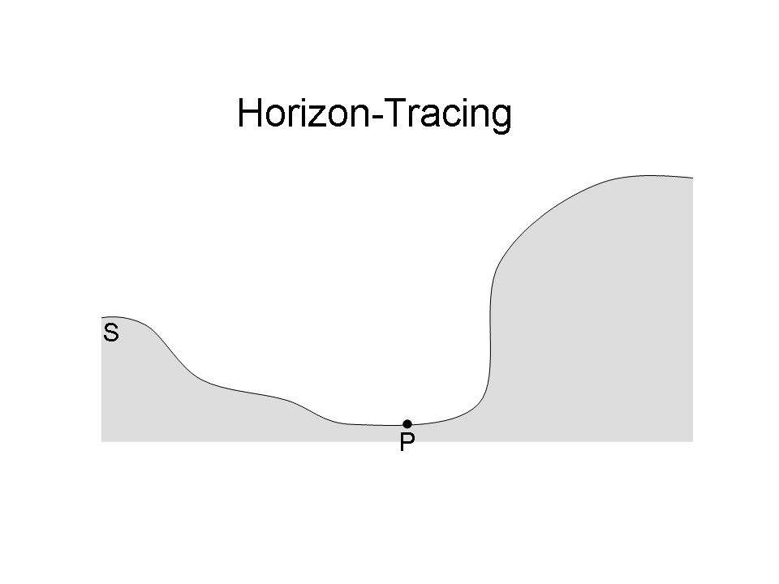
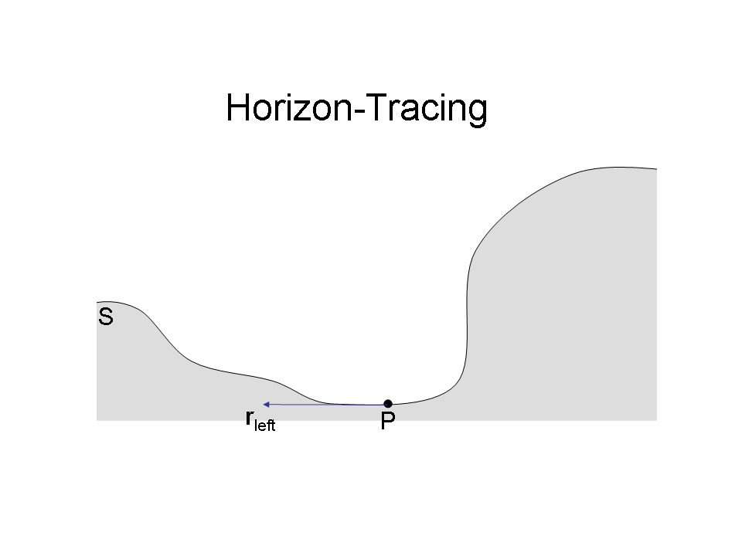
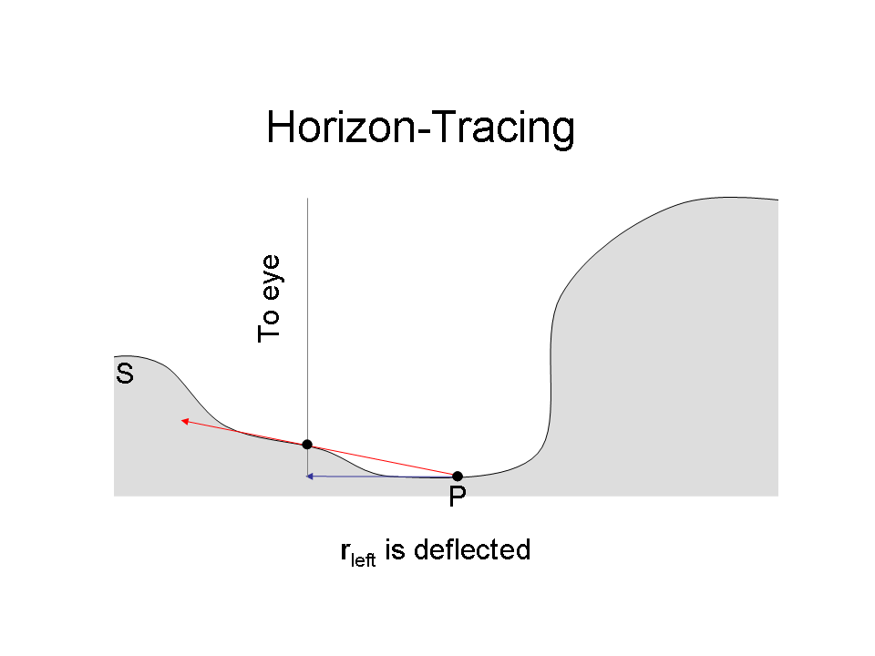
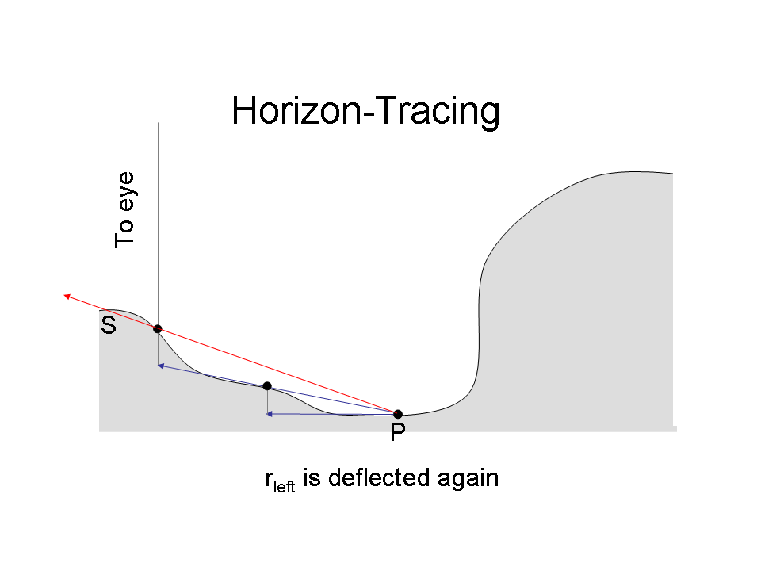
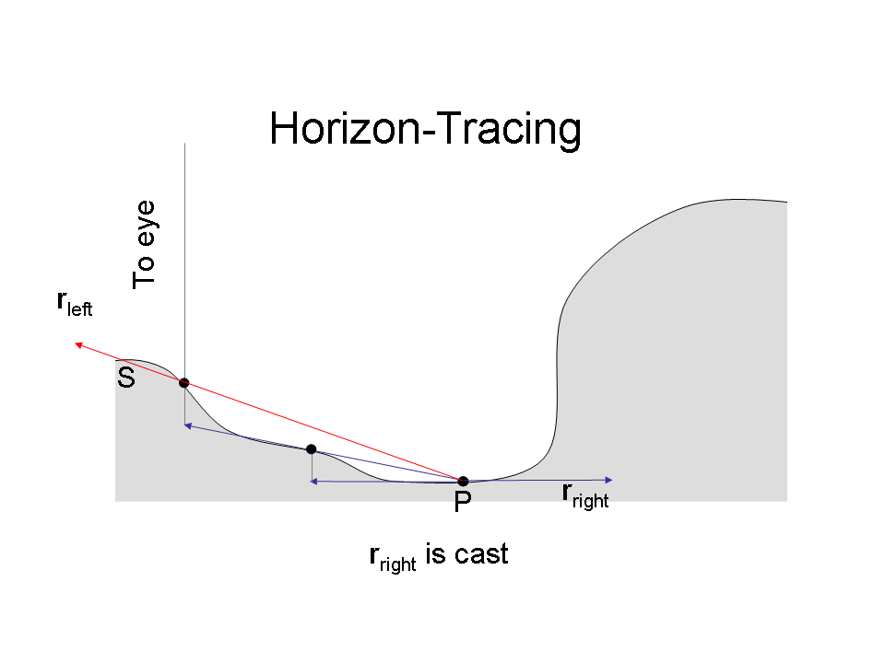
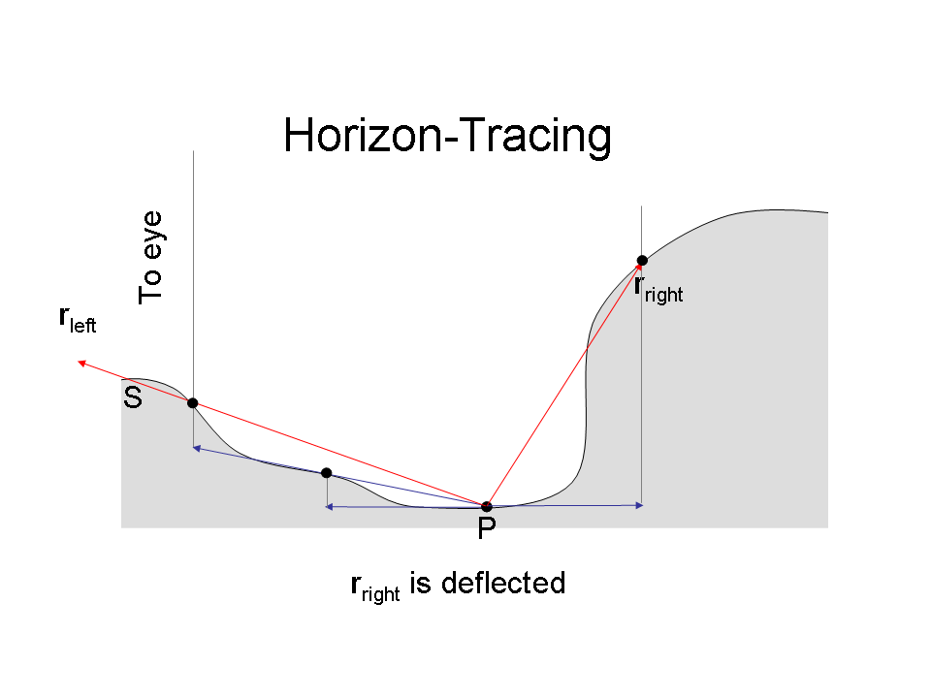
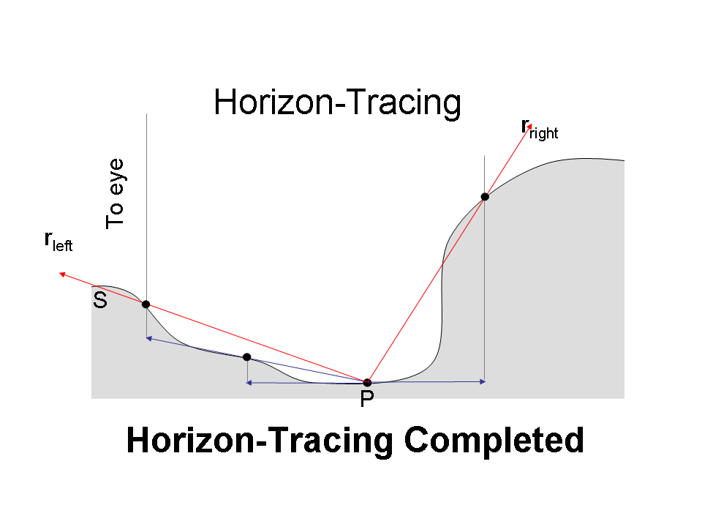
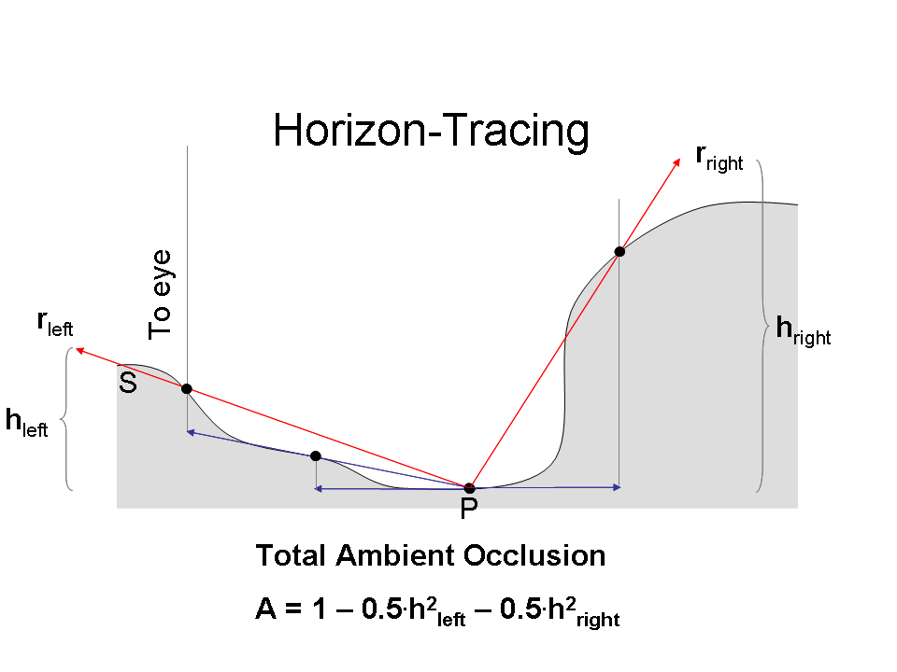
Horizon determination
For each tangent ray
Iterative approach
N steps per ray
Ray deflection towards surface
Notes:
Remove pseudocode
ANIMATION

Slide 9
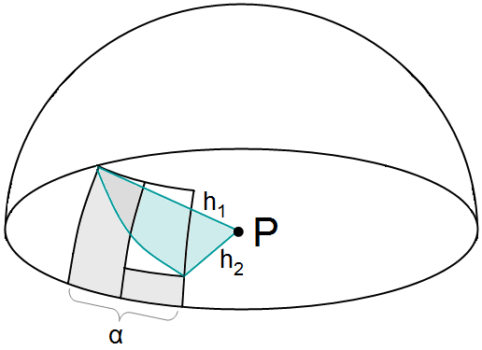
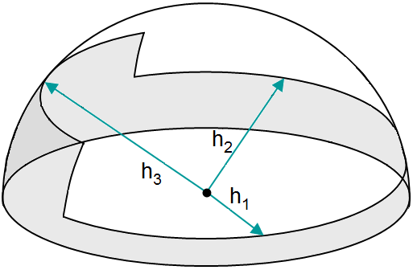
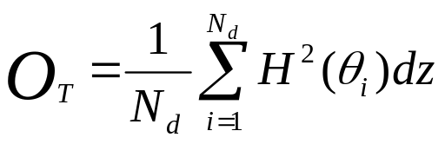
Horizon integration
Piece-wise linear approximation of the horizon
Closed form integral of occlusion contribution
Notes:
Improve figs (show h, show theta, show radius 1)

Slide 10
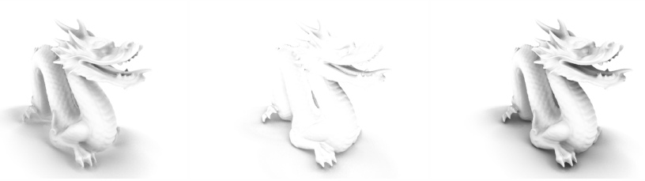
Normal occluders - intuition
On some surface orientations will not hit any tangent
V
N
P
Horizon
Normal

Slide 11
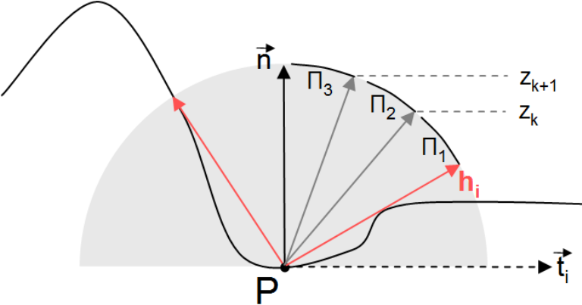
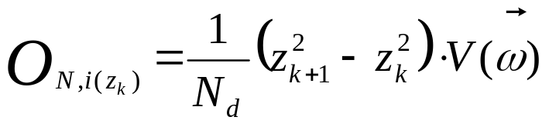
Normal occluders
Ray marching
Angle range constrained by the horizon
Closed form for ray direction and AO integration
Notes:
Imrove fig (heights)

Slide 12
Additional Tweaks
Linear attenuation
  Remove banding discontinuities at the boundaries
Smart Blur
  Remove the noise artifacts
  Use depth information to avoid edge leaking
Final compositing
  Multiplier or ambient term

Slide 13
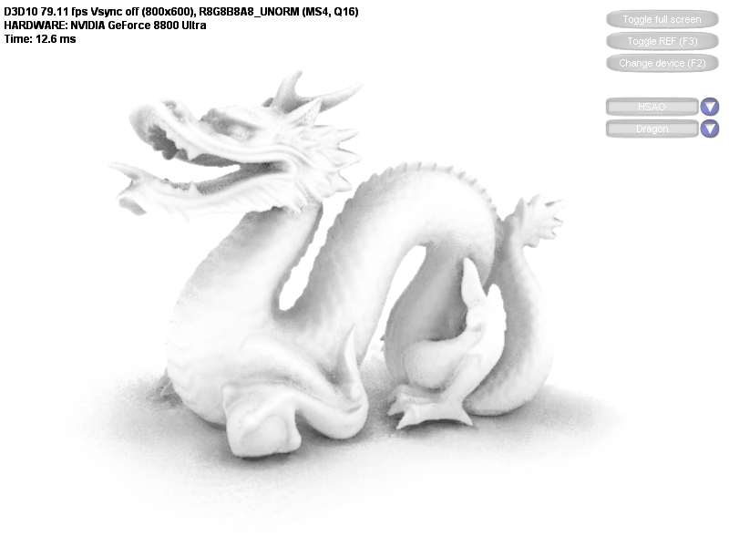
Dragon
Resolution: 800x600
AO Render Time: 8.6ms
Trace Radius: 1/4 Model’s Width
Horizon Rays: 8
Number of steps: 8
Normal Rays per Direction: 2

Slide 14
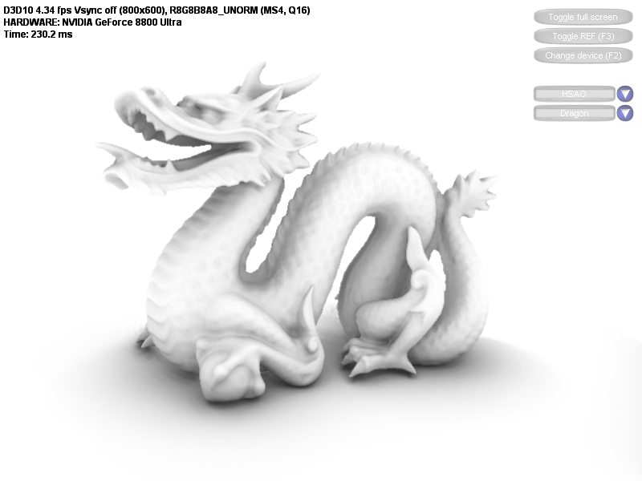
Dragon
Resolution: 800x600
AO Render Time: 226.1 ms
Trace Radius: 1/4 Model’s Width
Number of Directions: 16
Number of steps: 16
Normal Rays per Direction: 8
Ray Marched!!!

Slide 15
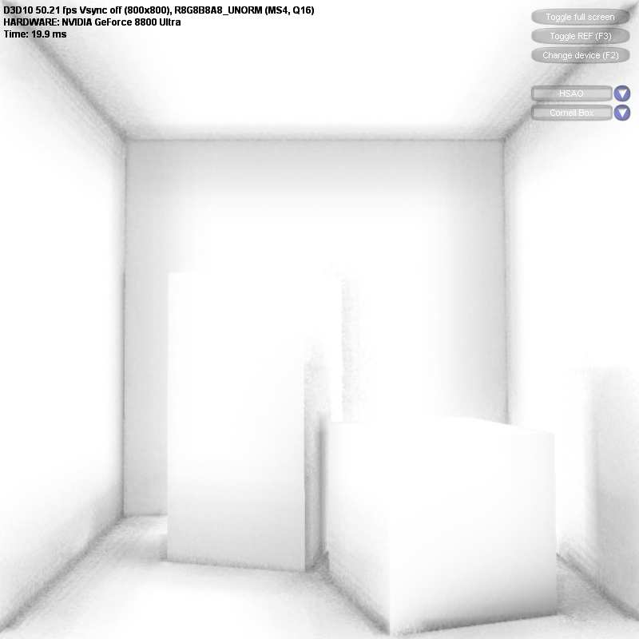
Cornell Box
Resolution: 800x800
AO Render Time: 16.9 ms
Trace Radius: 1/4 Model’s Width
Horizon Rays: 8
Number of steps: 8
Normal Rays per Direction: 2

Slide 16
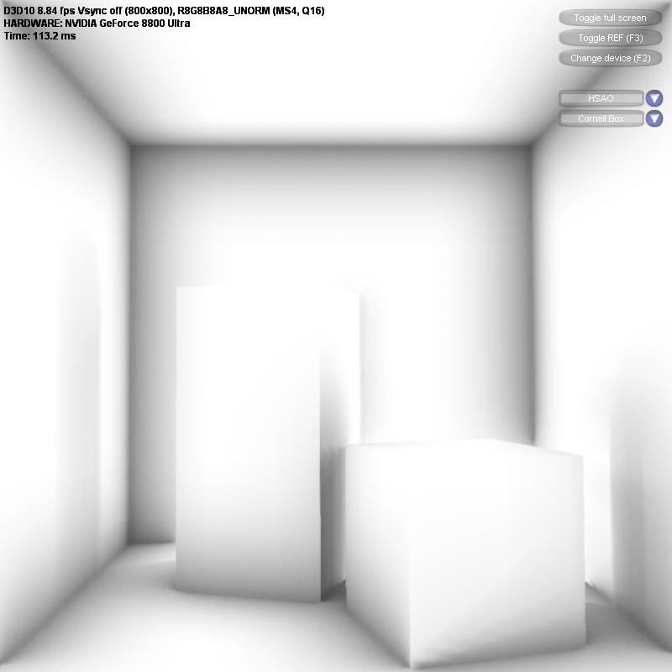
Cornell Box
Resolution: 800x800
AO Render Time: 110.2 ms
Trace Radius: 1/4 Model’s Width
Number of directions: 16
Number of steps: 16
Normal Rays per Direction: 4
Ray Marched!!!

Slide 17
Demo time!!!

Slide 18
Speed-up tricks
Shrink buffer
Warp previous frame onto current
  (keep around depth buffer too)
Attenuate and clip with distance
Less (or none) normal contribution

Slide 19
For more information
Contact me at msainz@nvidia.com
Slides, code and whitepaper developer.nvidia.com
(Thanks to Rouslan Dimitrov and Louis Bavoil)

