Slide 1
dashboardify
Irmantas Ivanauskas, Žygimantas Žilevičius, Martynas Kadiša

Slide 2
About us

Slide 3

THE FELLOWSHIP OF THE CODE

Slide 4
Working in a team

Slide 7
the project

Slide 8
idea
To allow user scrap content from websites

Slide 9
tIMELINE

Slide 11
aRCHITECTURE

Slide 12
tECHNOLOGIES

Slide 13
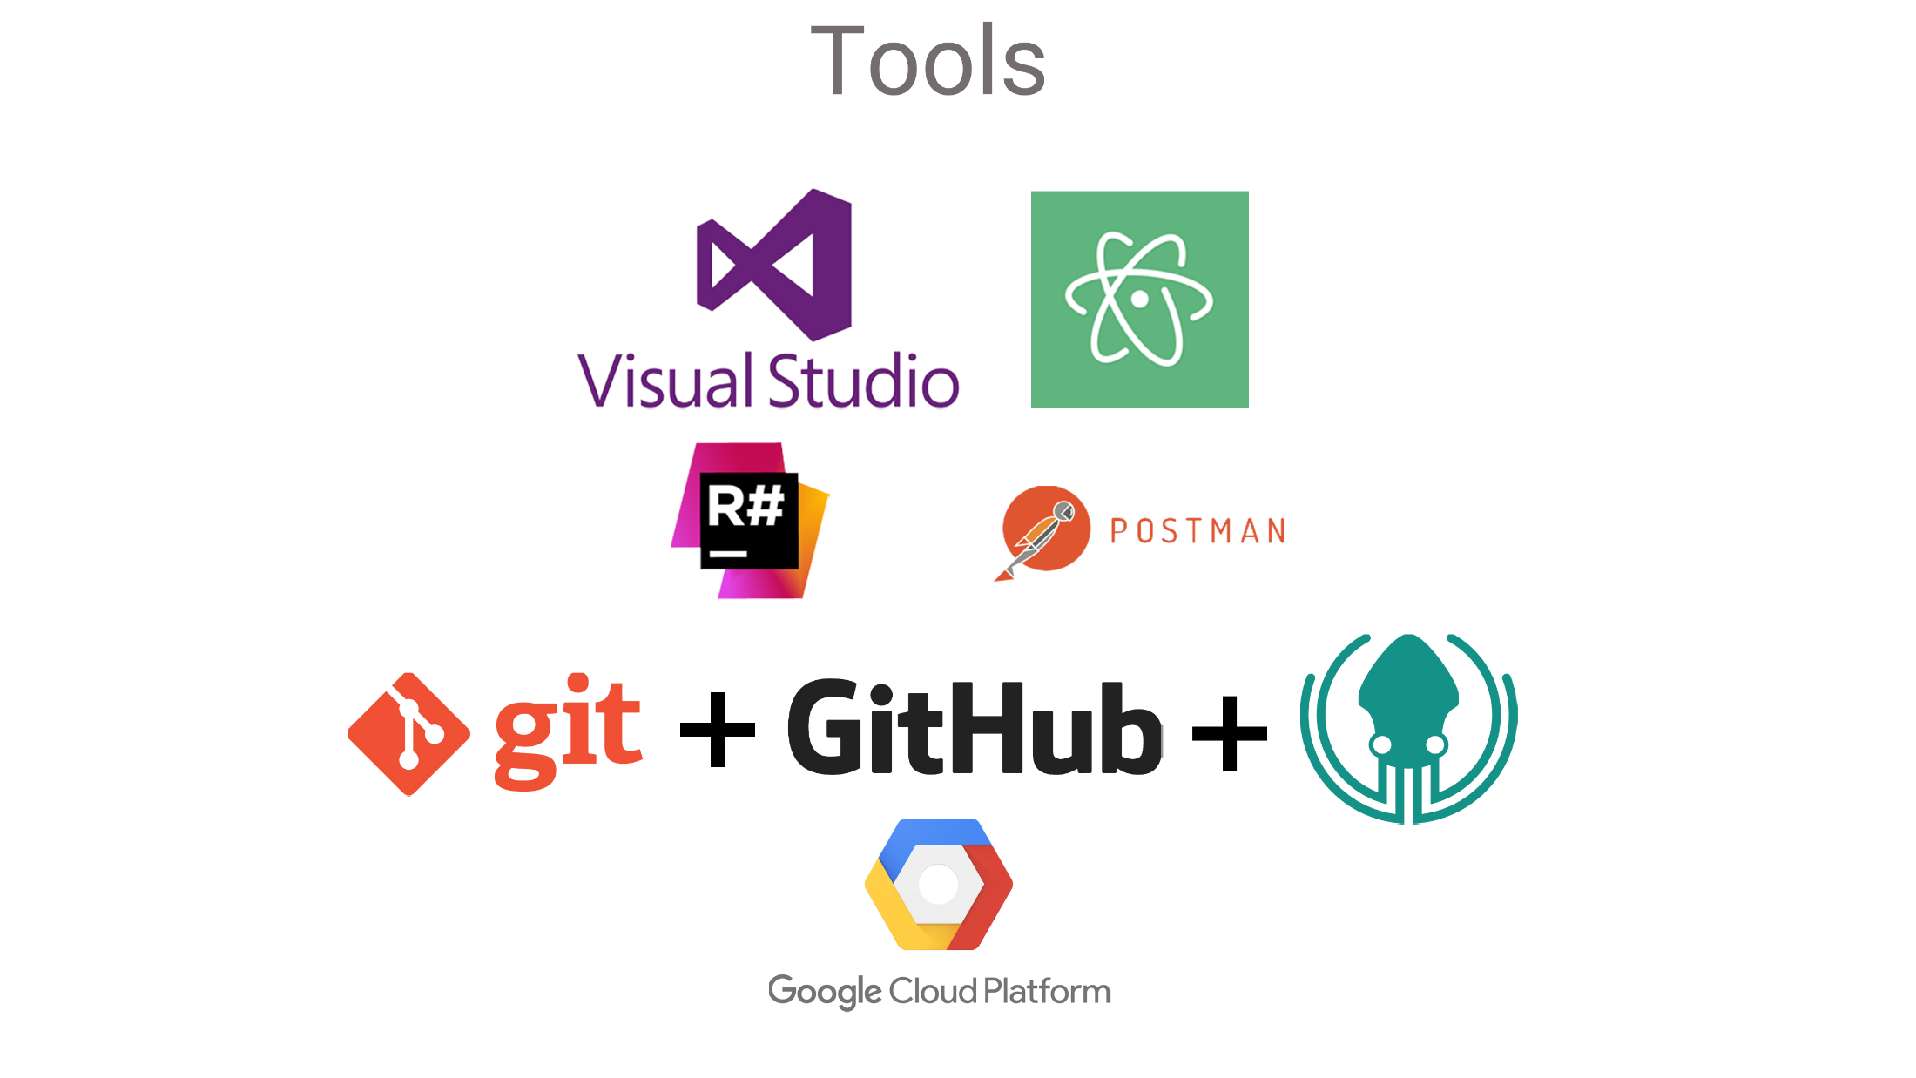

Slide 14



Slide 15
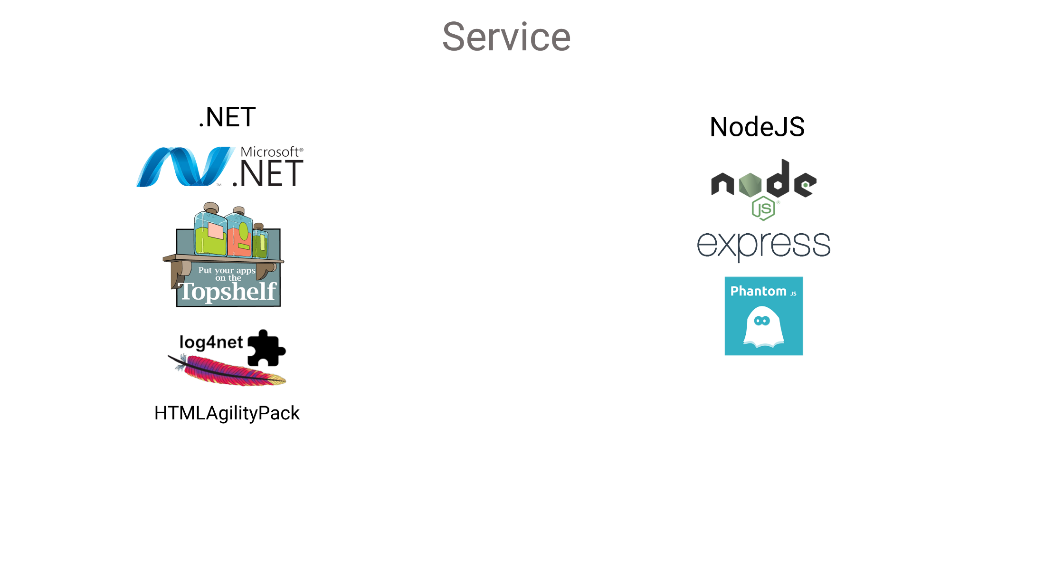

Slide 16
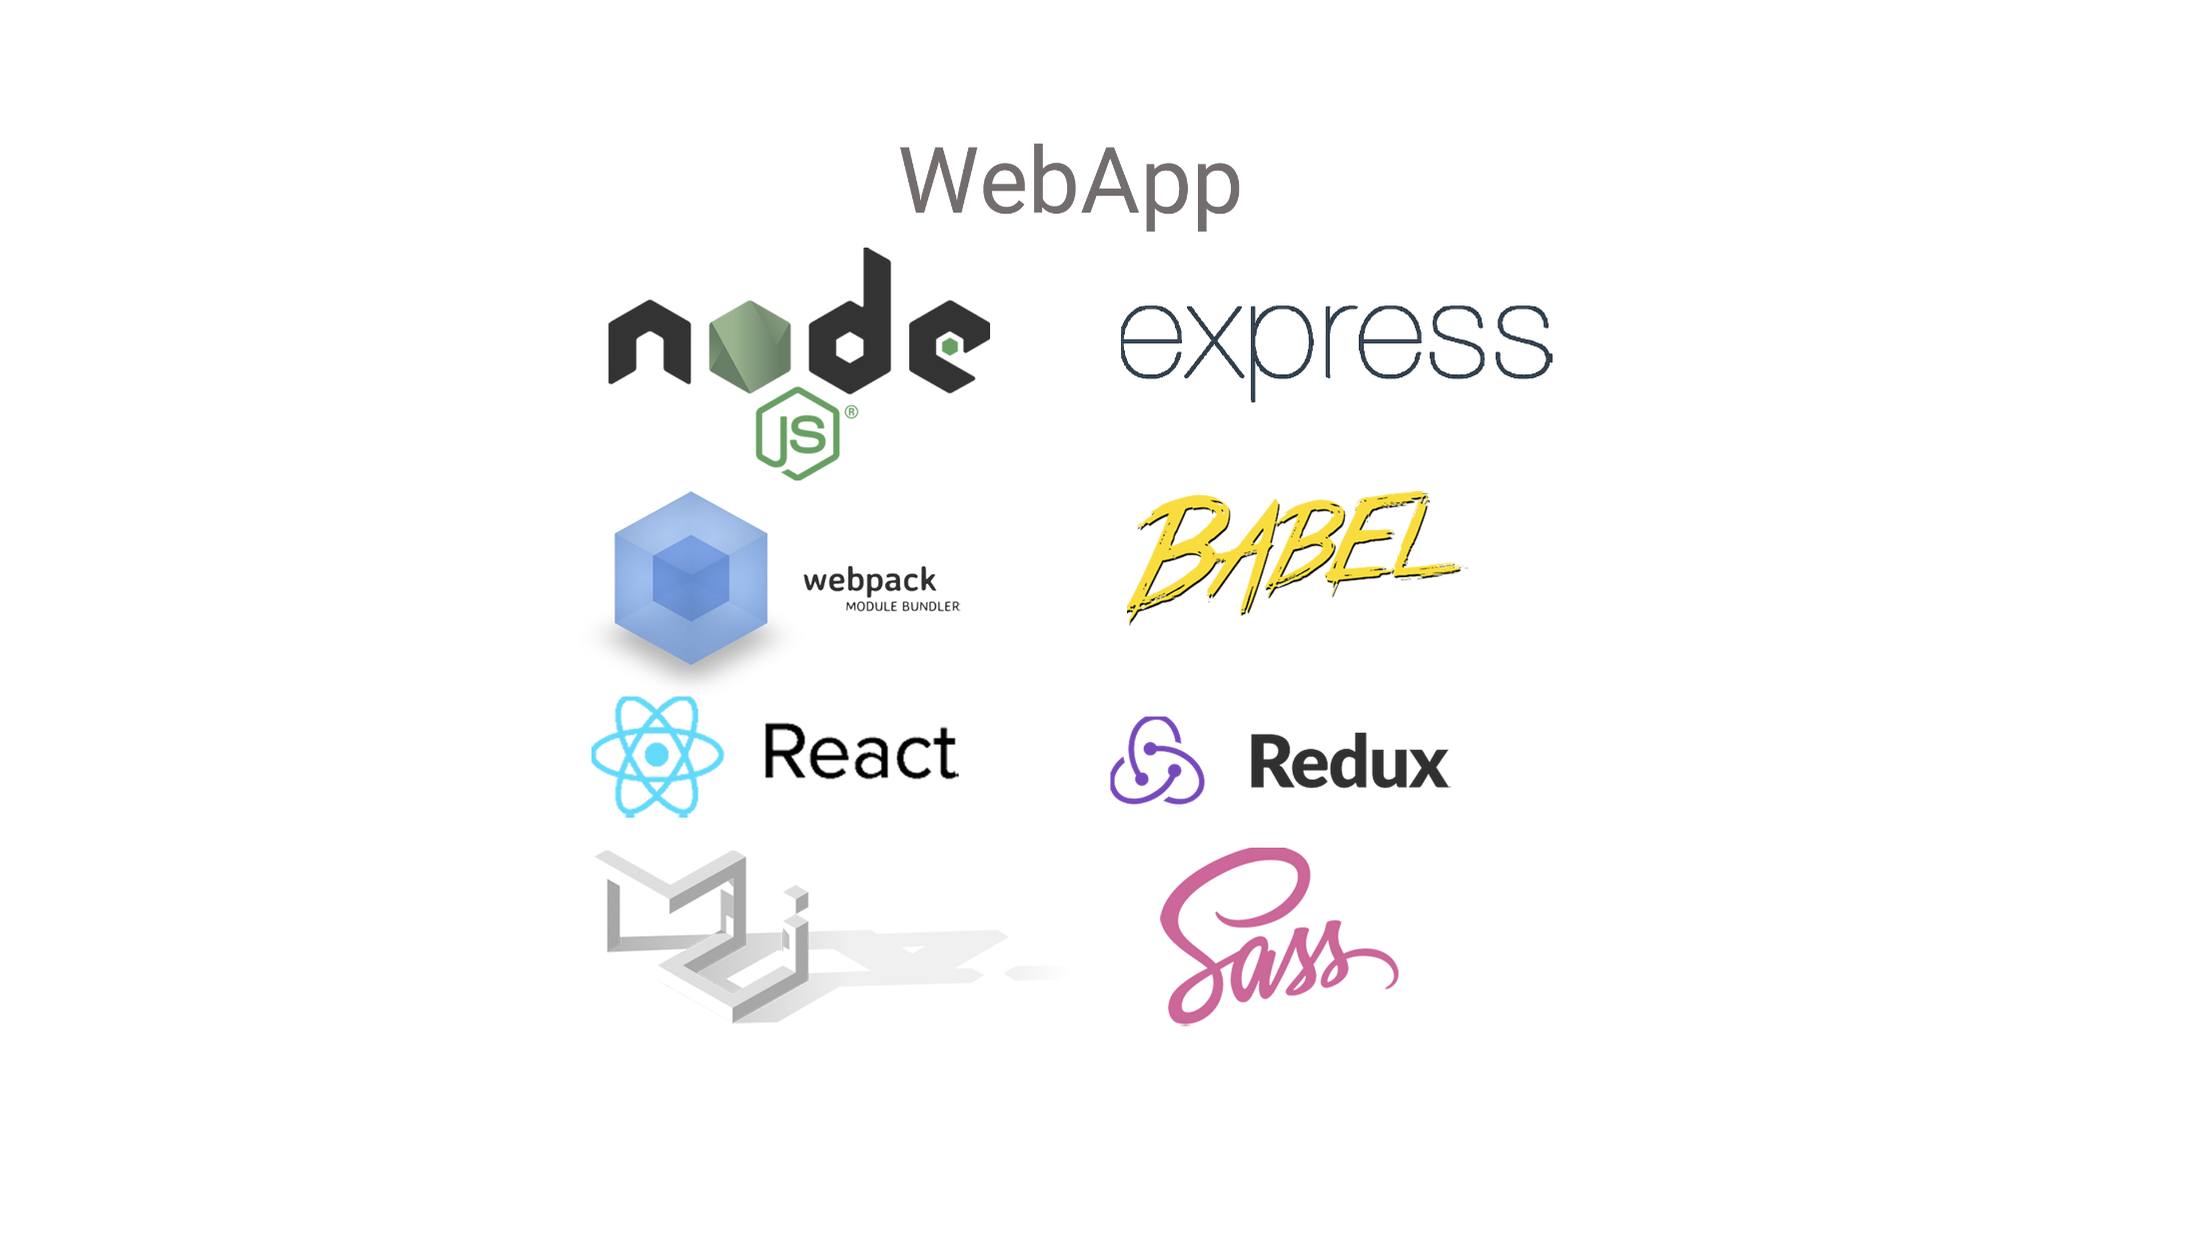

Slide 17


Slide 18
What we have learned

Slide 19
sUMMARY

Slide 20
@AdformTech

