Slide 1
Yu Liu
Client
ETEC 6440
/Qi Yao Educational
Technology
Focus: Tense Application in Writing
Designing for
Grammar Transfer
California State University San Bernardino

Slide 2


The
Performance Gap
Shine Stone.
Learn: Textbook Exposure
Structural
Misalignment
Fail to Apply:
Transfer Failure
Students learn grammar rules via textbook exercises.
Lack of learning outcomes and assessment.
Knowledge does not transfer to authentic writing.
The performance gap reflects a misalignment between instruction, assessment, and desired outcomes rather than mere exposure to content.

Slide 3
Shine Stone.
Learners and Design Constraints
“
Variable Learners
Mixed-grade (grade 2-5)
Beginner to low-intermediate
Driven by K-12 exam performance
Limited Instructional Time
Platform Environment
Curriculum Rules
1.5-2 hours per session
Notion delivery; Segmented & asynchronous
No structured assessment tools natively available.

Slide 4
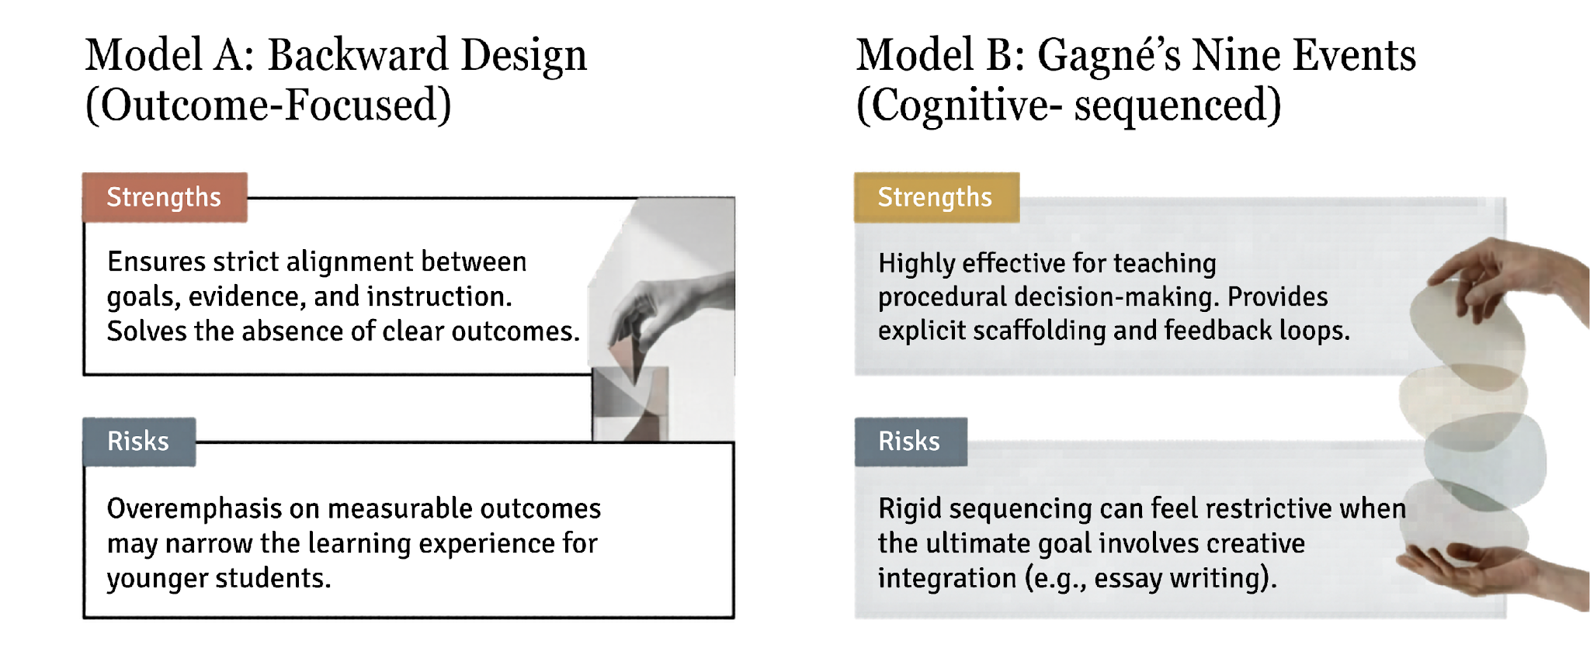
Hybrid Instructional Design Approach
Shine Stone.

Slide 5
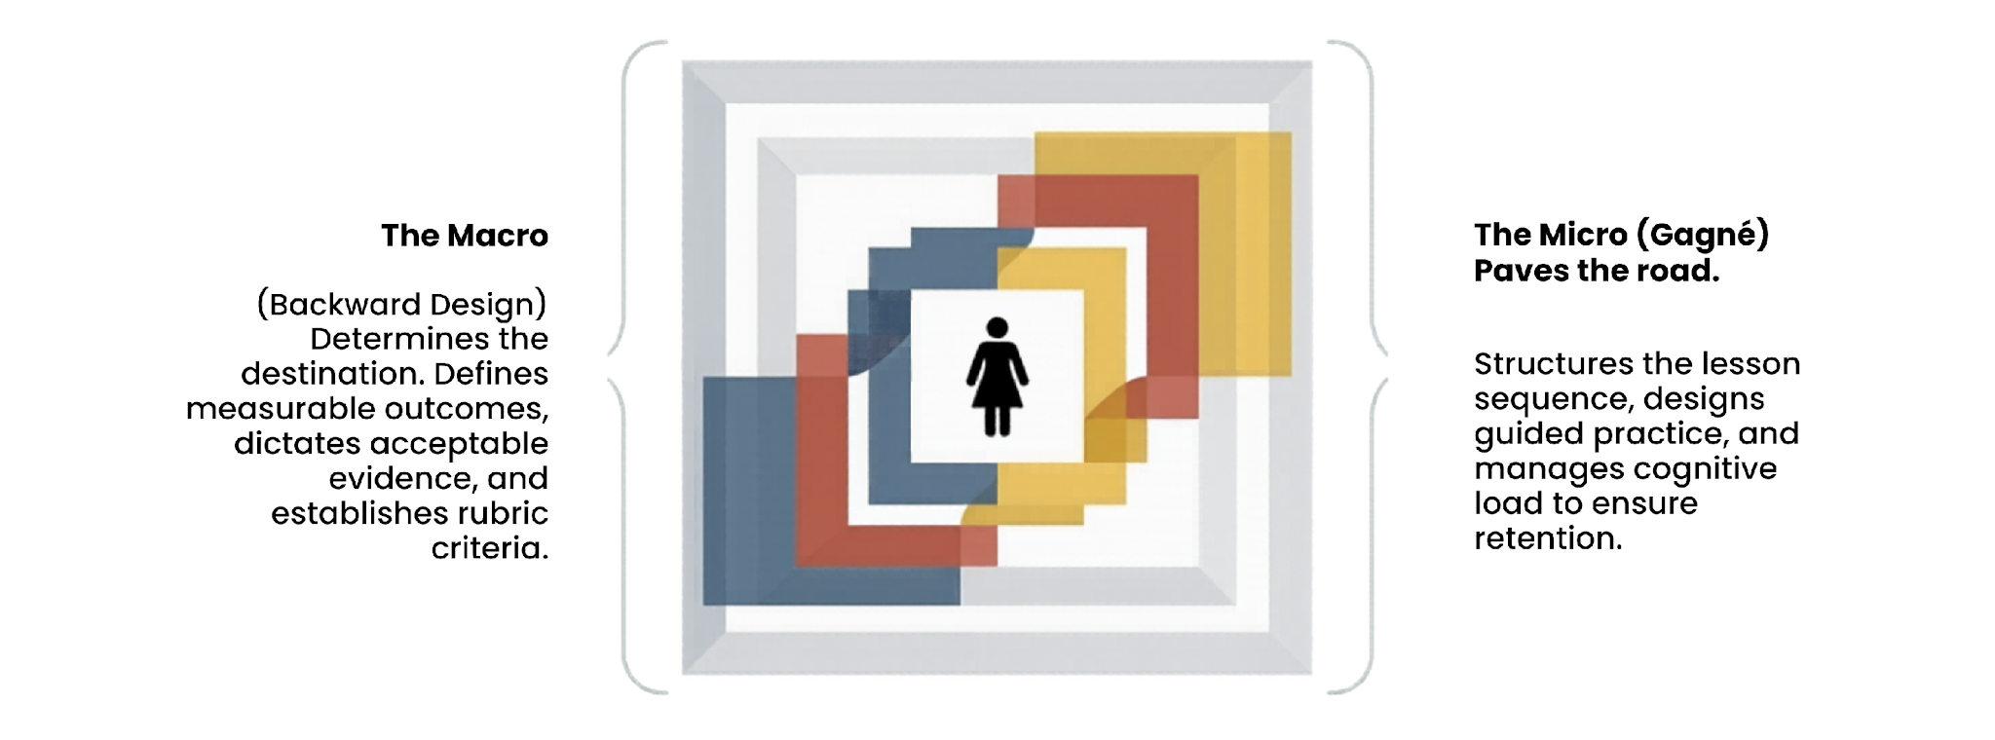
Backward Design (Macro Alignment) + Gagné (Micro Sequencing)
= Aligned Cognitive Scaffold.
Shine Stone.

Slide 6
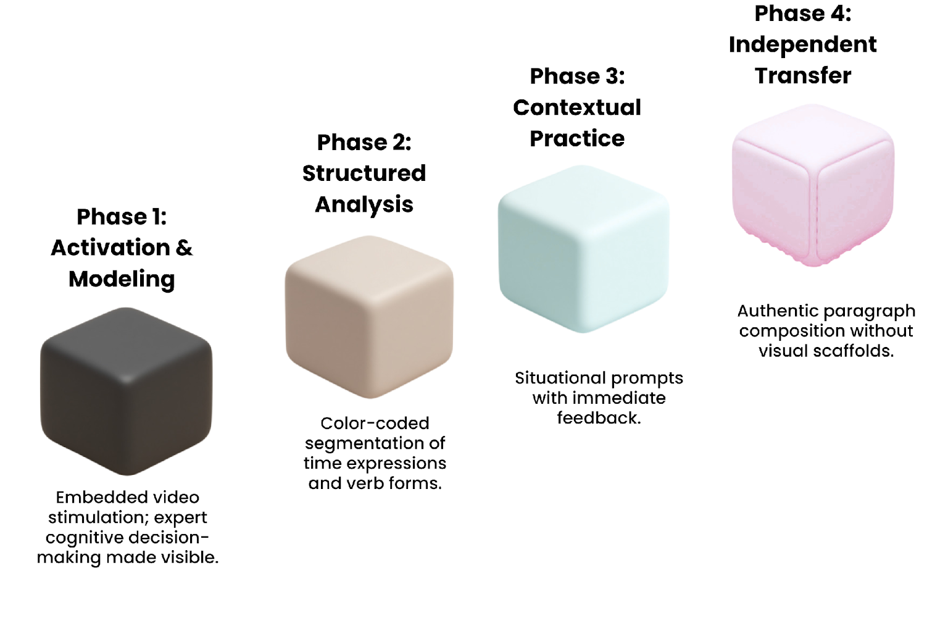
Shine Stone.
The Systematic fading of cognitive scaffolding.
“
Instructional
Flow.

Slide 7

Implementation
Shine Stone.

Slide 8
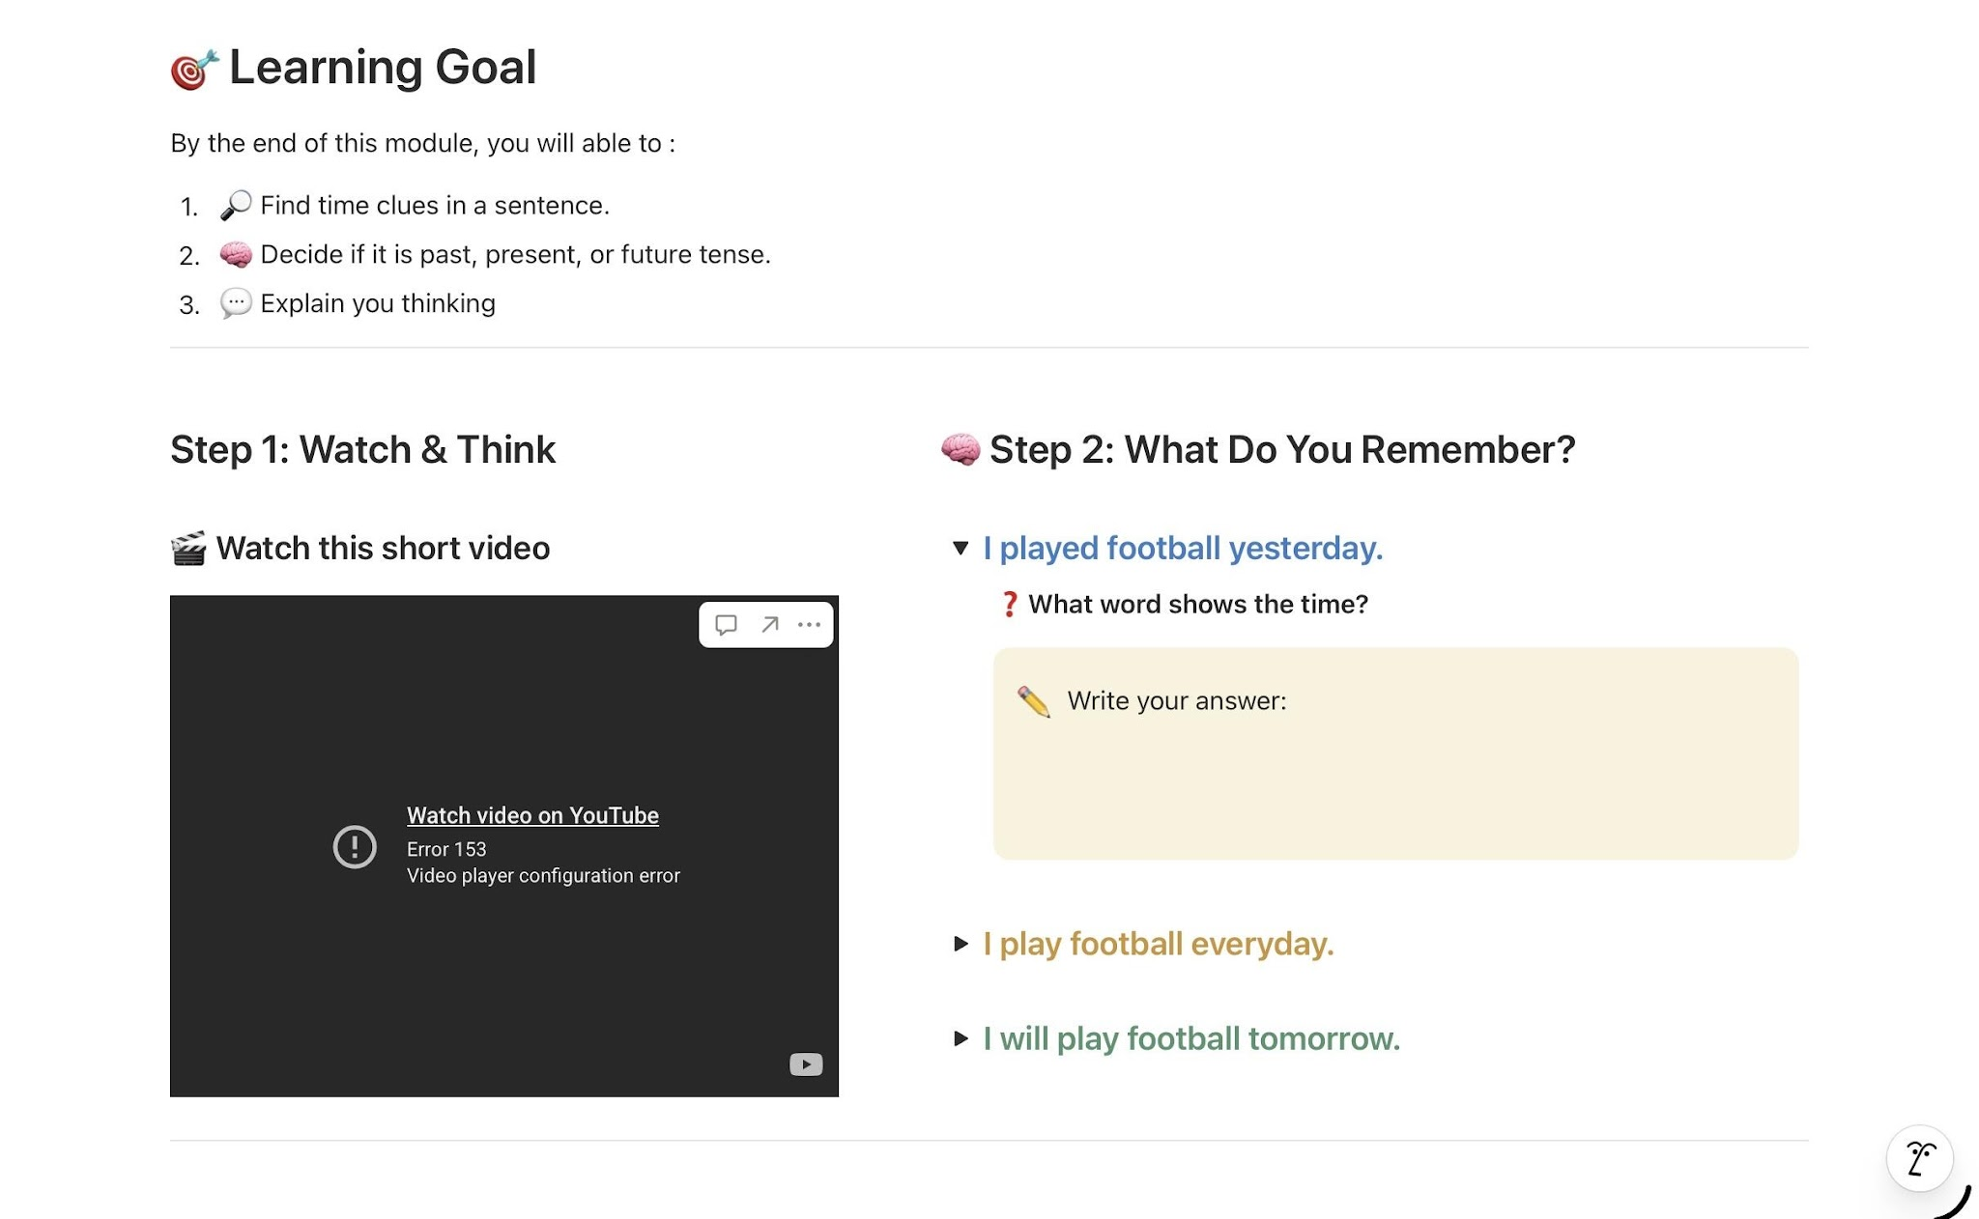
Shine Stone.

Slide 9
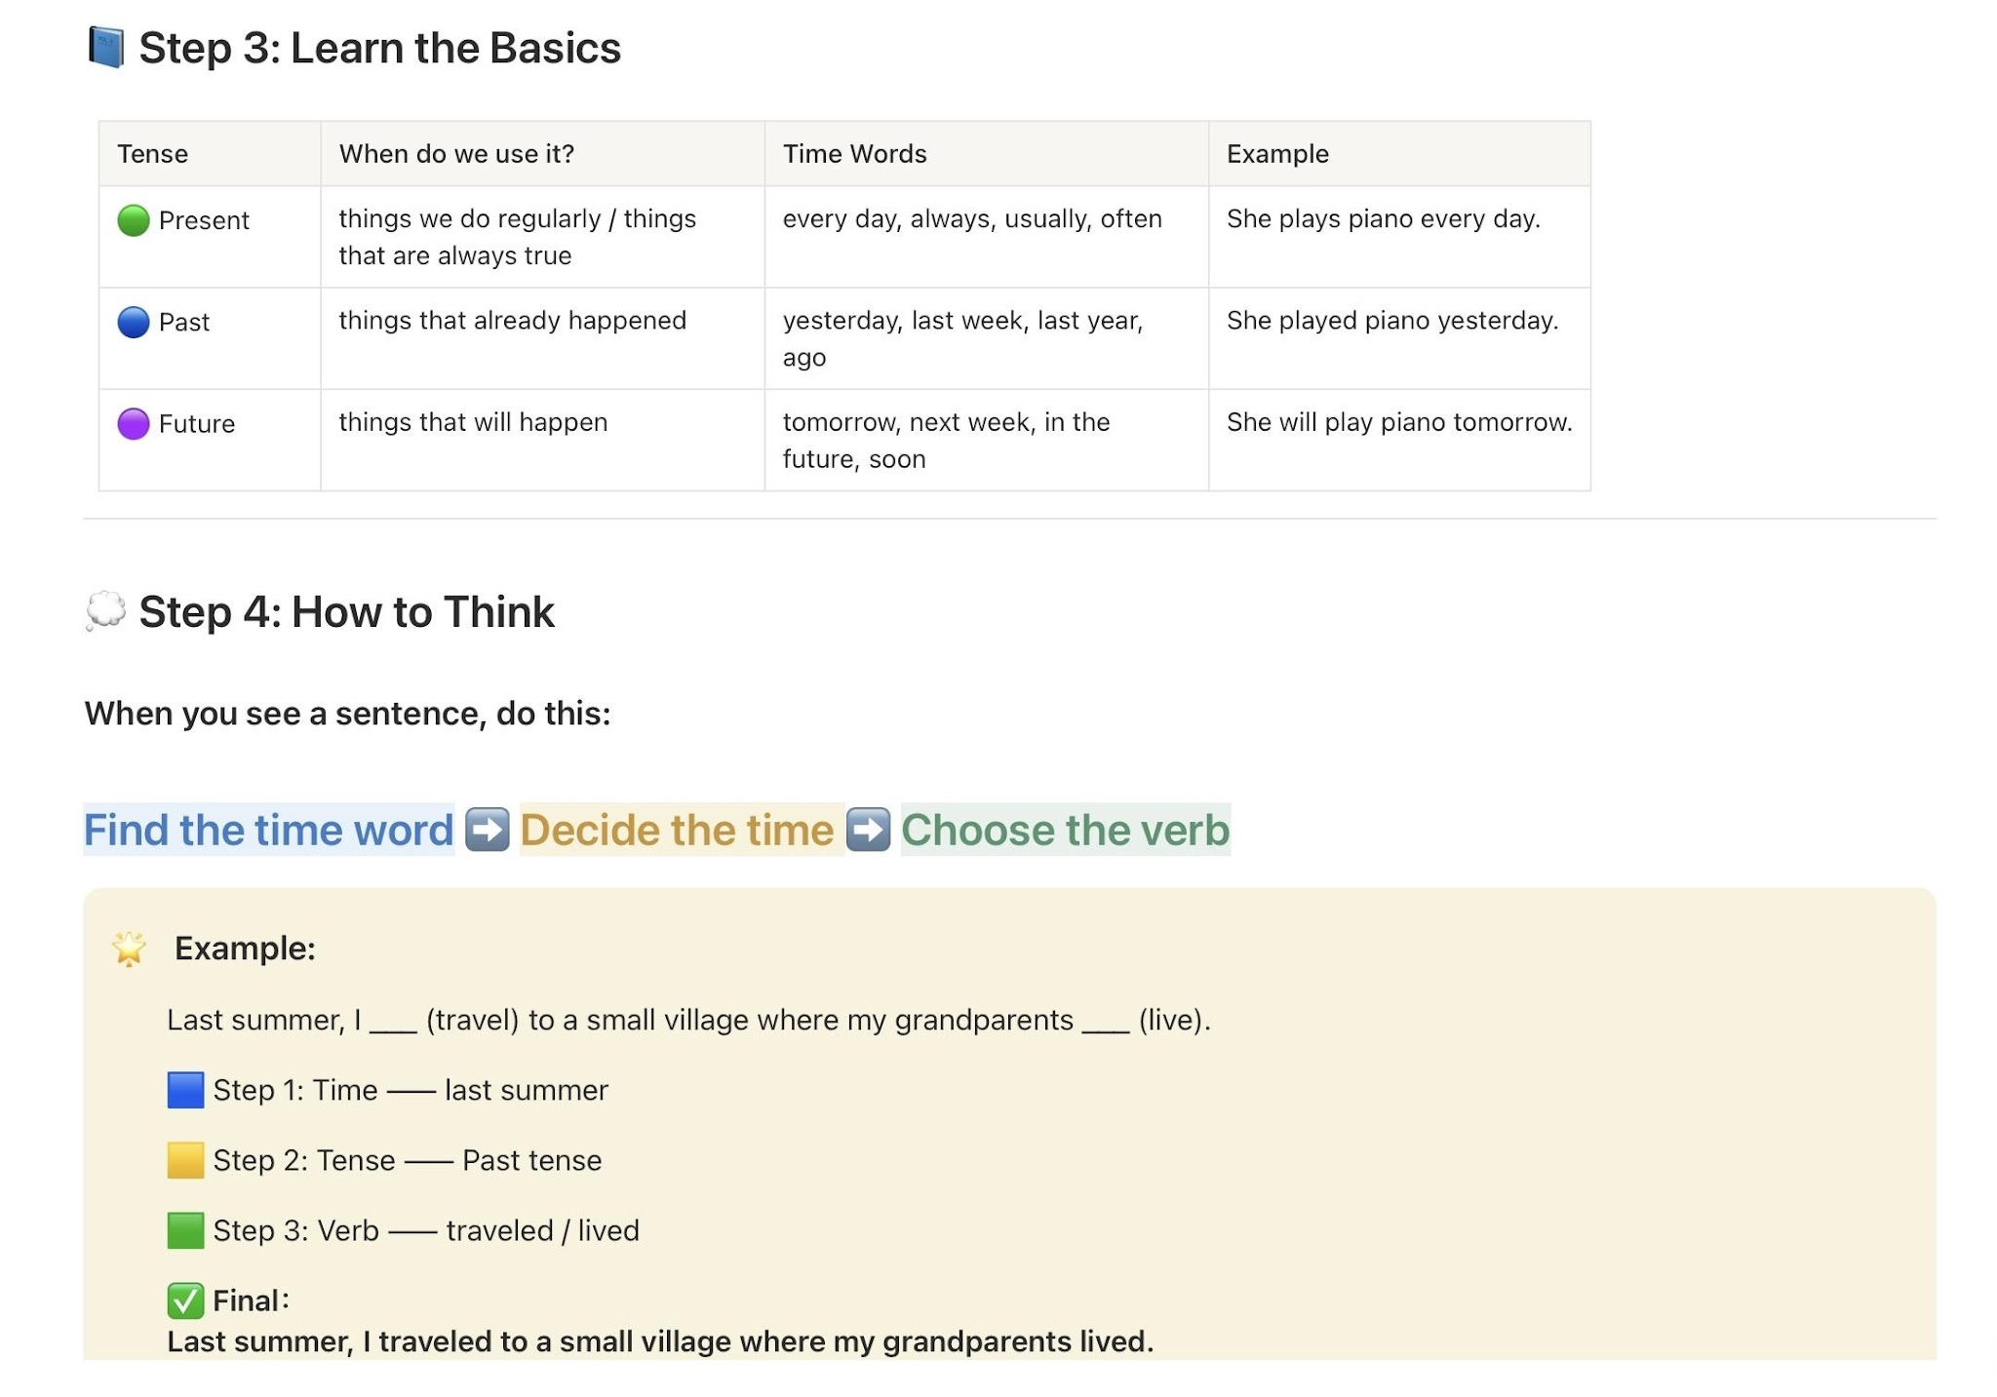
Shine Stone.

Slide 10
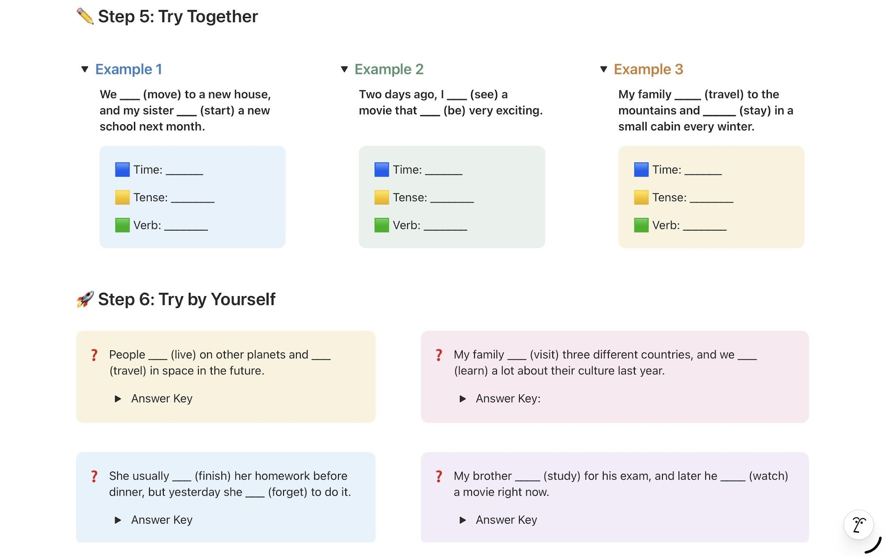
Shine Stone.

Slide 11
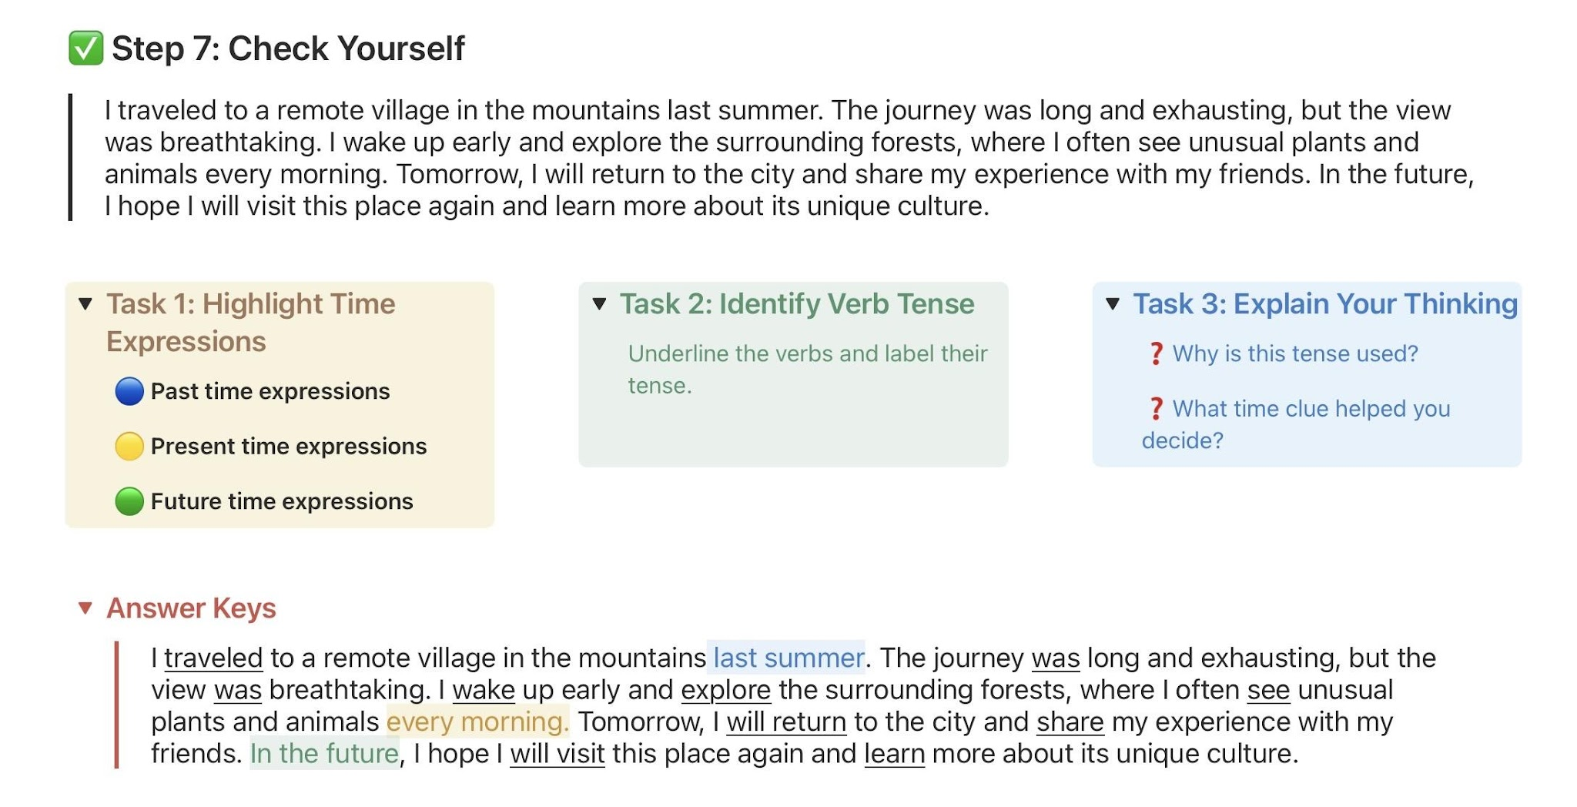
Shine Stone.

