Slide 1
SYS 3034: Group 1 Baseball Case
By: Alice Warner, Caleb Neale, Caton Gayle, Jenny Chun, Rose (Nia) Dennis, Noor Drissi, and Shivani Das
Emails: aw3be@virginia.edu, cmg4ft@virginia.edu, can4ku@virginia.edu, jc6ac@virginia.edu, rad7wgg@virginia.edu, sd5zd@virginia.edu, nd2wgy@virginia.edu
Assignment 1, Due: 2/9/21

Slide 2

Selecting Metrics
External Research Supporting Results:
After conducting data analysis it was apparent to us that runs scored are a key factor in the outcome of baseball games.
To dive deeper, we conducted external research to determine commonly used and strongly supported metrics in this category that we had access to. These metrics were found to be On Base Percentage + Slugging Percentage.
External research also agreed with our data analysis. With this information we decided to focus on On Base Percentage + Slugging percentage, Runs Batted In / At Bats, and Runs Scored/ At Bats.
Primary Metrics:
These 3 metrics heavily contribute to the value players bring to their team, and accordingly influences their contract size.
By selecting players who perform better within those metrics during free agency the Seattle Mariners will increase their total number of wins for the next season

Slide 3
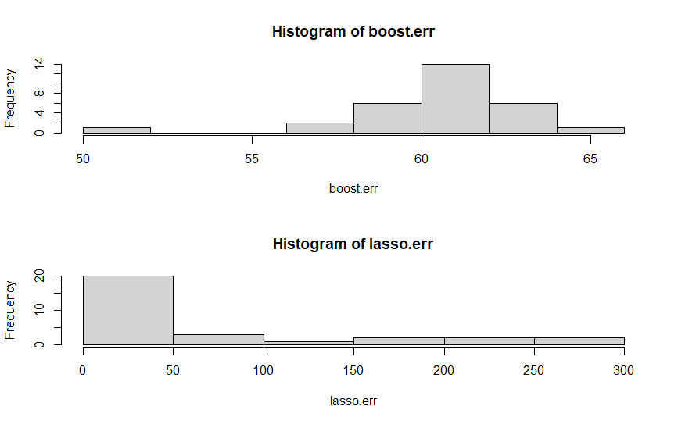
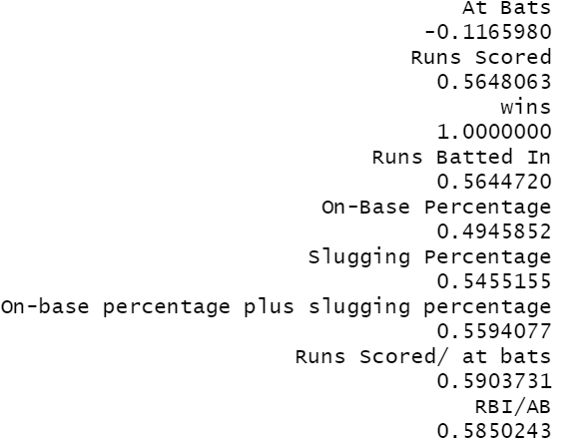
Analysis
Higher spearman values indicate a stronger “more is better” relationship that is not necessarily linear, allowing us to select metrics which most strongly correlate with wins.
Inadequate model performance led us to consider the spearman correlation coefficient, a more flexible, non-parametric approach to quantifying variable relationships.
Chun, Das, Dennis, Drissi, Gayle, Neale, Warner 3

Slide 4
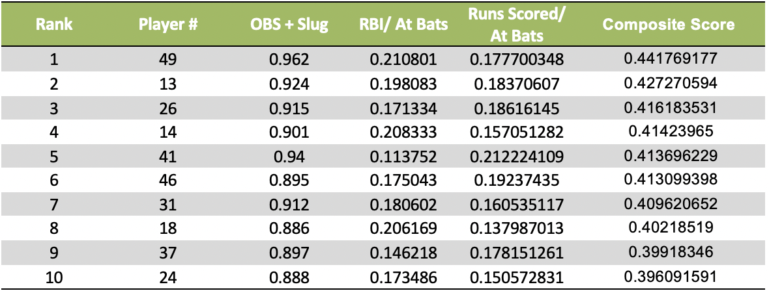
Player Rankings
Methodology
Using Spearman's coefficient the main three indicators were determined to be: Runs Batted In/At Bats, Runs Scored/At Bats, and On-Base Percentage + Slugging Percentage
Weights were determined for these individual indicators by dividing each Spearman coefficient by the sum of all three Spearman coefficients
Then a composite score was calculated for each player by adding the weighted scores together
Results

Slide 5
Draft Strategy
In order to make player draft picks different metrics were considered.
Player Ranking:
This metric is based on the composite score determined by the methodology used to rank players
Value for Money Determination:
This metric is a ratio of the composite score from the methodology used to rank players and the cost of each player (composite score / cost)
Keeping Minimum Budget:
It was decided that a minimum of $10 million would be reserved for the final two drafts in order to ensure that the budget can be optimized
As a result, despite a player’s high composite score, their cost ratio would also be considered to maintain the minimum budget for the final drafts

