Slide 1
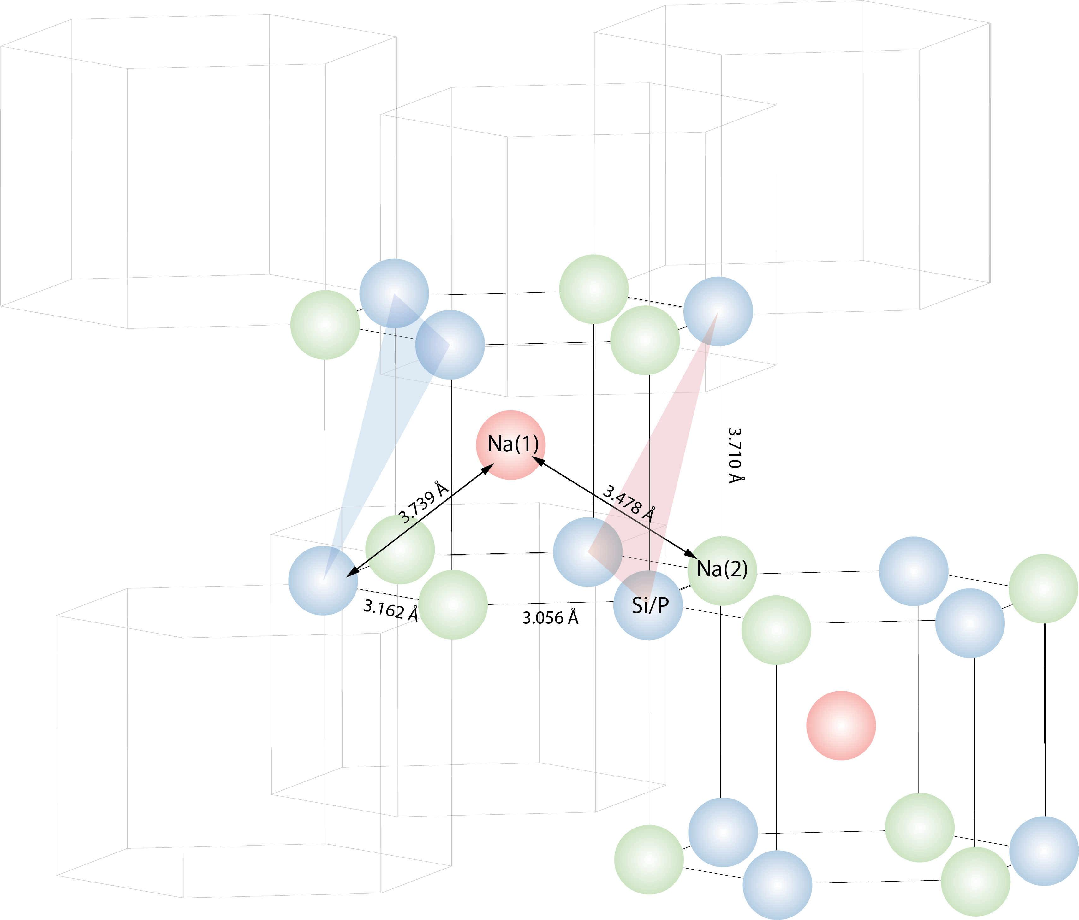
3
polyhedron[4]
polyhedron[6]
polyhedron[5]
1
6
2
5
3
4
DiffusionUnit[0]
12
11
10
12
7
13
8
9
14
15
22
polyhedron[2]
21
20
polyhedron[3]
16
polyhedron[1]
19
17
18

Slide 2
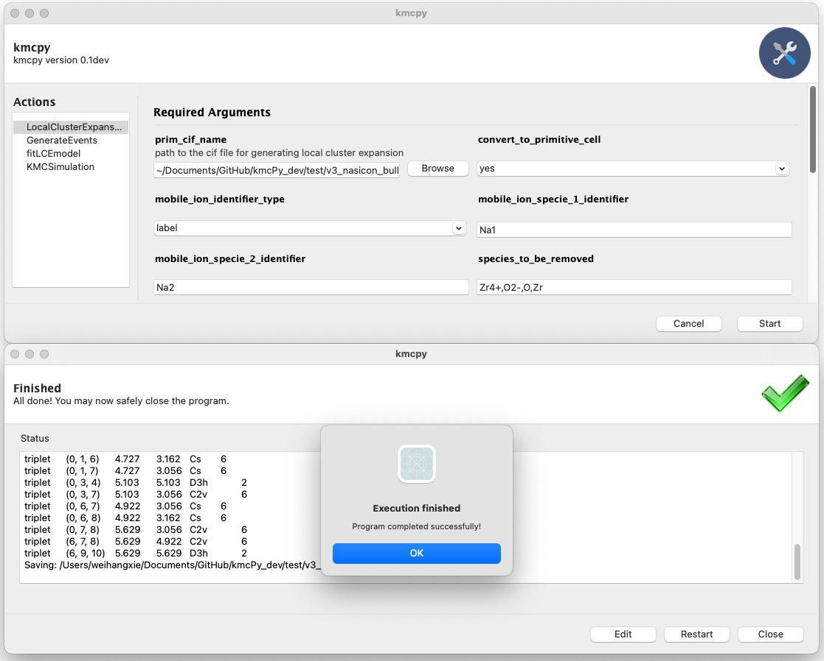
2
1
a
3
b
4

Slide 3
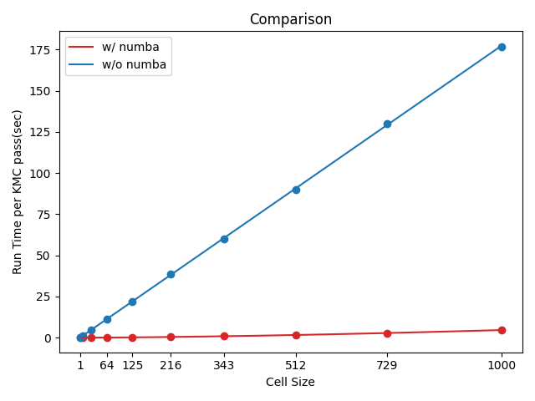
176.89
90.12
1.62
4.68

