Slide 1
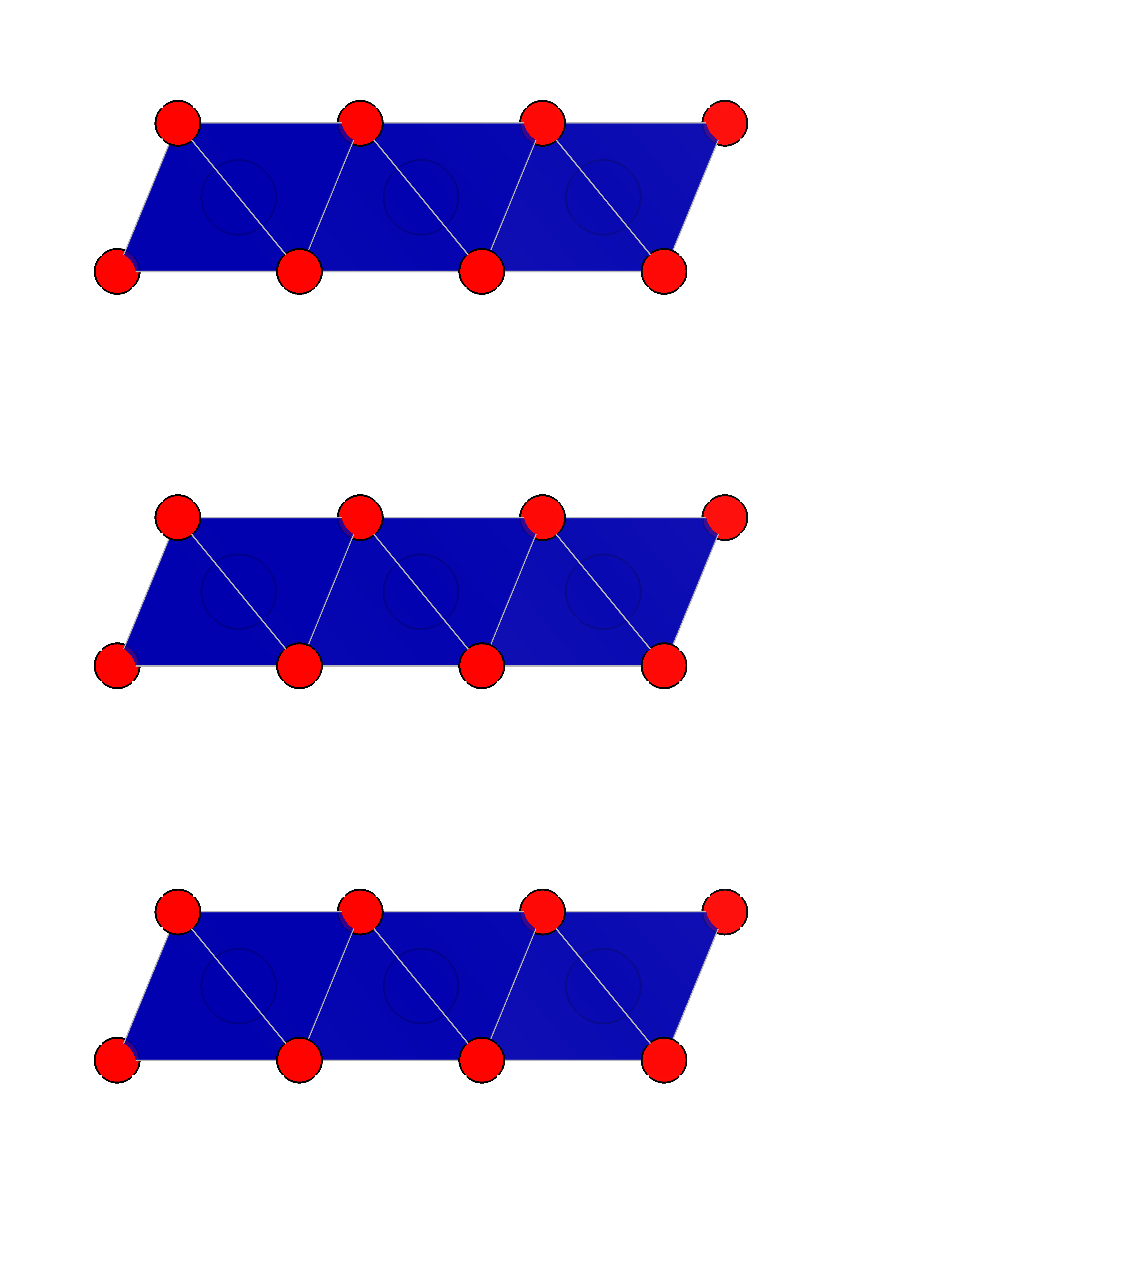
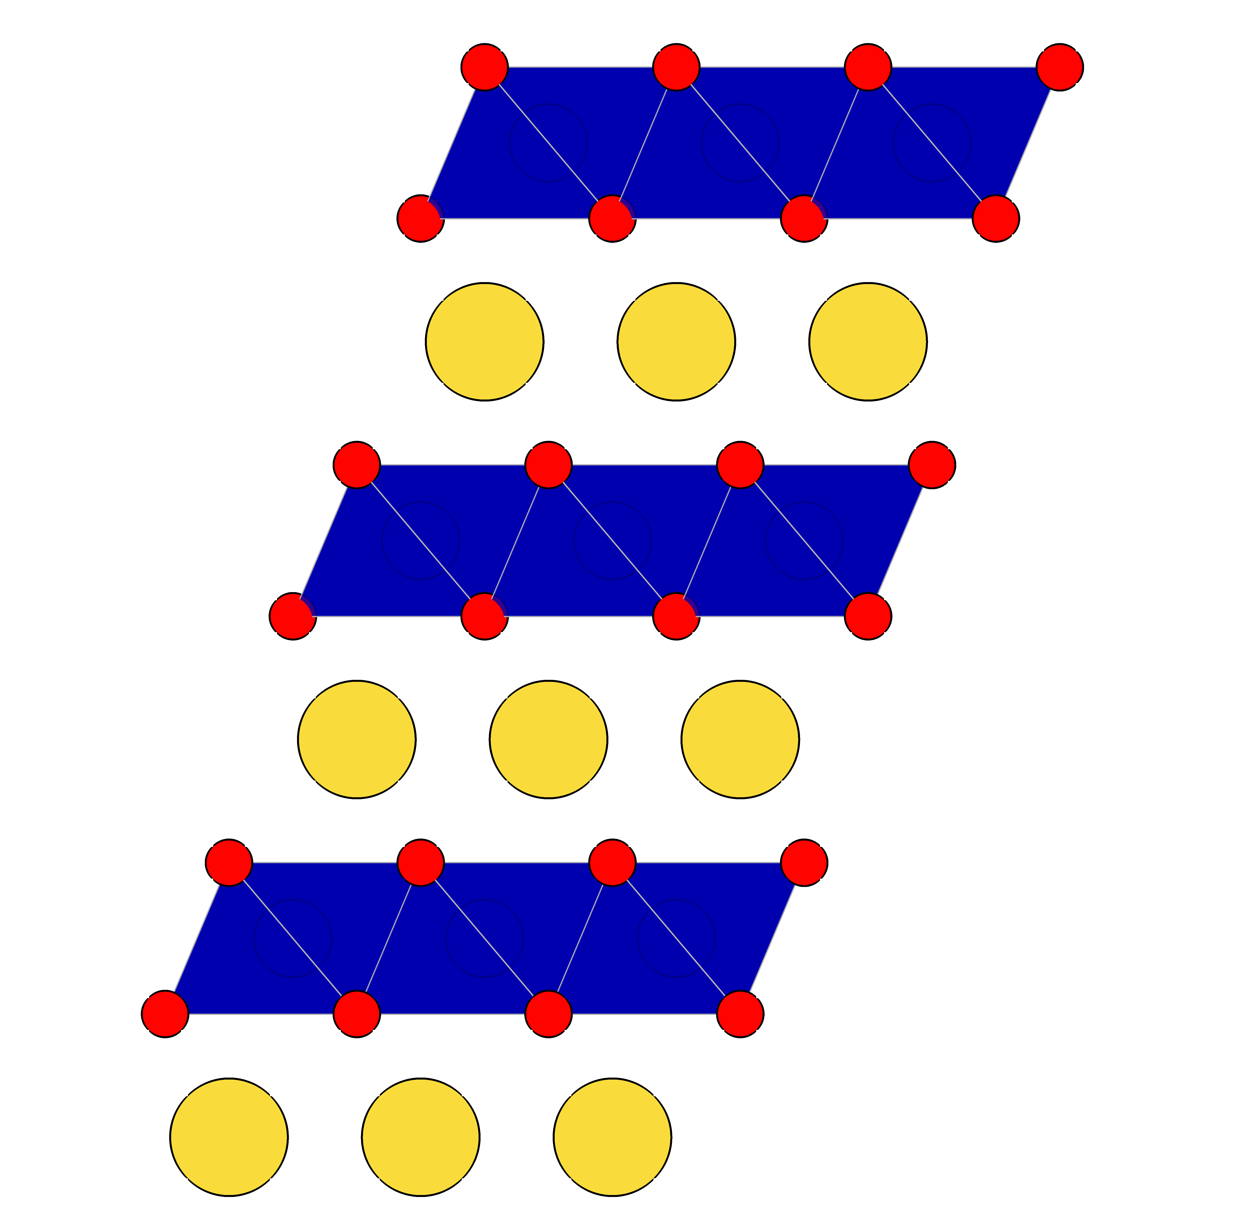
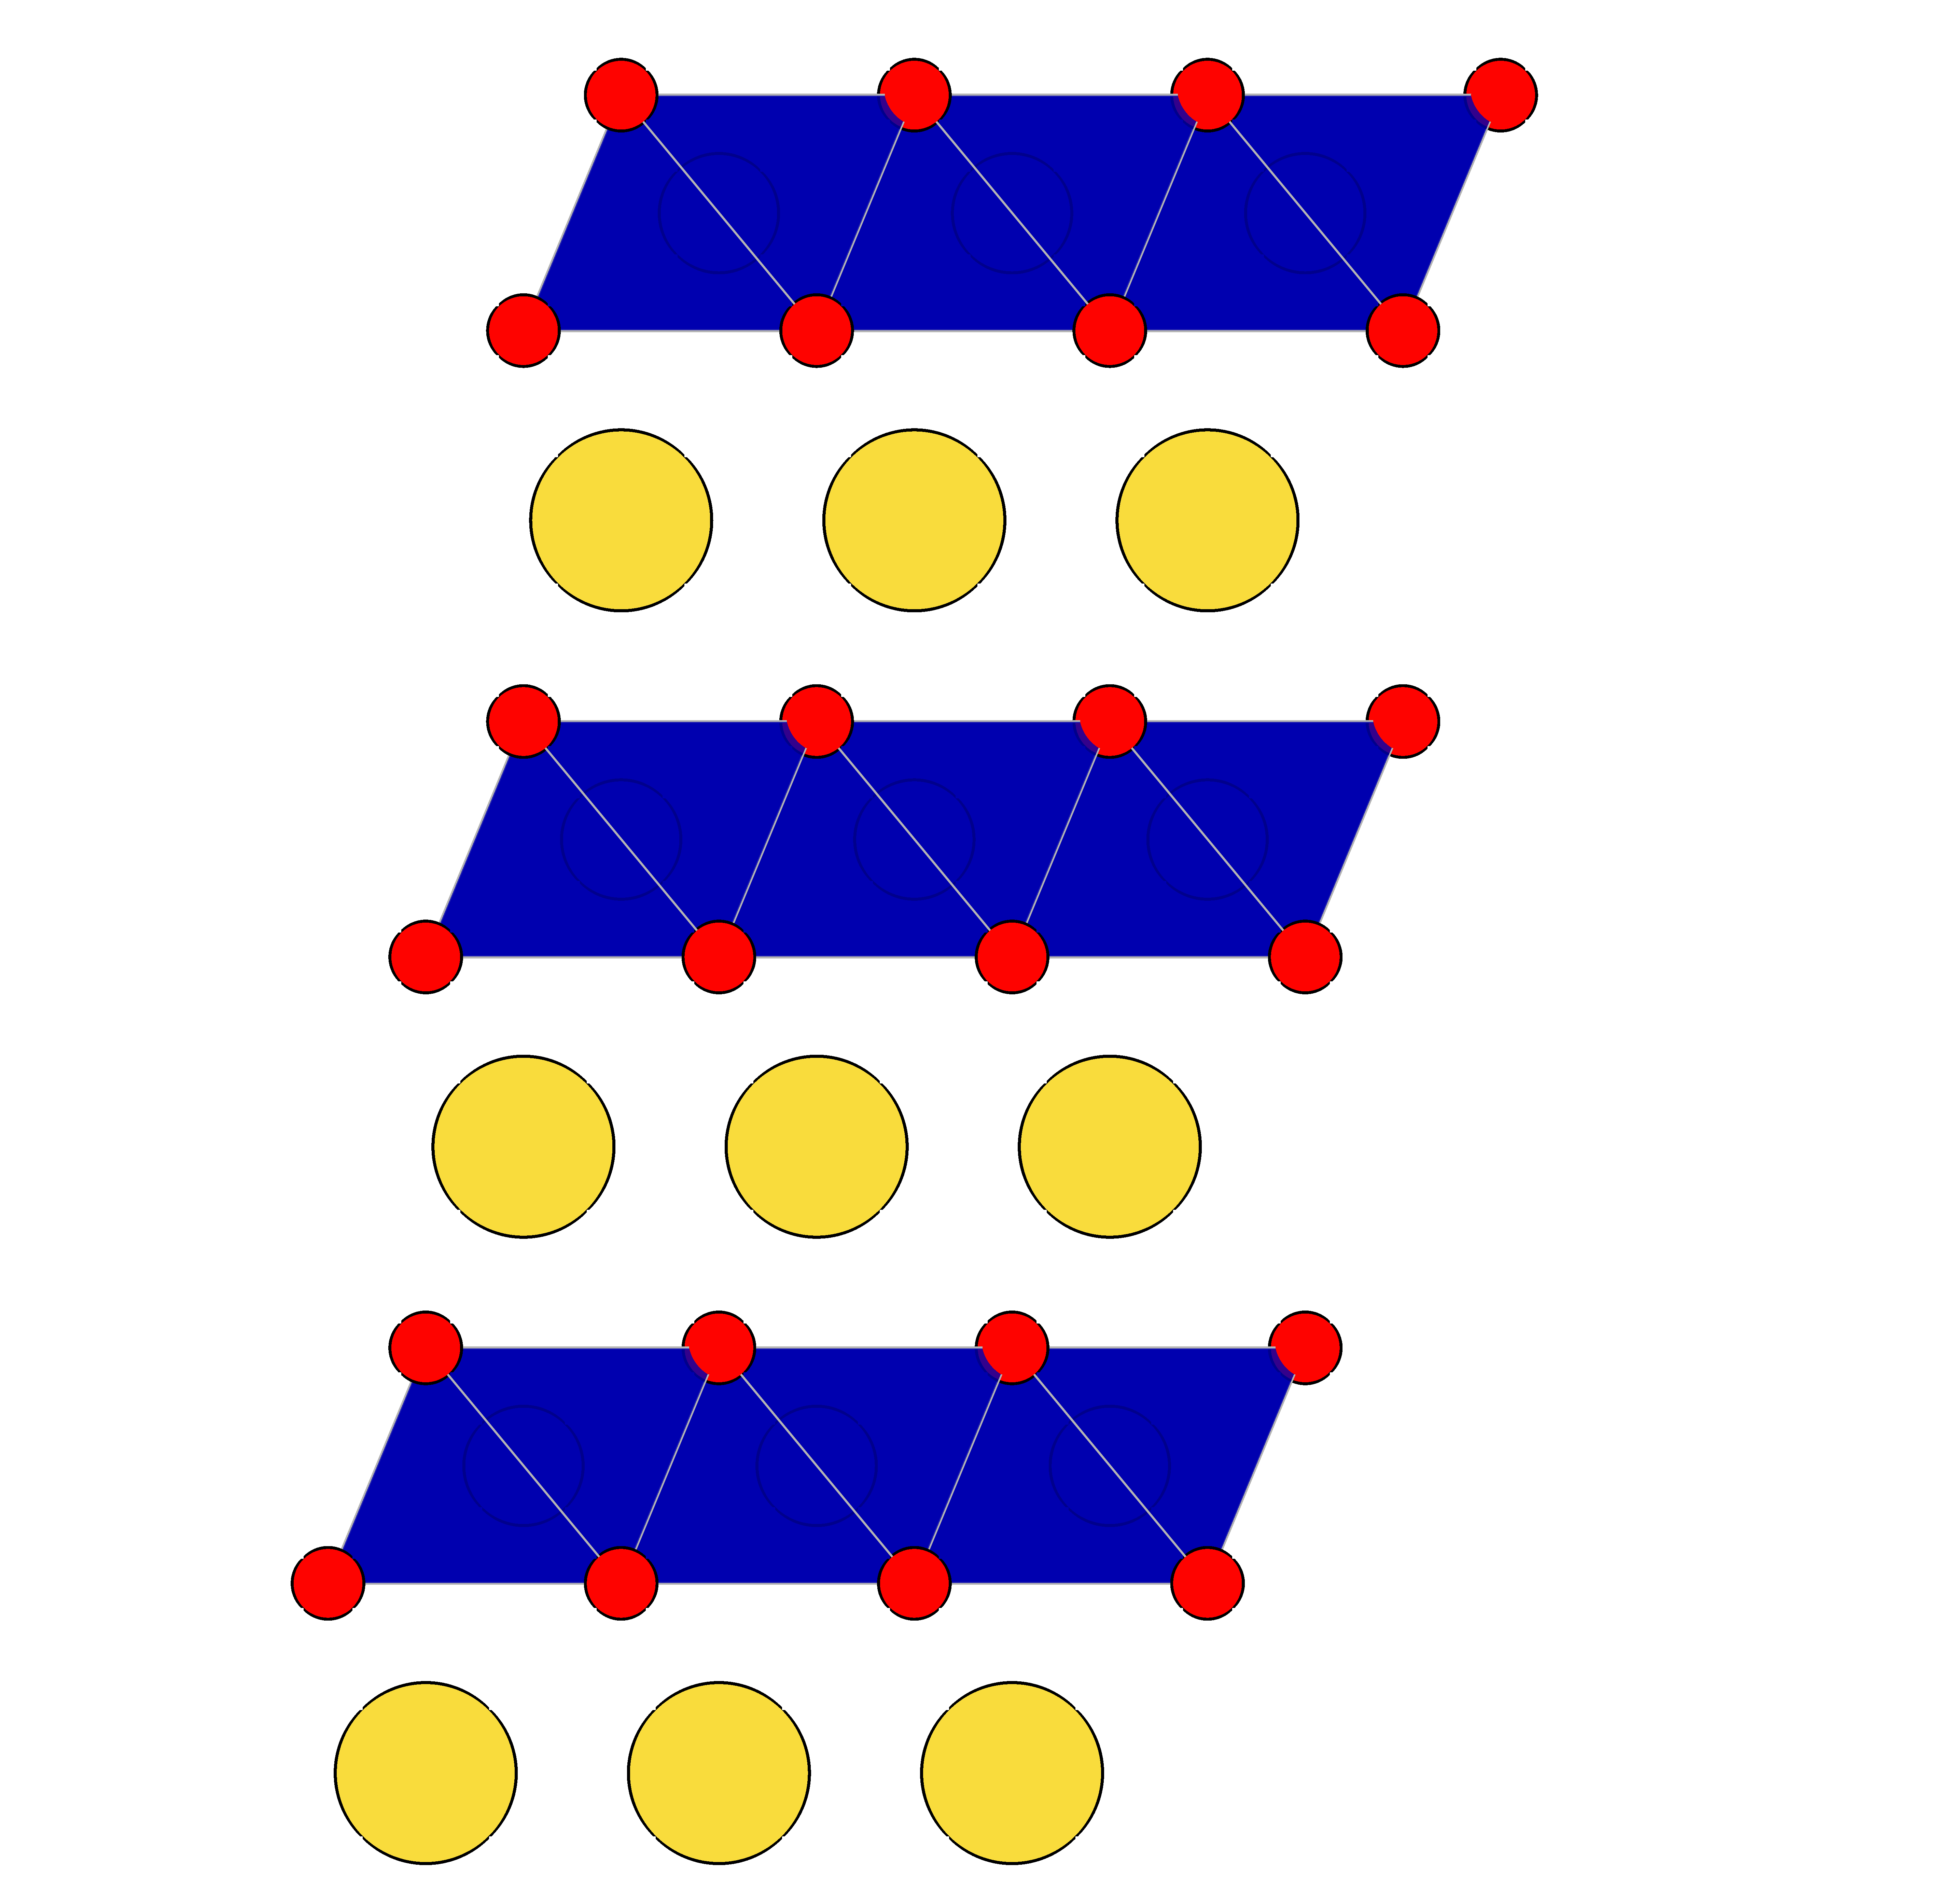
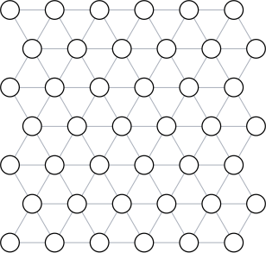
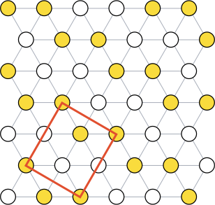
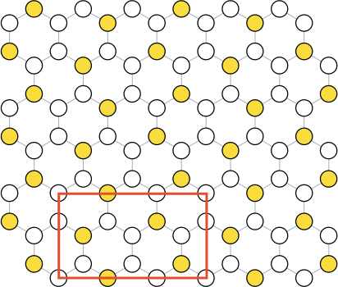
(a)
O1
(b)
O3
(c)
P3
A
TMO₂ layer
A
TMO₂ layer
A
TMO₂ layer
B
Octahedral
Na Site
(two shared face)
B
Octahedral
Na Site
(no shared face)
B
Prismatic
Na Site
(one shared face)
A
C
B
B
A
C
d(O-Na-O)
d(O-Na-O)
d(O-Na-O)
A
d(O-TM-O)
B
d(O-TM-O)
C
d(O-TM-O)
B
C
A
Triangular Na network
Triangular Na network
Honeycomb Na network

