Slide 1
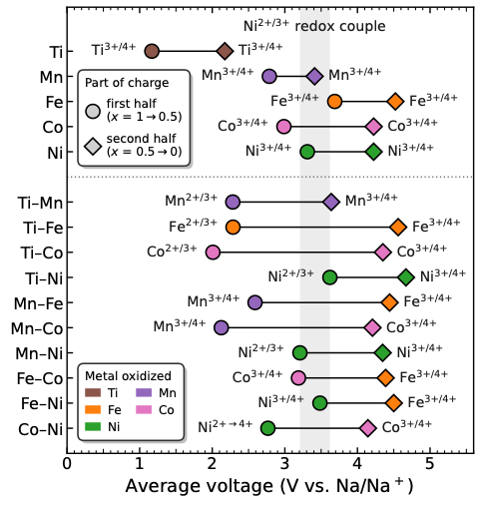
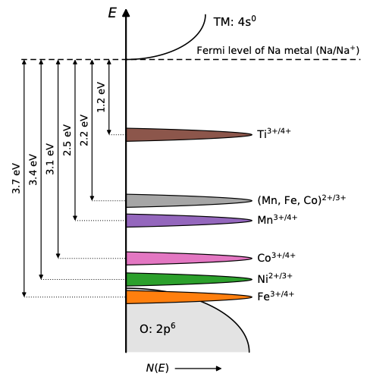
(a)
(b)

Slide 2
E
4s⁰
Na/Na⁺ Fermi energy
1.2 eV
2.4eV
Ti^{3+/4+}
3.1 eV
(Mn, Fe, Co)^{2+/3+}
3.3 eV
Mn^{3+/4+}
3.7 eV
Co^{3+/4+}
Ni^{2+/3+}
Fe^{3+/4+}
O: 2p⁶

Slide 3
E
TM: 4s⁰
Fermi level of Na metal (Na/Na⁺)
1.2 eV
2.2 eV
Ti^{3+/4+}
2.5 eV
3.1 eV
3.4 eV
3.7 eV
(Mn, Fe, Co)^{2+/3+}
Mn^{3+/4+}
Co^{3+/4+}
Ni^{2+/3+}
Fe^{3+/4+}
O: 2p⁶
N(E)

