Slide 1
Agricultural yield estimation with spatial smoothing
Caner Erdem

Slide 2
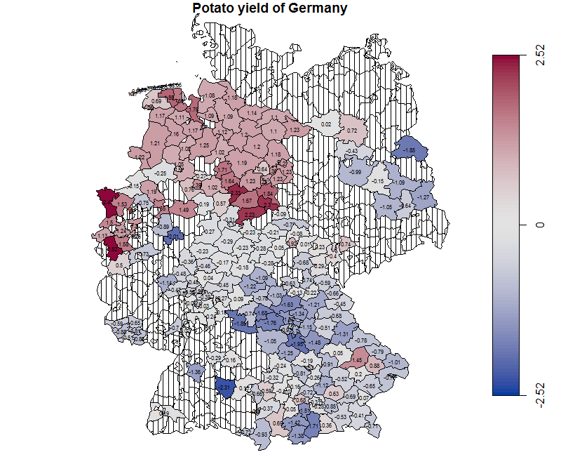
Goal
Spatial smoothing
Markov random field
Penalized least square criterion
One dependent variable and one covariate

Slide 3
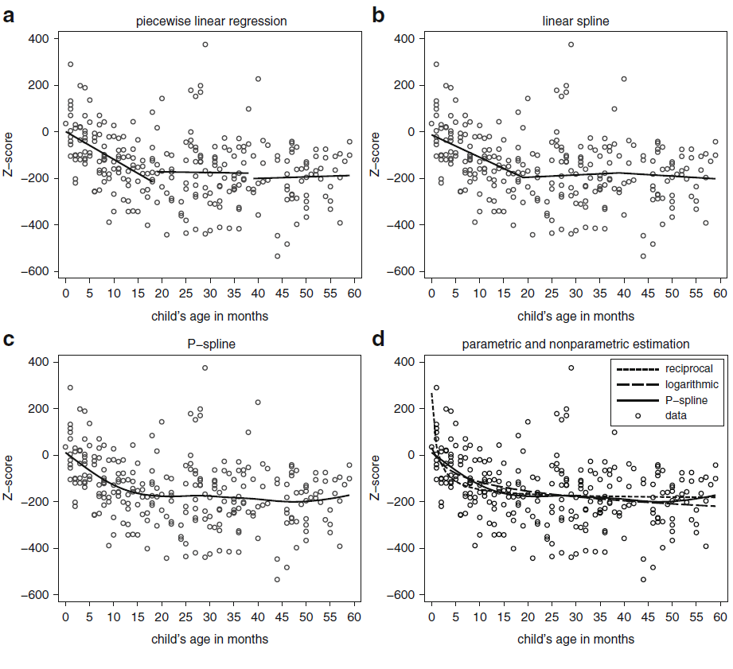
Background - 1
Nonparametric regression
Nonlinear effects
Difficult to fit parametric models
Data-driven & flexible
Exploratory data analysis
Source: Fahrmeir et al., 2013

Slide 4
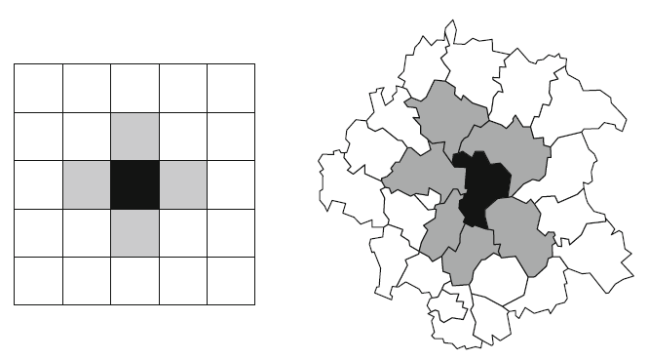
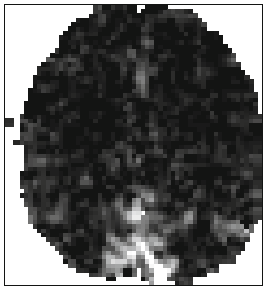
Background - 2
Spatial smoothing
Nonparm. method
Continuous location variables: geographic coordinates
Discrete spatial units: regions or grid
Sometimes overlap: human brain mapping
Euclidean distance vs. neighborhood
Source: Fahrmeir et al., 2013

Slide 5
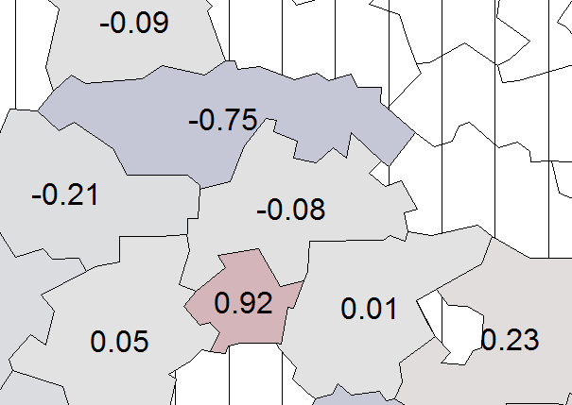
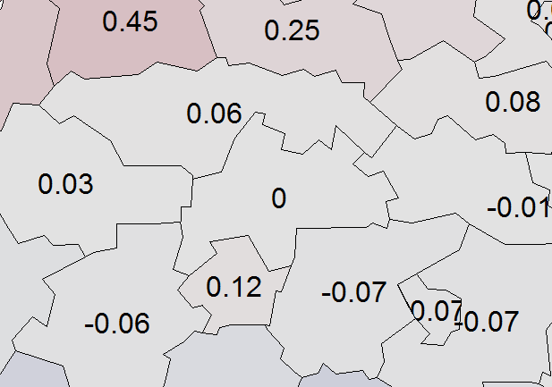
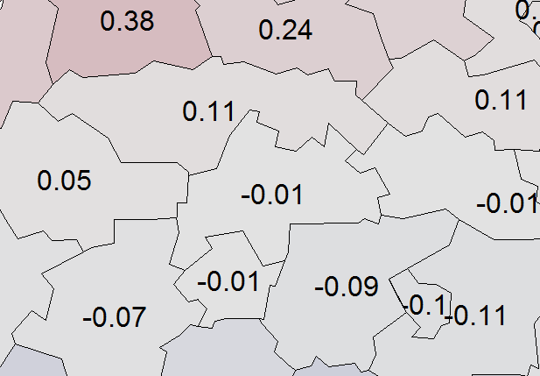
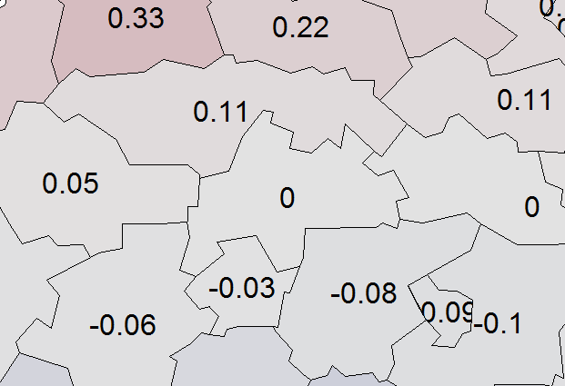





Background - 3
Markov random field
Relationship between regions: neighborhood
A graph $G=(V,E)$
$V=\{1,2,…,d\}$ associated with $γ_{s}$ for $s=1,…,d$
Neighborhood of $s$ is $N_{s}$, $r∈N_{s}$ $⇔$ $(s,r)∈E$
The property: $p\left(γ_{s} \right| {\{γ_{r}\}}_{r∈V\backslash s})=p\left(γ_{s} \right| {\{γ_{r}\}}_{r∈N_{s}})$
Information transfer through local connections
$$λ=0$$
$$λ=1$$
$$λ=3$$
$$λ=5$$
Sömmerda

Slide 6
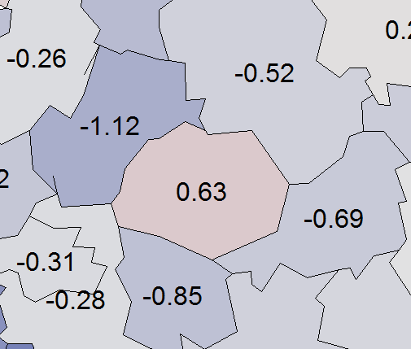
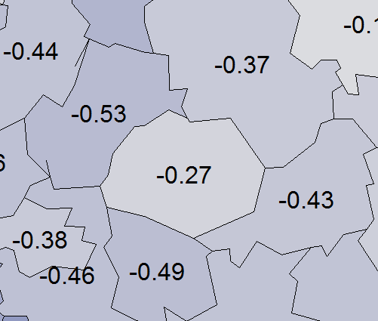
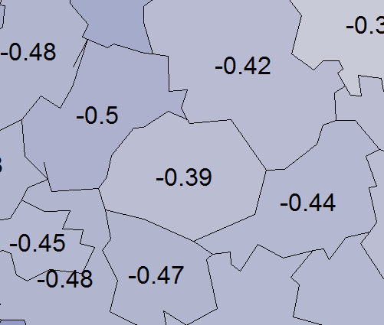
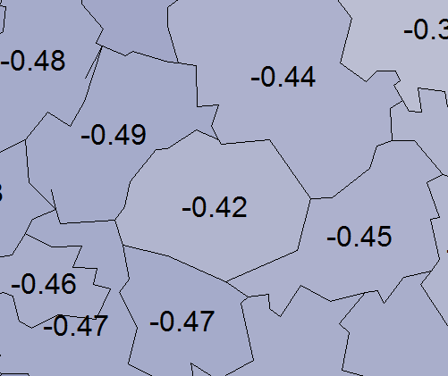





Background - 4
Penalized least square (PLS)
$s \sim r$ denotes region $s$ and $r$ are neighbors
Regression coeff. $f_{geo}\left(s\right)=γ_{s}$, $s=1,2,…,d$
PLS criterion:
$\sum_{i=1}^{n}{{(y_{i}−f_{geo}(s_{i}))}^{2}+λ\sum_{s=2}^{d}{\sum_{r∈N\left(s\right),r<s}{{(γ_{r}−γ_{s})}^{2}}}}$
Penalty term discourages large deviations in regression coefficients of nearby regions
$$λ=0$$
$$λ=1$$
$$λ=3$$
$$λ=5$$
Erding

Slide 7
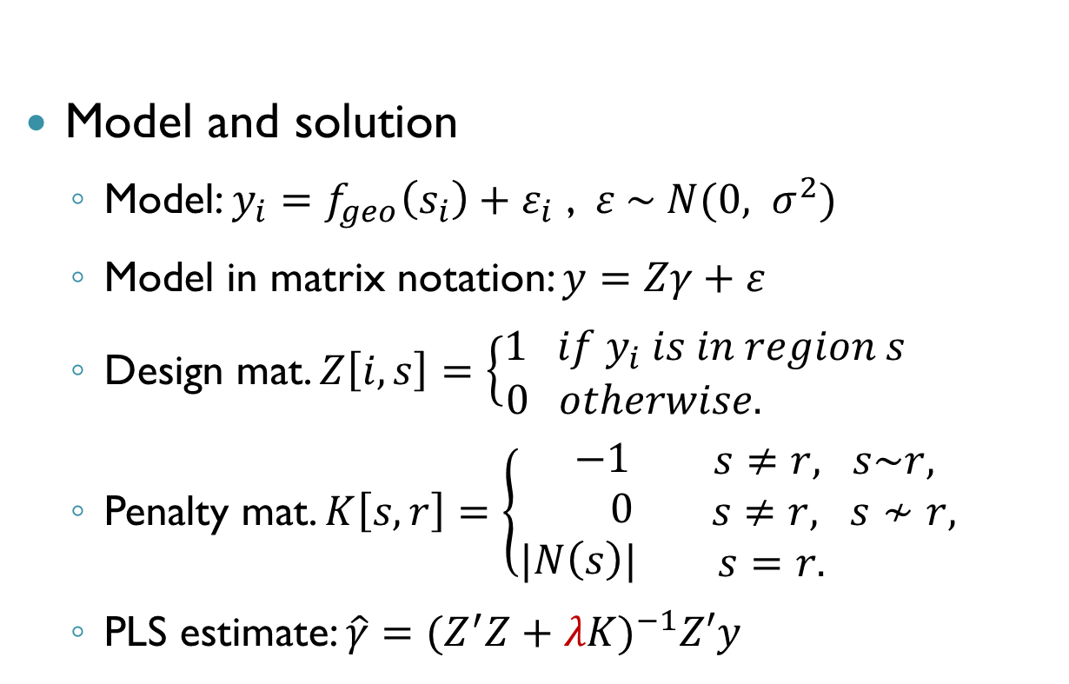
Background - 5
> GermanyGraph[5:10,5:10]
 | 1051 | 1053 | 1054 | 1055 | 1056 | 1057
1051 | 4 | 0 | -1 | 0 | 0 | 0
1053 | 0 | 7 | 0 | 0 | 0 | 0
1054 | -1 | 0 | 2 | 0 | 0 | 0
1055 | 0 | 0 | 0 | 4 | 0 | -1
1056 | 0 | 0 | 0 | 0 | 4 | 0
1057 | 0 | 0 | 0 | -1 | 0 | 5
Model and solution
Model: $y_{i}=f_{geo}\left(s_{i}\right)+ε_{i}$ , $ε \sim N(0, σ^{2})$
Model in matrix notation: $y=Zγ+ε$
Design mat. $Z\left[i,s\right]=\left\{\begin{aligned}1 if y_{i} is in region s \\ 0 otherwise. \end{aligned}\right.$
Penalty mat. $K\left[s,r\right]=\left\{\begin{aligned} −1 \\ 0 \\ |N\left(s\right)|\end{aligned}\right.\begin{matrix} s≠r, s\sim r, \\ s≠r, s≁r, \\ s=r. \end{matrix}$
PLS estimate: $\hat{γ}={(Z^{′}Z+λK)}^{−1}Z′y$

Slide 8

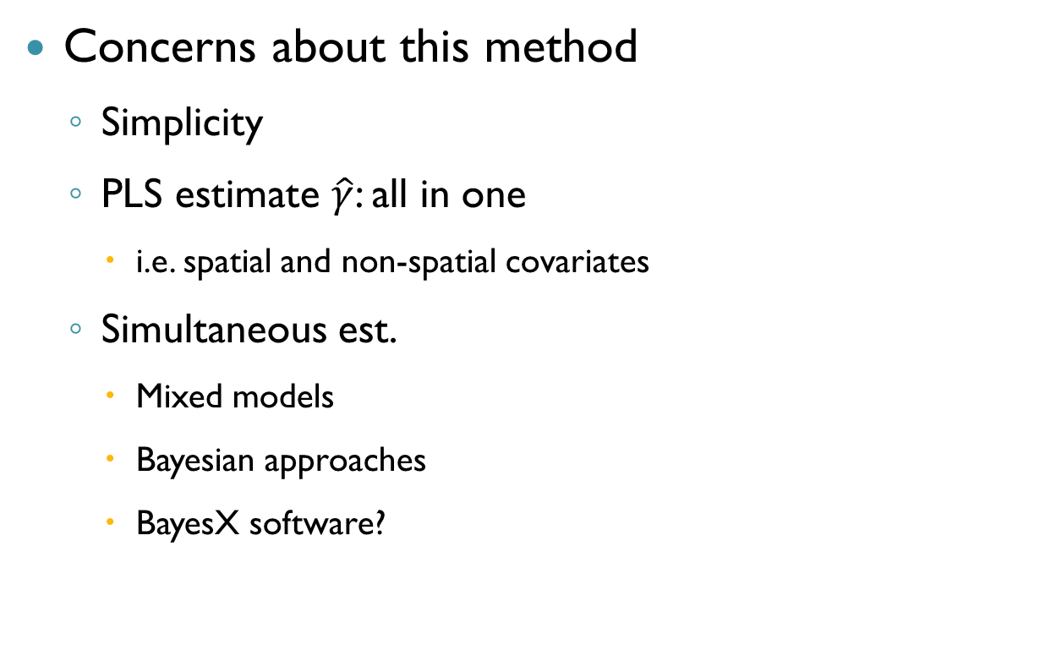
Background - 6
Concerns about this method
Simplicity
PLS estimate $\hat{γ}$: all in one
i.e. spatial and non-spatial covariates
Simultaneous est.
Mixed models
Bayesian approaches
BayesX software?
Source: eBay, 2017

Slide 9
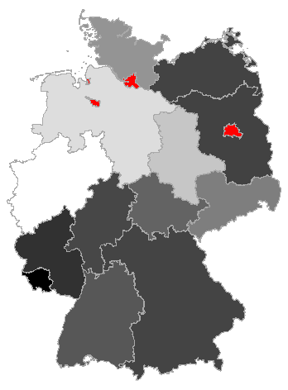
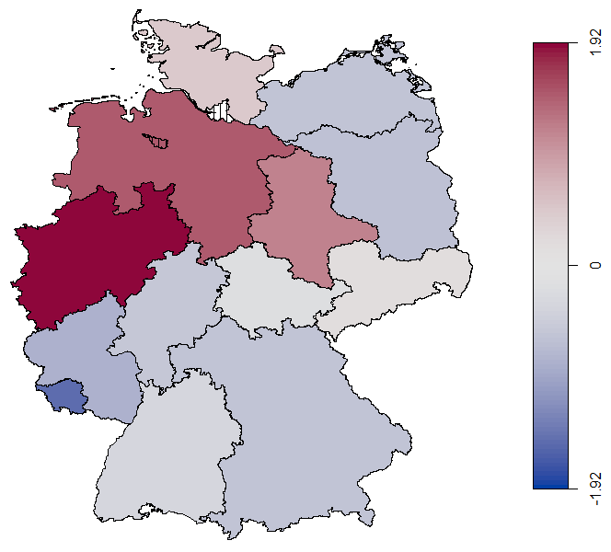
First steps
state based potato yield (100kg/ha)
only three states without official data
gadm.org & regionalstatistik.de

Slide 10
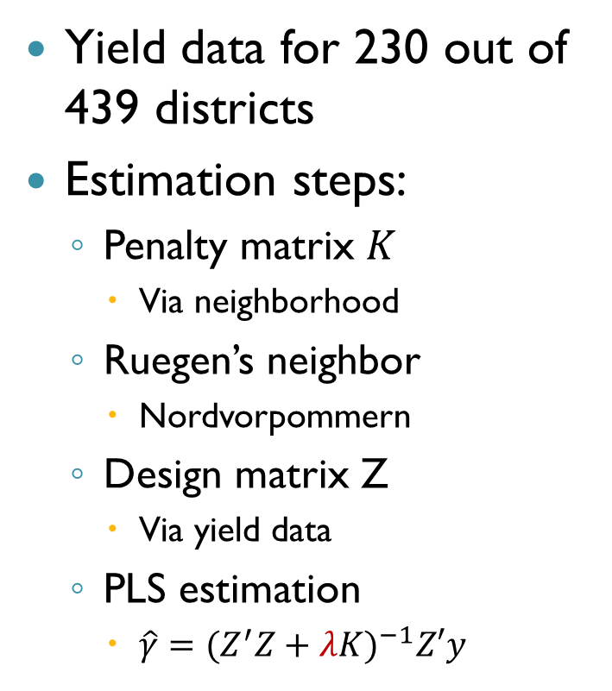
Estimation of spatial effects
Yield data for 230 out of 439 districts
Estimation steps:
Penalty matrix $K$
Via neighborhood
Ruegen’s neighbor
Nordvorpommern
Design matrix Z
Via yield data
PLS estimation
$\hat{γ}={(Z^{′}Z+λK)}^{−1}Z′y$
Before
 | 13057 | 13061
13057 | 5 | 0
13061 | 0 | 0
After
 | 13057 | 13061
13057 | 6 | -1
13061 | -1 | 1

Slide 11
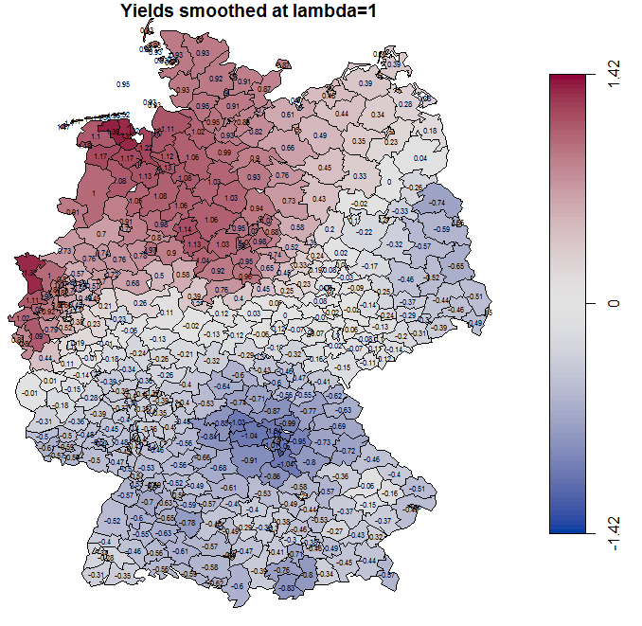
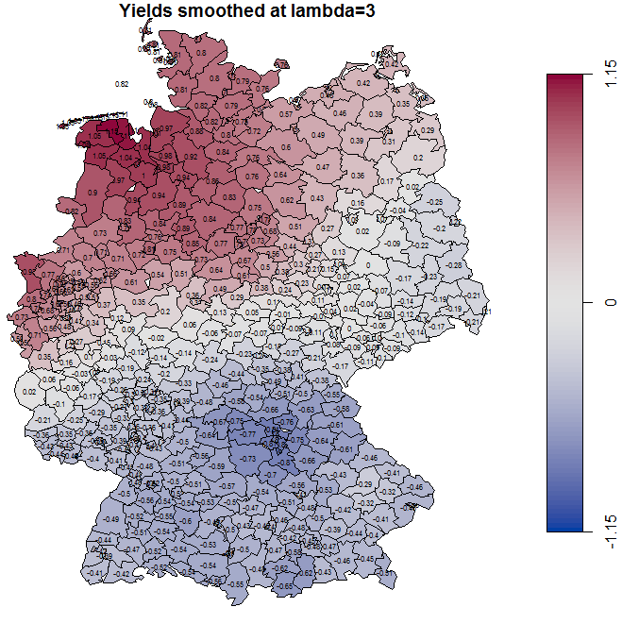
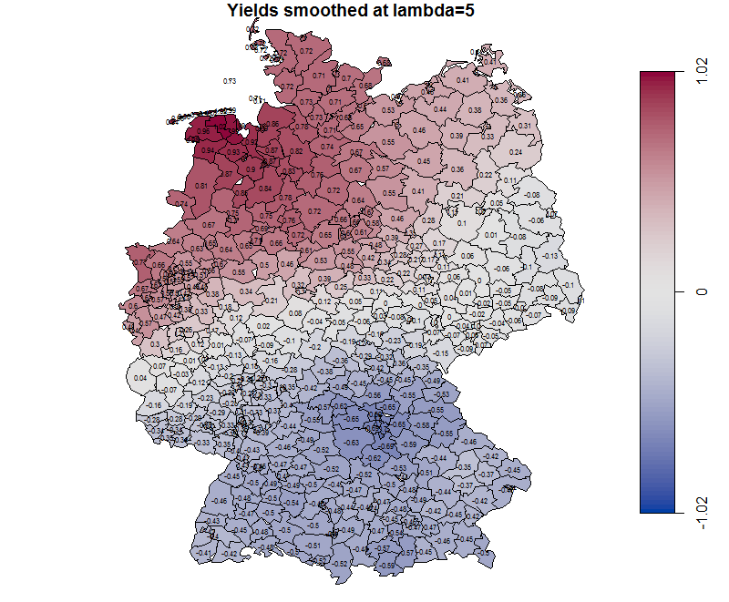

Results
as $λ↑$
$$smth↑$$
but,
$$as λ↑$$
$$σ_{ε}^{2}↑$$

Slide 12
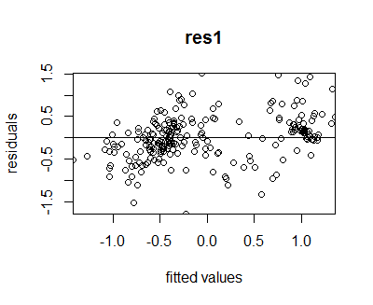
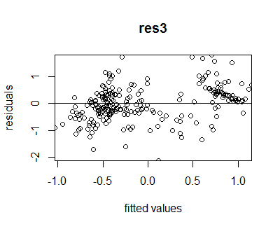
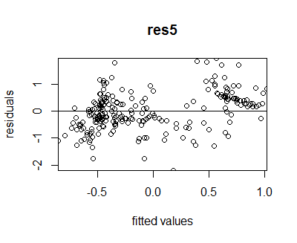

Assumptions
~ homoscedastic and
linear residuals
$σ_{ε|λ=1}^{2}=0.2673956$
$σ_{ε|λ=3}^{2}=0.4040608$
$σ_{ε|λ=5}^{2}=0.4691135$

Slide 13
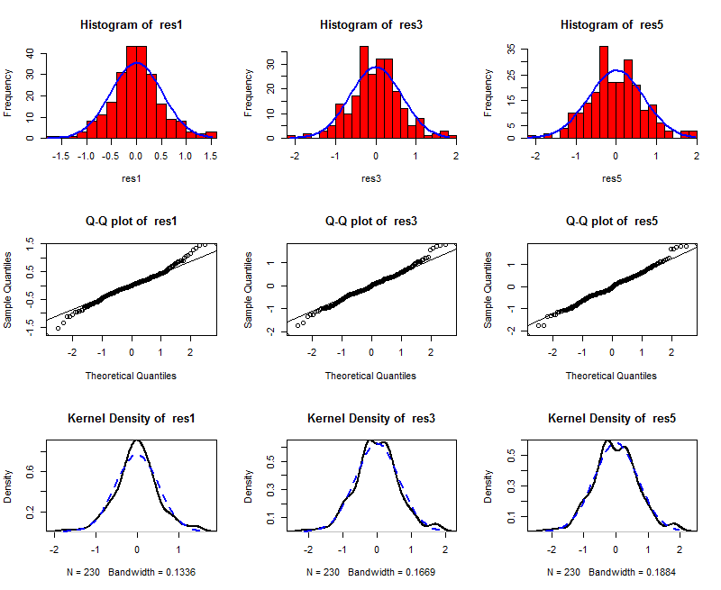
Assumptions contd.
~ normally distributed residuals

Slide 14
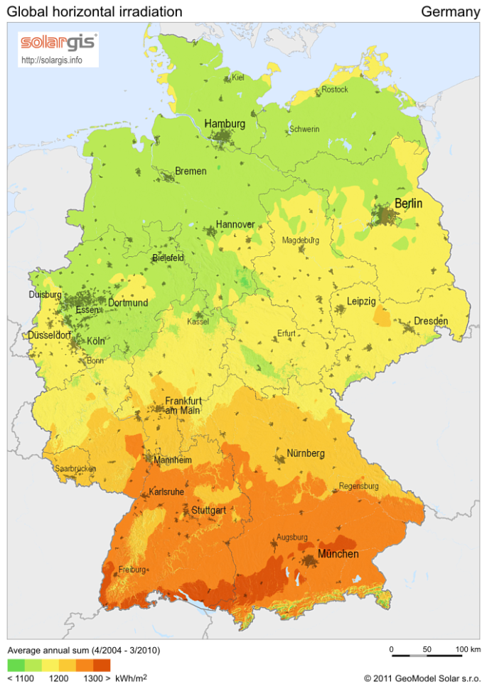
Reason
Solar potential? (no, probably other gainful products)
Source: Wikipedia, 2017

Slide 15
Thank you…
Caner Erdem

Slide 16
Sources
Fahrmeir, L., Kneib, T., Lang, S., & Marx, B. (2013). Regression: Models, Methods and Applications. Berlin Heidelberg: Springer-Verlag.
Fleet, D., & Jepson, A. Markov Random Fields. Retrieved July 08, 2017, from http://www.cs.toronto.edu/~kyros/courses/2503/Handouts/mrf.pdf
Wikipedia. Solar power in Germany. Retrieved July 12, 2017, from https://en.wikipedia.org/wiki/Solar_power_in_Germany
eBay. 8 Reasons Why Playing in the Sand Is Good for Kids. Retrieved July 12, 2017, from http://www.ebay.com/gds/8-Reasons-Why-Playing-in-the-Sand-Is-Good-for-Kids-/10000000177634049/g.html

