Slide 1
MULTITHREADED BANKER’S ALGORITHM FOR DEADLOCK AVOIDANCE

Slide 2
OUTLINE
Introduction
Program Description
Data Structures
Functions
Simulation

Slide 3
Introduction
Banker’s Algorithm
Resource allocation and deadlock avoidance algorithm
Maximum resource demand of each process must be declared
Processes request resource;
System will be in safe state -> Process allocates resource
System will be in unsafe state -> Process waits until other process releases enough resources.

Slide 4
Program Description
Implementation is done with Qt C++ Framework
This programming assignment combines three separate topics
Multithreading
Preventing Race Conditions
Deadlock Avoidance

Slide 5
Program Description
The Banker
Considers requests from n customers and m resource types
Allocates resource to requesting customer based on availability and max limit of that customer
Grants the request if it is safe to do
Denies the request if it is not safe to do

Slide 6
Program Description
The Customers
n customer request and release resource from the bank
The customers will continually loop, requesting and then releasing random numbers of resources within their threads.
The customer’s request will be limited by their need.

Slide 7
Data Structures
For n: number of customers , m: number of resources
Available[m]: available[j] indicates the number of resources available of the resource j
Maximum[n][m]: maximum[i][j] indicates the maximum number of resource j that can be allocated to customer i

Slide 8
Data Structures
Allocation[n][m]: allocation[i][j] indicates the number of resources of resource j currently allocated to customer i
Need[n][m]: need[i][j] indicates how many more instances of resource j that can be allocated to customer i
need[i][j] = maximum[i][j] – allocation[i][j]

Slide 9
Functions
bool isSafe (int customer_num, int request[])
Customer i‘s request for m resources is stored in request[m]
For every resource j,
IF request[j] <= need[i][j]
AND request[j] <= available[j]
THEN returns true

Slide 10
Functions
int request_resources (int customer_num, int request [])
If isSafe returns true,
For every resource j of the customer i,
available[j] -= request[j]
allocation[i][j] += request[j]
need[i][j] -= request[j]

Slide 11
Functions
int release_request (int customer_num, int release[])
If customer i’s request is succesful for every resource j
For every resource j of the customer i,
available[j] += release[j]
allocation[i][j] -= release[j]
need[i][j] += release[j]

Slide 12
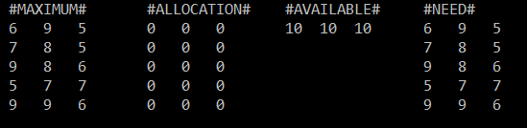
Simulation
Main Thread: Generating and printing all data

Slide 13
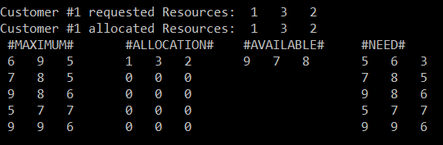
Simulation
Customer Threads: Requesting and allocating resources

Slide 14
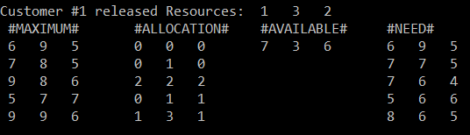
Simulation
Customer Threads: Releasing resources

Slide 15
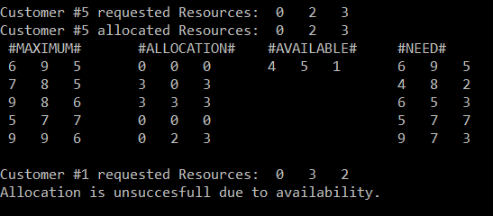
Simulation
Customer Threads: Request denied due to availability.

Slide 16
THANK YOU

