Slide 1




NASA Marshall Space Flight Center
Materials Levitation Lab
Thermophysical property measurements and comparison of Inconel 625 and 718 from competing vendor formulations using Electrostatic Levitation
Brandon Phillips¹*, Jannatun Nawer², Peace Muusha², Thomas Leitner³, Christoph Turk³ , Michael P. SanSoucie¹, and Douglas M. Matson²
¹NASA Marshall Space Flight Center, Huntsville, AL, USA
²Mechanical Engineering Department, Tufts University, Medford, MA, USA
³Voestalpine BÖHLER Edelstahl GmbH & Co KG, Kapfenberg, Austria
22nd Symposium on Thermophysical Properties
June 25, 2024
Notes:
STILL

Slide 2
Materials Levitation Lab
Electrostatic Levitator (ESL)

Slide 3
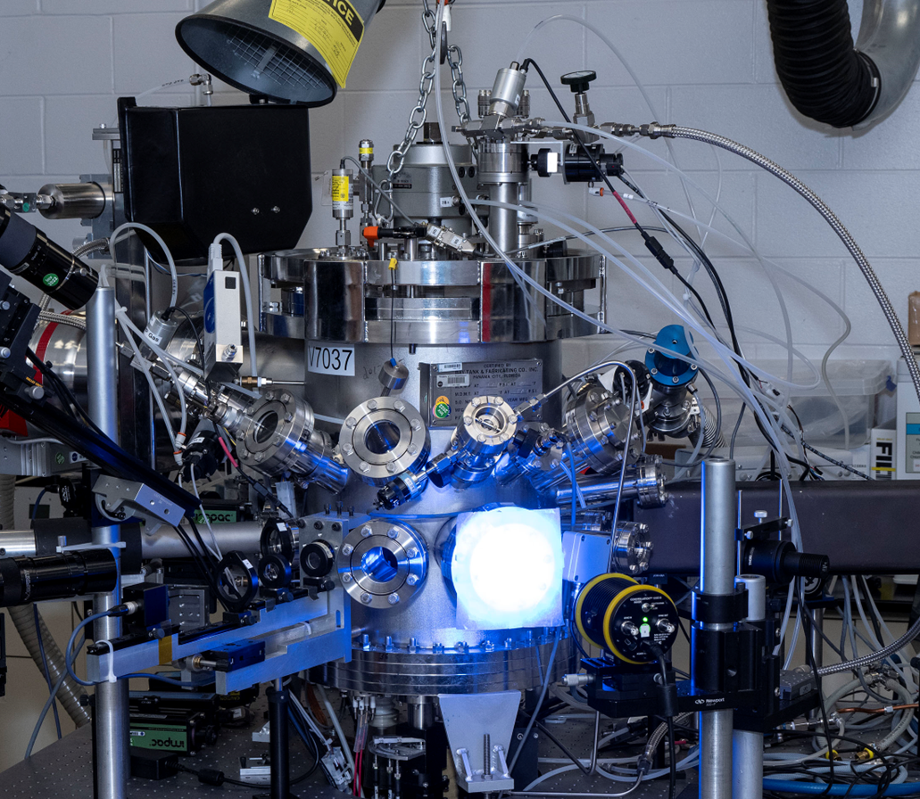
Electrostatic Levitator
The Electrostatic Levitator (ESL) is our most versatile levitator system with the following features:
  Vacuum Processing down to 10⁻⁸ [torr]
  Pressure Processing up to 5 [atm], using High Purity Argon or Nitrogen
  Partial Oxygen Pressure Flow System for precision studies
  Residual Gas Analyzer for improved mass spectroscopy
  Multi-axis laser source ports with CO2 and Yb Fiber Lasers for variable material coupling
  Multichannel Pyrometer for temperature measurement
  Hybrid Stem assembly for improved processing of samples with poor surface charge stability
  CREEP Motor assembly
  Quench assembly
  Triggered Nucleation assembly
  Single Sample feedthrough (no vacuum break)

Slide 4


Materials
 | Ni | Cr | Co | Mo | Nb+ Ta | Al | Ti | Cu | Fe | C | Mn | Si | P | Other
Inconel 718
ESPI | 53.87 | 18.46 | 0.13 | 3.03 | 5.09 | 0.59 | 0.93 | 0.09 | 17.63 | 0.03 | 0.05 | 0.08 | 0.009 | <0.5
Böhler | 54 | 17.71 | 0.20 | 2.98 | 5.15 | 0.51 | 0.96 | 0.06 | 18.23 | 0.025 | 0.06 | 0.06 | <0.005 | <0.05
Inconel 625
ESPI | 64.5 | 22.36 | - | 8.55 | 3.61 | 0.09 | 0.17 | <0.01 | 0.36 | 0.01 | 0.04 | 0.06 | <0.003 | <0.5
Böhler | 62.4 | 21.36 | 0.31 | 8.17 | 3.32 | 0.17 | 0.11 | 0.03 | 3.83 | 0.014 | 0.10 | - | <0.005 | <0.5
ESPI Metals, OR, USA
Inconel 718 Lot: SD 02357A
Inconel 625 Lot: DK 15344B

Slide 5

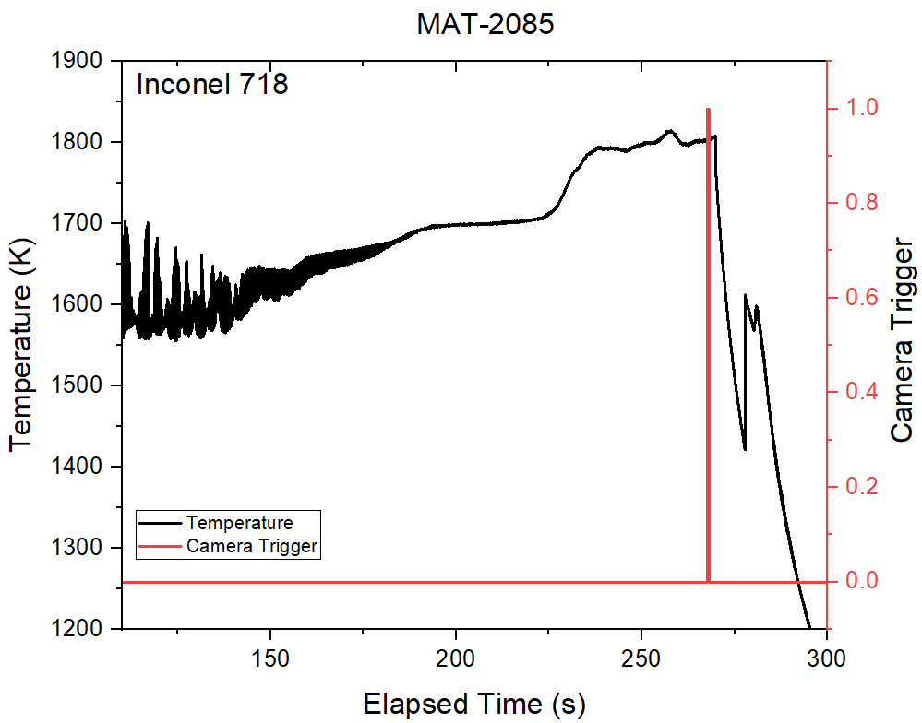
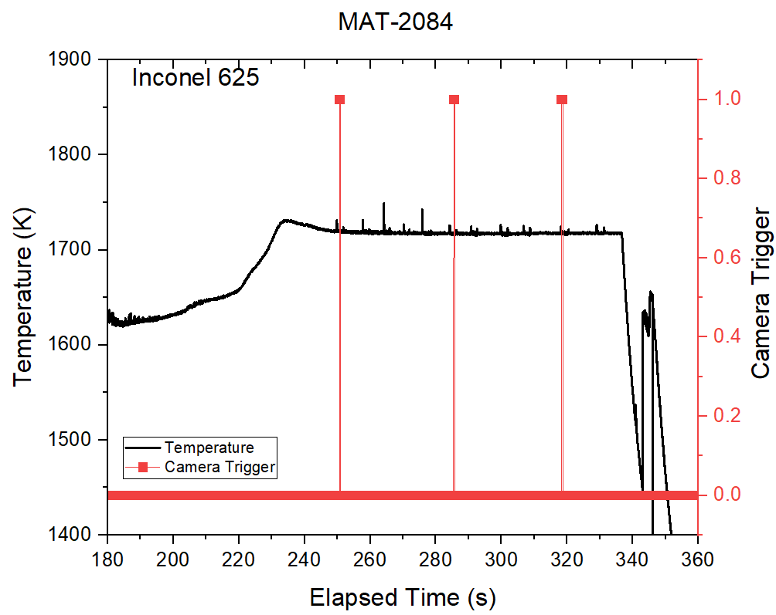
Thermal Profile
Density processing
Surface tension and Viscosity processing

Slide 6
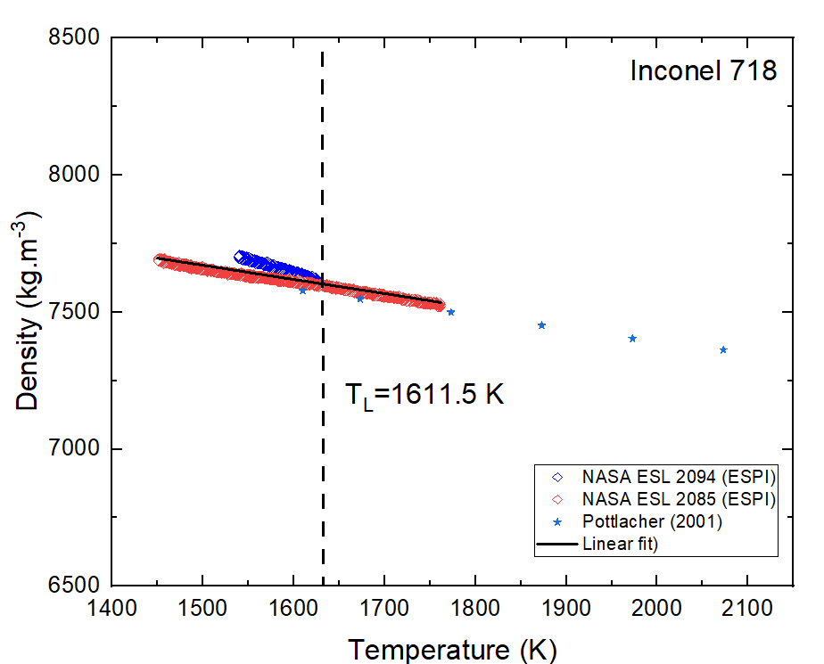
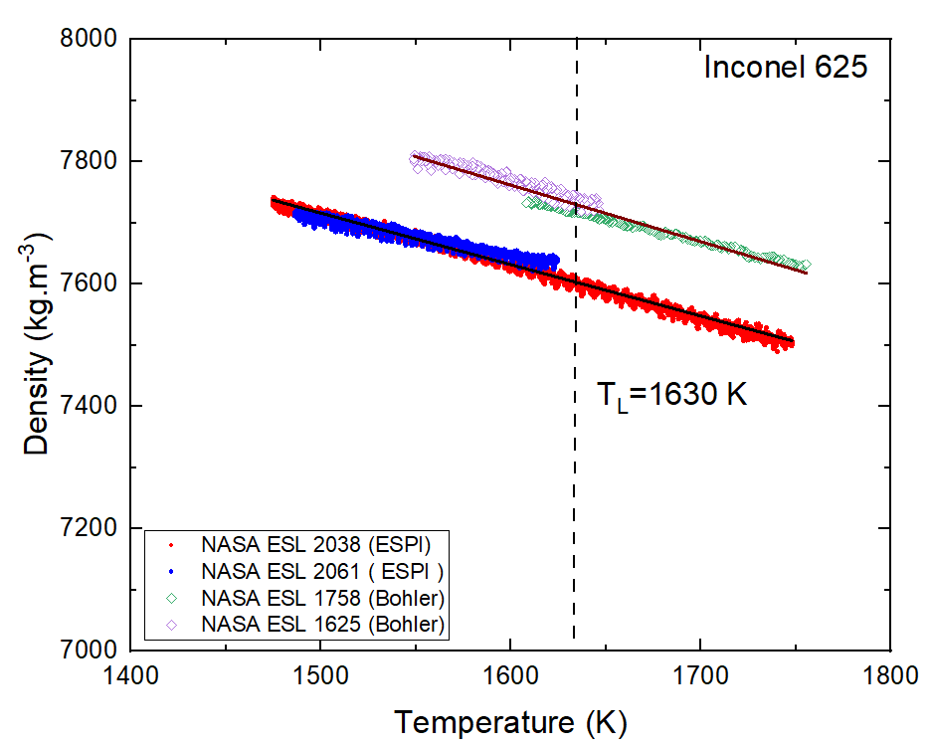

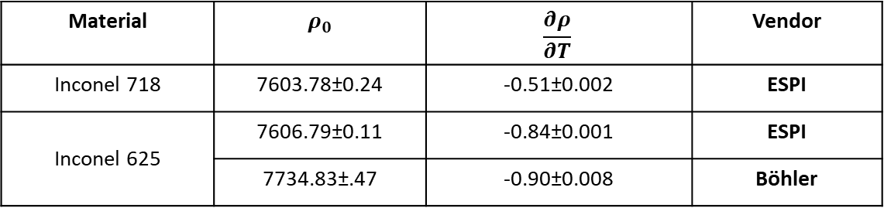
Results – Density Analysis
Material | $ρ_{0}$ | $$\frac{∂ρ}{∂T}$$ | Vendor
Inconel 718 | 7603.78±0.24 | -0.51±0.002 | ESPI
Inconel 625 | 7606.79±0.11 | -0.84±0.001 | ESPI
 | 7734.83±.47 | -0.90±0.008 | Böhler
$$ρ=ρ_{0}+\frac{dρ}{dT}(T−T_{L})$$

Slide 7
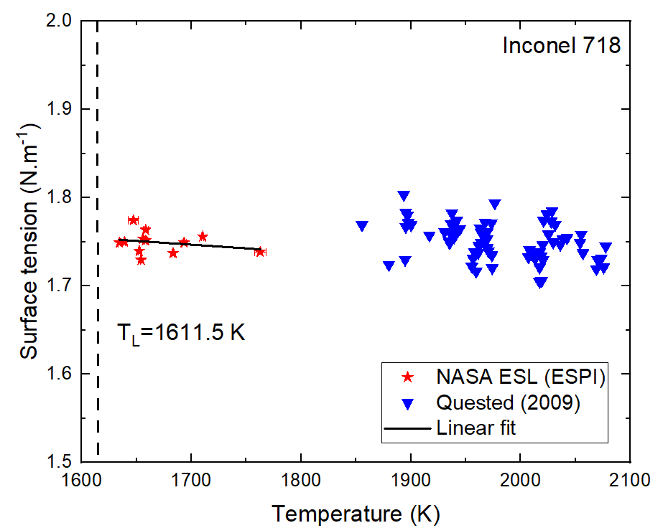
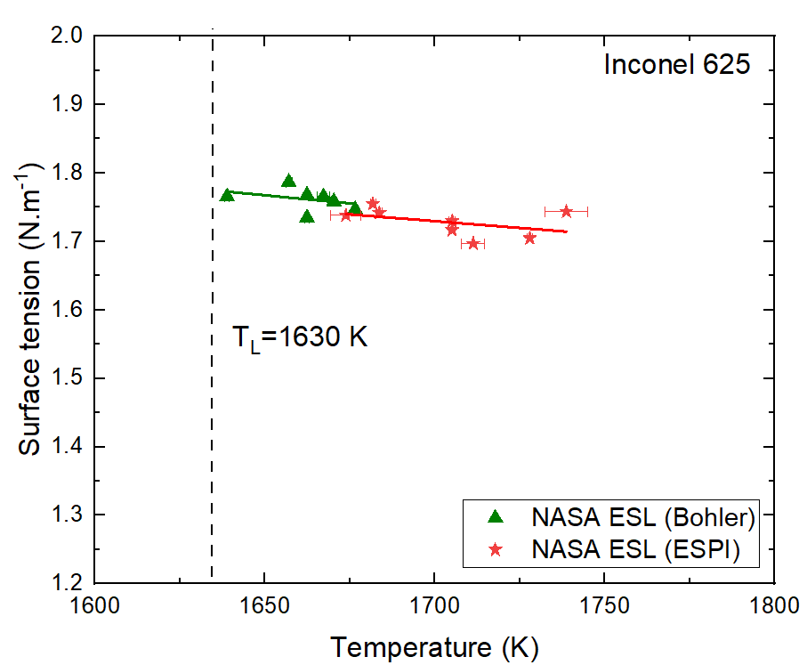
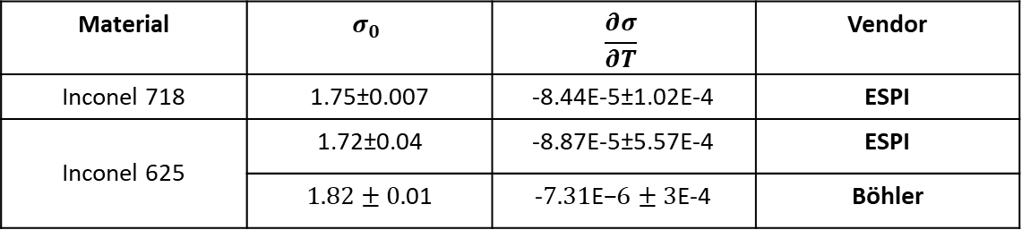

Results – Surface Tension
Material | $$σ_{0}$$ | $$\frac{∂σ}{∂T}$$ | Vendor
Inconel 718 | 1.75±0.007 | -8.44E-5±1.02E-4 | ESPI
Inconel 625 | 1.72±0.04 | -8.87E-5±5.57E-4 | ESPI
 | $1.82±0.$01 | -$7.31\text{E}\text{−}6±3$E-4 | Böhler
$$σ=σ_{0}+\frac{dσ}{dT}(T−T_{L})$$

Slide 8
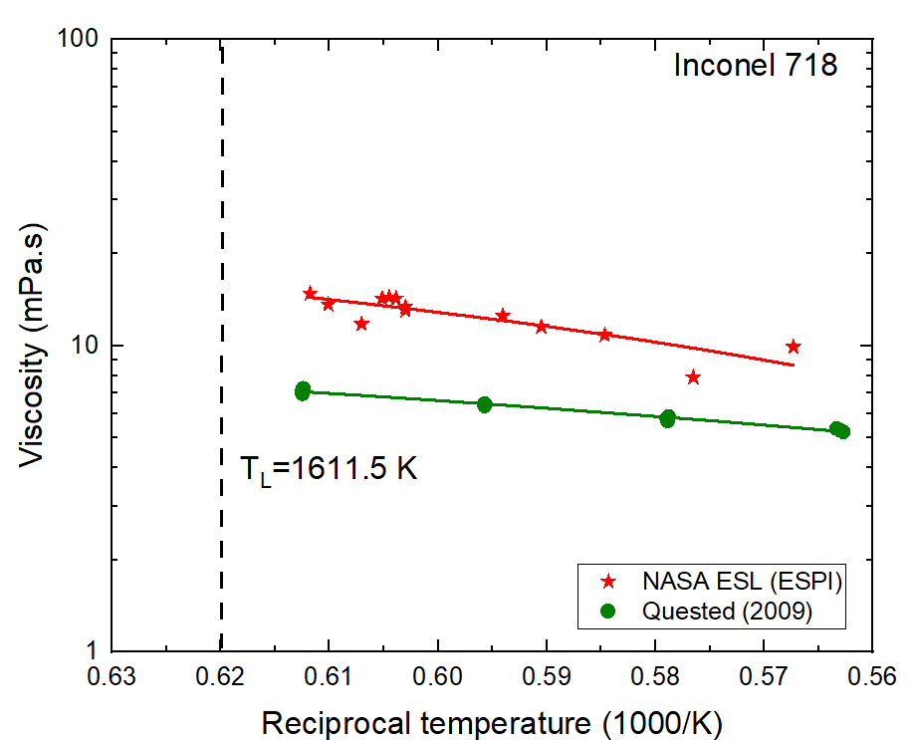
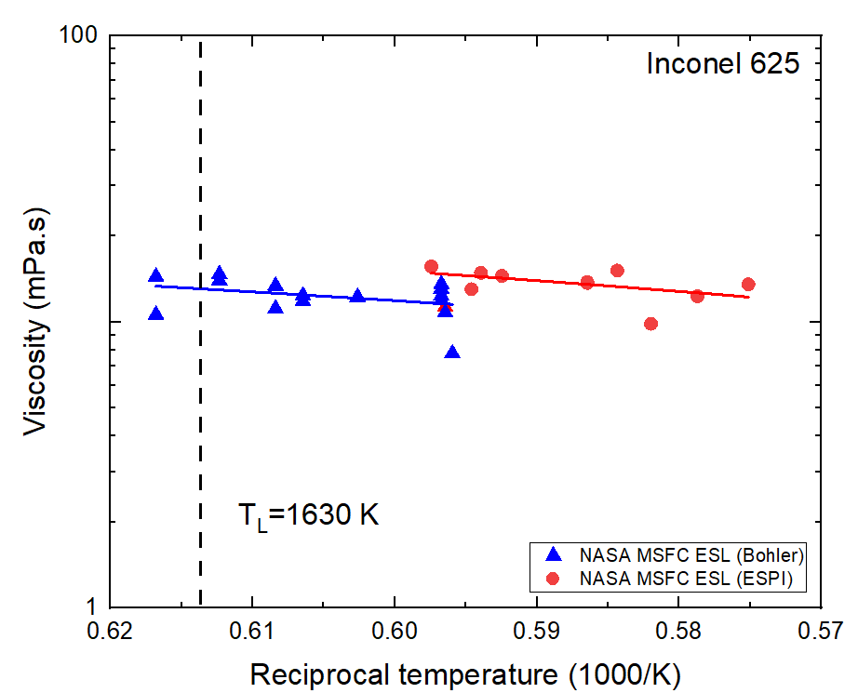

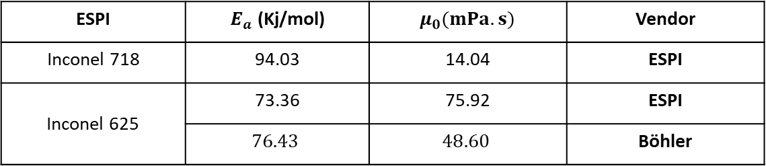
Results – Viscosity
ESPI | $E_{a}$ (Kj/mol) | $μ_{0}(mPa.s)$ | Vendor
Inconel 718 | 94.03 | 14.04 | ESPI
Inconel 625 | 73.36 | 75.92 | ESPI
 | $$76.43$$ | $$48.60$$ | Böhler
$$μ=μ_{0}exp⁡(−\frac{E_{a}}{RT})$$

Slide 9
Materials Levitation Lab
Additional Levitator & Support Capabilities

Slide 10
Additional Levitator & Support Capabilities
Electromagnetic Levitator – Used for processing larger metallic samples.
Aero Levitator – Used for sample processing of materials that have inherent charge stability issues.
Acoustic Levitator – Used for studying thermal convection and solidification, in addition to baseline studies for regolith separation and sorting for future hybrid solution.
Aqueous Solutions Levitator – Used for studying liquids and crystal growth, in addition to baseline studies for regolith ionic liquids reactor design improvements.
Various Sample Fabrication Capabilities
  Vacuum Hearth
  Laser Hearth
  Bench Top Arc Melter
  Chemical Etching

