Slide 1
FLEX-UF: Content-Adaptive Early Exit for DCVC-UF
Decode compute spent where the content needs it
Chair of Media Technology · TUM

Slide 2
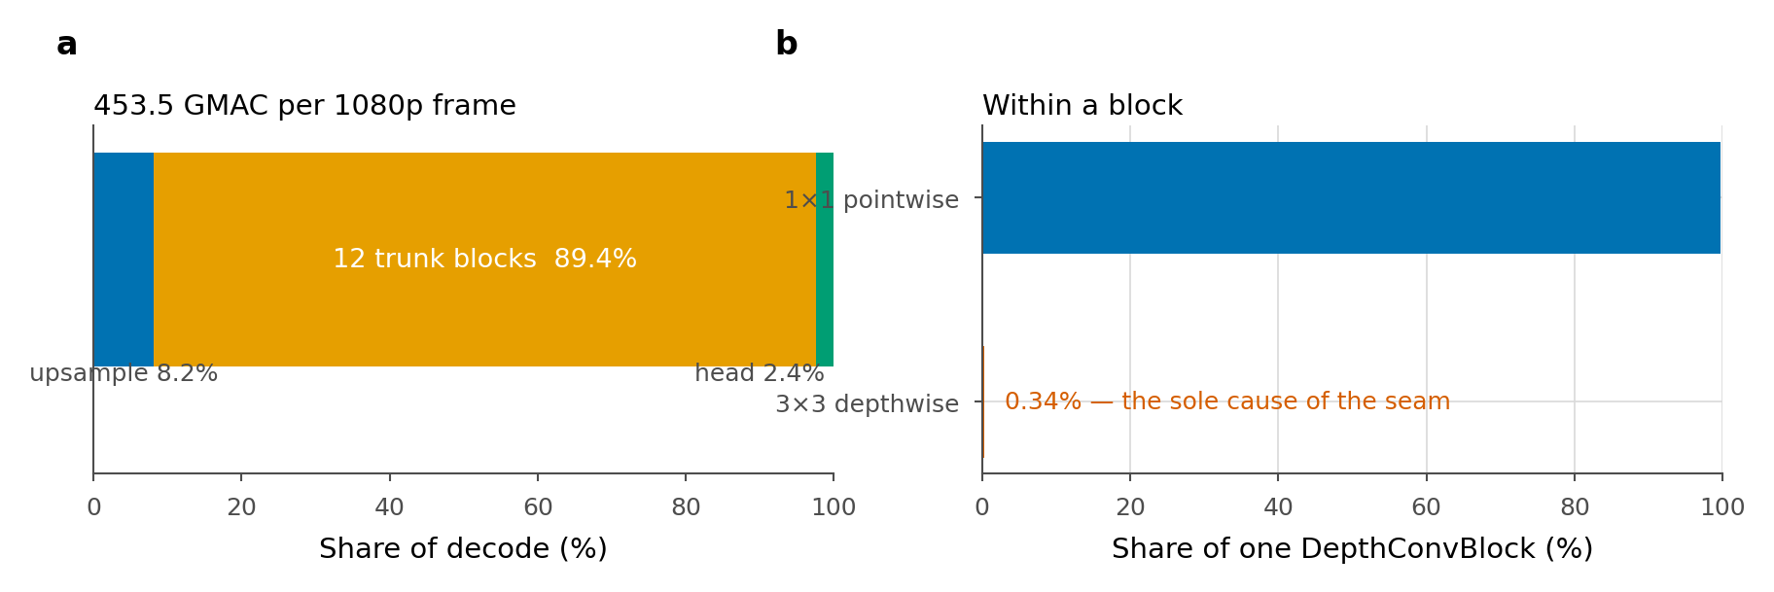
Uniform compute, non-uniform content
DCVC-UF intra decoder · 453.5 GMAC / 1080p frame
upsample 8.2% · 12 DepthConvBlocks 89.4% · head 2.4%
Target · 30–40% saved at ≤ 0.1 dB
Constraint · encoder, hyperprior, entropy model frozen
coded payload bit-identical → the decoder is the only variable

Slide 3
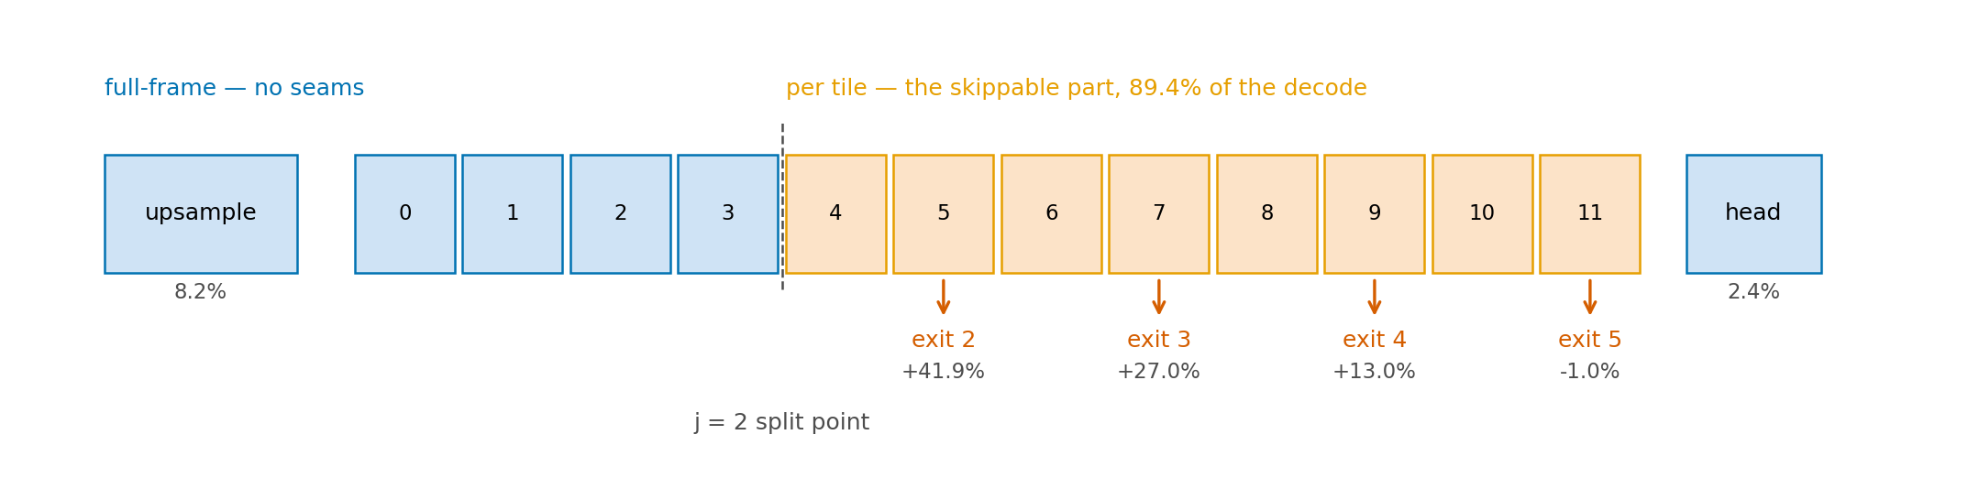
A ladder of exits over the trunk
K exits over 12 blocks, split depth j
groups 0…j−1 full-frame · groups j…K−1 per tile
shipped: K = 6, j = 2, 256 px tiles
Per-tile cost C_k (units of one stock decode)
0.581 0.581 0.581 0.730 0.870 1.010
exits 0,1 end inside the stem → C₀ = C₁ = C₂ · 6 rungs, 4 prices

Slide 4
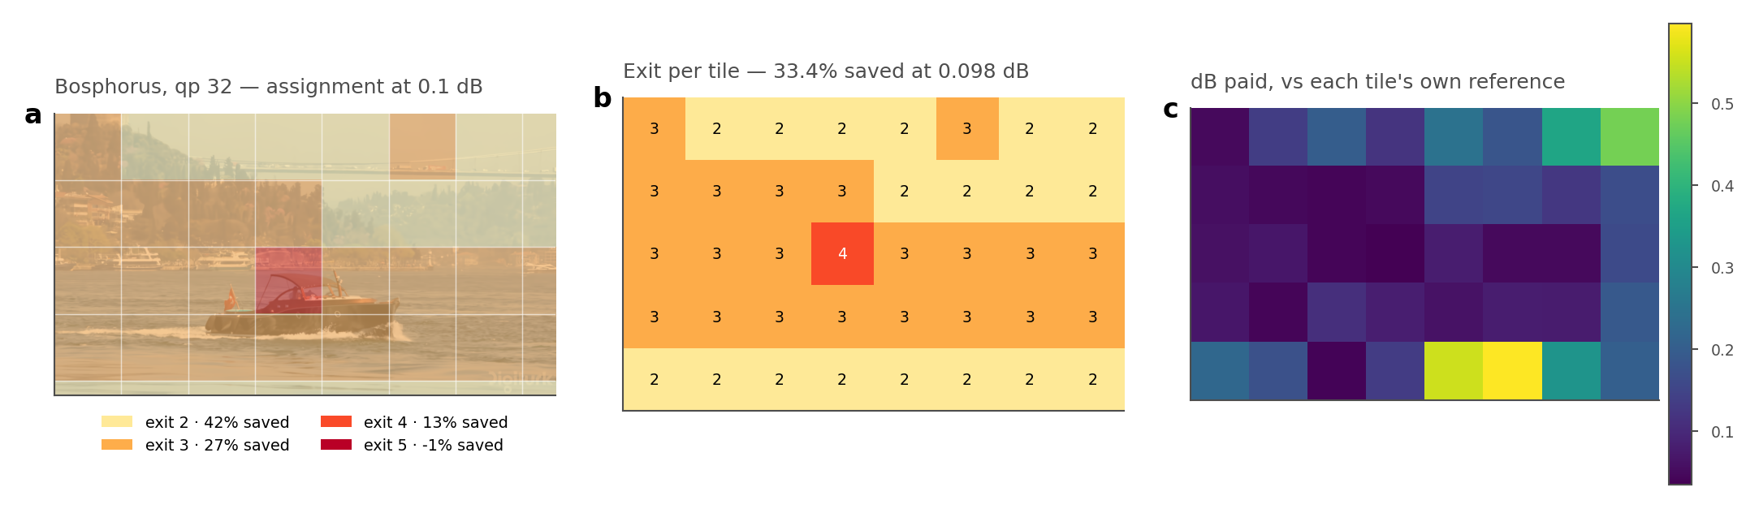
The assignment, on a frame
Bosphorus · qp 32 · λ* bisected to 0.1 dB · 40 tiles
boat → exit 4 water, sky → exit 2 shoreline → exit 3
33.4% saved at 0.098 dB
(c) dB vs each tile's OWN reference, not the frame mean

Slide 5
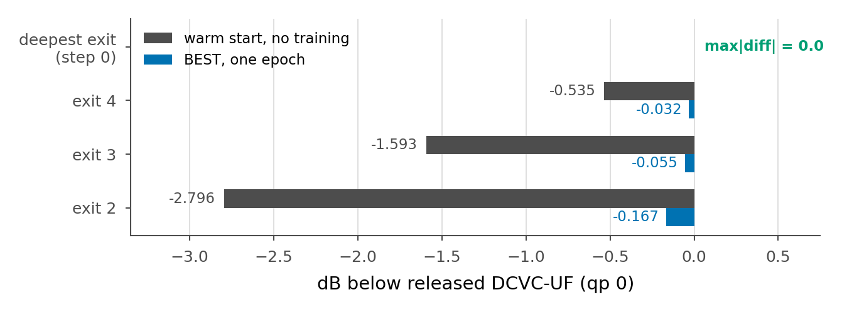
The reference IS the released decoder
Released weights re-expressed in ladder form · bijection over 143 tensors
Adapters and seam repair zero-init ⇒ identity at step 0
max | x̂_release − x̂_ours | = 0.0 at qp 0 / 32 / 63
through Microsoft's own DMCI class and forward_one_frame
So training must (a) lift shallow exits, (b) not damage the deepest

Slide 6
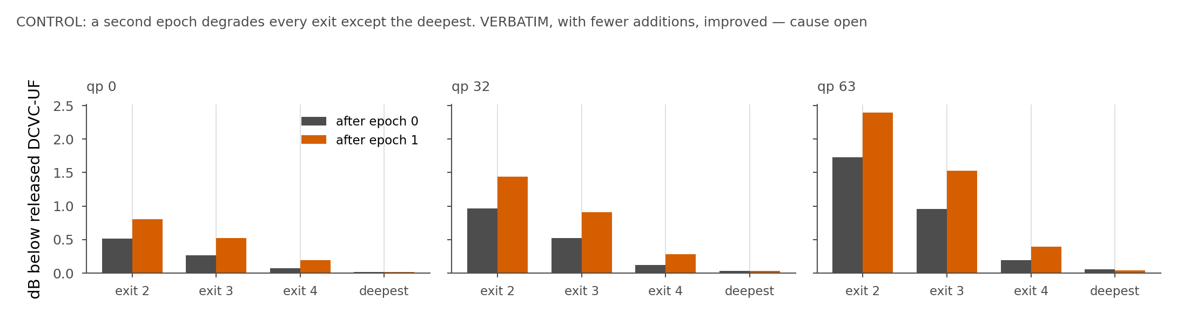
Recipe, checked against theirs
verify_recipe.py diffs each item against ~/DCVC/train_image.py
Deepest-exit drift vs release BEST -0.003 / -0.016 / -0.033 · VERBATIM (no anchor) -0.119 / -0.132 / -0.174 at qp 0/32/63
Saving at 0.1 dB, same architecture: anchor 0: unreachable at every rate · anchor 1: 3/3/2/2/2% · anchor 10: 42/42/42/42/42% (CONTROL→BEST moves four flags, so it is the bundle)
CONTROL, 2nd epoch: saving at qp0 13.3% -> 3.8% · damage grows the shallower the exit · VERBATIM improved over the same boundary → cause unknown
Additions, listed: --epoch_offset · --anchor_weight · --new_lr_scale · --freeze_encoder

Slide 7
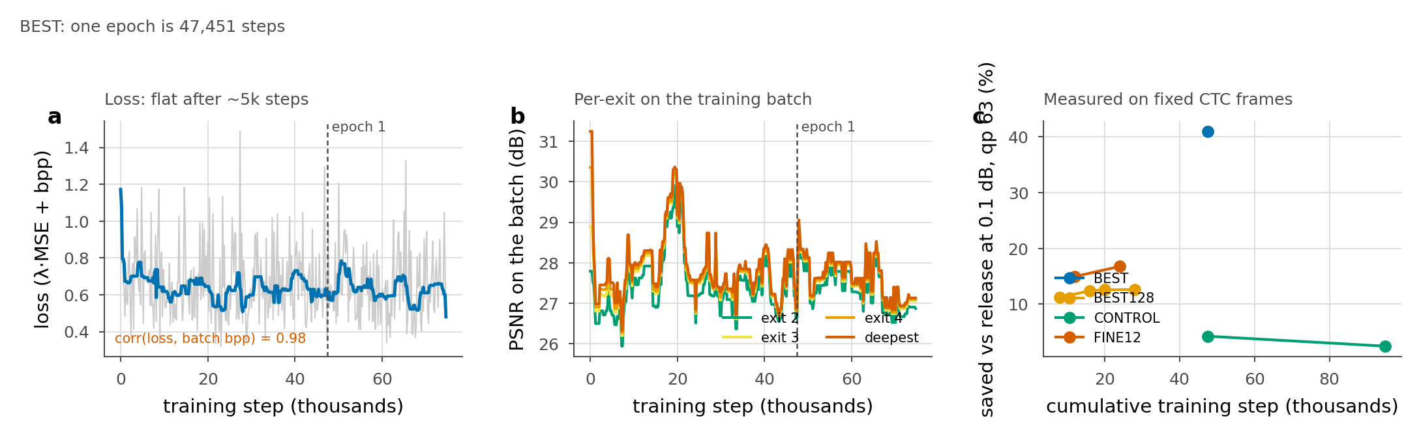
The loss is not the convergence signal
L = λ·MSE + bpp · corr(L, batch bpp) = 0.97
flat from step ~5,000; a 256 px crop's bitrate swings 2× per batch
(b) exits stay ordered, ~1 dB apart → ladder healthy
(c) saving on FIXED CTC frames, still rising at 20–24k steps
BEST128 11.2 → 12.6% FINE12 15.0 → 16.8% (qp 63)
1 epoch = 47,451 steps · every number here is one checkpoint

Slide 8
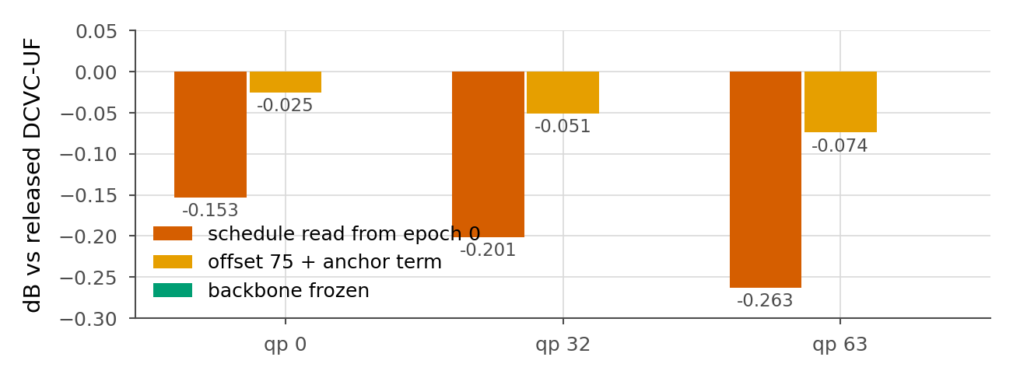
Schedule position, and a ×4 error
Reading the schedule from epoch 0 applies from-scratch lr to a converged model
deepest exit fell 0.153 / 0.201 / 0.263 dB in one epoch
→ 0.025 / 0.051 / 0.074 with --epoch_offset 75 + --anchor_weight
Freezing the trunk gives 0.000 drift — and collapses the ceiling 27.3% → 11.5%

Slide 9
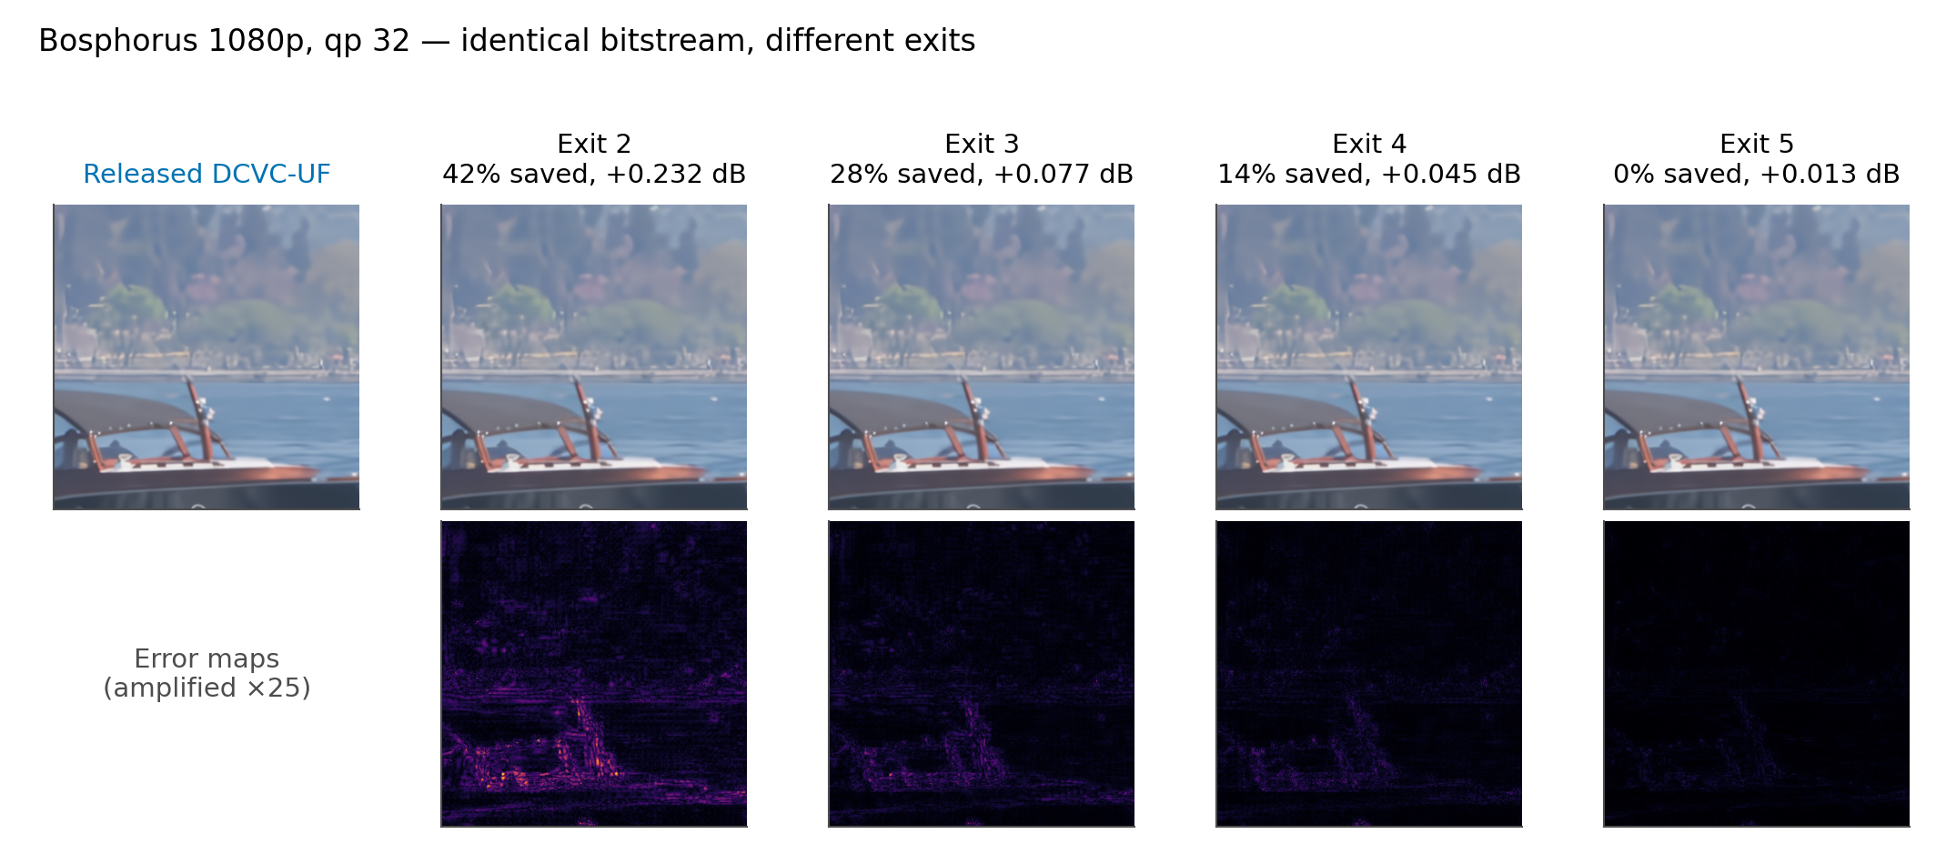
One frame, four exits
Bosphorus 1080p · qp 32 · identical bitstream at every exit
Error ×25 · damage is structured: detail and tile borders

Slide 10
Seam 1/5 · where it comes from
3×3 depthwise at (i, j):
y[i,j] = Σ_{u,v ∈ {−1,0,1}} w[u,v] · f[i+u, j+v]
Per tile, f[i+u, j+v] outside the tile does not exist → padding invents it
only the 3×3 depthwise has spatial extent; everything else is 1×1
⇒ exit adapters are 1×1 on purpose: no receptive field, no seam
Contamination grows one ring per layer. b per-tile layers, tile side F:
corrupted fraction = 1 − ((F − 2b) / F)² ≈ 4b / F
F = 32, b = 8 → 1 − (16/32)² = 75% of the tile
Not a line of bad pixels — the error propagates inward
Scales with tile PERIMETER, and with split depth j

Slide 11
Seam 2/5 · padding is an estimator
Border column x[0], unseen neighbour x[−1]:
zeros x̂[−1] = 0
replicate x̂[−1] = x[0] zeroth-order hold
linear x̂[−1] = 2·x[0] − x[1] first-order
arls x̂[−1] = a·x[0], a fitted per channel AR(1)
Pure seam penalty · CTC · 256 px · full depth · dB above the release
qp 0 qp 32 qp 63
zeros 0.1005 0.2162 0.5477
replicate 0.0616 0.0854 0.1070
linear 0.1793 0.2315 0.2638
arls 0.0518 0.0707 0.0879
linear > replicate: extrapolating a gradient amplifies boundary noise
arls wins on dB, REJECTED on cost · +10.7% wall-clock for 0.019 dB

Slide 12
Seam 3/5 · the perimeter law
Prediction 4b/F ⇒ doubling F halves the penalty
zeros qp 63: 128 px 1.1670 → 256 px 0.5477 ×0.47
replicate qp 63: 128 px 0.2125 → 256 px 0.1070 ×0.50
Free in compute — a tiled decode's MAC count is independent of F
Paid in routing granularity · 40 tiles/frame at 256 px vs 160 at 128
Halo, same law: tile F with halo h computes ((F+2h)/F)² pixels
F = 16, h = 4 → 2.25× F = 32, h = 4 → 1.56×
⇒ halo on the HEAD only (2.40% of MACs); on the trunk it exceeds the saving

Slide 13
Seam 4/5 · repair told where to look
A translation-invariant 3×3 must INFER the boundary from content
and corrects the ~25% clean interior, where any correction is damage
But the lattice is known — unpatchify lays tiles on a fixed P×P grid
Repair(f) = f + G[i mod P, j mod P] · PW( WSiLU( DW3×3(f) ) )
G : P × P = 256 scalars, shared over all 384 channels
0.0007% of decoder parameters, no MAC beyond a broadcast multiply
G₀ = exp(−d / τ), d = distance to nearest tile edge
⇒ the gate starts on the seam; training refines, not discovers
PW zero-init ⇒ module starts as identity ⇒ warm start stays bit-exact
Cost 0.95% of the decode — charged inside every saving, incl. the deepest exit (C_{K−1} = 1.0095, not 1.0)

Slide 14
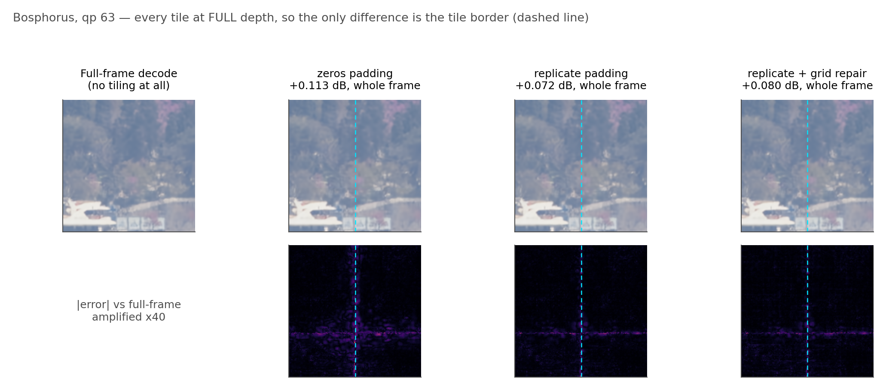
Seam 5/5 · at pixel scale, and what repair is worth
192 px across a tile boundary · qp 63 · full depth · error ×40
Repair ON vs OFF, 8 sequences: full depth 0.0672 → 0.0750 (worse) · routed 0.1259 → 0.1239
0.0020 dB/point of decode · arls was rejected at 0.0018
trained jointly ⇒ an inference ablation is not the clean test

Slide 15
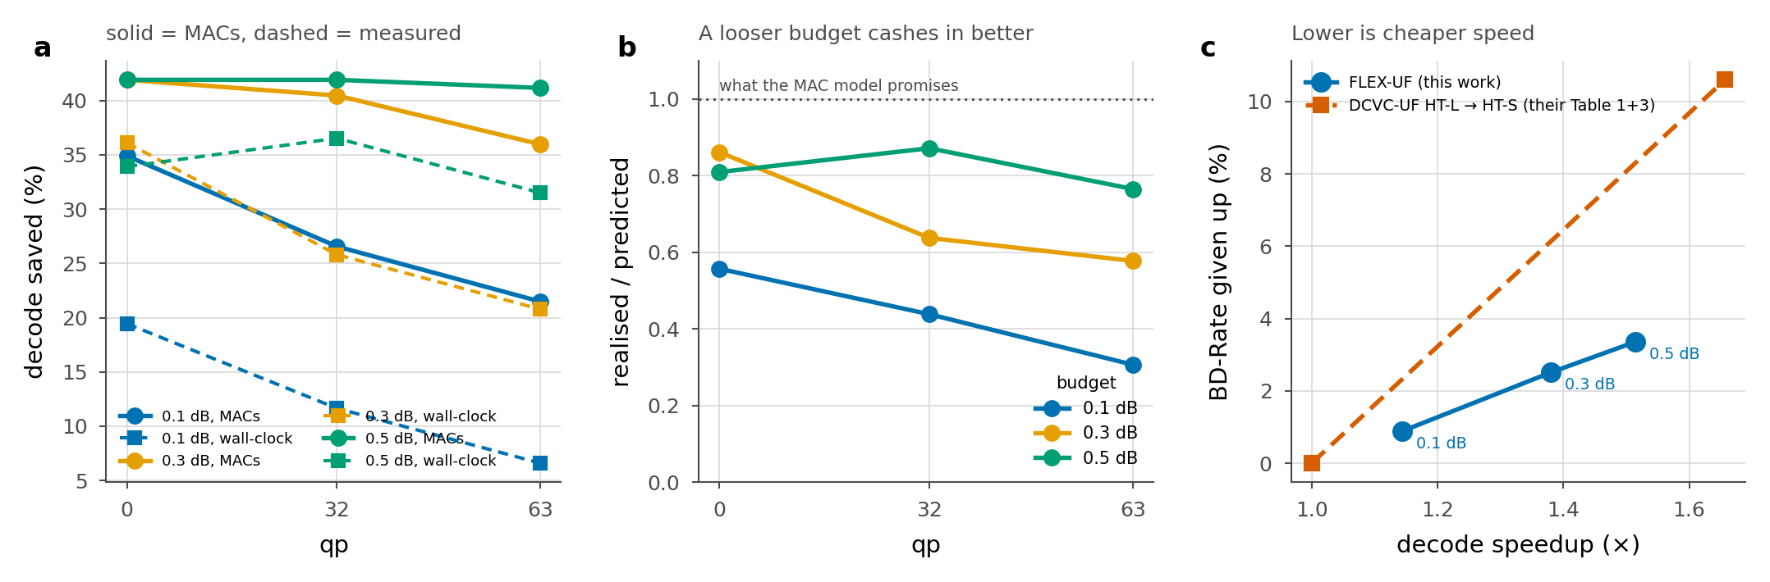
MACs are not milliseconds
1920×1088 · interleaved · median of 40
0.1 dB: 28% of MACs -> 13% of wall-clock (1.14x)
0.3 dB: 39% of MACs -> 28% of wall-clock (1.38x)
0.5 dB: 42% of MACs -> 34% of wall-clock (1.51x)
Gap = tiling overhead 3.7–6.5% + per-group bookkeeping
mask + gather + scatter + one device↔host sync per group
36.4 ms vs 77.5 ms of convolution = 32% of the loop
Recoverable · sort by exit depth once → 23–37% back, bit-identical

Slide 16
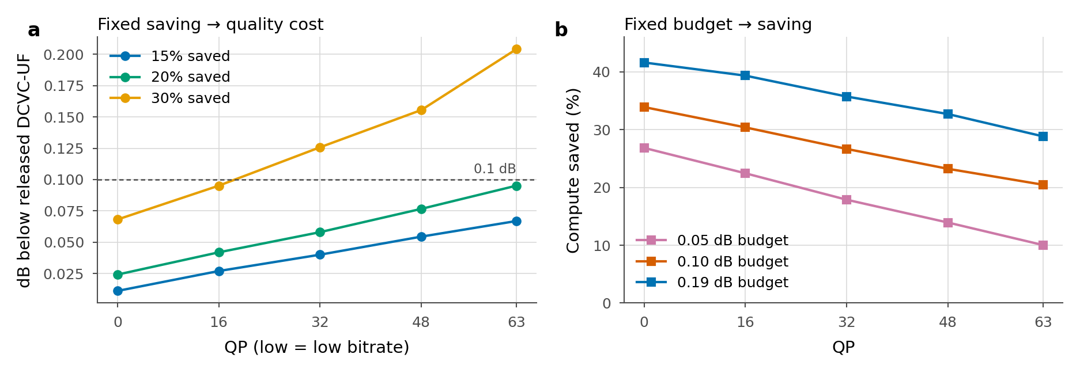
Against the released decoder
At 0.1 dB · 34.0% · 26.8% · 20.8% (qp 0 / 32 / 63)
÷ RELEASE (1.0), not our deepest exit (1.0095) — earlier decks read 0.6–0.75 pts higher
The 30% target is cleared by qp 0/16 at 0.1 dB, and by qp 32/48/63 at 0.3 dB
Ladder ceiling 41.9% at every rate, set by the split depth j=2, not by training
BD-saving 30.8% over dB in [0.064, 0.196] (qp 0: 37% · 16: 34% · 32: 31% · 48: 27% · 63: 24%); BD-quality 0.062 dB over saving in [10%, 30%]

Slide 17
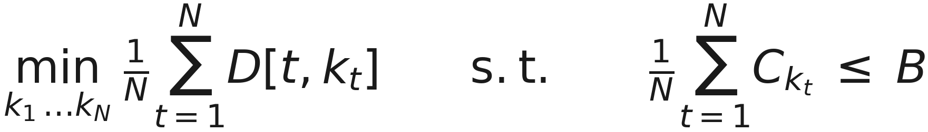
The allocation problem
N tiles, K exits. D[t,k] = distortion of tile t at exit k. C_k = its cost.
Lagrangian relaxation decouples it — every tile solves independently:
sweeping λ traces the lower convex hull of the achievable (cost, distortion) set
λ is found by BISECTION on the realised dB, so a 0.1 dB budget is exactly 0.1
Both configurations solve this. They differ only in where D[t,k] comes from.

Slide 18
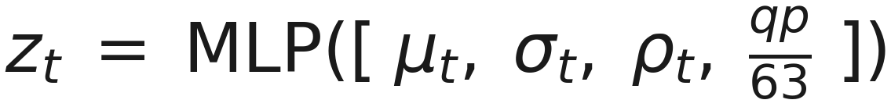
Two ways to obtain the decision
A · the encoder holds the source, so D[t,k] is measured, and k* is exact
the answer is then transmitted: H(k) · N + 8K bits ≈ 94 bit/frame
B · the decoder never sees x, so D[t,k] does not exist. It predicts instead.
μ, σ : mean and std over tile t of a learned 384→48 view of the stem
ρ : a 512→32 view of the latent ŷ concatenated with the entropy scales σ̂
β plays λ's role, but trades log-likelihood against cost, not distortion against cost

Slide 19
Training the router, and why it collapsed
Target is the oracle's choice, weighted by what the decision is worth:
agreement on ties is worth nothing; the regret term says so
Collapse control without an auxiliary loss (arXiv:2408.15664):
b is a buffer, nudged by usage — no interference gradient enters ℒ
balanced toward the ORACLE's mix π*, not uniform: exits are not interchangeable experts
Trained JOINTLY with the decoder → collapsed to a constant, agreement 0.000 at qp63. Against the FROZEN decoder → 0.848.

Slide 20
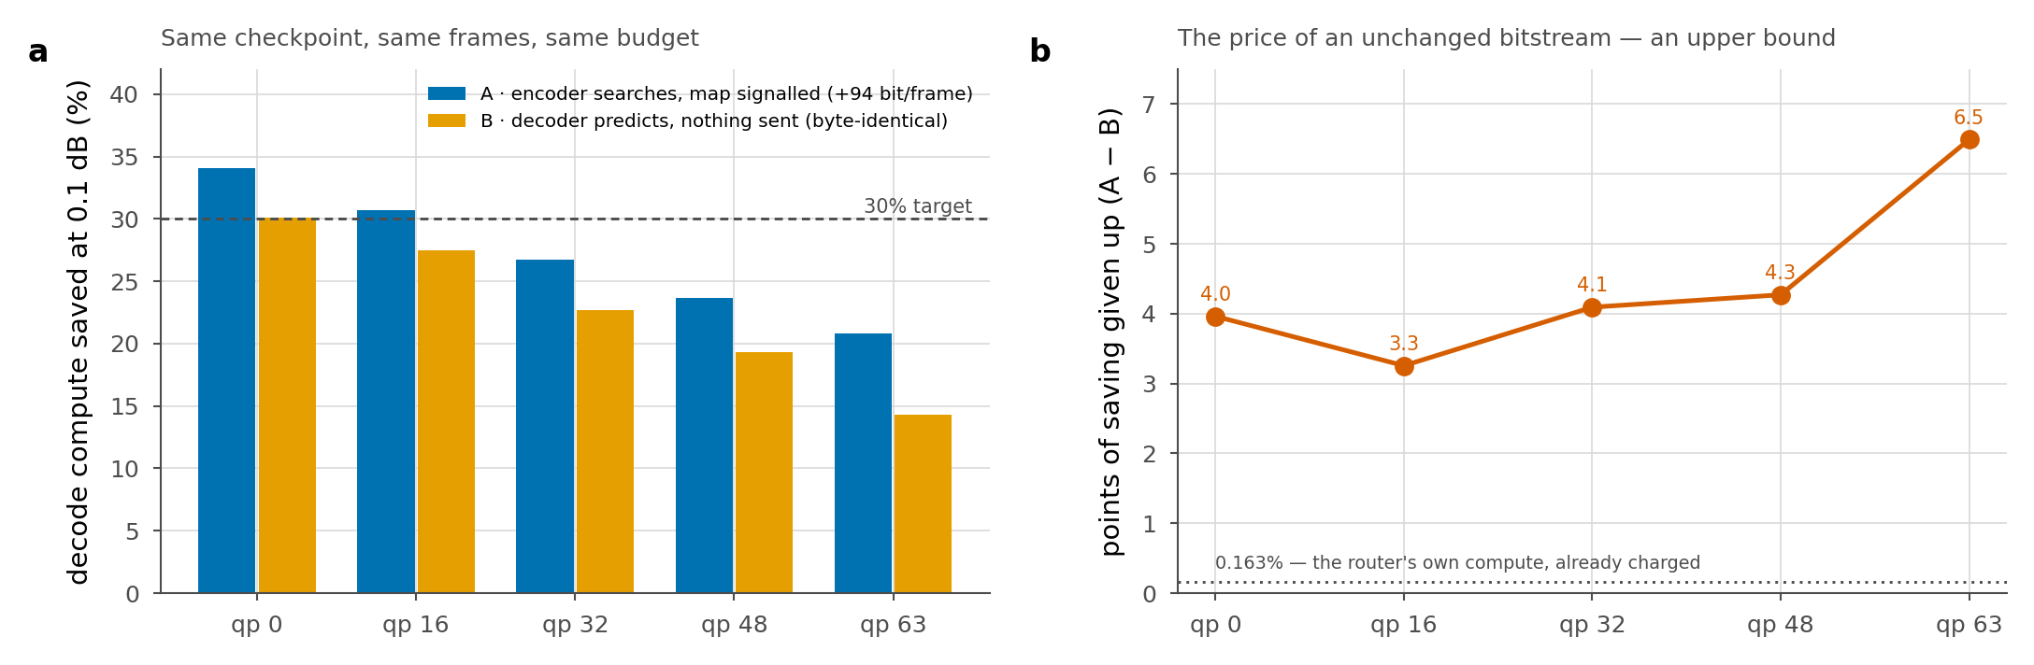
Who decides
A argmin_k ( MSE[t,k] + λ·C_k ) ~94 bit/frame = 0.008–0.020% of rate
B argmax_k ( log softmax(z)_k − β·C_k ) nothing sent, file byte-identical
qp0: A 34.0% signalled vs B 30.1% predicted — gap 3.96 pts
qp32: A 26.8% signalled vs B 23.9% predicted — gap 2.82 pts
qp63: A 20.8% signalled vs B 19.3% predicted — gap 1.50 pts
Asymmetric · A: +1.21 decodes at the ENCODER · B: +0.163% at the decoder

Slide 21
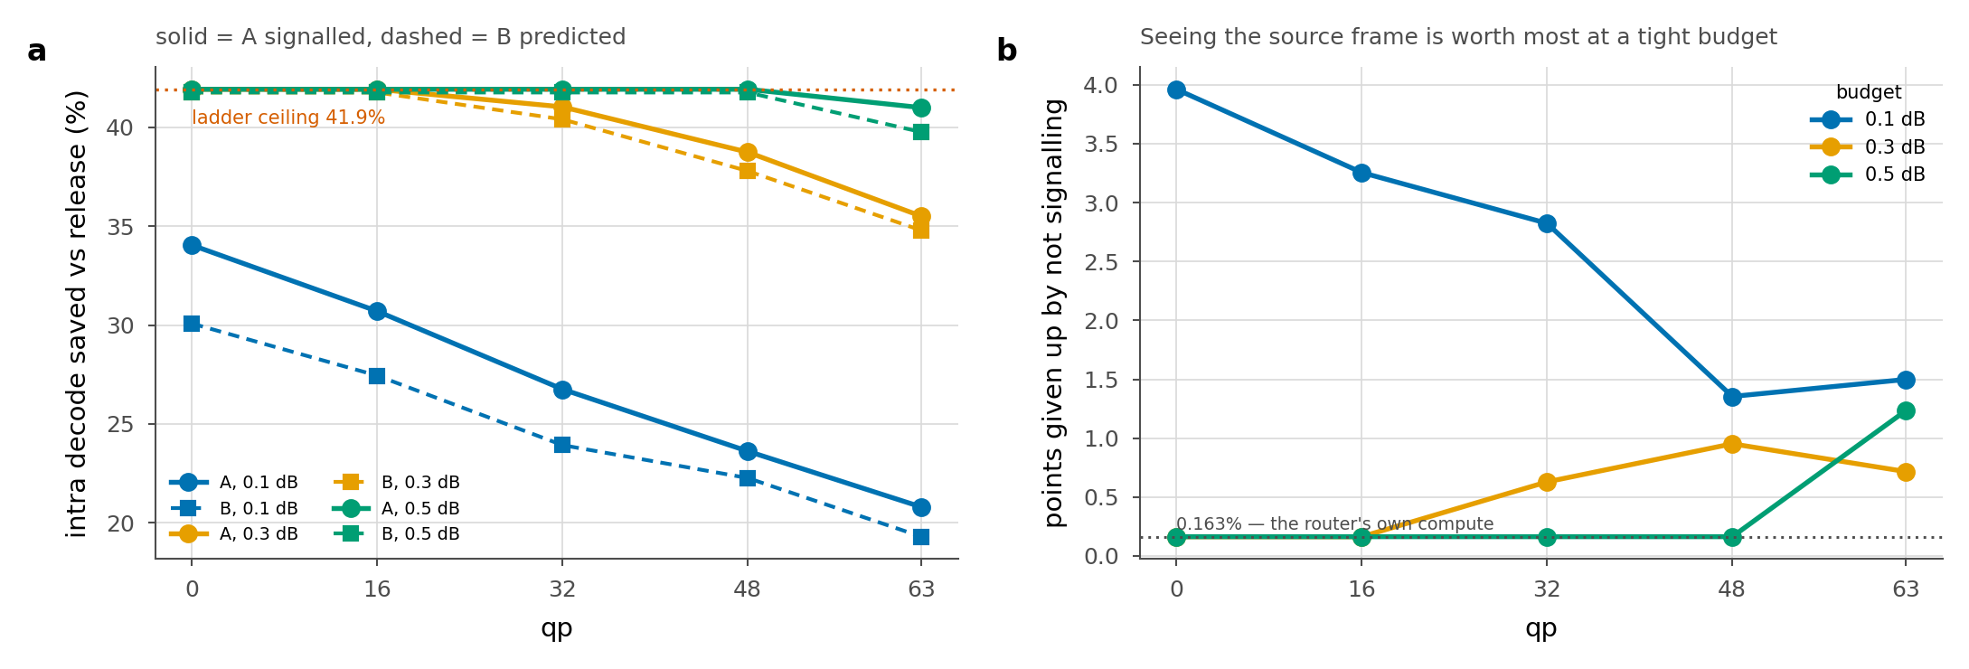
A claim overturned
Earlier claim: prediction fails, signalling works
that was ONE router — BEST's, trained jointly with a moving decoder — not routing as such. Agreement 0.000 at qp 63, 239 of 240 tiles to one exit
Routing works. Three routers, three outcomes:
BEST, joint collapsed to a qp-dependent constant
FINE12, joint did NOT collapse · budget met, β ≈ −0.01
retrained on FROZEN 0.848–0.923 agreement · budget met at every rate
⇒ the limit was the training target, not the information — and joint training does not always break it, which is itself unexplained
Cost of not signalling · 0.1 dB 1.35–3.96 pts · 0.3 dB 0.16–0.95 · 0.5 dB 0.16–1.23
at the ceiling the gap is 0.16 = the router's own 0.163%

Slide 22
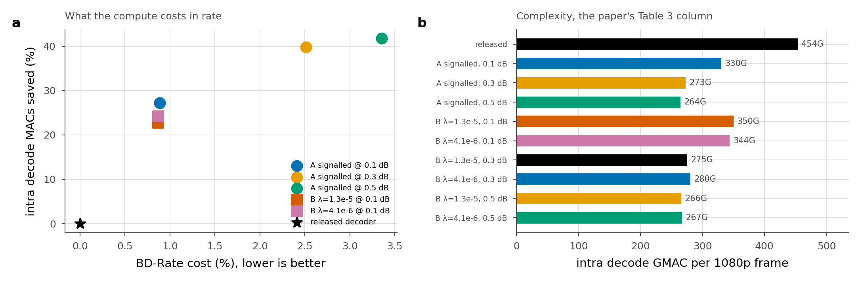
The price of speed
BD-Rate = cost · MACs saved = benefit · released intra decoder, YUV420
0.1 dB 0.88% / 27.6% 0.3 dB 2.51% / 39.5% 0.5 dB 3.36% / 41.7%
Per unit of REAL speedup: 6.2 · 6.6 · 6.5 BD-Rate points
flat across the range — an exchange rate, not a chosen operating point
DCVC-UF HT-L → HT-S: 10.6 points for 1.66× = 16.1 points per unit
⇒ adaptive depth buys speed 2.4× cheaper than shrinking the model
their pair is whole-video, ours intra-only → a calibration, not a head-to-head

Slide 23
Related work
Early exit / dynamic depth · BranchyNet, MSDNet, SkipNet
decide from the network's own output; ours decides per SPATIAL TILE for a fixed output
ClassSR
routes patches to differently sized SR branches for a cost target
ours: a DEPTH inside one network, for a quality target, bitstream fixed
Xie et al. · RDC optimisation in neural image compression · 2305.07678
adaptive spatial mask decoded from side information — closest to our B
adapts the ENTROPY model's dependencies; we adapt SYNTHESIS depth
Spatial competition · 2605.13243
per-region mode map at 1.8e-4 bpp (ours 4.5e-5) — selects CODECS for rate, not depth for compute
Loss-free load balancing · 2408.15664 · used directly
balanced toward the ORACLE's exit mix, not uniform — exits are not interchangeable experts

Slide 24
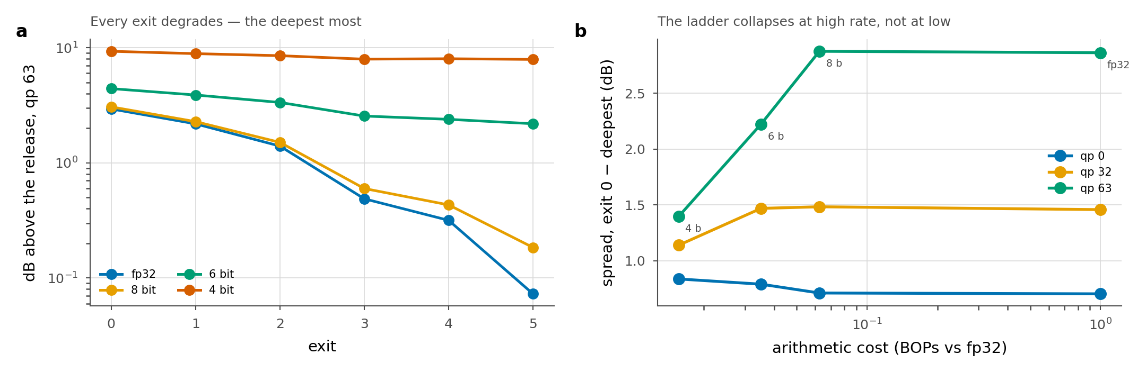
Quantisation · a second, orthogonal lever
Weight-only · per-channel · no calibration · decoder only
Registered prediction — shallow exits suffer more — FALSIFIED
qp 63, 8 bit: exit 2 +0.108 dB, deepest +0.111 dB, ratio 0.97
the deepest starts at 0.073 dB and has no headroom for a noise floor
What matters is the SPREAD — the only thing a router can act on
qp 63 fp32 2.864 → 8 b 2.876 → 6 b 2.224 → 4 b 1.398 · BOPs 1.000 → 0.062 → 0.035 → 0.016
qp 0 0.704 → 0.712 → 0.791 → 0.837 — flat to rising, no collapse
8 bit composes cleanly at 16× fewer BOPs · the collapse is a HIGH-RATE effect, not a general one
caveat: 8 bit still raises the floor 0.073 → 0.184 dB at qp 63

Slide 25
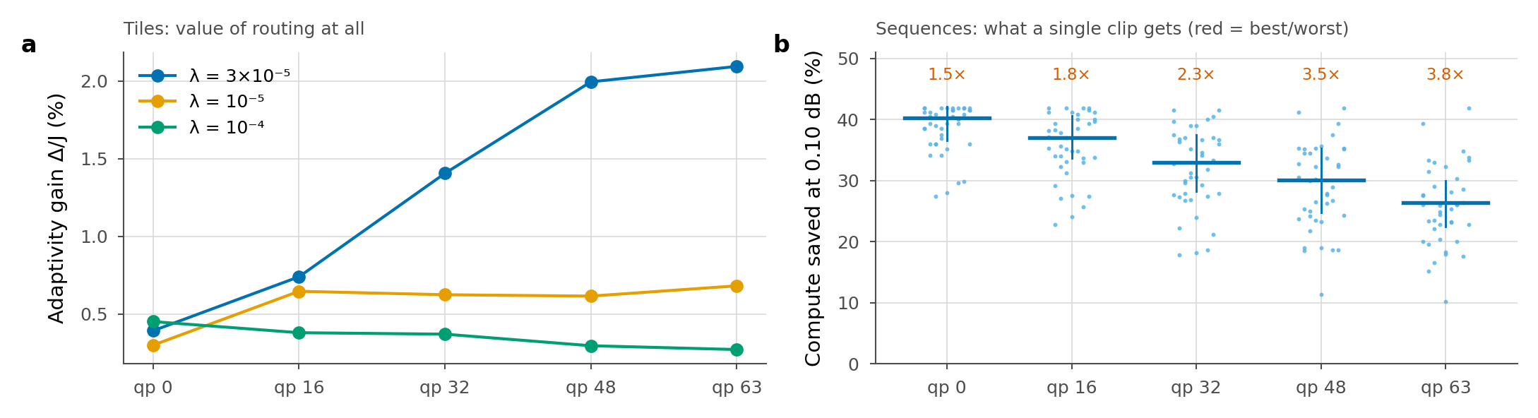
Why per-tile beats any fixed mix
Cost additive over tiles, MSE a mean over tiles ⇒ both affine in the assignment
fixed proportions → convex hull of the K exit points
per-tile assignment → Minkowski average of the N tile hulls
Gap = min-of-average − average-of-min ≥ 0
zero iff every tile prefers the same exit — this IS the value of adaptivity
Measured Δ/J: 0.39% → 2.09% with rate
Same mechanism per sequence · best/worst CTC clip 3.8× at qp 63 vs 1.5× at qp 0

Slide 26
What is still owed
A static decoder truncated to the depth we average
6.95 of 12 blocks at qp 0 · 8.78 at qp 63
decides whether adaptivity is the contribution
All six runs to 4 epochs
every number here is one checkpoint; the saving is still climbing
HEVC B / C / D · 13 of 53 sequences · reported as NOT MEASURED
Sorted-tile execution, end to end
prototyped and bit-identical; not landed while six runs import the decoder
Wall-clock on an idle card · these ratios were taken at 100% utilisation
Open · CONTROL degrades over its second epoch and the cause is unknown

