Slide 1
GPU Accelerated
Symmetric
Encryption & Decryption
M. Caner TOL
26.03.2019

Slide 2



Background
Symmetric Encryption
Plain Text
Plain Text
P
P
A
“Paraları sıfırla”
“Paraları sıfırla”
B

Slide 3

Background
Symmetric Encryption
Unsecure
Channel
Plain Text
Plain Text
P
P
A
“Paraları sıfırla”
“Paraları sıfırla”
B

Slide 4

Background
Symmetric Encryption
Unsecure
Channel
Plain Text
Cipher Text
Plain Text
P
C
P
A
“Paraları sıfırla”
“Paraları sıfırla”
B
“aO8Rfohe+wlVBreM=“

Slide 5

Background
Symmetric Encryption
Unsecure
Channel
Plain Text
Cipher Text
Plain Text
Encryption Algorithm
Decryption Algorithm
P
P
C
A
“Paraları sıfırla”
“Paraları sıfırla”
B
“aO8Rfohe+wlVBreM=“
Secret Key 128-256 bits

Slide 6
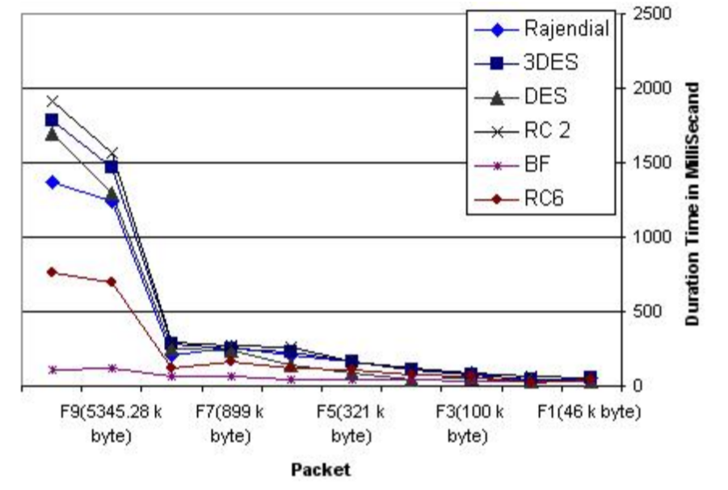
Encryption Algorithms
High data size
High encryption time
High decryption time

Slide 7
3DES
Triple Data Encryption Standard
Symmetric key
Block Cipher
Slow on software

Slide 8
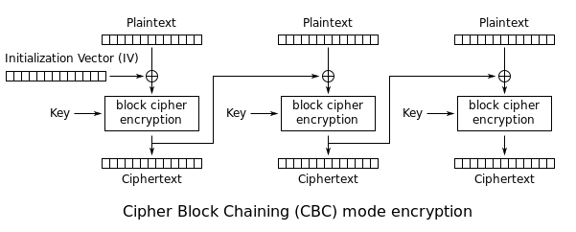
3DES

Slide 9
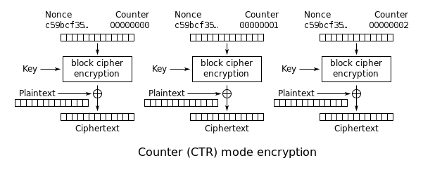
3DES
Parallel encryption and decryption
Possible to implement on GPU

Slide 10
References
Elminaam, D. S. A., Kader, H. M. A., & Hadhoud, M. M. (2008). Performance evaluation of symmetric encryption algorithms. IJCSNS International Journal of Computer Science and Network Security, 8(12), 280-286.
Abdel-Karim, A. (2006). Performance analysis of data encryption algorithms.

