Slide 1
GPU Accelerated Symmetric Encryption & Decryption
M. Caner TOL
26.03.2019

Slide 2



Background
Symmetric Encryption
Plain Text
Plain Text
P
P
A
“Paraları sıfırla”
“Paraları sıfırla”
B
Notes:
First let me give some background about cryptography and lets see what a symmetric encryption is.
For example, There are two people, A and B.
Person A want to send a message to B through such a communication channel. We call this message , the plain text.
Plain text is transmitted on this channel and arrives to B.
But there is something A doesn't know about.

Slide 3

Background
Symmetric Encryption
Unsecure Channel
Plain Text
Plain Text
P
P
A
“Paraları sıfırla”
“Paraları sıfırla”
B
Notes:
The plain text can be seen by an intruder while its being transmitted on the channel. Since there is no guarantee that this will not happen, we call this kind of channel, an insecure channel.

Slide 4

Background
Symmetric Encryption
Unsecure Channel
Plain Text
Cipher Text
Plain Text
P
C
P
A
“Paraları sıfırla”
“Paraları sıfırla”
B
“aO8Rfohe+wlVBreM=“
Notes:
Therefore, person A changes the plain text in such a way that it cannot be understood by other people than person B. The plain text is transmitted on the insecure channel as an encrypted message. So the intruder sees the cipher text, but cannot understand it.

Slide 5

Background
Symmetric Encryption
Unsecure Channel
Plain Text
Cipher Text
Plain Text
Encryption Algorithm
Decryption Algorithm
P
P
C
A
“Paraları sıfırla”
“Paraları sıfırla”
B
“aO8Rfohe+wlVBreM=“
Secret Key 128-256 bits
Notes:
For doing this, person A uses an Encryption Algorithm to turn plain text to cipher text. And Person B uses a decryption algorithm to turn the cipher text to the plain text again. In order to prevent the intruder from predicting the plain text from cipher text a shared secret key is used. This key is actually nothing but a large number including 200 to 300 bits

Slide 6
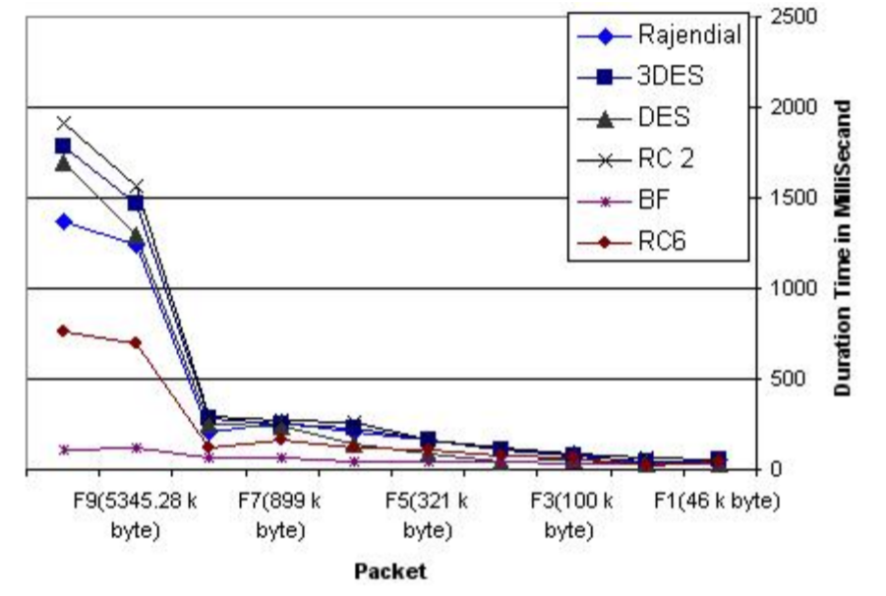
Encryption Algorithms
High data size
High encryption time
High decryption time
Notes:
So we are encrypting our data using encryption algorithms. But there is a cost of this extra operation.
As the size of the data increases the number of operations on data gets higher.
So it uses higher CPU time for encryption and decryption.

Slide 7
3DES
Triple Data Encryption Standard
Symmetric key
Block Cipher
Slow on software
Notes:
One of the well known encryption algorithms is 3DES. It stands for Triple Data Encryption Standard.
It is actually a symmetric key algorithm. That is, it uses a shared secret key for encryption and decryption.
It is also a block cipher. It takes the data as blocks and encrypts according to its mode of operation.
3DES is slow on software implementations because it is designed to use on hardware.
But it is still being used on many common software applications.

Slide 8
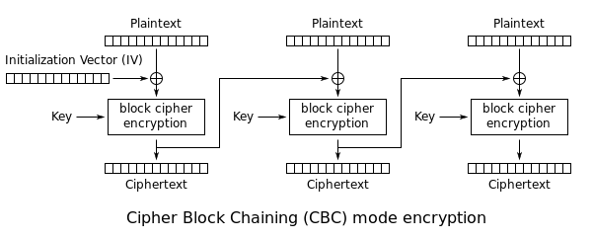
3DES
Notes:
There are several modes of operation of a block cipher. One of them is Cipher Block Chaining mode. In this mode each block waits the previous blocks to be encrypted. Therefore it is a sequential operation and not suitable for parallel computation.

Slide 9
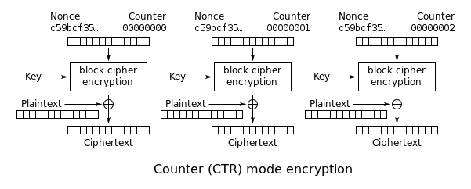
3DES
Parallel encryption and decryption
Possible to implement on GPU
Notes:
Another mode is the counter mode. In this mode, each block of data is independently encrypted and decrypted. So parallel encryption and decryption is possible.
3DES in counter mode is possible to implement in GPU and I belive that it will provide large performance gain for large data sizes.

Slide 10
References
Elminaam, D. S. A., Kader, H. M. A., & Hadhoud, M. M. (2008). Performance evaluation of symmetric encryption algorithms. IJCSNS International Journal of Computer Science and Network Security, 8(12), 280-286.
Abdel-Karim, A. (2006). Performance analysis of data encryption algorithms.

