Slide 1
Detecting Circles and Rectangles in MATLAB
Caner Topuz
090200358

Slide 2
What Did I Use?
For Circles:
Circularity
For Rectangles:
The fundamental properties of rectangles
Fast Method for Rectangle Detection by Cheng Wang
And
MATLAB Image Processing Toolbox

Slide 3
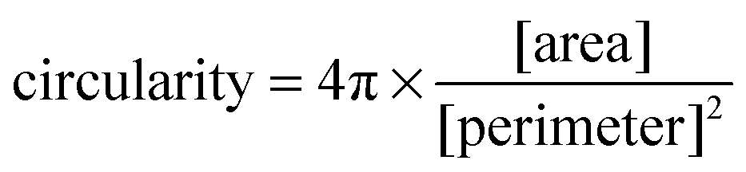
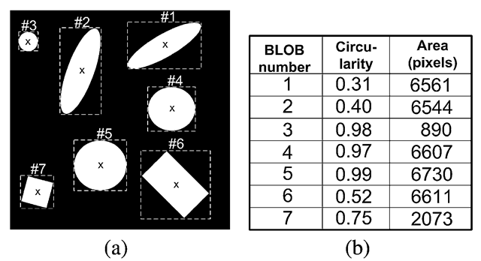
Circularity
This ratio will be 1 for a circle and goes down as far as 0 for highly non-circular shapes.

Slide 4
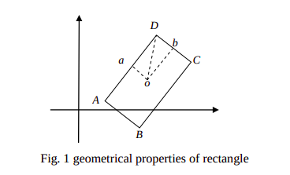
The method I use to detect rectangles
Fast Method for Rectangle Detection by Cheng Wang
Calculate the length of oa, ob, oD and area S using by MATLAB tools.

Slide 5
MATLAB Image Processing Toolbox
imbinarize()
  Binarize grayscale 2D image or 3D volume by thresholding.
bwareaopen()
  Remove small objects from binary image.
imfill()
  Fill image regions and holes
bwlabel()
  Label connected components in 2-D binary image.
regionprops()
  Measure properties of image regions.
bwboundaries()
  Trace region boundaries in binary image.

Slide 6
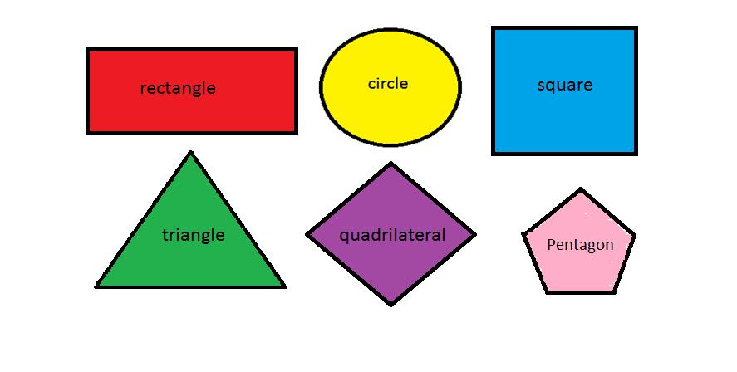
Example(step-by-step)
1) Sample Image

Slide 7
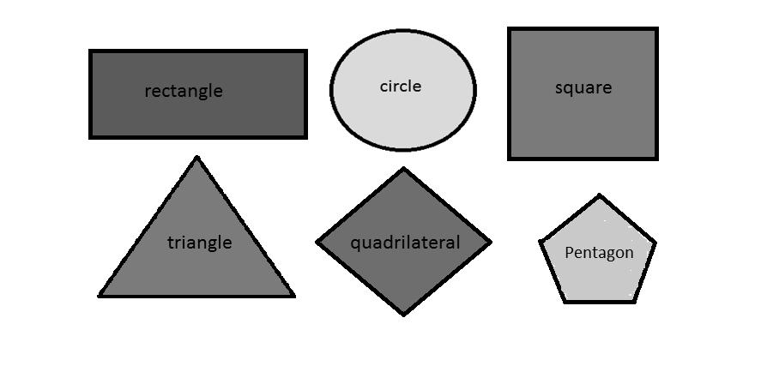
Example(step-by-step)
2) Gray image
~rgb2gray()

Slide 8
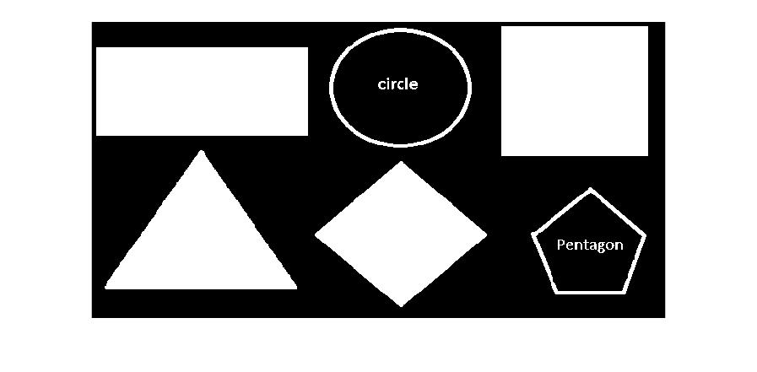
Example(step-by-step)
3) Binarized image
~imbinarize()

Slide 9

Example(step-by-step)
4) Clear binarized image
~bwareaopen()

Slide 10
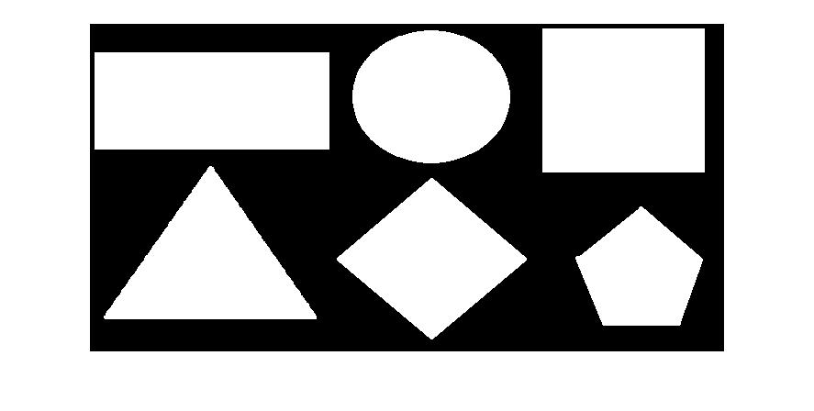
Example(step-by-step)
5) Final binarized image
~imfill()

Slide 11
Example(step-by-step)
6)
bwlabel()
regionprops()
bwboundaries()
We find the measurements ​​using the above functions

Slide 12
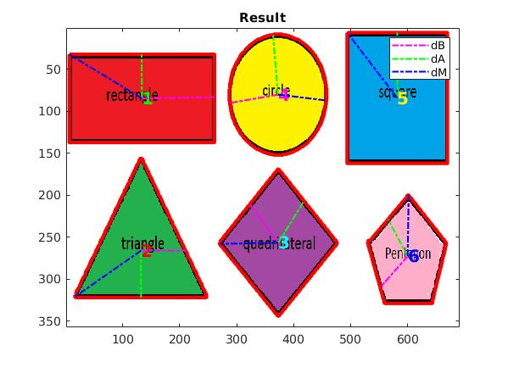
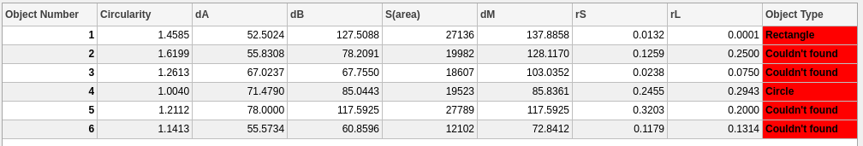
Example(step-by-step)
0.95< Circularity <1.05
rS < 0.1(%10)
rL < 0.05(%5)
𝑟S = abs((𝑆 − 4*𝑑A ∗ 𝑑B )/𝑆)
𝑟L = abs((𝑑M − sqrt(𝑑A^2+ 𝑑B^2)/ 𝑑M)

