Slide 1
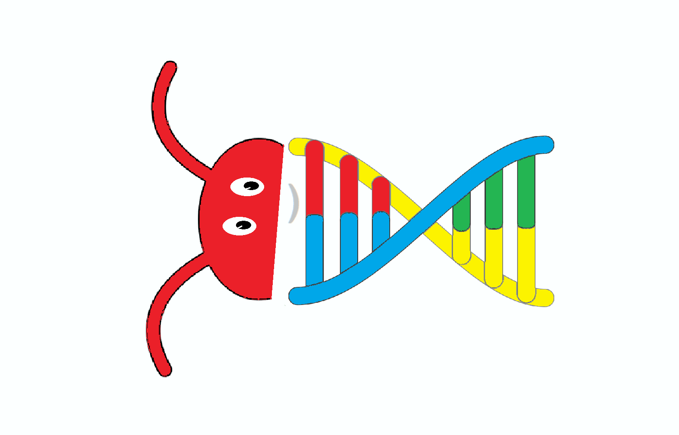
GenomeBugs
Insect Biodiversity Dynamics from their Genome Sequences
NASA International Space Apps 2021
Challenge:
Seeing the unseeable - Viewing Bugs from Space
Team:
Enrique Canessa,
Livio Tenze

Slide 2
What?
To study the dynamics of insects biodiversity via their whole genome sequencing can be a solution to uncover and visualize distinctive patterns embedded in their intrinsic data organization over time.
The goal is to detect, track and predict changes over time along the history of insects life using, e.g., available resources from NCBI Genome Datasets.
We aim to determine today's genetic information of insects at a single nucleotide level to pass it to future generations of humans to preserve the knowledge and environments.

Slide 3
Why?
Our planet Earth so far as we know is unique and it contains life depicted in millions of creatures of different species.
It becomes extremely urgent to combat any loss of life biodiversity for the well-being of all species.
To achieve this goal, we propose to consider quantifying and characterizing the dynamics of insects biodiversity in order to preserve and understand better their Nature.

Slide 4

How?
GenomeBugs is based on our recent Genomebits open source program to study characteristics of signals from genome sequences of viruses according to their progression along the nucleotide bases position.
see: https://github.com/canessae/GenomeBits
The GUI runs under Linux Ubuntu O.S., and it can be useful to study the dynamics of insects genome variants using available available resources, e.g., those from NCBI Genome Datasets.

Slide 5
How?
One deals with a certain type of alternating finite series having terms converted to binary values (0,1) for the nucleotide bases (A)denine, (C)ytosine, (G)uanine and (T)hymine according to their progression along the genome sequences.
This mapping into four binary projections of the sequences follows previous studies on the three-base periodicity characteristic of protein-coding DNA sequences.
For example, by this method we uncover distinctive signals of the intrinsic gene organization revealed by the genome sequences of the single-stranded RNA coronaviruses, and similarly to the genomics sequence of insects.

Slide 6
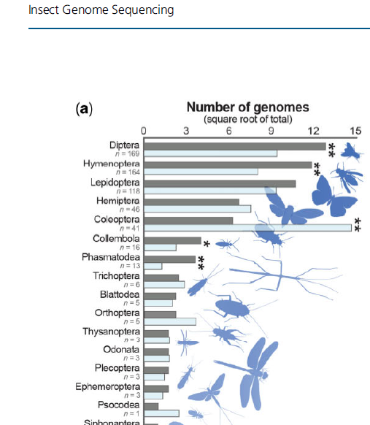
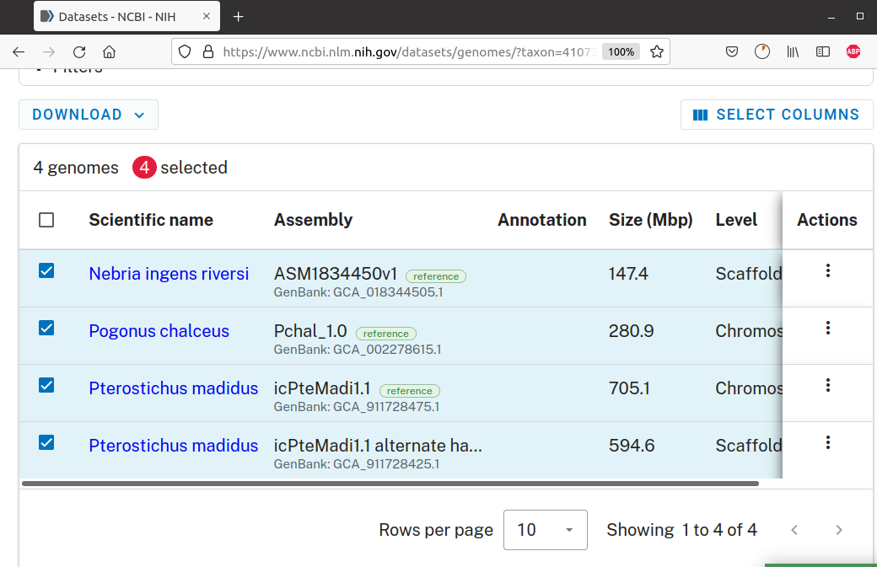
Examples Insects
Open Genome Data
Taken from: Genome Biol. Evol. 13(8)
doi:10.1093/gbe/evab138
Advance Access publication 21 June 2021
NASA International Space Apps Challenge

Slide 7
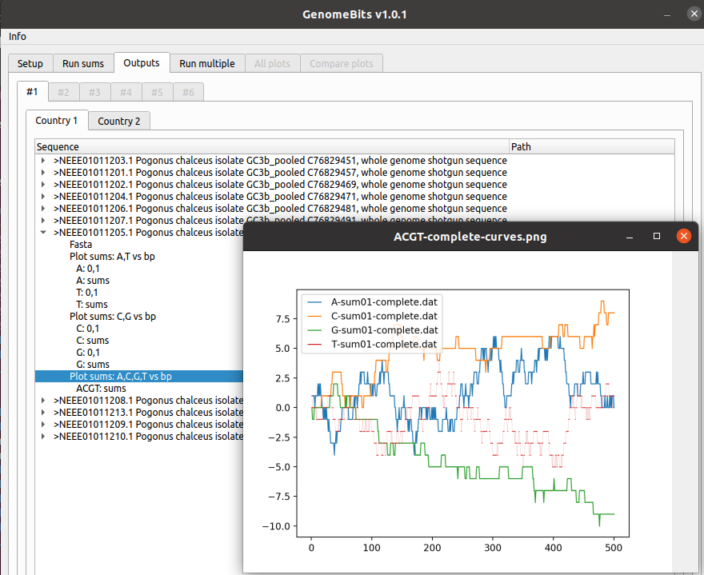
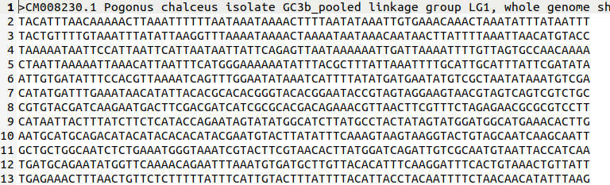
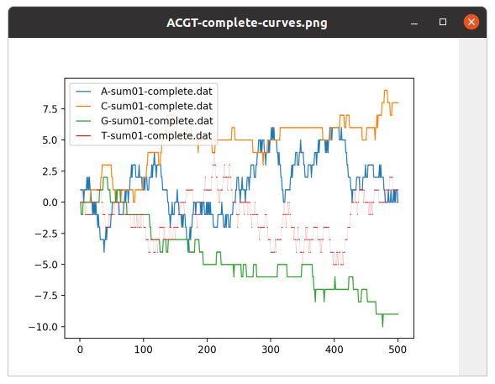
Genome carries our Future!
Results from
GenomeBugs

