Slide 1
Expanding E-Commerce Services in Brazil
Ammad Baber
Evan Canfield
Roma Dutta
Max Lawrence
Amit Pandit
Notes:
Group

Slide 2
Olist
Brazilian E-Commerce Website
Growing well, and internationally recognized as a leader in this new market
Attempting to expand the number of small retailers that use the website as a platform
Hope this expansion will allow them to remain ahead of new competitors (Amazon, other Brazilian startups, etc.)
Gave out data on Kaggle competition in order to allow for others to help them
Notes:
Max

Slide 3
Our Research Question
How can Olist increase the number of sales they make in order to enhance their attractiveness to small scale retailers that they are competing for against Amazon and other e-commerce providers?
Notes:
Max

Slide 4
Data
The main data we used came from Olist providing it to Kaggle
The dataset was a sample of the sales data from 2016 through 2018. The dataset included information on 100,000 unique sales.
The dataset also included additional information:
Geographic Location (Customer and Seller)
Detailed Order Description
Logistical Operation Information for each order
We also used used Brazil’s 2019 population projections for secondary analysis
Notes:
Max

Slide 5
Data Description (Summary Statistics)
Purchases per Customer
Minimum: 1
Median: 1
Maximum: 17
Price by Order($R)
Minimum: 0.01
Mean: 154
Maximum: 13,664
Delivery Time (Days)
Minimum: 0.5
Mean: 13
Maximum: 210
Notes:
Max

Slide 6
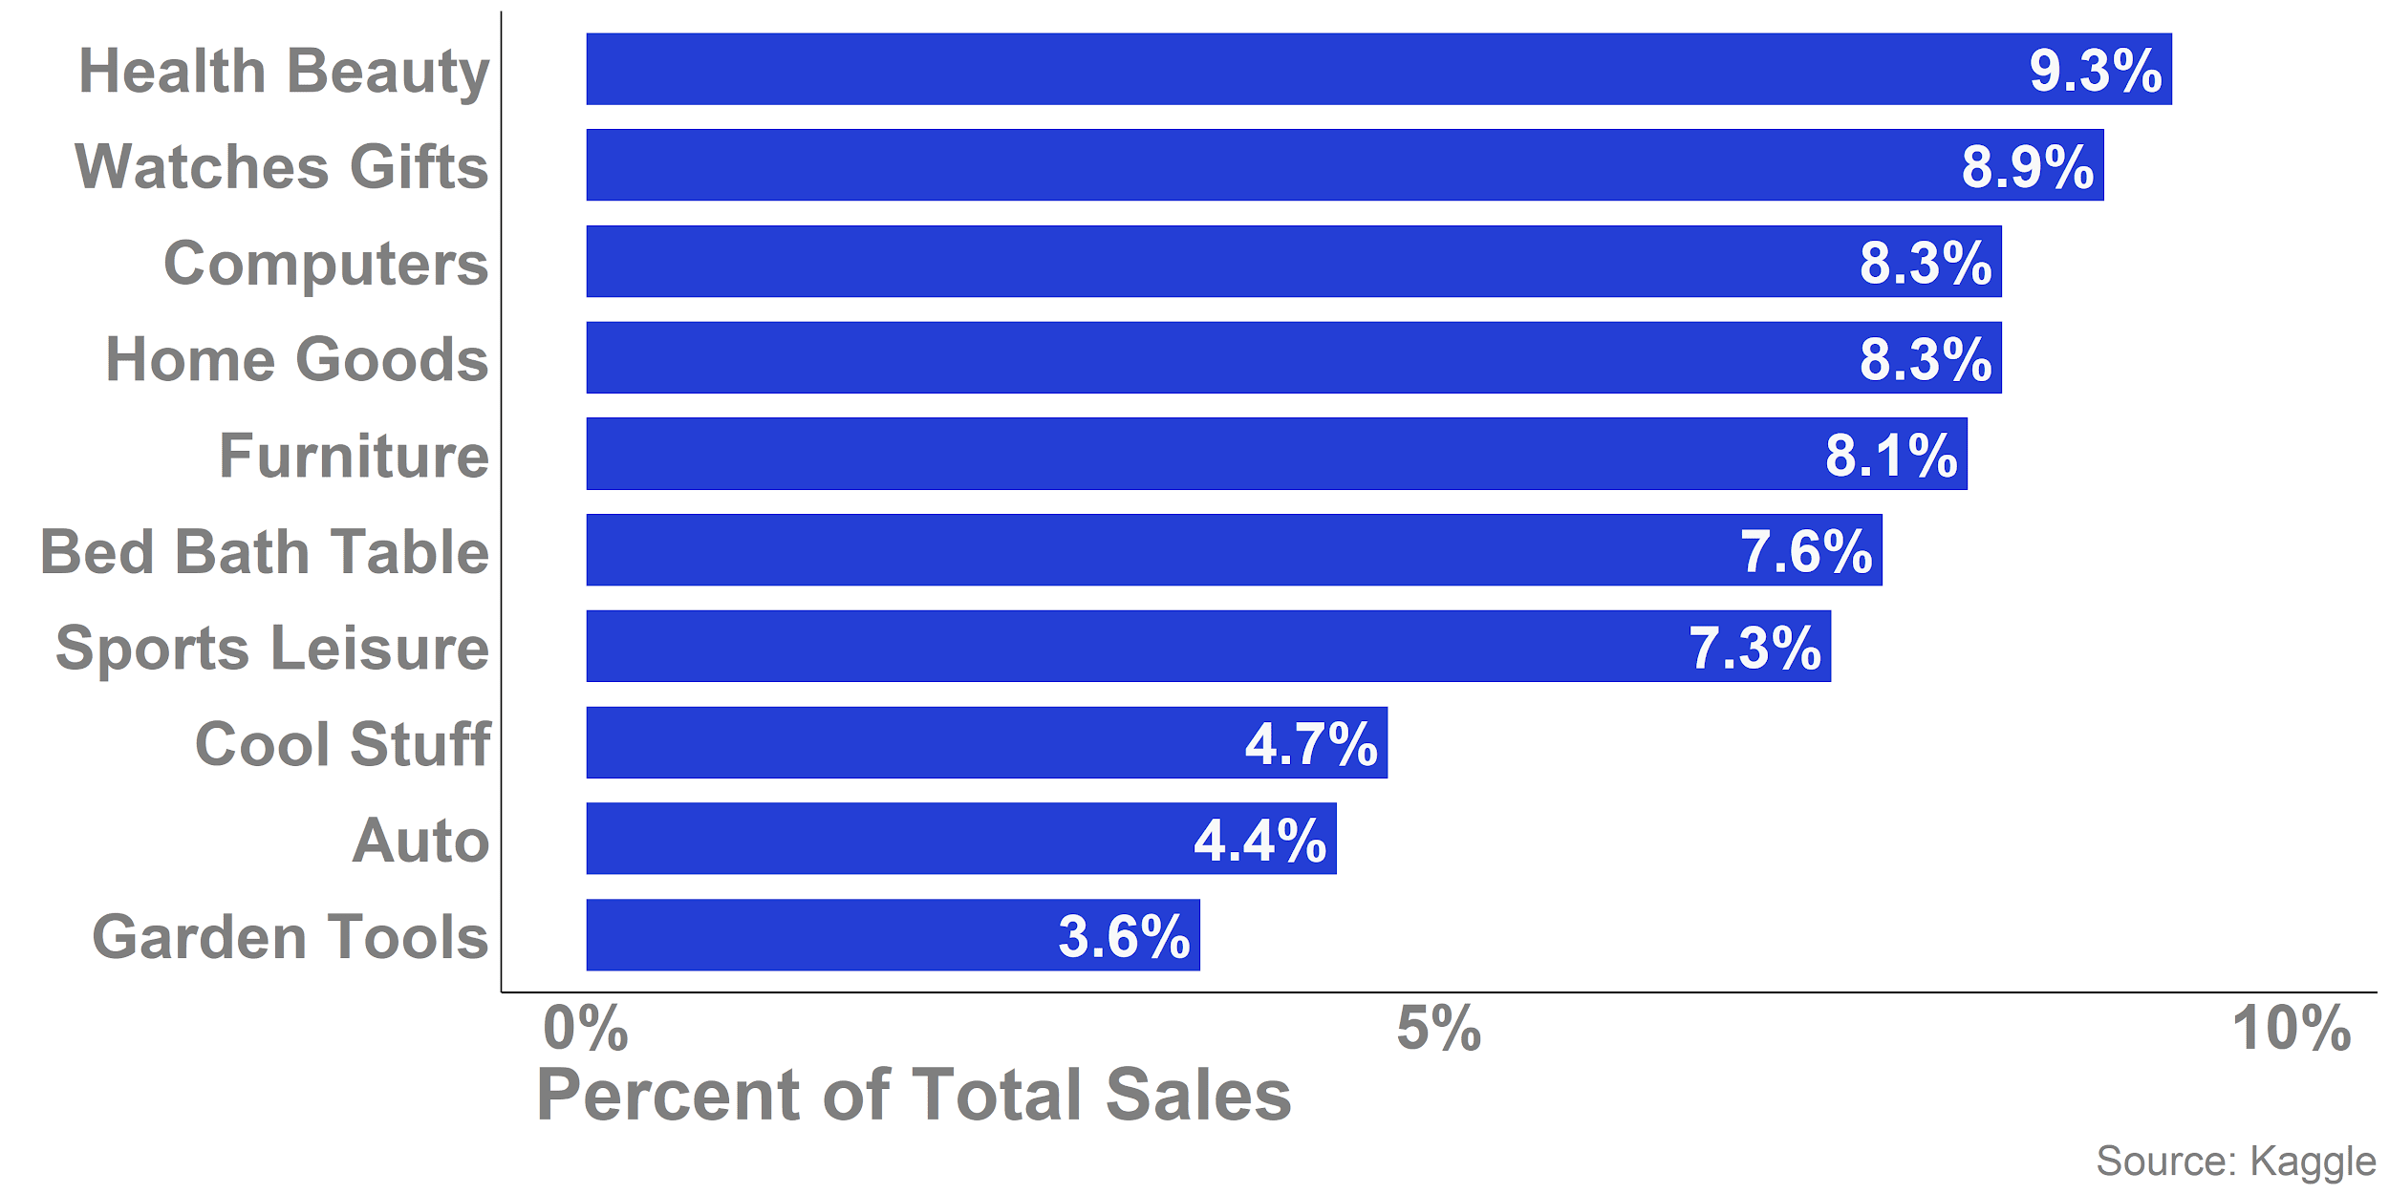
Top 10 Product Categories
Notes:
Max

Slide 7
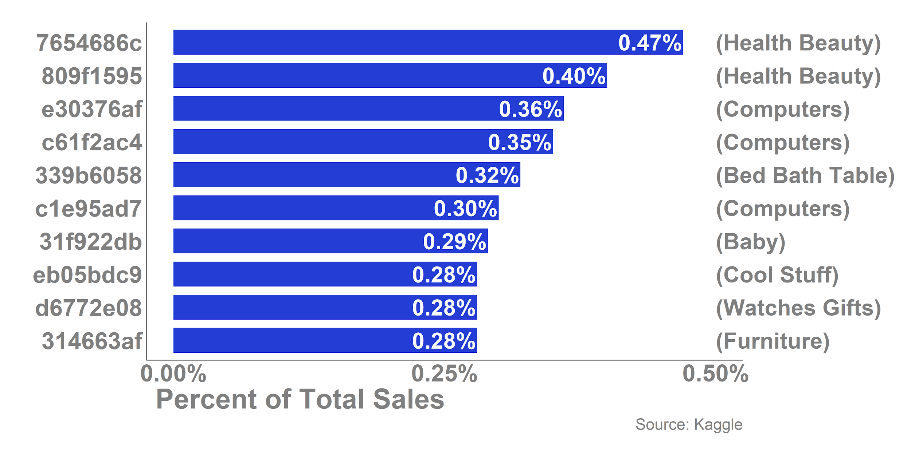
Top 10 Products
Product Tag
Product Category
Notes:
Max

Slide 8
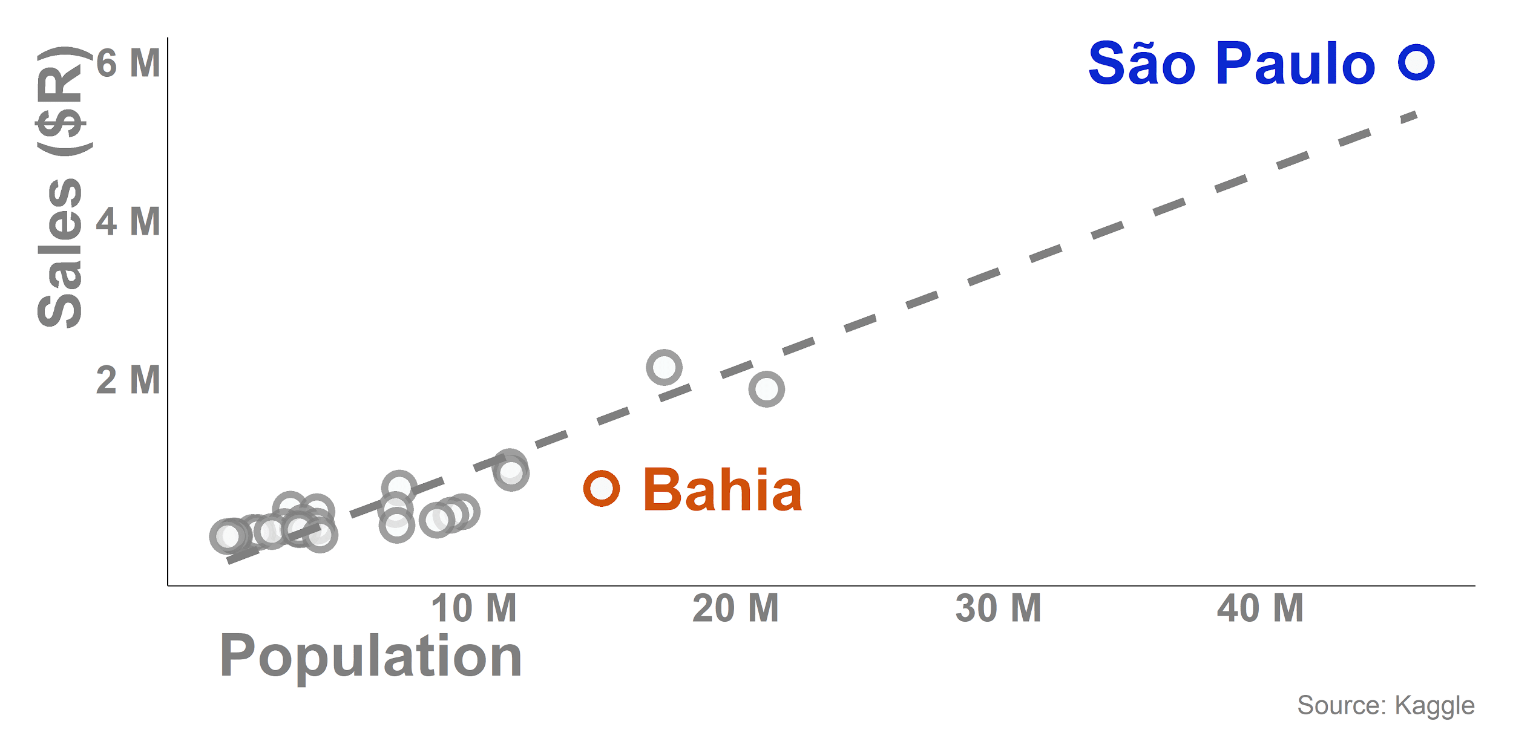
State Sales is Correlated with Population
(Most Overperforming State)
(Most Underperforming State)
Notes:
Evan

Slide 9
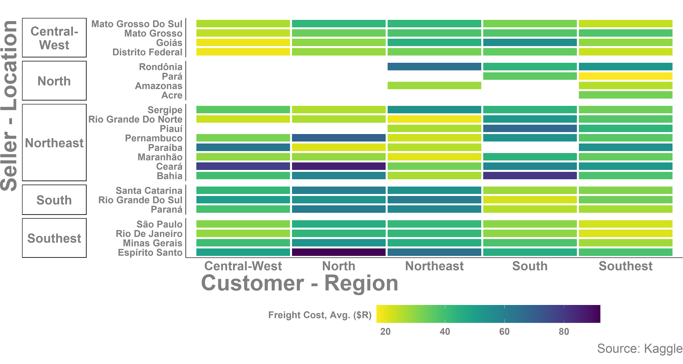
Local Shipments Are Far Less Expensive
Region
State

Slide 10
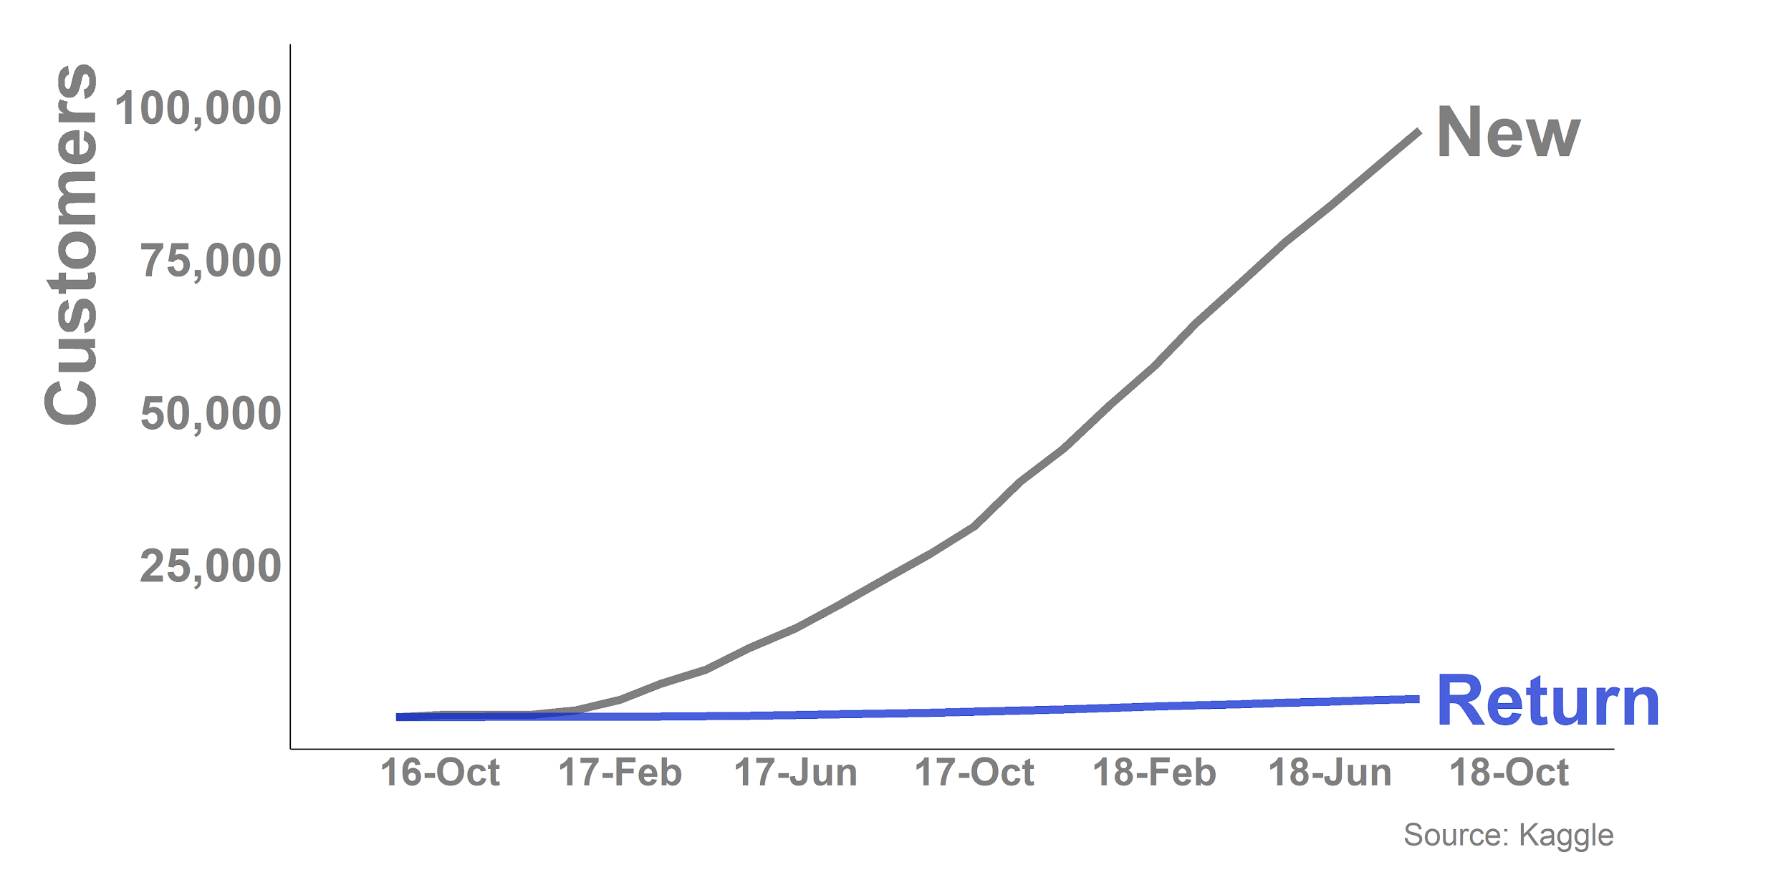
Return Customer Growth is Sluggish
Notes:
Evan

Slide 11
Return Customer Breakdown
While Brazil is a very large country, Olist cannot continually rely only on new customers as growth increases.
To safely grow the total sales, Olist must increase the percentage of return customers.
Current Return Customer Statistics:
Make up 3.1% of all unique customers
Account for 6.7% of all items ordered
Account for 5.7% of all sales (R$)
Notes:
Evan

Slide 12
Return Customer Modeling
In order to identify factors important to Return Customers, we performed a logistic regression analysis with the data.
This dataset included the following variables:
Target Variable
Return: Binary variable indicating if a customer made more than one unique orders
Predictor Variable - Continuous
Spend: Customer spend, average ($R)
Distance: Distance between customer and seller, average (km)
Shipping Time: Time from purchase to delivery, average (days)
Predictor Variable - Categorical
Late: Binary variable indicating if the package was delivered before or after projected date
Method of Payment (4 categories)
Product Category (39 categories)
Review Score: 1 - 5 Likert Scale (discrete values)
Notes:
Evan

Slide 13
Return Customer Factors
Based on the the logistic regression targeted at return customers, the following factors were found to be important and significant:
The number of days from purchase to delivery have no effect on being a Return Customer (Odds Ratio of 1.02, p value < 0.05)
BUT customers who received late orders were 76% less likely to be Return Customers, compared to customers who did not receive late orders.
Product Categories (compared to customers who purchased from Health Body):
Customers who purchased from Bed Bath Table were 43% more likely to be Return Customers
Customers who purchased from Cool Stuff were 37% less likely to be Return Customers
Notes:
Evan

Slide 14
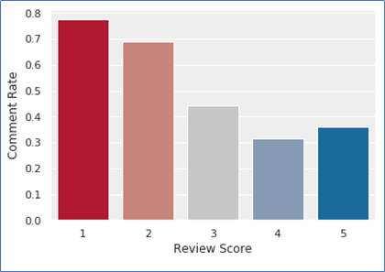
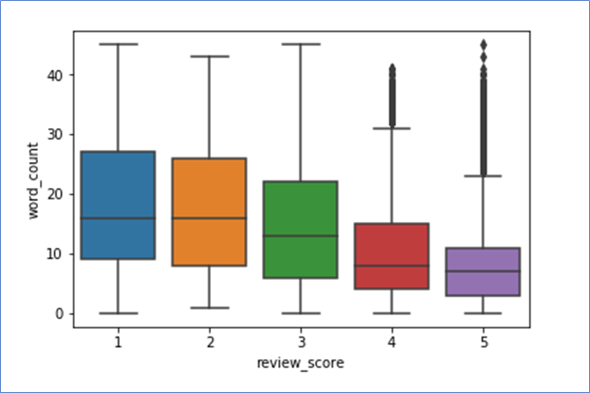
Customer Sentiment
Less satisfied customers are more likely to write review comments
Less satisfied customers are more likely to write longer comments
1-star reviews are complaining about :
Not received their goods yet
Difficulty purchasing multiple products together
Received wrong and bad quality fake goods
Customers with 5-star reviews enjoy most about the fast delivery
Notes:
Roma: Have added the pictorial view to start with.

Slide 15
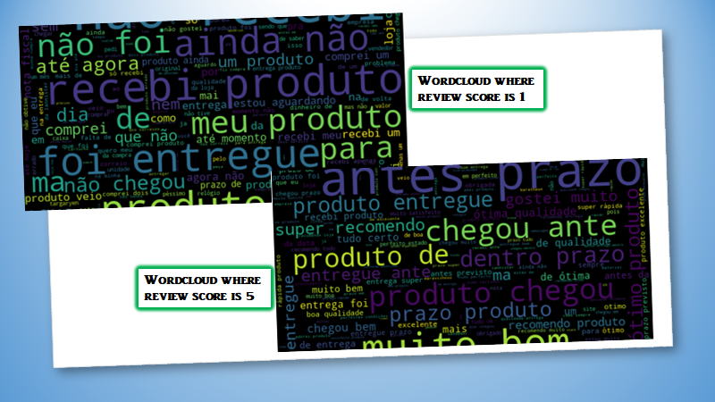
Notes:
Roma: added wordcloud

Slide 16
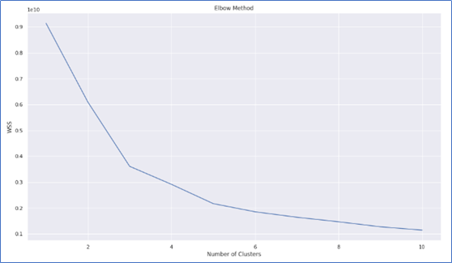
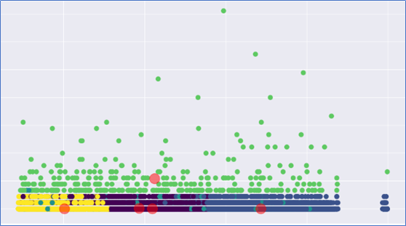
Customer Segmentation - Method 1
In order to deduce necessary marketing action, we performed K-means clustering to broadly divide customers into different segments.
Elbow method indicated to have K value as 5.
Customers,Orders and Order Payments datasets were merged to derive the variables - Recency, Frequency, Monetary_Value and Client_Since.
Notes:
Roma

Slide 17
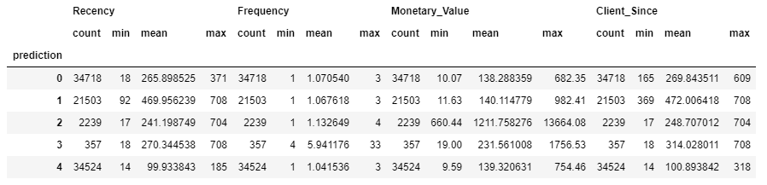
#CLUSTER | CLUSTER LABEL | DESCRIPTION | MARKETING STEP
2 | Big Spenders | Spend the most | Olist can market their most expensive products
3 | Best Customers | Bought most often | Need no price incentives or loyalty programs. Olist can easily campaign for new products
4 | Loyal Customers | Buy most frequently, however, conservative spender | Little to medium price incentives
0 | Almost Lost | Have not purchased for long, spend the least | Aggressive price incentives
1 | Lost | Have not purchased for long | Aggressive price incentives in terms of voucher/coupon etc

Slide 18
Customer Segmentation - Method 2
Recency, Frequency, Monetary (RFM)
Low Value: Customers who are less active than others, not very frequent buyer/visitor and generates very low - zero - maybe negative revenue.
Mid Value: In the middle of everything. Often using our platform (but not as much as our High Values), fairly frequent and generates moderate revenue.
High Value: The group we don’t want to lose. High Revenue, Frequency and ow Inactivity.
Notes:
Evan

Slide 19
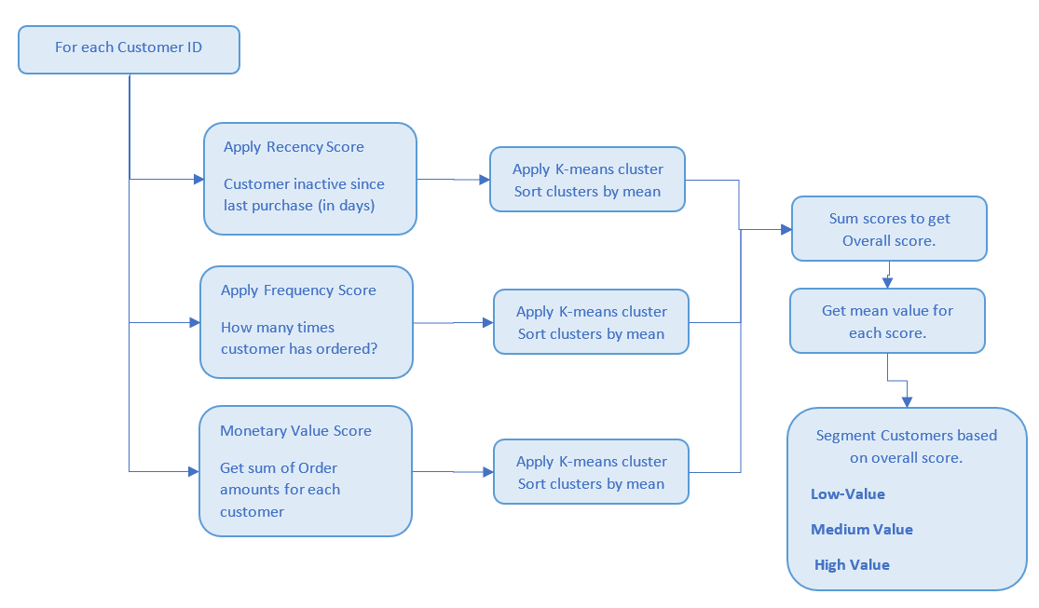
Customer Segmentation - RFM

Slide 20
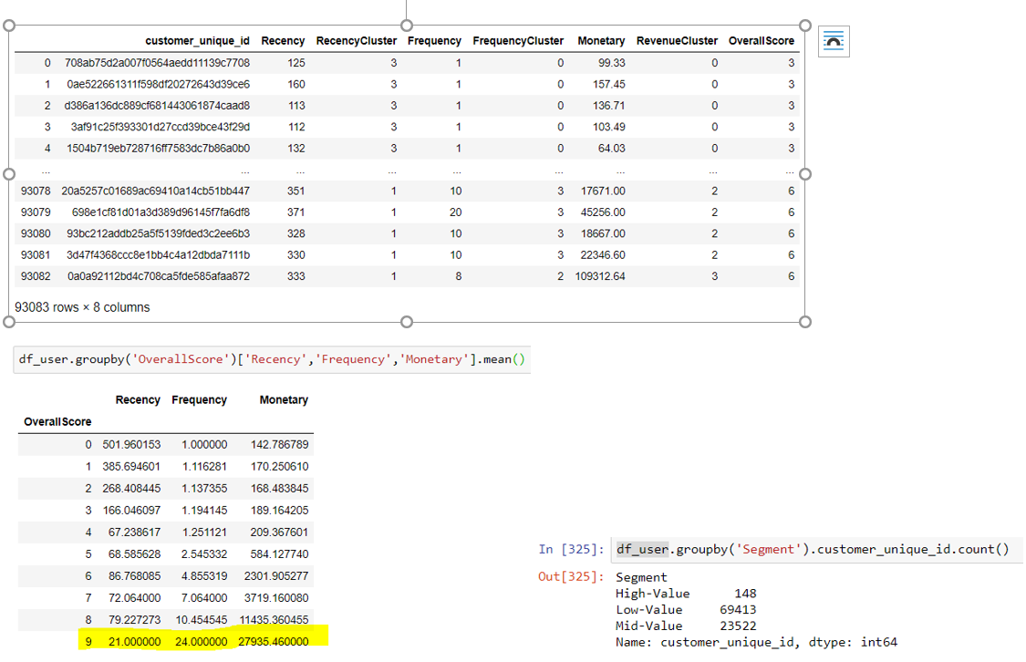
Customer Segmentation - RFM (Cont.)

Slide 21
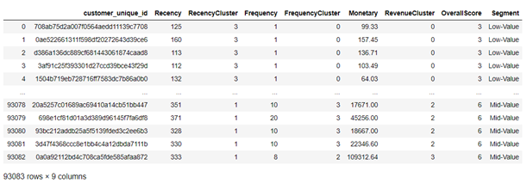
Customer Segmentation - Analysis
We can align different marketing campaigns/strategies based on the different customer segments.

Slide 22
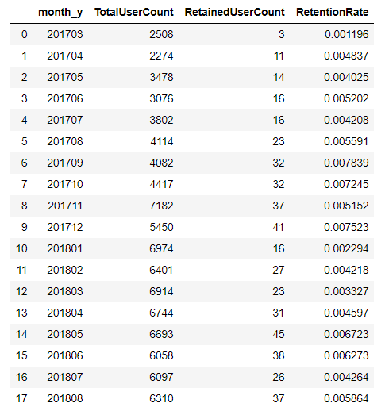
Retention Rate
Retained User Count: Customers for the month who also visited previous month.
Total User Count: Customers for the current month. We see that retention rate is very small, which is a issue since there are very few repeat customers.
Sellers have to address these issues in future.

Slide 23
Future Considerations for Analysis
We lack standard store sales data (compared to e-commerce data)
We lack data from other ecommerce sites (Amazon or otherwise)
Expanded internal dataset. Research indicates that there may be implicit bias in the creation of the available dataset.
We weren’t provided demographic info on customers (Age, sex, income, etc.)
Data set is biased to those who leave reviews
Notes:
Ammad

Slide 24
Conclusion
Olist is not building a loyal customer base of returning shoppers to attract small retailers with
Reliable shipping and operational efficiency seem to be the traits that attract customers to return
Customers and sellers are mostly located in the more developed sections of Brazil (South-East Coast, etc.)
There are clear segments of customers based on how much they spend, and what types of products they buy
Notes:
Ammad

Slide 25
Recommendation
Olist should invest in assisting retailers in delivering the product (monitoring, delivery company contacts, etc.)
Olist and/or sellers should offer customers discounts and sales based on their background and type (Coupons for products that often are bought by return, etc.)
Marketing campaign catering to differing kinds of customers based on customer segmentation
Invest in more marketing in states that are underperforming based on population (will also allow for building brand recognition)
Olist should explore the possibility of creating its own delivery service in the future to combat Amazon
Notes:
Ammad

Slide 26
Questions?
Notes:
Presenter: Ammad

