Slide 1




Streaming Cross-listings:
Identifying stock price differentials between Germany and UK
Notes:
Greetings Everyone, my name is C Cangin. Thanks for coming today.
My project selects the stocks with best price differentials between Frankfurt Germany and London exchanges.

Slide 2
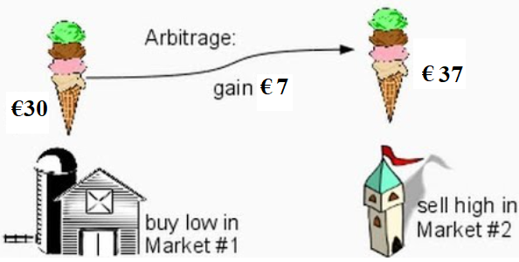
Same item @ different prices in different markets
All Google images citations
Notes:
As we all know, the same item can be priced differently in different markets at different locations, particularly after converting foreign exchange rates.

Slide 3
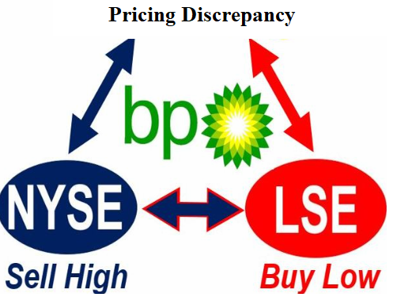

Stock Cross-listing
Common for companies
Started locally but grew internationally
Stock is fungible between exchanges.
More liquid than receipts EDRs, GDRs etc.
  Not European Depositary Receipt (EDR),
  Not global depository receipt (GDR) repackaged
All Google images citations
Notes:
Many Global companies started locally and later grew internationally; their stocks are often cross-listed in different countries.
These cross listed stocks are fungible between exchanges.

Slide 4


Stock Cross listings
Royal Dutch Shell, HSBC, and Siemens are all traded in multiple markets
€ Euro in Frankfurt
£ Pound in London
Prices are NOT kept in perfect alignment between markets.
All Google images citations
Notes:
#4 cross-listed companies are traded in different currencies in different exchanges: Euro in Frankfurt and pounds in UK. No international regulators to keep the pricecs uniform between markets.

Slide 5


Pricing differentials
Example: Frankfurt and London
All Google images citations
Notes:
#5. We want to display real-time "effective" pricing differences of cross-listed stocks between Frankfurt and London.
Frankfurt time is one-hour earlier than London time.

Slide 6






Initial Pipeline
Redis
  In-memory database
  Non-distributed
  Inefficient for writing data
  Slow-writes
  Use-case requires fast-writes
All Google images citations
Notes:
#6. The initial pipeline utilized stateful structured streaming and in-memory Redis database.
redis is non-distributed, non-scalable, inefficient for writing, slow writes.
Our use-case requires fast-writes.

Slide 7




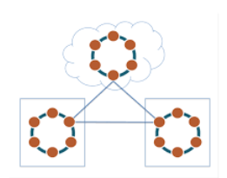
Current Pipeline
Stateless Spark streaming
Use case driven: Fast-writes
All Google images citations
Notes:
Currently, Kafka platform reads and process the streaming data before sending them to Kafka Topic.
Regular RDD Spark streaming (instead of structured streaming) conducts further computations and send the results to distributed Cassandra database.[eventually consistent ]
Simulated UK data (stock & ETF)
Real Germany data (stock & ETF)
Deutsche Boerse
deutsche-boerse-xetra-pds

Slide 8
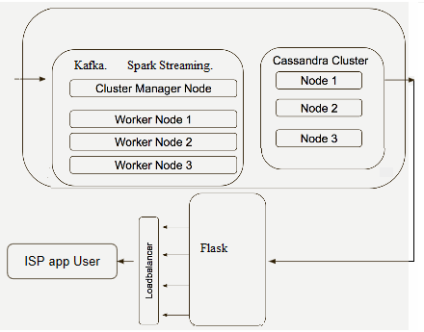
Distributed pipeline
Notes:
Kafka run on 3 machines/hosts. Kafka "CLEANED UP" all data formats before sending the data to the Kafka Topic.
Spark streaming run on the same cluster of 3 machines, performed computations.
Cassandra runs on separate dedicated cluster of 3 nodes).

Slide 9
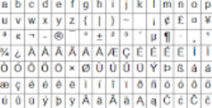
Data ingestion & cleaning
Data validation
  Missing value?
  Sensible range?
    Negative prices?
    Negative counts?
  Correct format?
Notes:
Real International data needs data validation and cleaning.
Unicode? Range? format?

Slide 10
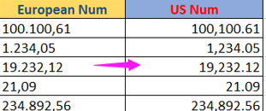
Kafka
Special character
Comma
    Used tokenize optimization
    Quote-enclosed comma becomes Quoted underscore
  From "NESTLE NAM. SF-, 1,0 , 10"
  To "NESTLE NAM. SF-_1 _0 _ 10"
Notes:
Kafka CLEANS up special character, and assure correct data fromat.
If the COMMA is used for delimitation and COMMA is found within each field, then convert all quote-enclosed comma to underscores.
Kafka handles special character.
comma was used for BOTH field-delimitation and within-field description.
Replaced all wrongly-placed "within Quotes" commas with UNDERSCOREs.

Slide 11
What does Spark Streaming do?
The 3 spark streaming nodes:
Currency conversion
Convert UK pound £ to euro €
Frankfurt stock prices in €
London stock prices in £
Notes:
spark streaming node: converts pounds to euro, computed EURO-pricing differences.

Slide 12
UK versus Germany
https://www.youtube.com/watch?v=OydJajxOXPo&feature=youtu.be
http://germanlondon.space/
Notes:
Sorted all the stocks to display those with the highest inter-market price differentials. For the BIG-CAPITalization stocks, Display inter-market pricing differences between Germany and UK. Old https://www.youtube.com/watch?v=_6zyMP8pH8Q

Slide 13
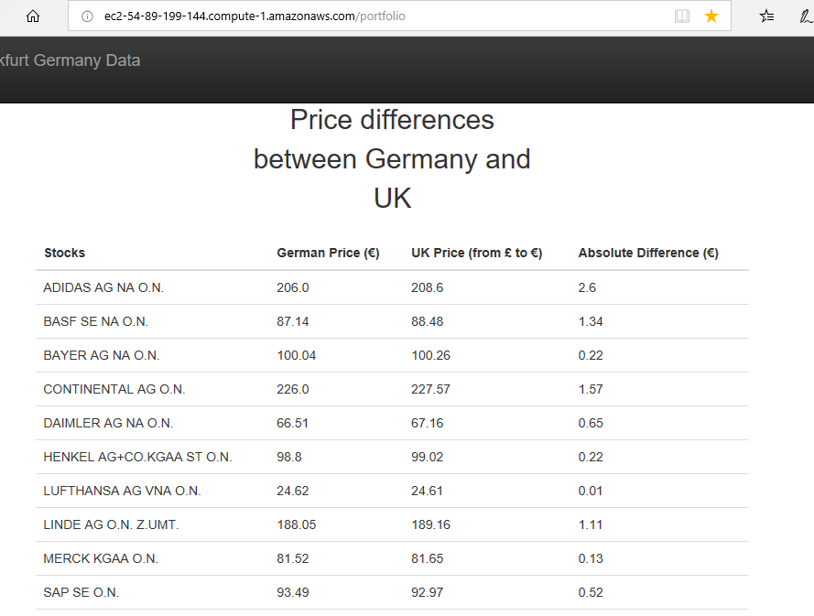
Watching Large-Cap stocks

Slide 14
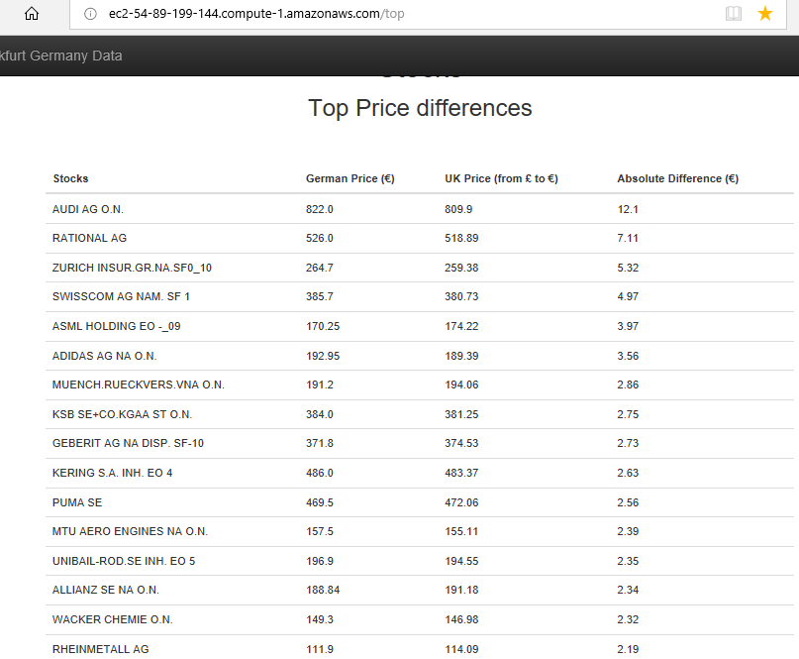

Slide 15


Causenge Cangin
Ph.D. kinesiology research utilized statistical computing
Master of Science in Computer Science
Statistical modeling and analyses of CDC data
computational projects using Gene expression omnibus data
Software engineering experience
Volunteer at Habitat for Humanity (caulking, baseboards carpentry)
Notes:
This is C. Cangin, quantitative Ph.D. in kinesiology utilizing vast statistical computing methodologies from Ohio state university, Master of Science from UC Davis. I had software engineering experience, worked with large datasets from Center of Disease Conotrol, and international gene expression (micro-RNA array) omnibus repositories from all 5 continents.
In one summer, The good people at Habit at Humanity taught me how to do trim carpentry (for baseboards window door moldings).
Thank you for your attention.

Slide 16
