Slide 1
Visual Studio Code for Documentation
Using VS Code for writing docs in Markdown

Slide 2
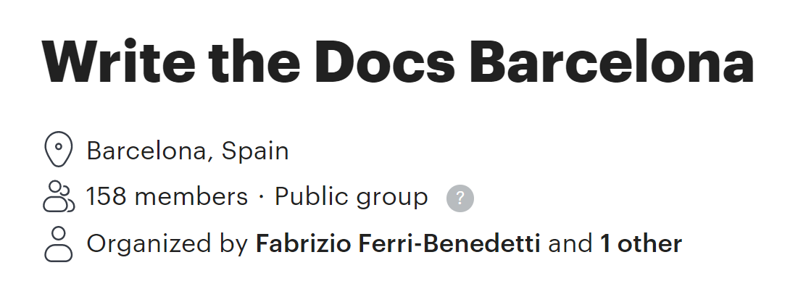

Presentation
Meetup Group
Carlos Angulo Mascarell
Software Engineer at Ohpen
@cangulo in Github
in/angulomascarell/ in LinkedIn
@AnguloMascarell on Twitter

Slide 3
Index
Introduction to Markdown (MD)
VS Code out of the box features
VS Code extensions for MD
VS Code Snippets

Slide 4

1. Introduction to Markdown (MD)
Definition
Origin
Syntax
Processor
Flavors

Slide 5
1. Introduction to MD – Definition and Origin
Definition
Origin
MD is a plain text format with a specific markup syntax.
It is focused is on making readable documents as possible.
MD documents are converted into HTML by processors.
Created back in 2004 by John Gruber and Aaron Swartz
Spec available

Slide 6
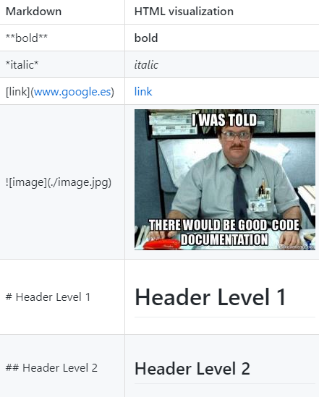
1. Introduction to MD - Syntax
Headers
Bold
Italic
Links
Images
Inline code
Quote
Lists
Tables

Slide 7
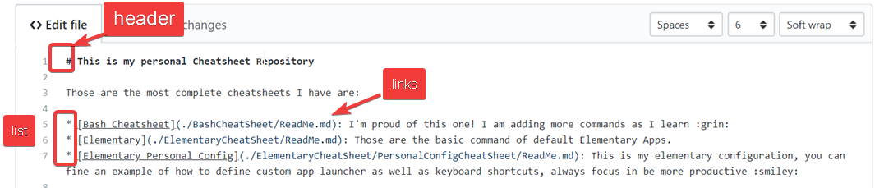
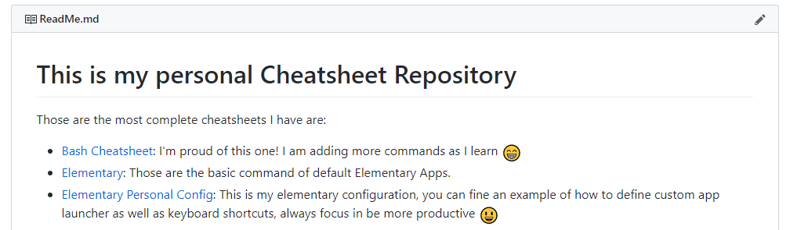
1. Introduction to MD - Processor
ReadMe file of the repository!
Example

Slide 8

1. Introduction to MD – Syntax Demo
Using all the basic MD syntax in VS Code
Bold
Italic
Links
Images
Headers
Inline code
Quote
Lists
Tables
Visualization in GitHub

Slide 9
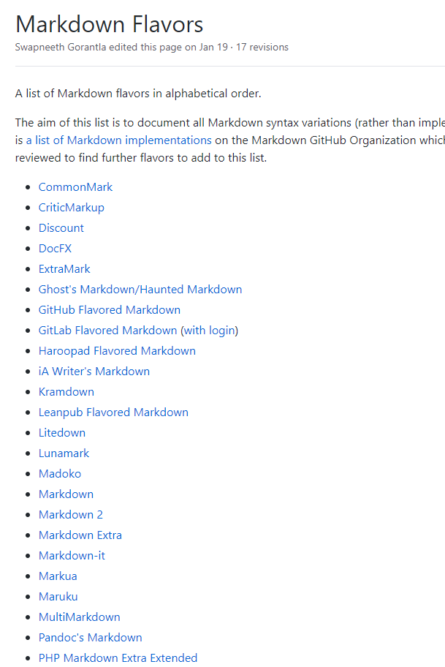
1. Introduction to MD - Flavors
Markdown
CommonMark
GitHub Flavored MD
GitLab Flavored MD
Supported by VS Code
Syntax available at commonmark.org/help/

Slide 10
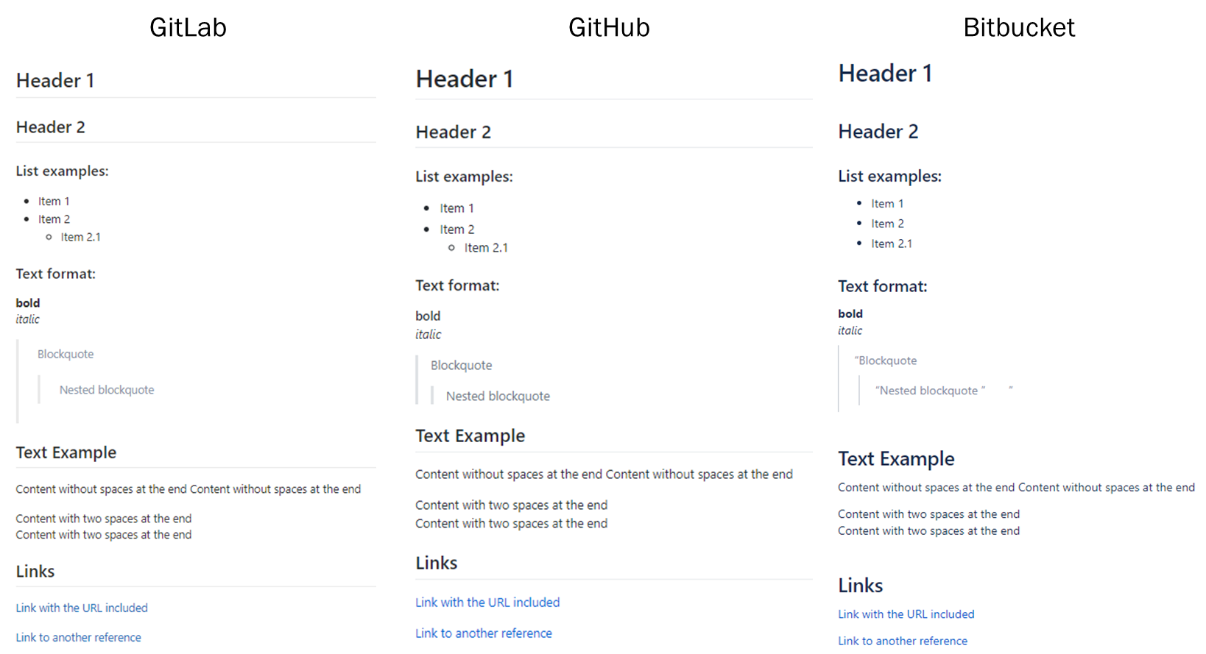
1. Introduction to MD - Flavors
CommonMark support

Slide 11
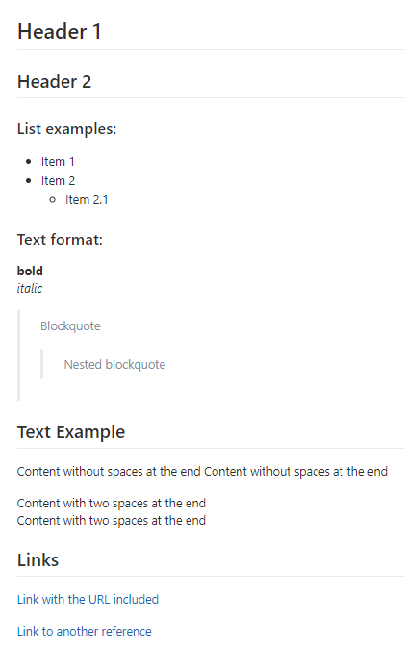
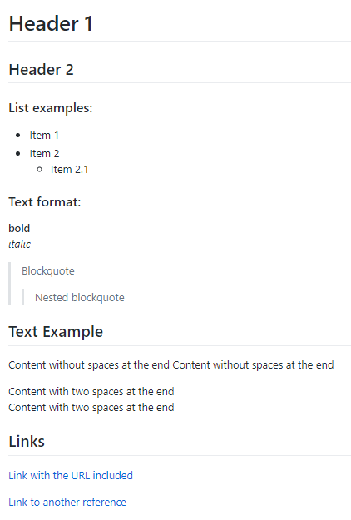
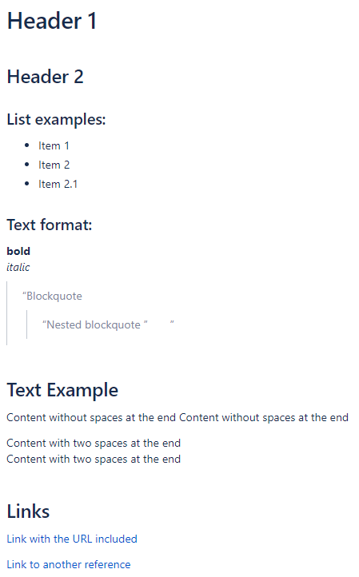
1. Introduction to MD - Flavors
GitLab
GitHub
Bitbucket

Slide 12
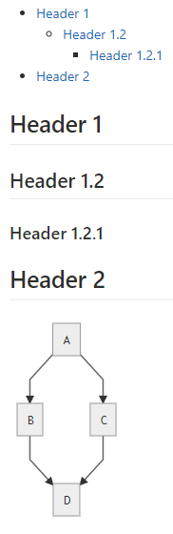
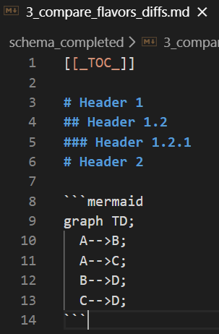
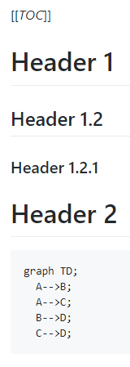
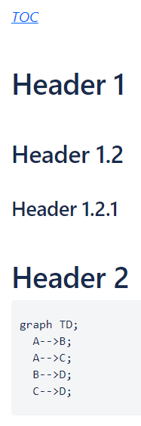
1. Introduction to MD - Flavors
Custom Features
GitHub Flavored MD
GitLab
GitHub
Bitbucket
Table of Content
Mermaid

Slide 13
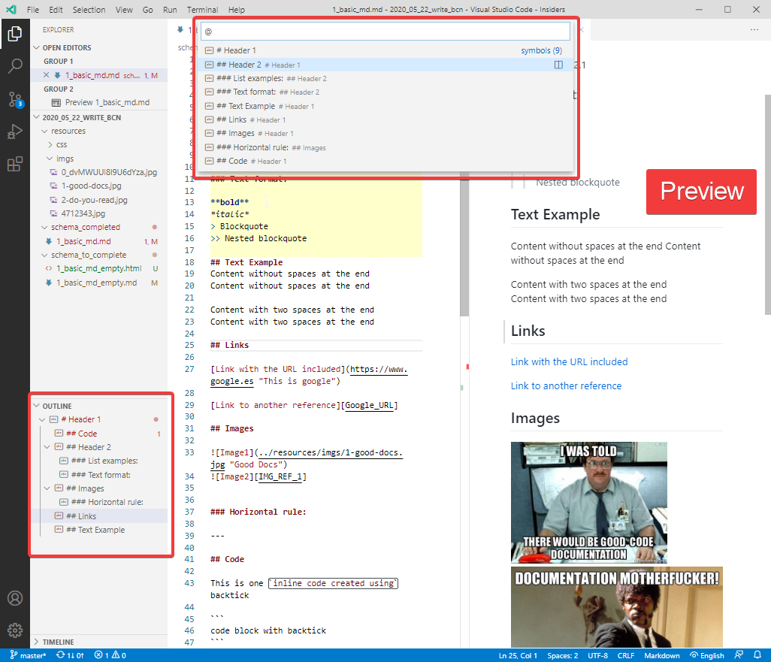
2. VS Code out of the box features
MD File Preview
File structure listed
Code Navigation through symbols
Snippets

Slide 14

2. VS Code out of the box features - Demo
MD File Preview
File structure listed
Code Navigation through symbols
Snippets
Action / Command | Keyboard Shortcut
Open Command Palette | Ctrl + Shift + P
Markdown: Open Preview | Ctrl + Shift + V
Markdown: Open Preview to the Side | Ctrl + K , V
Explorer: Focus on Outline View | Execute via Command Palette
Quick Open | Ctrl + P
List Symbols | Ctr + P, @
Focus Breadcrumb | Ctrl + Shift + .

Slide 15
2. VS Code out of the box features - Demo
MD File Preview
File structure listed
Code Navigation through symbols
Snippets
Action / Command | Keyboard Shortcut
List Snippets (if there is no text select) | Ctrl + Space
To apply text on a specific text | Select the text from right to left Ctrl + Space Navigate to the end
Tip: Configure Snippets to be first options:
"editor.suggest.showWords": false,
"editor.snippetSuggestions": "top",

Slide 16
3. VS Code extensions for MD
Markdown All In One
GitHub Markdown Preview
Markdown Shortcuts

Slide 17
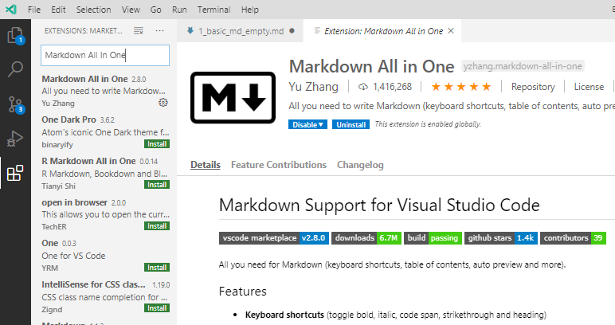
3. VS Code extensions for MD
Markdown All In One
Format Document
Autocompletion for relative path
Autocompletion for lists
Keyboard Shortcuts
Table of Content

Slide 18
3. VS Code extensions for MD - Demo
Markdown All In One
Format Document
Autocompletion for relative path
Autocompletion for lists
Action | Keyboard Shortcut
Format Document | Shift + Alt + F
Autocomplete | Ctrl + Space
Tip: Configure VS Code to format on save or paste content:
"editor.formatOnSave": true,
"editor.formatOnPaste": true

Slide 19
3. VS Code extensions for MD - Demo
Markdown All In One
Keyboard Shortcuts
Table of Content
Action | Keyboard Shortcut
Bold | Ctrl + B
Italic | Ctrl + I
Create TOC | Execute via Command Palette

Slide 20
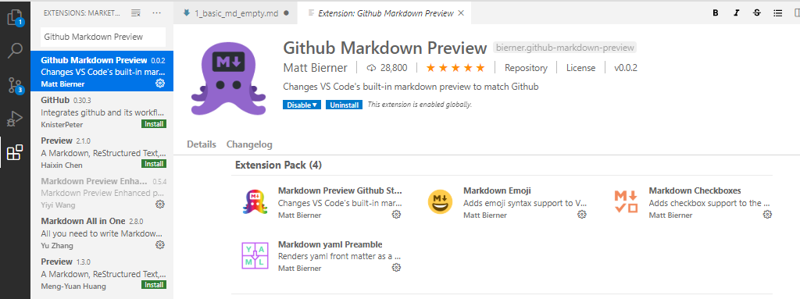
3. VS Code extensions for MD
2. GitHub Markdown Preview
Code Fence
Checkbox
Emoji

Slide 21

3. VS Code extensions for MD - Demo
2. GitHub Markdown Preview
Code Fence
Checkbox
Emoji
```csharp
Some Code
```

Slide 22
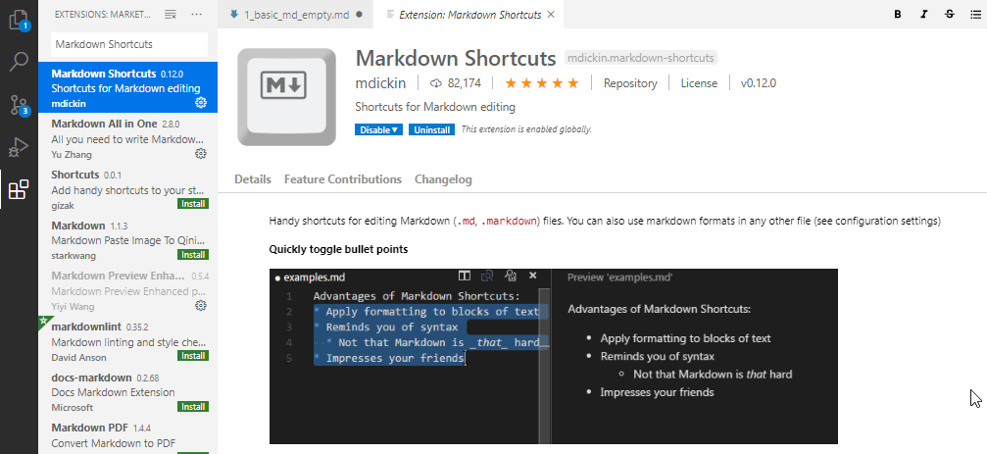
3. VS Code extensions for MD
3. Markdown Shortcuts
Specific Menu for MD commands
Create tables from tabular content
Create keyboard shortcuts for its commands

Slide 23
3. VS Code extensions for MD - Demo
3. Markdown Shortcuts
Specific Menu for MD commands
Create tables from tabular content
Action | Keyboard Shortcut
Open Menu | Ctrl + M, Ctrl + M

Slide 24
3. VS Code extensions for MD - Demo
3. Markdown Shortcuts
Customize keyboard shortcuts for most used commands
Useful if you want to share shortcuts with other apps
Action | Keyboard Shortcut
Create Link | Ctrl + L, by default
Preferences: Open Keyboard Shortcuts | Execute via Command Palette

Slide 25
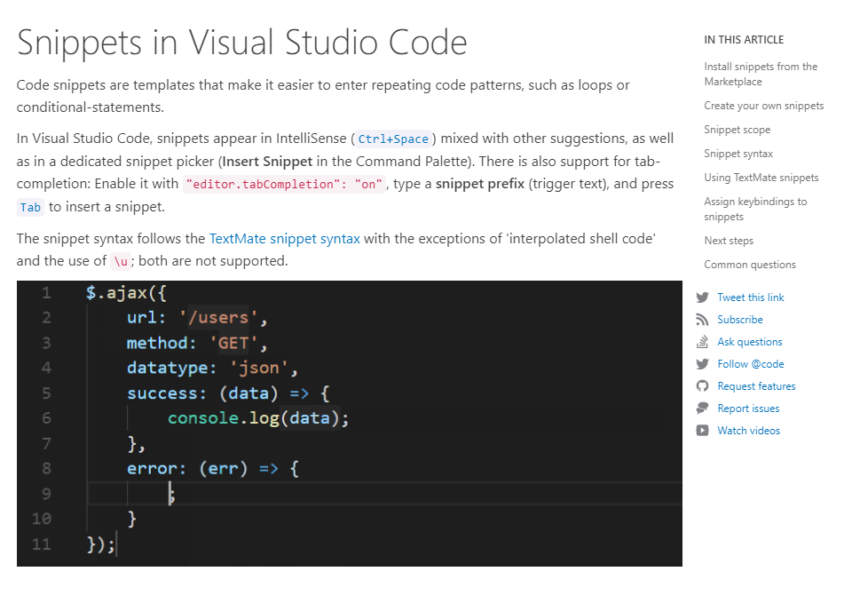
4. VS Code Snippets
Available snippets
How to create snippets
Simple Code Snippets
Use HTML in snippets
Snippets with predefined parameters as MD templates

Slide 26
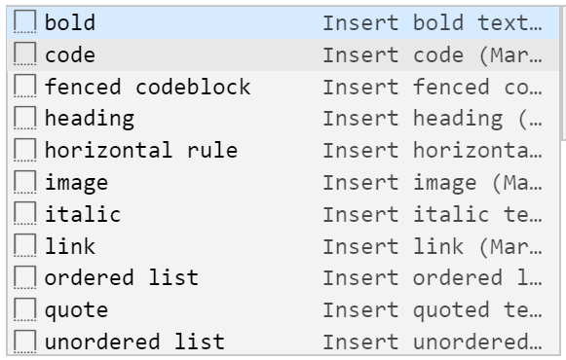
4. VS Code Snippets
Available snippets
Bold
Italic
Link
Image

Slide 27

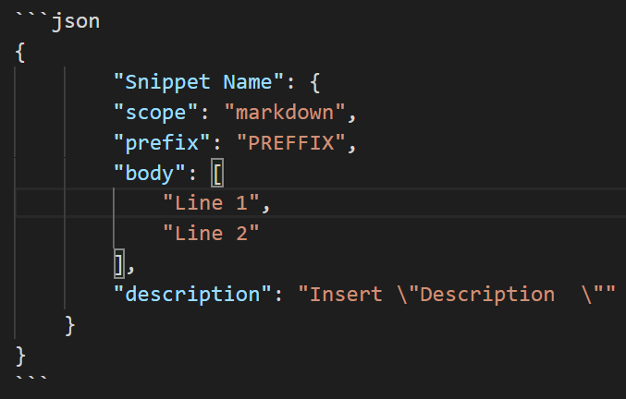
4. VS Code Snippets - Demo
How to create snippets
1. Simple Code Snippets, useful for common areas along documents:
Contact Information
Action / Command | Keyboard Shortcut
Preferences: Configure User Snippets | Via Command Palette
Create new file | Ctrl + N
Change Language Mode | Access Via Command Palette
Multiselection in VS Code | Ctrl+Alt+Down Ctrl+Alt+Up

Slide 28
4. VS Code Snippets - Demo
How to create snippets
2. Use HTML in snippets, useful for:
Style customizations
Action / Command | Keyboard Shortcut
Preferences: Configure User Snippets | Via Command Palette
Multiselection in VS Code | Ctrl+Alt+Down Ctrl+Alt+Up

Slide 29
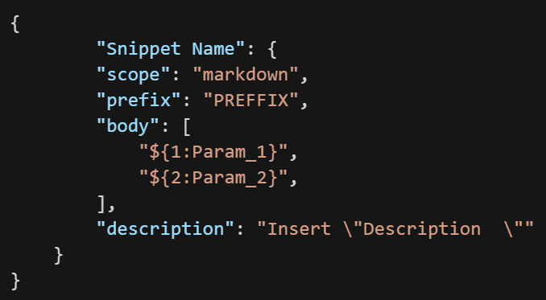
4. VS Code Snippets - Demo
How to create snippets
3. Snippets with predefined parameters as MD templates
Action / Command | Keyboard Shortcut
Preferences: Configure User Snippets | Via Command Palette
Multiselection in VS Code | Ctrl+Alt+Down Ctrl+Alt+Up

Slide 30
Summary
Introduction to MD
VS Code out of the box features
VS Code extensions for MD
VS Code Snippets

Slide 31
Thank you

Slide 32
Questions?

Slide 33
Reference
My Articles in LinkedIn
VS Code for Documentation - I
VS Code for Documentation - II
Static Web Sites Generators that accept MD
GitHub Pages using
jekyllrb
Gatsby

