Slide 1
On the onset of high-Reynolds-number grid-generated wind tunnel turbulence
Paper-reading Sharing
018370210001 仓宇
2018-12-10

Slide 2
Contents
Paper-reading Sharing
Introduction
Experimental apparatus
Results
Conclusion

Slide 3
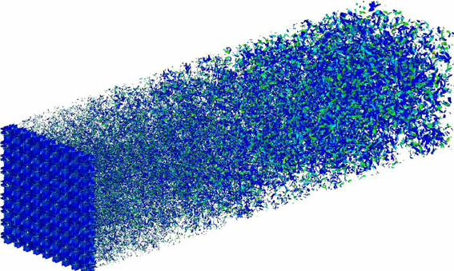
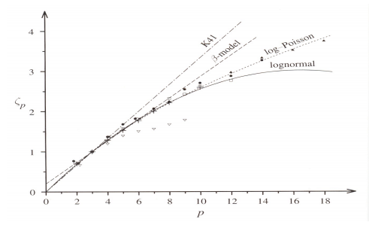
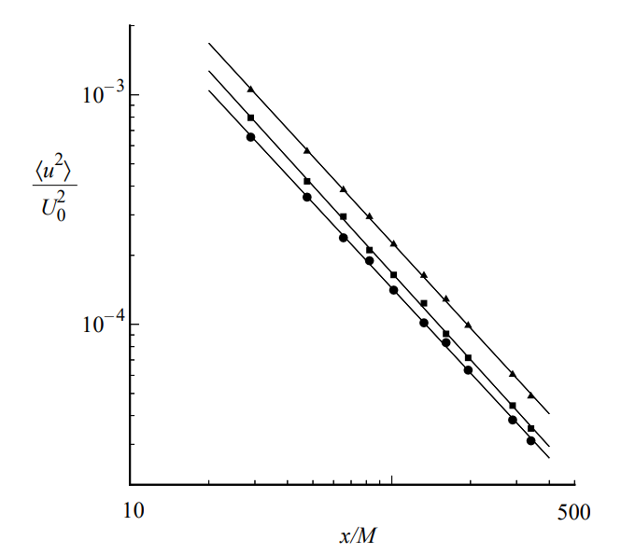
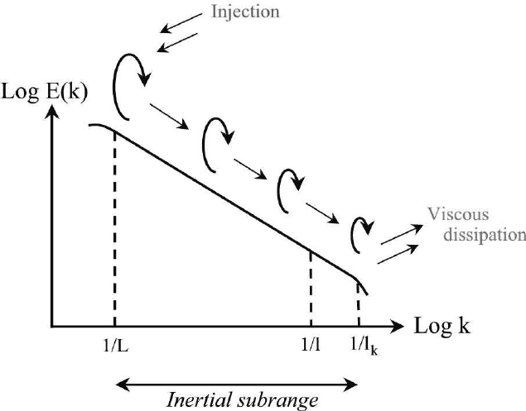

Introduction
Paper-reading Sharing
Classical grid turbulence inside wind tunnel:
Shear-less decaying.
(minor velocity gradient, trivial production)
Objective:
Find the critical $Re_{λ}$ that turbulence(the Kolmogorov sense) occurs in such a flow.
(An evolution process)
K41:
(when Re is high enough)
(departure due to internal intermittency)

Slide 4
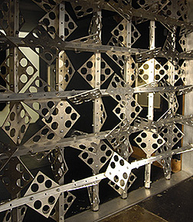
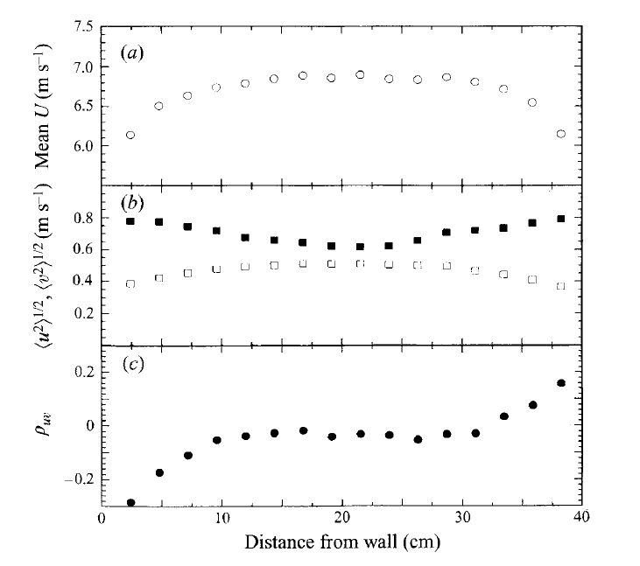
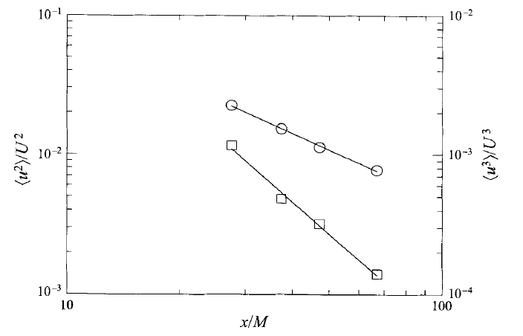
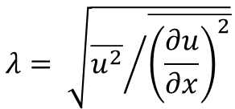


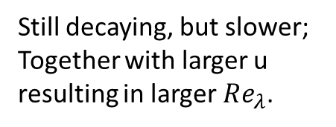
Experimental apparatus
Paper-reading Sharing
Q: How to generate High $Re_{λ}$ turbulence while the shear-less decaying property still maintained?
A: The active grid!
$$λ= \sqrt{{\overline{u^{2}}}/{\overline{{\left(\frac{∂u}{∂x}\right)}^{2}}}}$$
$$Re_{λ}= \frac{uλ}{ν}$$
Performance:
Departure from isotropy, but got strictly confined.
Still decaying, but slower;
Together with larger u resulting in larger $Re_{λ}$.
Wall Effect

Slide 5
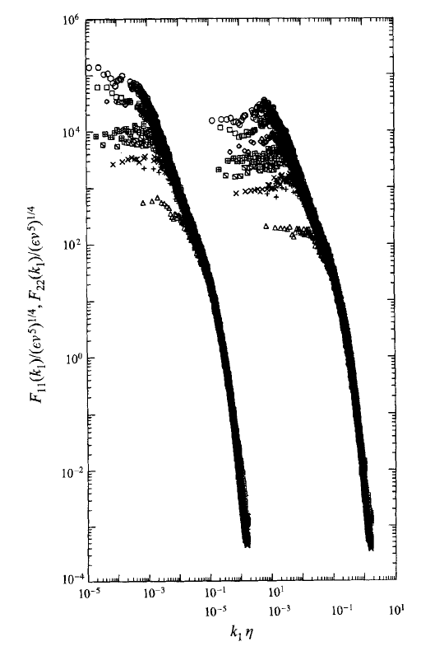
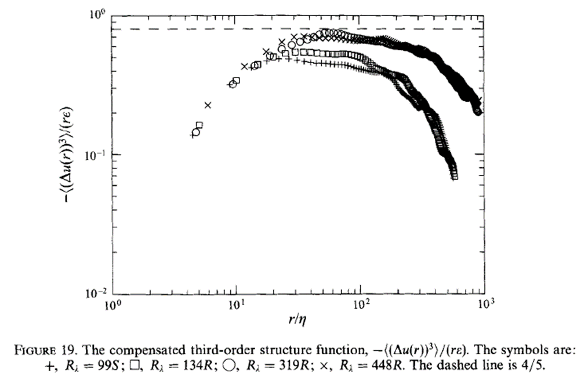
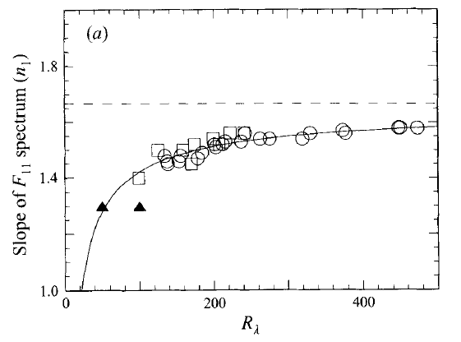
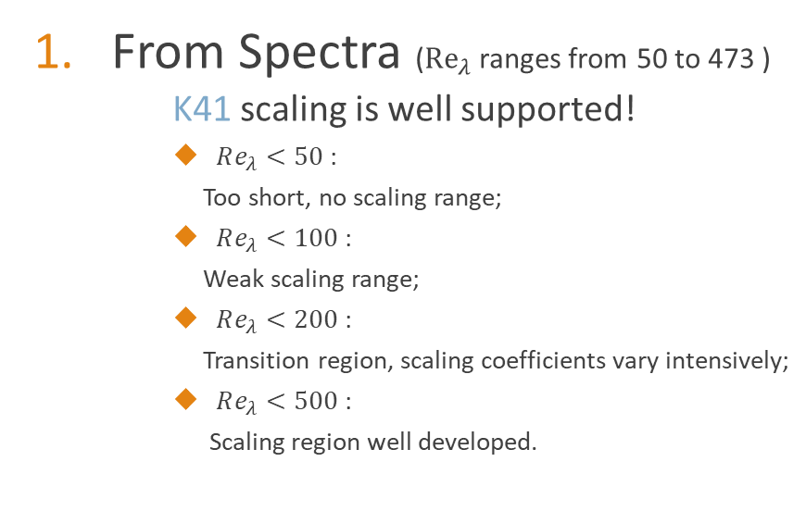

Results
Paper-reading Sharing
Transition
From Spectra (${Re}_{λ}$ ranges from 50 to 473 )
K41 scaling is well supported!
$Re_{λ}<50$ :
Too short, no scaling range;
$Re_{λ}<100$ :
Weak scaling range;
$Re_{λ}<200$ :
Transition region, scaling coefficients vary intensively;
$Re_{λ}<500$ :
Scaling region well developed.
Re
Strong Turbulence
Weak Turbulence
The -4/5 plateau is also met in the 3rd order structure function when Re is large.
Departure at low Re also indicates that the turbulence is weak there.
(1D，$u$ and $v$ power spectra)

Slide 6
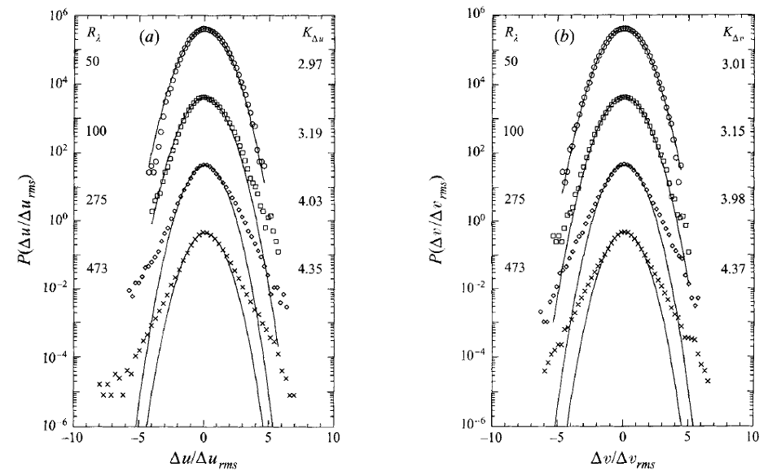
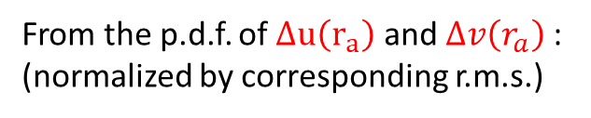
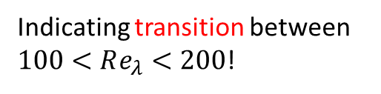
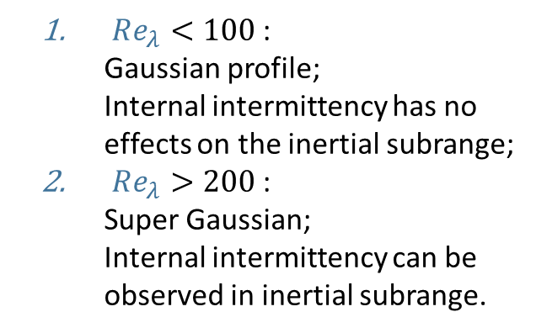
Results
Paper-reading Sharing
From the p.d.f. of $Δu\left(r_{a}\right)$ and $Δv\left(r_{a}\right)$ :
(normalized by corresponding r.m.s.)
Gaussian
$Re_{λ}<100$ :
Gaussian profile;
Internal intermittency has no effects on the inertial subrange;
$Re_{λ}>200$ :
Super Gaussian;
Internal intermittency can be observed in inertial subrange.
Indicating transition between $100<Re_{λ}<200$!
Due to internal intermittency predicted by K62.

Slide 7
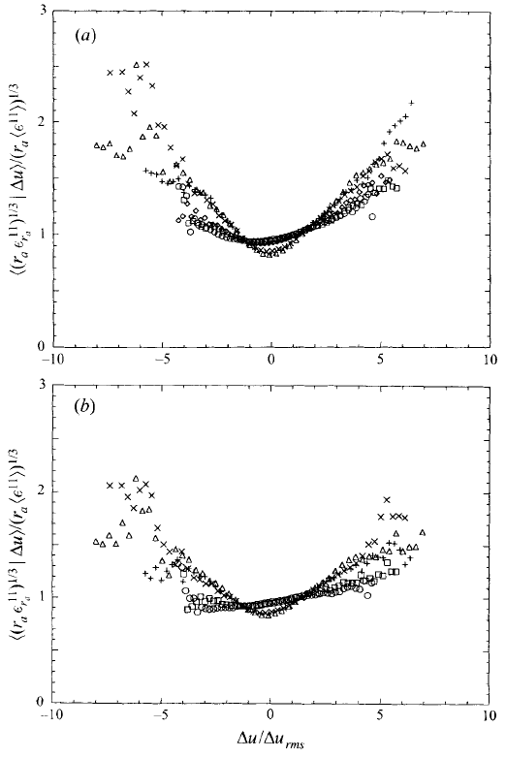
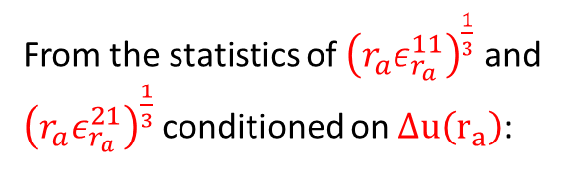

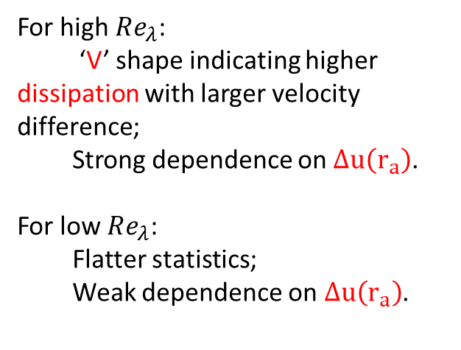
Results
Paper-reading Sharing
From the statistics of ${\left(r_{a}ε_{r_{a}}^{11}\right)}^{\frac{1}{3}}$ and ${\left(r_{a}ε_{r_{a}}^{21}\right)}^{\frac{1}{3}}$ conditioned on $Δu\left(r_{a}\right)$:
For high $Re_{λ}$:
‘V’ shape indicating higher dissipation with larger velocity difference;
Strong dependence on$Δu\left(r_{a}\right)$.
For low $Re_{λ}$:
Flatter statistics;
Weak dependence on$Δu\left(r_{a}\right)$.
Re
$Δu\left(r_{a}\right)=V {\left(rε_{r}\right)}^{\frac{1}{3}}$ hypothesized from K62

Slide 8
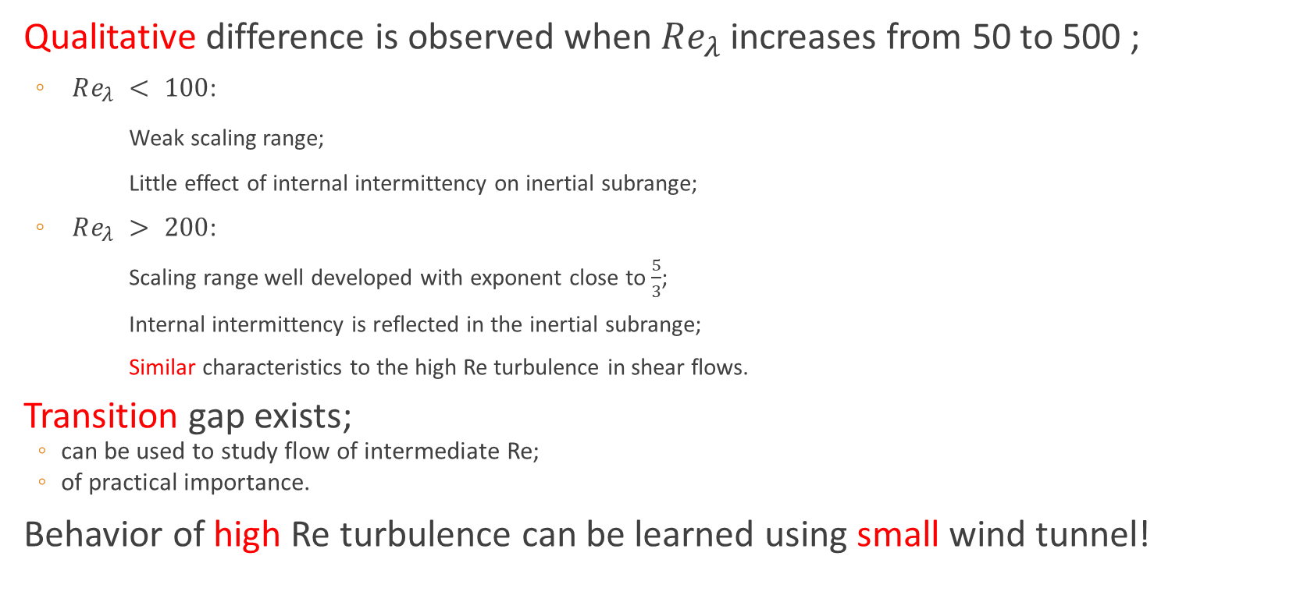
Conclusion
Paper-reading Sharing
Qualitative difference is observed when $Re_{λ}$ increases from 50 to 500 ;
$Re_{λ} < 100$:
Weak scaling range;
Little effect of internal intermittency on inertial subrange;
$Re_{λ} > 200$:
Scaling range well developed with exponent close to $\frac{5}{3}$;
Internal intermittency is reflected in the inertial subrange;
Similar characteristics to the high Re turbulence in shear flows.
Transition gap exists;
can be used to study flow of intermediate Re;
of practical importance.
Behavior of high Re turbulence can be learned using small wind tunnel!

Slide 9
Paper-reading Sharing
Thanks for listening!

