Slide 1
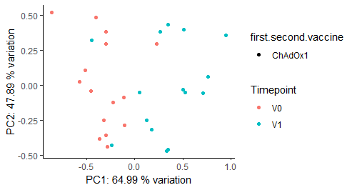
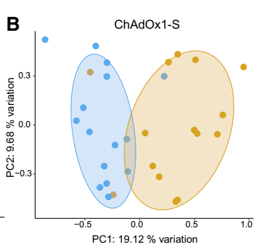
Fig2B-MDS analysis at V1 vs V0 for ChAdOx vaccine
Dr. Ryan’s paper
Procedure
Subset only ChAdOx1 vaccine with time point V0 and V1
Filter and normalize
Do timepoint correction
Do MDS and PCA analysis

Slide 2
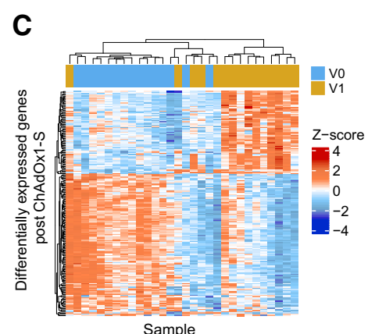
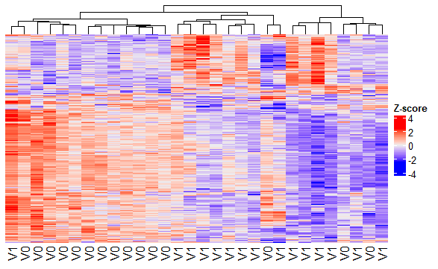
Fig2C-heatmap of DEG at V1 vs V0 for ChAdOx vaccine
Dr. Ryan’s paper

Slide 3
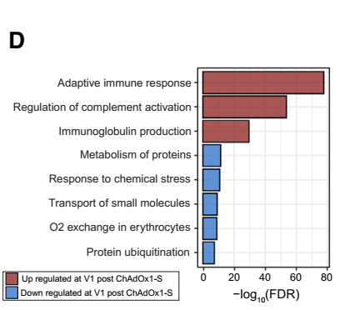
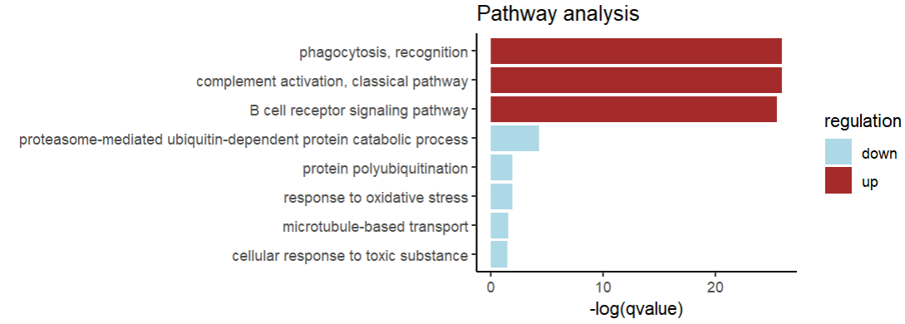
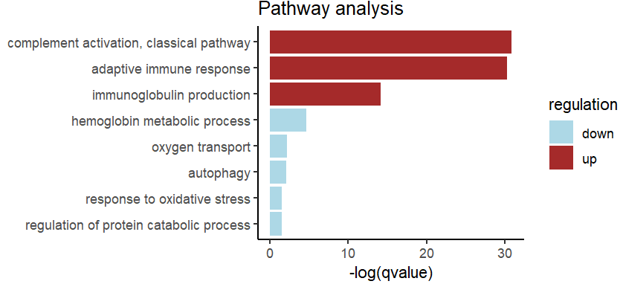
Fig2D-pathway based on GO analysis on DEGs at V1 vs V0 for ChAdOx vaccine
Dr. Ryan’s paper
edgeR
DESeq2

