Slide 1
index.html Login Page
homepage.html Header
3/4 Columns
Footer
task.html Create/Edit
about.html ??? About page
Legal stuff
Creators
Minimum 3 pages!
Intuitive layout
Use section or div, for the partitions:
https://www.w3schools.com/howto/howto_css_four_columns.asp
https://www.w3schools.com/howto/howto_css_login_form.asp
settings.html ???
Language Color Scheme

Slide 2


index.html Login Page
Username
Password
Login btn

Slide 3


homepage.html Homepage
Header : Username
TODO
DOING
Save
DONE
RETROSPECTIVE
Footer

Slide 4
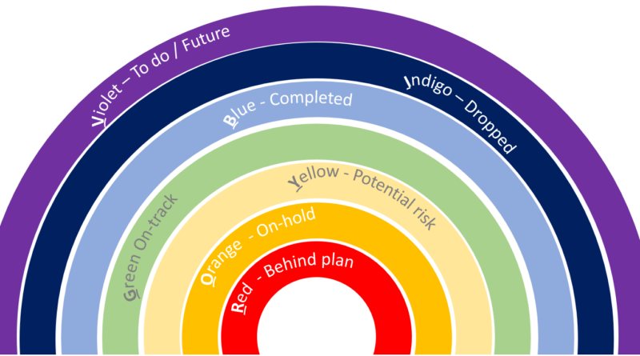
Green, yellow, blue, violet?

Slide 5
task.html Task Create/Edit Page
Back tem de ter um salvar o draft/rascunho
Que não é mostrado
Header : Username
permitindo ao utilizador alterar, eliminar ou adicionar detalhes à tarefa. ???
Pedir ao professor para clarificar
Back
Title
Description
Edit
Save
Date/deadline ???
Subgroup:default=TODO ???
Del
Footer

