Slide 1
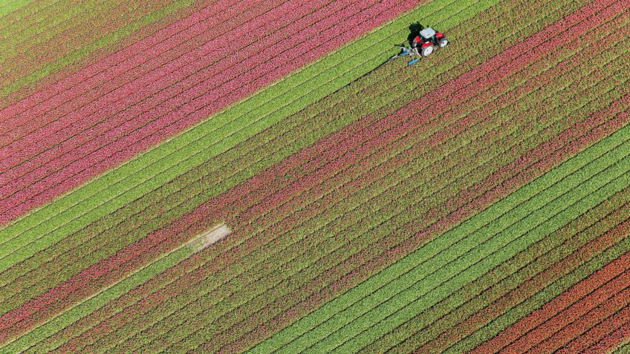

Project Kickoff Presentation
Presented By: Jason Caniz
Title: Project Manager

Slide 2





| Project Brief
Project Name:
Crop Farm Traceability System
Project Justification and Background
A medium-sized crop farm company requiring an immediate traceability system (TS). The operations manager (OM) notes they produce and supply grains, vegetables, and plants such as (but are not limited to):
Main Project Objective and Priorities
Operations Manager would like to provide data-driven information and details to their smallholders to expand and access other markets as soon as possible
Status
Pending All Stakeholders' Approval
Sorghum Millet | Potatoes Cassava | Tea Coffee

Slide 3



| Project Breakdown
Project Priorities
Implement a TS that will enhance productivity, and help the operations team manage their crops and teams effectively
Ensure the traceability system collects crop production and process data to maximize the return on investment (ROI) for crop yields
Ensure the traceability system collects detailed first-mile information to provide supply chain stakeholders in-depth produce information
Project Deliverables
Collect all additional needed data
Provide accurate headcount of all involved project stakeholders
Provide details on data supermarkets requested
Once project is approved have PM travel to sites to investigate needs and challenges
Ensure no out-of-scope services are needed before project commences
5. Update CFRS document if needed
6. Compose database and update
PM/PCM on any additional
resources needed to ensure
TS implementation is successful​
7. Prep teams and sites for TS
implementation; brainstorm
ideas to maximize
maximize productivity​
8. Train all staff and field teams
members​
9. Provide continuous remote support
to OM and team if needed
‹#›

Slide 4










| Project Scopes
In-Scope
Out-of-Scope
Traceability
GPS Field Mapping
In initial request
Can be added
Growing Activities
Certifications
In initial request
Can be added
Yield Forecasting
Compliance Docs
In initial request
Can be added
Custom Surveys
Farm Loan Management
Can be added
Can be added
‹#›

Slide 5
1-YEAR ACTION PLAN
| Project Timeline
= Month
2027
Start and monitor site TS implementation phase
Start rainy season data collecting phase
Handover project to OM
Start and monitor site TS implementation phase
Start rainy season data collecting phase
Handover project to OM
Assess Accra site additional TS needs
Start site training phase
Assess Nairobi site additional TS needs
Start site training phase
Dates based on the size of farms & season factors: Africa Dry & Rainy Seasons Article Project Timeline dates can vary based on client needs
‹#›
‹#›
‹#›
‹#›

Slide 6


| Project Success
Success Criteria
Business Success Criteria
  Market Access Expansion: Smallholders use data-driven insights to access new markets within the upcoming year.
  Maximized ROI: System collects data demonstrating quantifiable ROI for crop yields.
Operational & System Success Criteria
  Complete Data Collection: Traceability system collects detailed production data, including first-mile stages.
  Productivity Enhancement: Operations team confirms enhanced productivity and crop management.
  Staff Proficiency: All staff and field teams receive software training for effective system use.
Project Execution Success Criteria
  On-Time Completion: Accra & Nairobi phase completes on schedule (Accra: Mar 31, 2027; Nairobi: Sep 30, 2027).
  Stakeholder Sign-off: Updated CTFS document is approved prior to implementation planning.
  Budget Adherence: Final cost remains within budget; costs reported immediately to PM.

Slide 7


| Project Challenges
Project Constraints
Unreported changes and uncollected data vital during client lifecycle
Not meeting project deliverable deadlines
Base project timelines solemnly on weather forecasts without considering client needs or specifications
Not meeting important travel events
Pest or disease outbreaks
Not ensuring communication channels are clear and set for all stakeholders
Project Assumptions
All data must be collected on a timely manner; sudden findings need to be reported immediately
All delays need to be shared with stakeholders prior to hitting project slack time to avoid extra costs
Discovery of additional needs must be assessed and included in project timeline and documentation
Plan traveling necessities accordingly and factor those needs to minimize costly delays
Ensure proper pest or disease outbreaks procedures are set in place
Communicate with PM and PCM on budget and cost updates quickly to ensure extra costs are mitigated appropriately
Ensure we have clear communication with all stakeholders at all times during all phases of TS implementation​

Slide 8


| Project Stakeholders
Project Team Members
Project Manager (PM): Jason Caniz
Contact Info: jason.caniz@farmforce.com
  Create and vet initial CFTS project document for OM
  Further investigate needs and specific challenges to compose database per location
  Train OM and staff during rainy seasons while collecting seasonal data, then pass project over to OM
  Remain as CFTS Farmforce-side operations team project PoC and provide additional future remote support (if needed)
Procurement Manager (PCM): John Smith
Contact Info: j.smith@aandncrops.com
  Vet CFTS document for contracting teams; add estimated budget and TS requirement costs
  Ensure to pass down any important budget and needed staff member updates down the stakeholder supply chain
  Start acquiring necessary hardware (HW) and TS building resources ready for implementation of TS (if not already obtained)

Slide 9
| Project Stakeholders
Supporting Team Members
8 Field Management Staff Members (SM)
Contact Info: staffmemebers@aandncrops.com (create distro list if needed**)
  Assist operations in collecting required data on crop production process and team members to aid in database creation (if not already collected)
  Prepare direct report team members for TS implementation
12,000 Contract Smallholders (*estimated, actual headcount needed)
6,000 Spot Farmers (*estimated, actual headcount needed)
2,000 – 3,000 Off-Season Farmers (*estimated, actual headcount needed)
Contact Info: farmmemebers@aandncrops.com (create distro list if needed**)
  Assist in collecting required data on crop harvesting and growth (vital for supermarket info), as well as previous pest or disease outbreaks to aid in database creation (if not already collected)
  Prepare current field team members for TS implementation

Slide 10


| Project Cost Estimate
Item | Estimated Cost
Farmforce Software Licenses | $105,000
Staff Training | $220,000
Travel and Accommodation | $10,000
Hardware Cost | $50,000
Resource Acquisition | $25,000
Project Actual Cost, Completion Cost, and Variance will be determined as project evolves

Slide 11
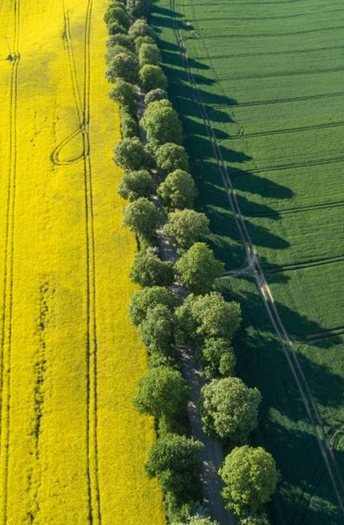
THANK YOU
| Project Presentation Q&A
Jason Caniz​
Project Portfolio
Project Charter Document
me@jasoncaniz.com

