Slide 1


VHRHarmonize
an open-source Python library, CLI, and QGIS plugin for preprocessing very high resolution (VHR) satellite imagery into analysis-ready products
github.com/cankanoa/vhrharmonize
Kanoa Lindiwe, Joseph Emile Honour Percival, Ryan Perroy

Slide 2
Better imagery, difficult preparation
Computer vision/machine learning is expanding what we can learn from satellite imagery
Very High Resolution imagery (VHR) reveals buildings, vegetation, and other fine-scale features
But complex and scalable preprocessing remains a major barrier

Slide 3
VHRHarmonize:
Automates VHR imagery preprocessing
Produces consistent, scalable, and idempotent results
Enables researchers to focus on analysis of single images, mosaics, or time series

Slide 4
So, what does it do?

Slide 5
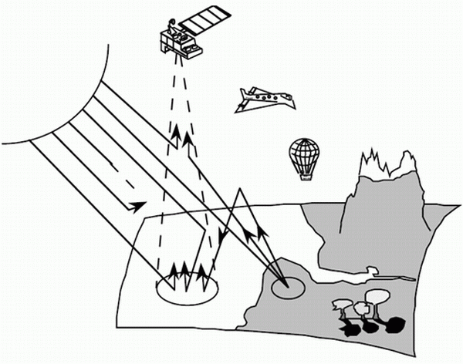
Atmospheric correction (6S)
S.A.L.S.A., 2026

Slide 6
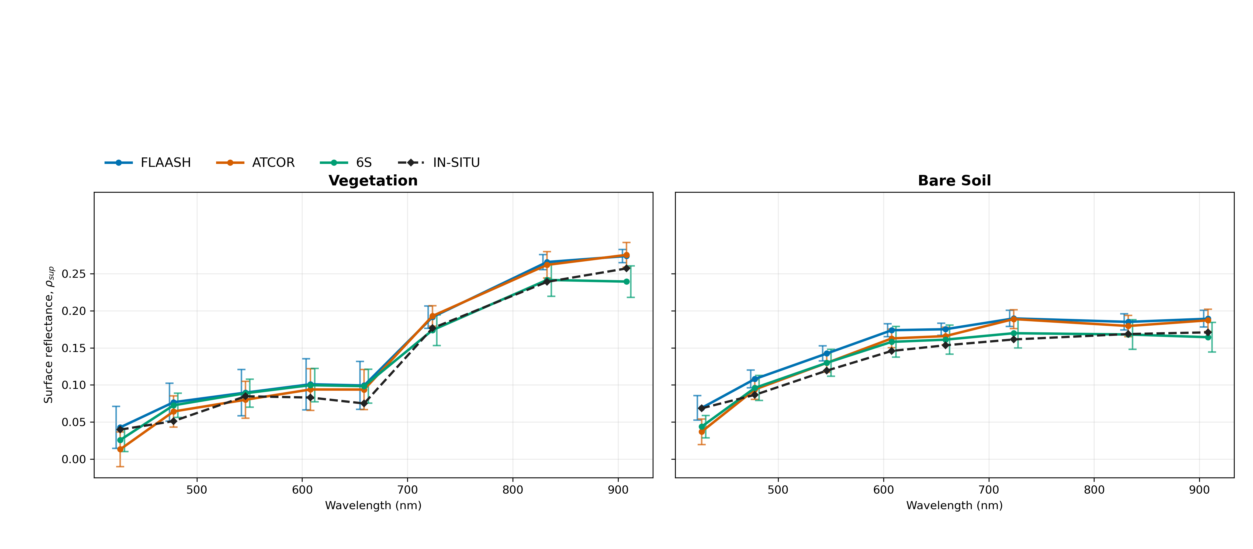
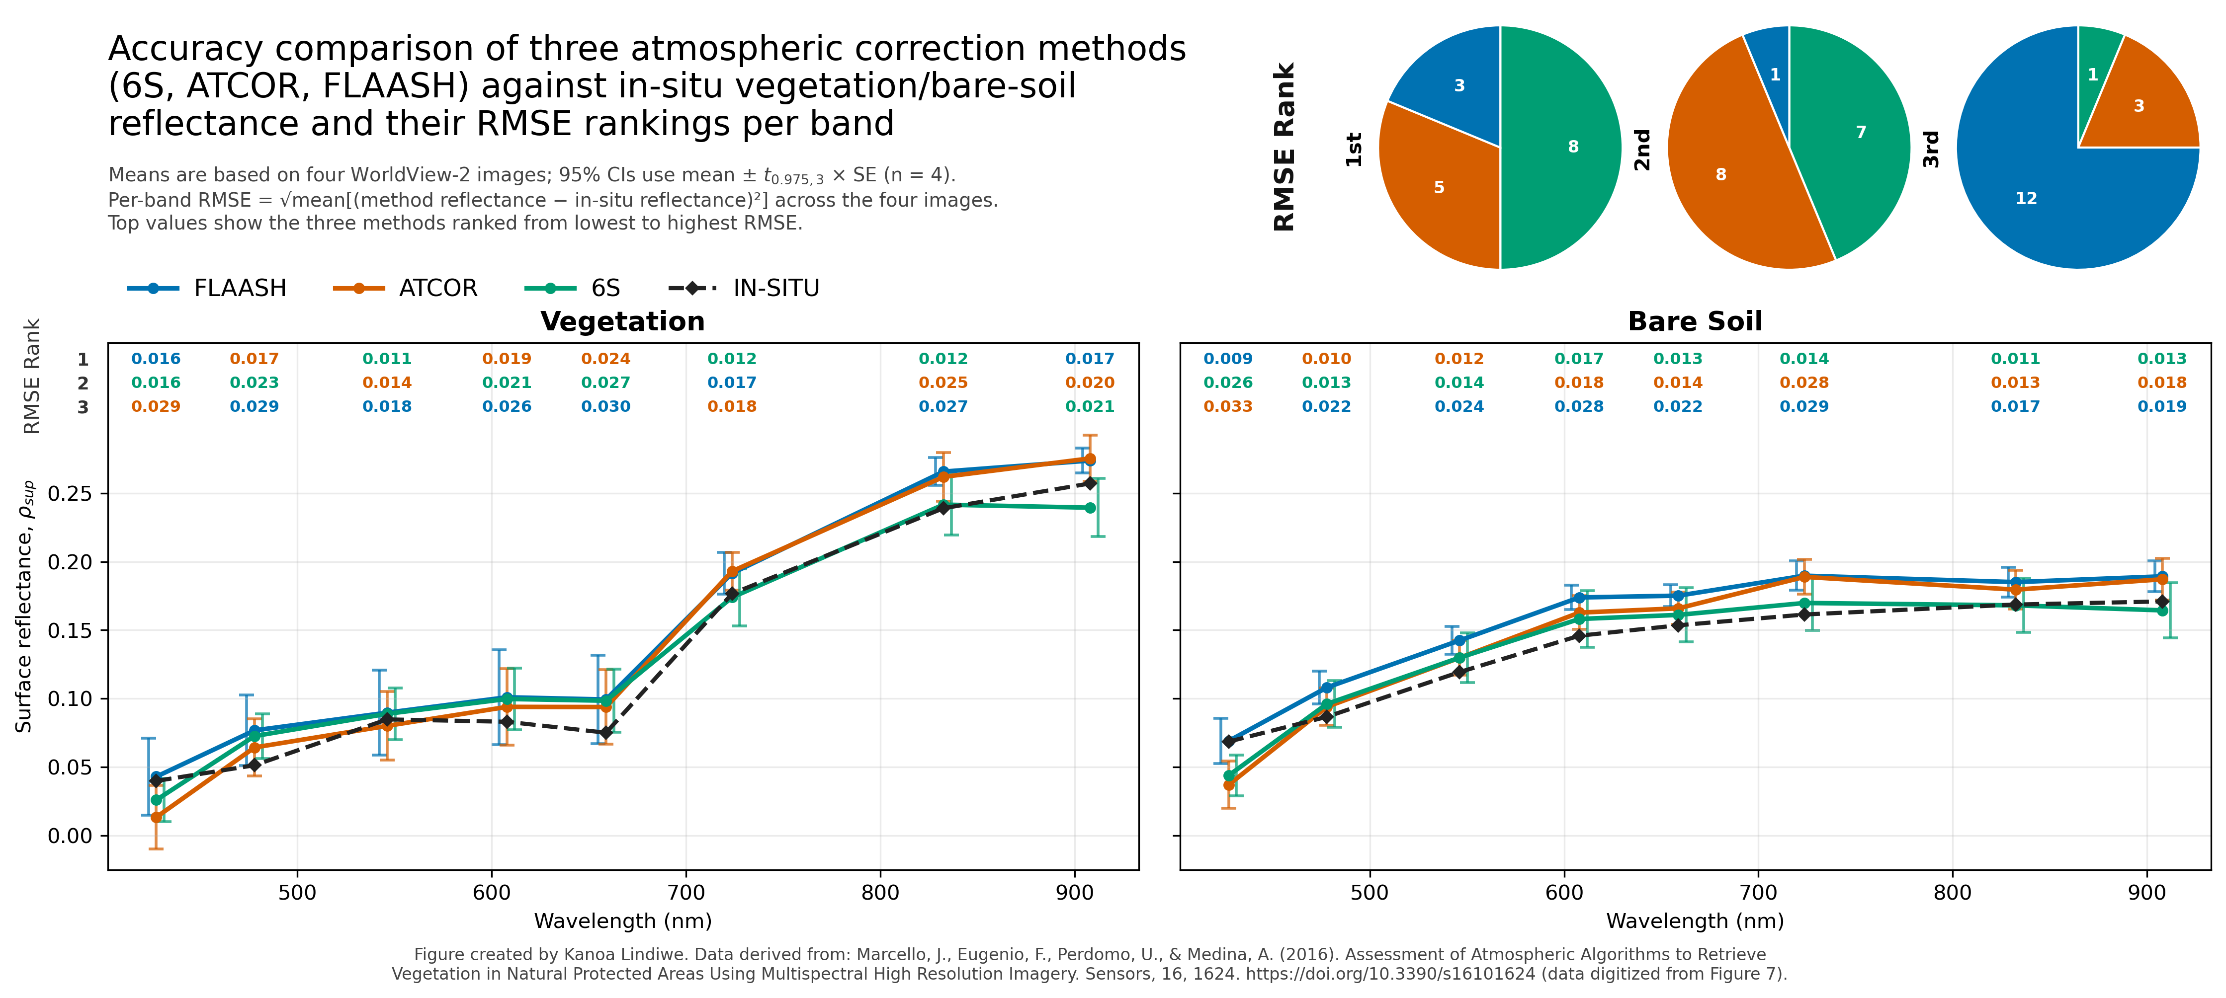
Atmospheric Correction Methods
Derived from Marcello et al., 2016

Slide 7
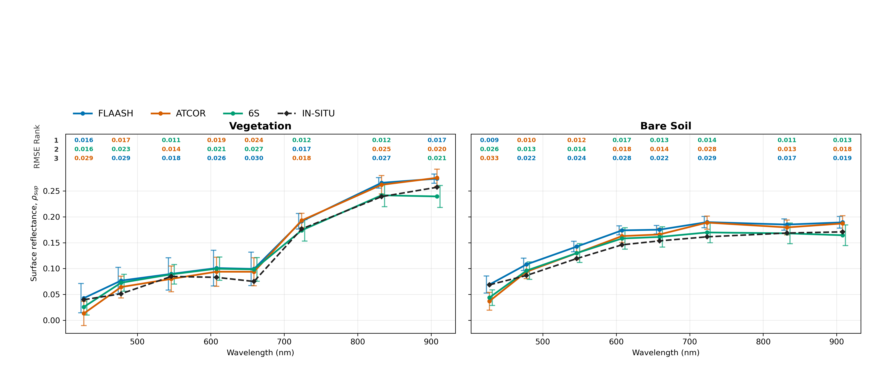
Atmospheric Correction Methods
Derived from Marcello et al., 2016

Slide 8
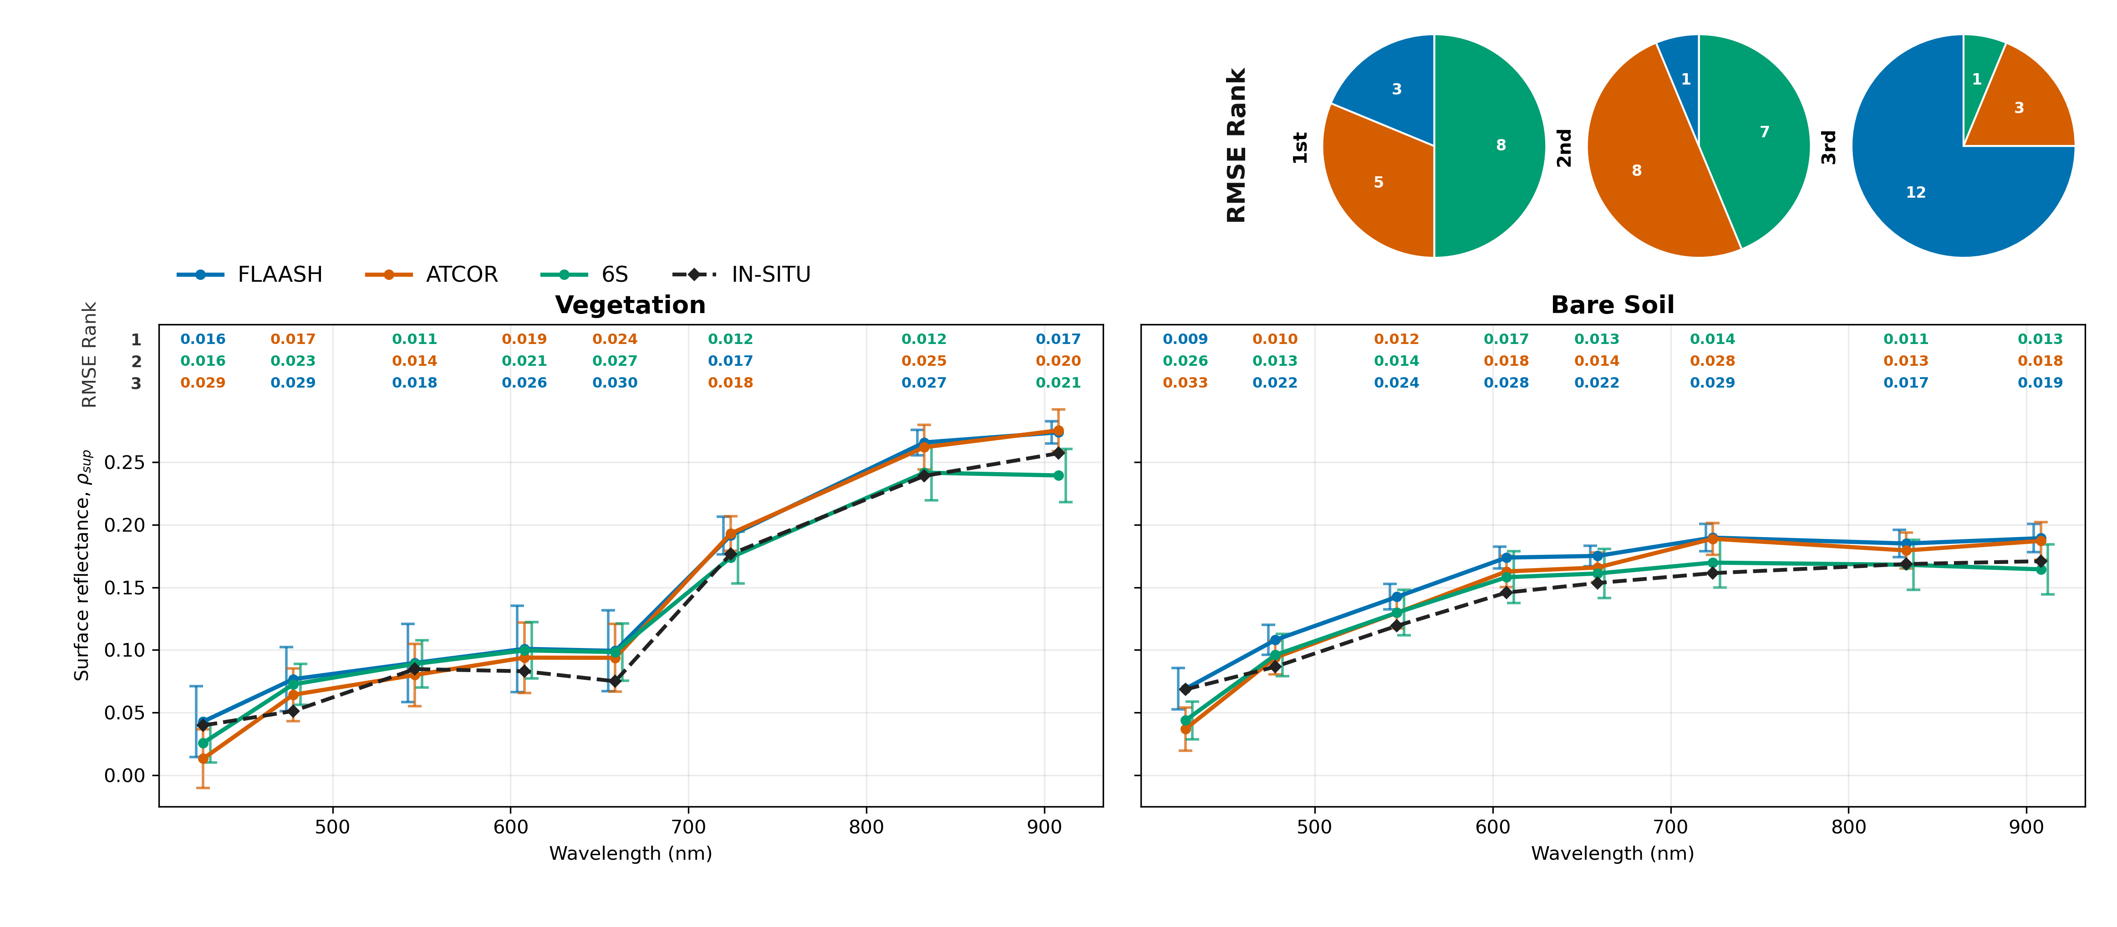

Slide 9
Marcello et al., 2016

Slide 10
Atmospheric Correction Methods
Derived from Marcello et al., 2016

Slide 11
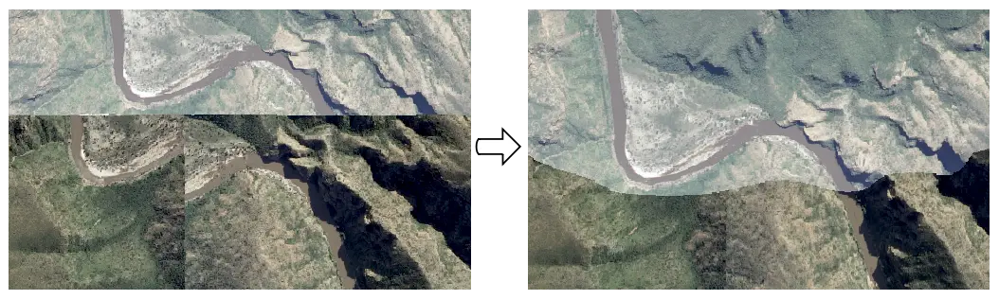
RPC orthorectification (Orthority)
Orthority, Github

Slide 12
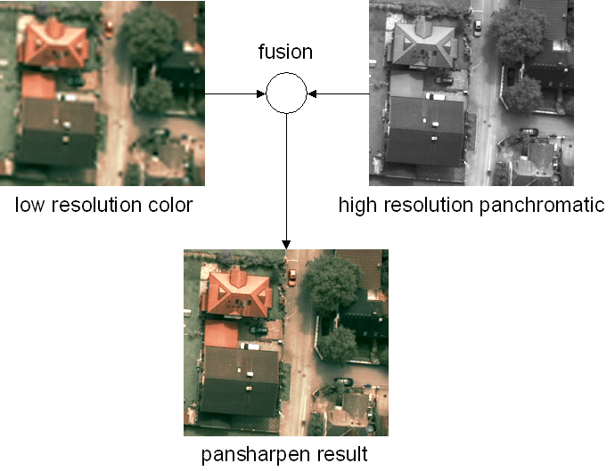
Pansharpening (Orthority)
Roland Perko, 2004

Slide 13
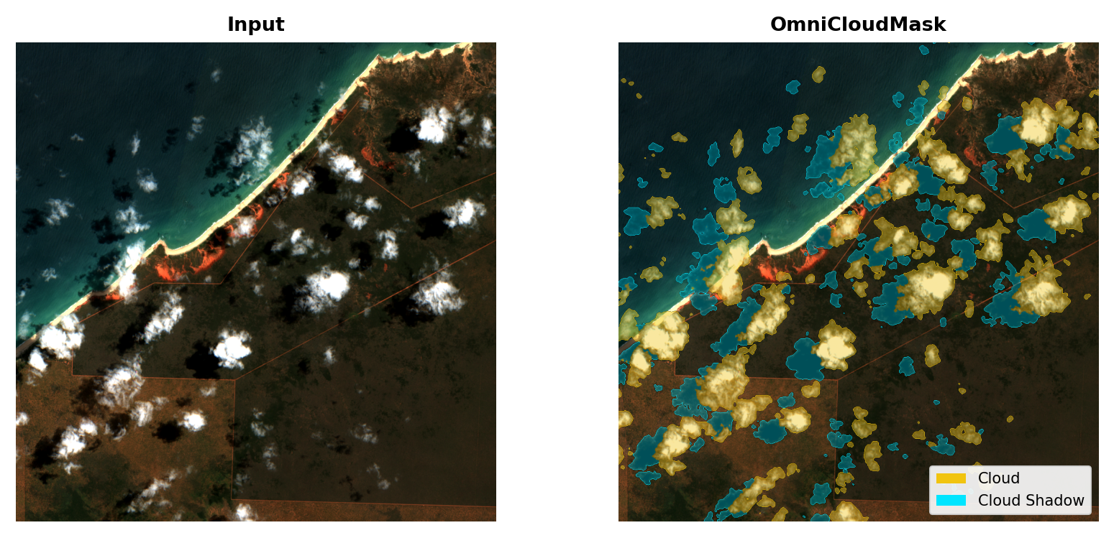
Cloud masking (OmniCloudMask)
Wright et al., 2025

Slide 14
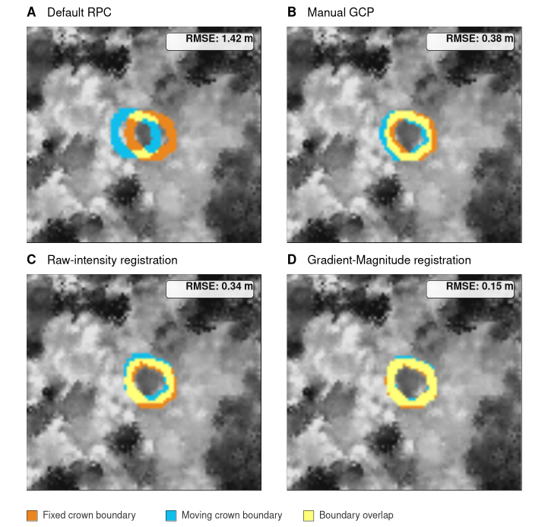
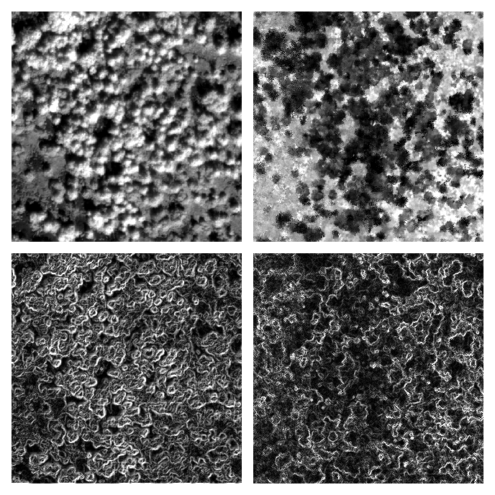
Spatial Alignment (Coregix)
Image
LiDAR
(pre-spatial alignment)
Edge Detection
Registration
Joseph Emile Honour Percival, 2026

Slide 15
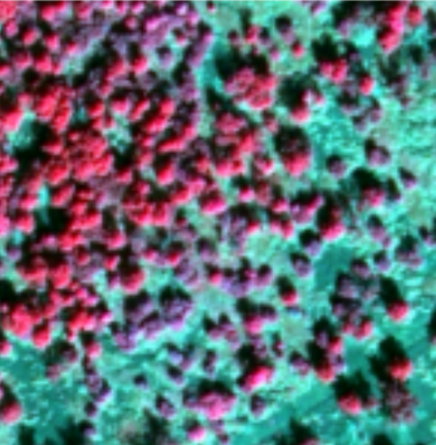
Joint Coregistration (Spectralmatch)
Lindiwe et al., 2026

Slide 16
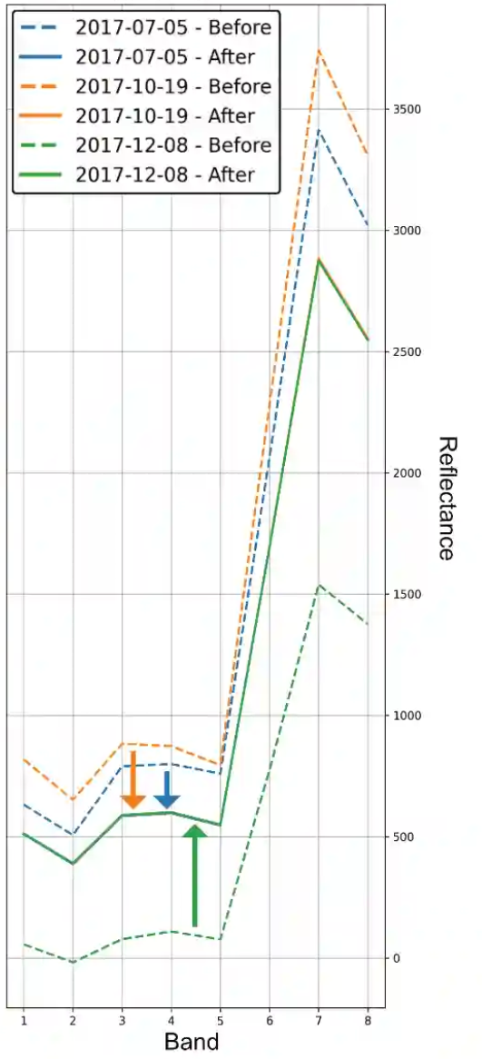
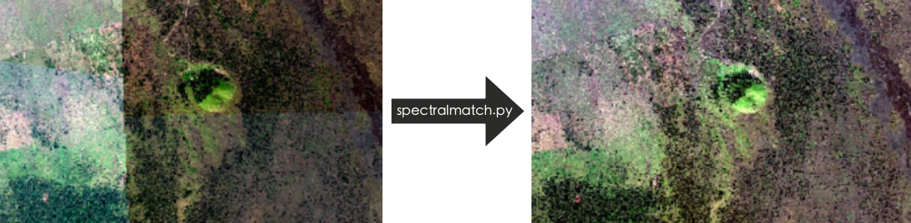
Relative Radiometric Normalization (Spectralmatch)
Lindiwe et al., 2026

Slide 17
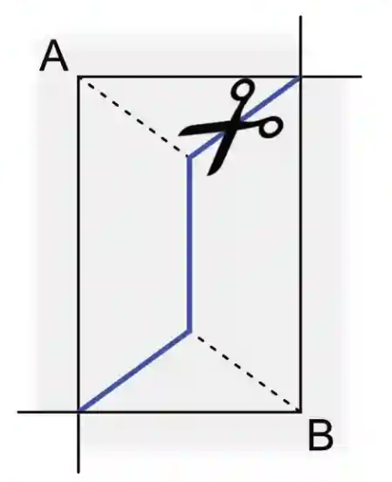
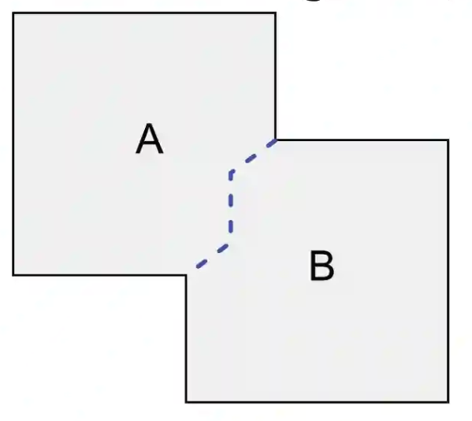
Seamlines and Mosaicing (Spectralmatch)
Lindiwe et al., 2026

Slide 18
Other Features
Automated data and metadata discovery
Partially processed data discovery (independent)
High Performance Compute with distributed workers for large raster operations

Slide 19
Under the Hood

Slide 20
Three Config Files
* only for HPC
provider.yml
Imagery input/output
Select processing steps
Step settings
Defines simple multiprocessing
hpc.yml*
Connection params
Converts IO paths
File sync and reuse
Stores job state
References other two files
slurm.sbatch*
Initiate slurm nodes
Optional multi-node Dask scheduler
Activate software environment
Runs “start” command

Slide 21
VHRHarmonize Pipeline
* font marks CLI commands
VHR Image Bundle(s)
CLI | QGIS Plugin
Other auxiliary data
Environment:
Local
High Performance Compute (SLURM)
provider.yml
hpc.yml
slurm.sbatch
staged.provider.yml
staged.slurm.sbatch
*required image files
Config files:
provider.yml
prepare
( )
upload
( )
Start Process:
start()
simply a local run on HPC
Start^{hpc}()
local
HPC
Monitor:
CLI Output
status ( staged.hpc.yml )
Output:
Final Product(s)
download ( staged.hpc.yml )

Slide 22
Worldview Price
Prices are subject to change and have unique restrictions not covered
 | Processor | Price/km² for analysis ready product | Price/km² for basic product
LAND INFO | Maxar | *$45 | $25.50
Geopera | Legato | $18–$28 | -
NASA(CSDA) *Access only to gov research | Maxar | *Free (with more limited availability) | Free (with limited availability)
SkyWatch | Maxar | *$19.00 | -
Apollo (academic price) | Maxar | *$40 | $16.80
* Only to the orthorectification stage

Slide 23
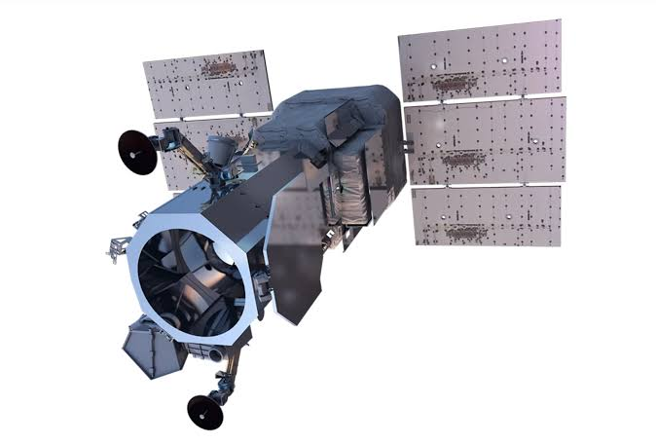
Supported Imagery
Worldview
Planned support for Planet and others
Individual tools are sensor agnostic

Slide 24
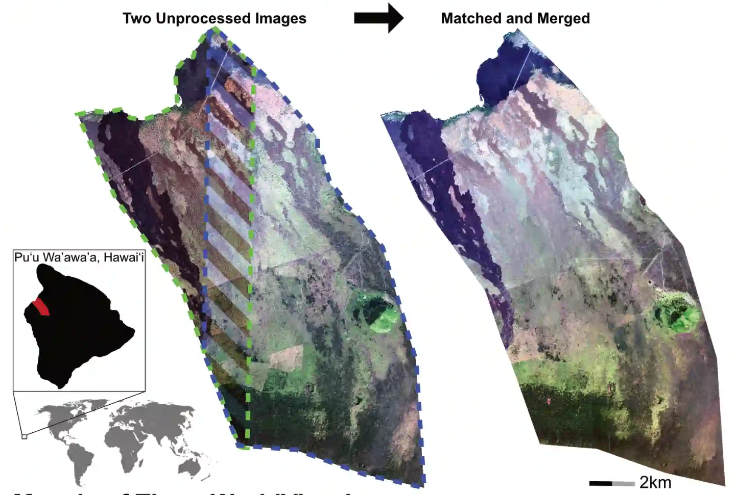
Results

Slide 25
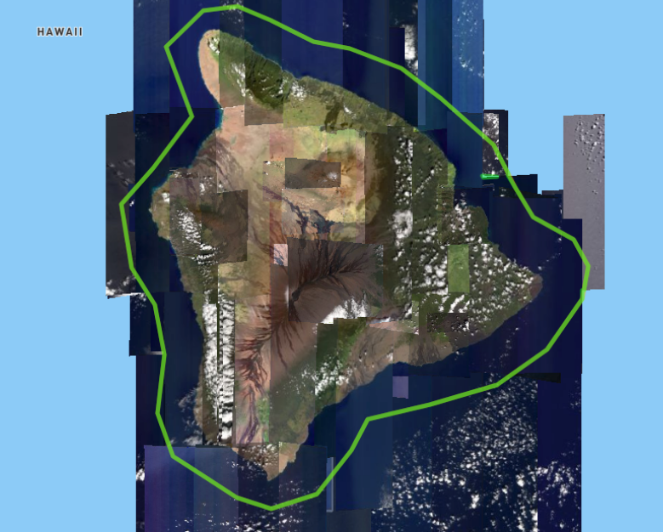
Next Steps
> 3.1 TB of data

Slide 26

Thank you!
Email: cankanoa@gmail.com
Kanoa Lindiwe
Joseph Emile Honour Percival
Ryan Perroy
github.com/cankanoa/vhrharmonize
Hou’oli Mau Loa
National Science Foundation
Change(HI)
University of Hawaii at Hawaii at Hilo
Spatial Data Analysis and Visualization Lab (SDAV)
Tropical Conservation Biology and Environmental Science

