Slide 1


Introduction to Classes Part1: Declaring a class, creating objects
Week 2
Ozacar Kasim, PhD | Assist. Prof. Computer Engineering Department

Slide 2
Previously on OOP
Summary: week1
Computer Languages in terms of levels
Lecture plan
Classes and Objects
OOP Concepts
Setup IDE

Slide 3
Table of Contents
main() method
Introduction to Java
POP vs OOP
Writing simple app using Procedure-oriented programming(POP)
Rewriting it using Object oriented Programming (OOP)
Using java built-in objects
Scanner class: reading Keyboard
Coding standards

Slide 4
First Program in Java: Print Line (Printing a Line of Text)
public class Welcome {
public static void main(String[] args) {
System.out.println("Welcome to Java!");
}
}
output : Welcome to Java!

Slide 5
Compiling Your First Java Application Displaying text with println and printf
public static void main(String[] args) {
System.out.println("Welcome to Java");
System.out.printf("%s %s %n", "Welcome", "to Java");
}

Slide 6
FORMAT SPECIFIERs
FORMAT SPECIFIER | CONVERSION APPLIED
%% | Inserts a % sign
%x %X | Integer hexadecimal
%t %T | Dime and Date
%s %S | String
%n | Inserts a newline character
%o | Octal integer
%f | Decimal floating-point
%e %E | Scientific notation
%g | Causes Formatter to use either %f or %e, whichever is shorter
%h %H | Hash code of the argument
%d | Decimal integer
%c | Character
%b %B | Boolean
%a %A | Floating-point hexadecimal
Integer formatted output
System.out.printf("Sum is %d%n", sum);
Format specifier %d is a placeholder for an int value
The letter d stands for “decimal integer.”

Slide 7
main Method (or function)
( )
public static void main( String[] args ) { … }
Starting point of every Java application.
Parentheses after the identifier main indicate that it’s a program building block called a method (same as function).
main method must be defined as shown; otherwise, the JVM will not execute the application.

Slide 8
Primitive Types
Category | Types | Size (bits) | Minimum Value | Maximum Value | Precision | Example
Integer | byte | 8 | -128 | 127 | From +127 to -128 | byte b = 65;
 | char | 16 | 0 | 2¹⁶-1 | All Unicode characters^{[1]} | char c = 'A'; char c = 65;
 | short | 16 | -2¹⁵ | 2¹⁵-1 | From +32,767 to -32,768 | short s = 65;
 | int | 32 | -2³¹ | 2³¹-1 | From +2,147,483,647 to -2,147,483,648 | int i = 65;
 | long | 64 | -2⁶³ | 2⁶³-1 | From +9,223,372,036,854,775,807 to -9,223,372,036,854,775,808 | long l = 65L;
Floating-point | float | 32 | 2⁻¹⁴⁹ | (2-2⁻²³)·2¹²⁷ | From 3.402,823,5 E+38 to 1.4 E-45 | float f = 65f;
 | double | 64 | 2⁻¹⁰⁷⁴ | (2-2⁻⁵²)·2¹⁰²³ | From 1.797,693,134,862,315,7 E+308 to 4.9 E-324 | double d = 65.55;
Other | boolean | -- | -- | -- | false, true | boolean b = true;
 | void | -- | -- | -- | -- | --

Slide 9
Java basics
Conditional statements
If-else
Switch-case
Loops
For, foreach
While
Do-while
Methods
Arrays
Int[] numbers, float[] scores, String[] names …

Slide 10
Why not using Procedure-oriented Programming (POP)? Why need for OOP?
Task: computing average score for multiple students.
We put students name, midterm and final exam
Create a method to compute average score of a student.
float getScore();
Create another method to show student all info
void displayNameAndScore();
Let's move to IDE

Slide 11
Need for OOP
There is no need for OOP concepts at all. Almost all the software in the world can be achieved using procedural (POP).
But OOP allows the programmer to think in terms of objects and classes that makes it
much easier to understand the code
easy to code and modify it
Reuse and existing code
Much easier to hide data.
It makes software a set of interacting Objects.

Slide 12
Writing a program using Object-Oriented Programming (OOP)
Task: Same task
We first create a Student class
put students name, midterm and final exam
Create a student object from the class
float CalculateScore();
using student object
Create a method to show all info
void ShowStudentInfoAndScore()
Let's move to IDE

Slide 13
Object illustrated
RAM
Memory (Stack)
Memory (Heap)
public class Student {
String name;
int age;
void doStudy() {…}
}
new Student()
name=null
age =0
Student s1
new Student()
Student s1 = new Student()
Student s2 = new Student()
Student s3 = s2;
Student s2
name=null
age =0
Student s3
For static memory allocation
For dynamic memory allocation
Notes:
Static Allocation means, that the memory for your variables is allocated when the program starts. The size is fixed when the program is created.
In Dynamic Memory Allocation, Allocation is done during program execution. It uses the data structure called heap for implementing dynamic allocation.
Class Area - This area contains the static members of the class.
Method Area - This area contains the method definition and executable code.
The methods are stored in JVM internal heap, which is not garbage collected.

Slide 14
Stack Memory vs.Heap Memory
Static Memory Allocation ( in Stack) | Dynamic Memory Allocation (in Heap)
Variables get allocated permanently | Variables get allocated only if the program unit gets active
Allocation is done before program execution | Allocation is done during program execution
It uses the data structure called stack for implementing static allocation (LIFO) | It uses the data structure called heap for implementing dynamic allocation
Less efficient | More efficient
There is no memory reusability | There is memory reusability . Memory can be freed when not required

Slide 15
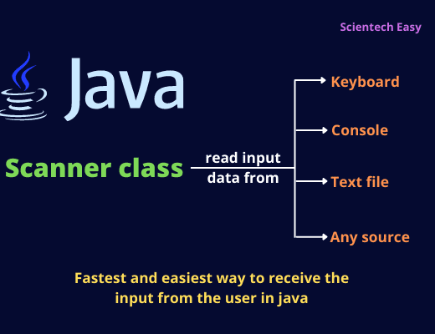
Using java built-in classes Scanner class: read input
An object must be declared with a name and a type before they can be used.
Declaration statement (Usage) Scanner input = new Scanner(System.in);
Scanner Class
Enables a program to read data for use in a program.
Data can come from many sources, such as the user at the keyboard or a file on disk.

Slide 16
Scanner class: Usage
public static void main(String[] args) {
Scanner input = new Scanner(System.in);
System.out.println("Please enter first number: ");
int numberOne = input.nextInt();
System.out.println("Please enter second number: ");
int numberTwo = input.nextInt();
int result = numberOne + numberTwo;
System.out.printf(“ the result is %d %n“, result);
}

Slide 17
Code Conventions: Method Names
Methods can either return something or return void. If a method returns something, then its name should explain what it returns, for example:
void get() BAD!
boolean isValid(String name); GOOD!
String content(); GOOD!
int ageOf(File file); GOOD!

Slide 18
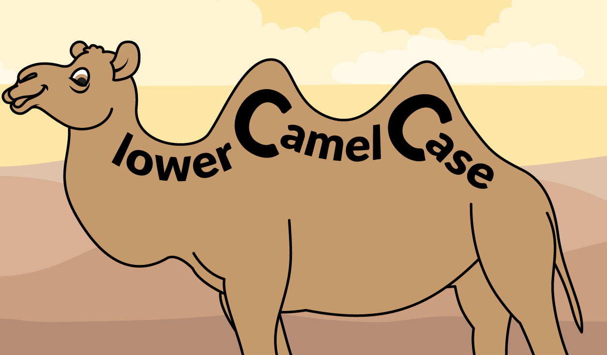
naming Conventions
If it returns void, then its name should explain what it does. For example:
Method Names
void saveToLocation(File file);
void process(Work work);
void append(File file, String line);
Variable Names
Eg: name, age. mobileNumber

Slide 19
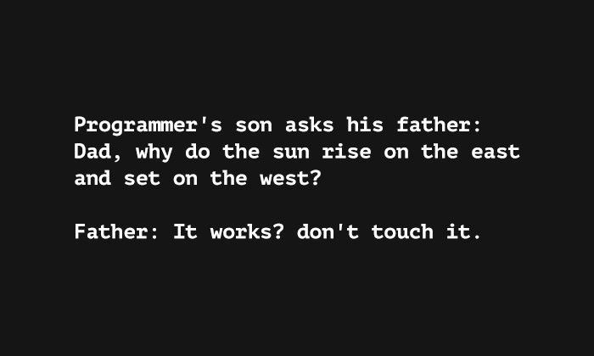
This is the end of lecture
LAB EXERCISE
ON THE NEXT SLIDE

Slide 20
Exercise for Lab (Week 2)
Create a Worker class includes
Attributes
name (string)
socialSecurityNumber (int)
wage (float)
workingHours (int)
Behaviours
displayInfo()
Print name + socialSecurityNumber;
displaySalary()
Print salary (salary= wage * workingHours)
Create a worker object and initialize attributes.
Call displayInfo() and displaySalary() methods for worker object.
Create another worker, and this time get attributes from the keyboard

