Slide 1


Introduction to Classes (Part2): Access Modifiers, Class Constructors, UML, Data Hiding(Encapsulation)
week3
Ozacar Kasim, PhD | Assist. Prof. Computer Engineering Department

Slide 2
Previously on OOP
Summary: week2
Class declaration
Object creation
Terms
Object: a reference type includes attributes and behaviors created from a class
Instance: a specific object created from a class
Reference variable: a variable pointing an object in memory
Scanner class: Read Keyboard input
Scanner scanner = new Scanner(System.in)
scanner.next(), scanner.nextInt(), scanner.nextFloat() etc.

Slide 3
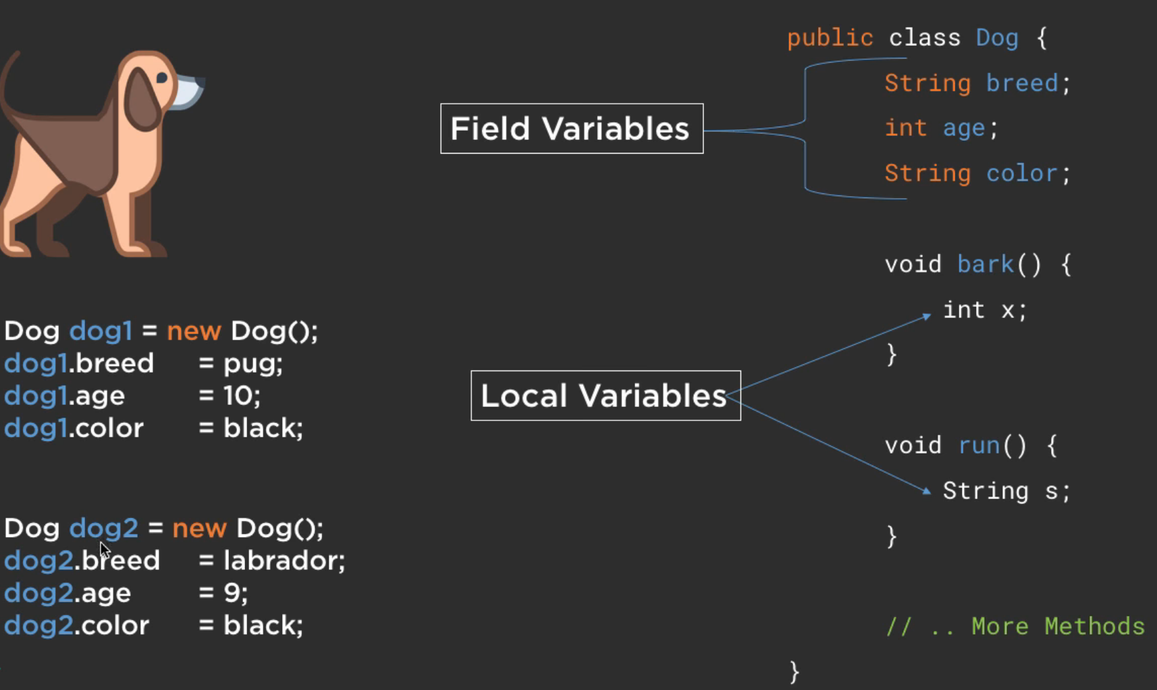
Summary: week2
Class declaration
Attributes
(Global variables)
Behaviours
(Methods)
Local variables
Instance variables
(a.k.a. Objects, reference var)

Slide 4
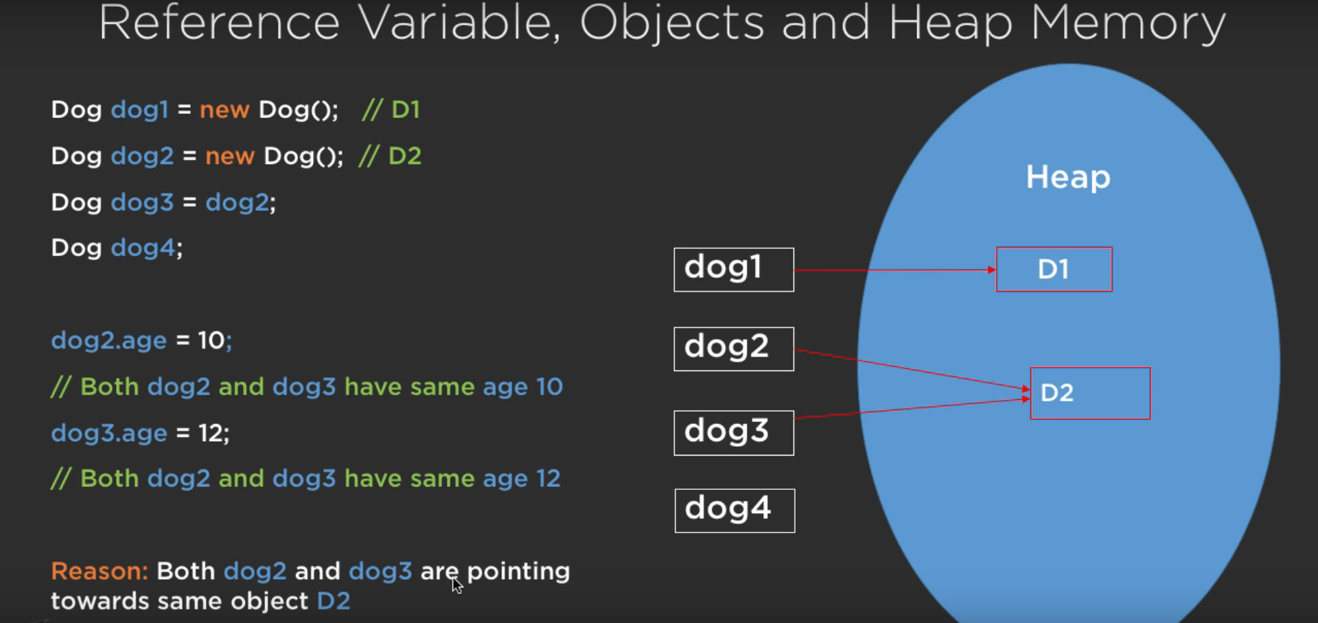
Summary: Reference variable, Object and Heap memory
Summary: week2

Slide 5
Primitive Types vs. Reference Types
Summary: week2
Types in Java are divided into two categories—primitive types and reference types.
The primitive types are boolean, byte, char, short, int, long, float and double.
All other types are reference types, so classes, which specify the types of objects, are reference types.
A primitive-type variable can store exactly one value of its declared type at a time.
Primitive-type instance variables are initialized by default.
Variables of types byte, char, short, int, long, float and double are initialized to 0.
Variables of type boolean are initialized to false.

Slide 6
Primitive Types vs. Reference Types (Cont.)
Summary: week2
Reference-type variables (called references) store the location of an object in the computer’s memory.
Such variables refer to objects in the program.
The object that’s referenced may contain many instance variables and methods.
Reference-type instance variables are initialized by default to the value null.
A reference to an object is required to call an object’s methods.
Primitive-type variables are not objects, therefore, cannot be used to call a method. (String is not a primitive type; it is a reference type)

Slide 7
Week 3: Table of Contents
week3
Access Modifiers
Class Constructors
Default constructor
Overloaded constructors
UML: Unified Modelling Language
OOP Concepts:
Data Hiding (Encapsulation a.k.a setters & getters)

Slide 8
Access Modifiers?
Java provides a few access modifiers to set access levels for classes, variables, methods, and constructors.
The four access levels are −
Visible to the package, the default. No modifiers are needed.
Visible to the class only (private).
Visible to the world (public).
Visible to subclasses (protected) – We will skip this for now

Slide 9
Default Access Modifier - No Keyword
A variable or method declared without any access control modifier is available to any other class in the same package.
(“Doğru” ve “Yanlış” olmak üzere iki değer alan veri tipidir. Uygulama içerisinde true(doğru) ve false(yanlış) değer ataması yapılmaktadır. Kontrol işlemlerinde sıklıkla kullanılmaktadır.)
String version = "1.5.1";
boolean processOrder() {
return true;
}

Slide 10
Public Access Modifier - Public
A class, method, constructor, interface, etc. declared public can be accessed from anywhere.
Therefore, attributes, methods, blocks declared inside a public class can be accessed from any class belonging to the Java Universe.
public static void main(String[] arguments) {
// ...
}
The main() method has to be public. Otherwise, it could not be called by a Java interpreter to run the class.

Slide 11
Private Access Modifier - Private
Methods, variables, and constructors that are declared private can only be accessed within the declared class itself.
Private access modifier is the most restrictive access level. Class cannot be private.
Using the private modifier is the main way that an object encapsulates itself and hides data from the outside world.
class Character {
private String name;
}
public class MainClass{
public static void main(String[] arguments) {
Character character = new Character();
character.name =“Mark”;
}
}
this is will cause a compilation error.
because name is not accessible due to its protection level.

Slide 12
Class Constructors
this is a class constructor
public class MyClass {
int id;
//Constructor
public MyClass(){
System.out.println(“Hi From Constructor!“);
id=5;
}
}
public class Test {
public static void main(String[] args) {
MyClass obj = new MyClass();
}
}
We call class constructor when create an object

Slide 13
Class Constructors
A constructor is a method which is used to initialize an object
Constructor method of a class has the same name as that of the class, they are called when an object of a class is created.
When Attributes of an object are not available while creating objects, the default constructor is called.
It is optional to write constructor method(s) in a class but due to their utility they are used.
public class MyClass
{
//constructor
public MyClass()
{
...
}
...
}
constructor doesn’t have a return type !!!

Slide 14
Initializing Account Objects When They’re Created (Cont.)
Default Constructor
If a class does not define constructors, the compiler provides a default constructor with no parameters, and the class’s instance variables are initialized to their default values.
There’s No Default Constructor in a Class That Declares a Constructor
If you declare a constructor for a class, the compiler will not create a default constructor for that class.

Slide 15
Constructor Overloading
class Player{
private int id;
private String name;
private int age;
Player(){
id = 100;
name = "New Player";
age = 18;
}
Player(int id, String name, int age){
this.id = id;
this.name = name;
this.age = age;
}
}
Constructor with no parameters
Overloaded constructor
Now, Let’s create a player object…

Slide 16
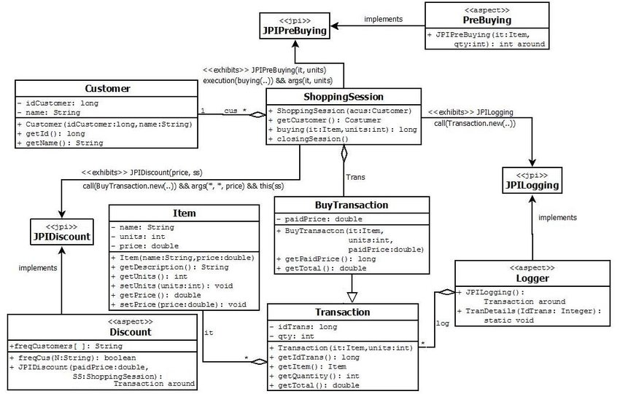
UML: Unified Modelling Language
The Unified Modeling Language (UML) is a general-purpose, developmental, modeling language in the software engineering field.
It provides a standard way to visualize the design of a system.

Slide 17
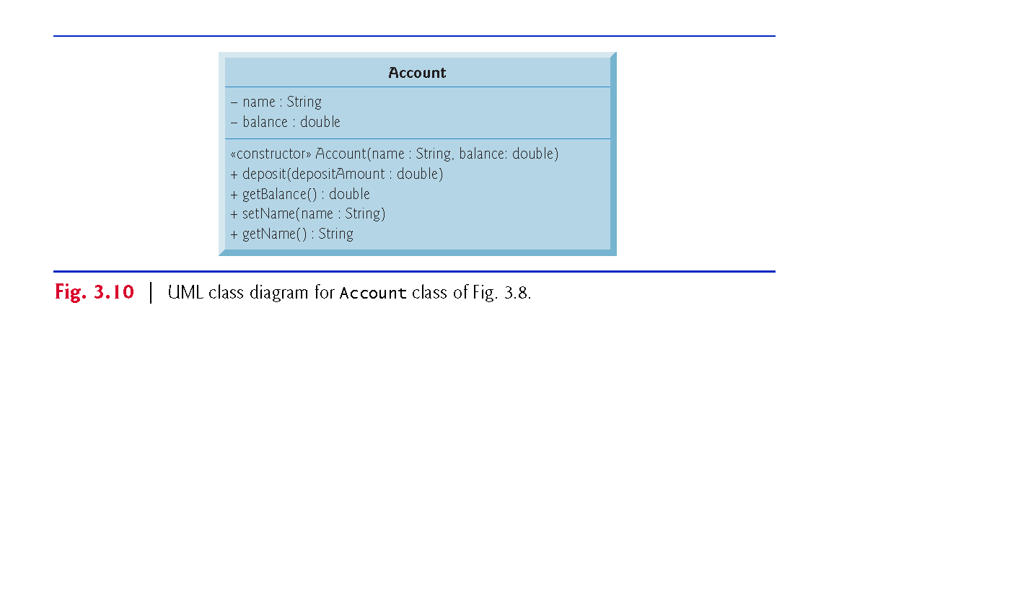
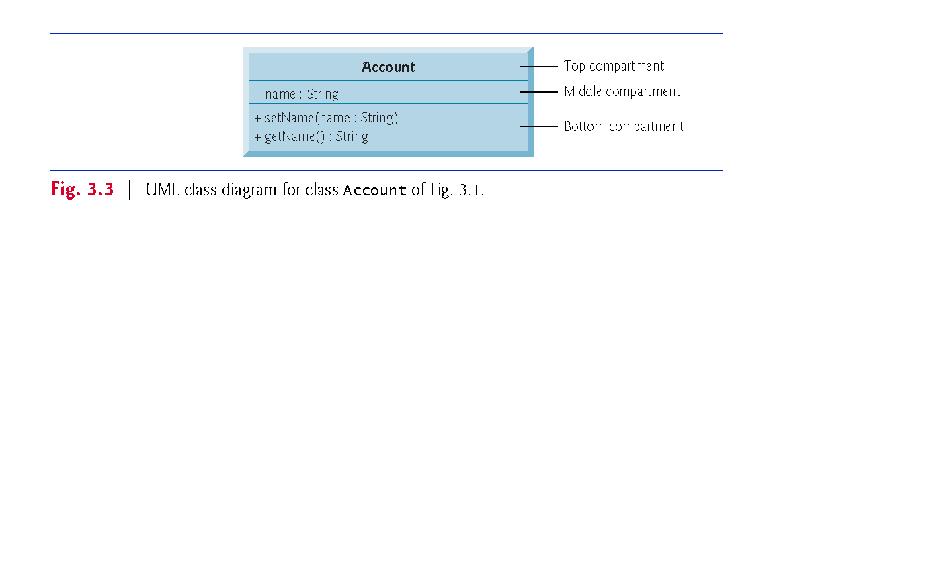
UML Class Diagram
Adding the Constructor to Class Account’s UML Class Diagram
The UML models constructors in the third compartment of a class diagram.
To distinguish a constructor from a class’s operations, the UML places the word “constructor” between guillemets (« and ») before the constructor’s name.

Slide 18
Account UML Class Diagram with an Instance Variable and set and get Methods
Top Compartment
In the UML, each class is modeled in a class diagram as a rectangle with three compartments. The top one contains the class’s name centered horizontally in boldface.

Slide 19
Middle Compartment
It contains the class’s attributes, which correspond to instance variables in Java. Here minus (-) means that the method is private

Slide 20
Bottom Compartment
It contains the class’s operations, which correspond to methods and constructors in Java.
The UML represents instance variables as an attribute name, followed by a colon and the type.
Private attributes are preceded by a minus sign (–) in the UML.
The UML models operations by listing the operation name followed by a set of parentheses.
A plus sign (+) in front of the operation name indicates that the operation is a public one in the UML (i.e., a public method in Java).

Slide 21
Return Types
The UML indicates an operation’s return type by placing a colon and the return type after the parentheses following the operation name.
UML class diagrams do not specify return types for operations that do not return values.
Declaring instance variables private is known as data hiding or encapsulation.
Parameters
The UML models a parameter of an operation by listing the parameter name, followed by a colon and the parameter type between the parentheses after the operation name

Slide 22
An Example : Lets create an Account Class using UML

Slide 23
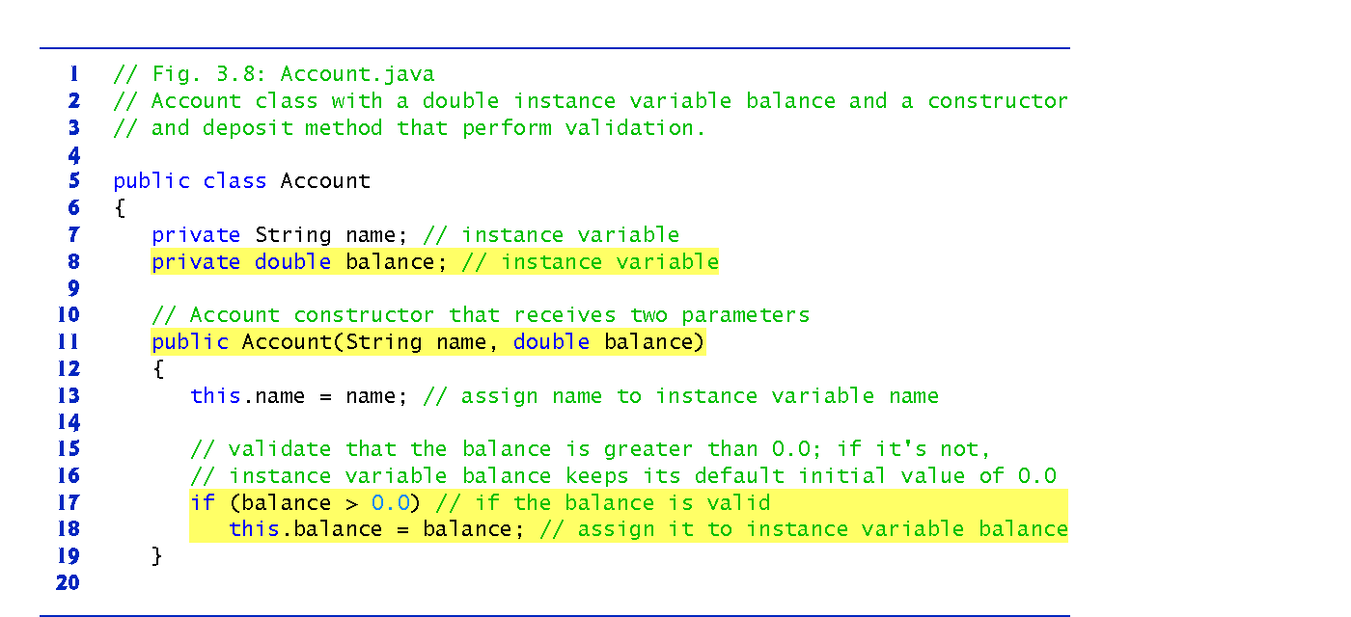
Account Class

Slide 24
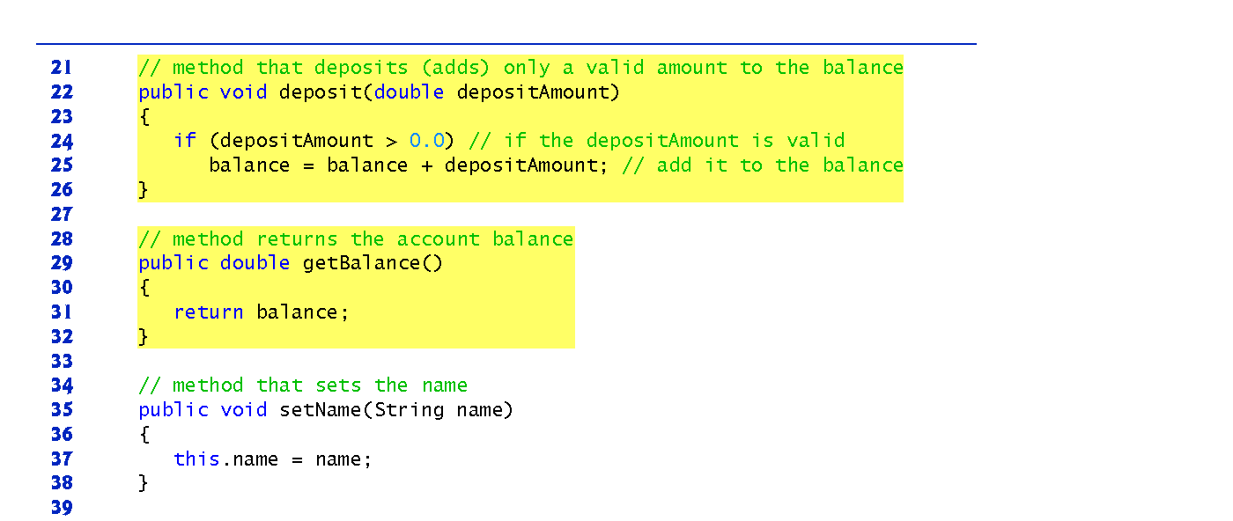
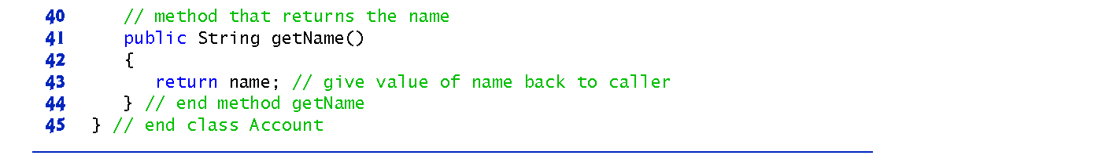

Slide 25
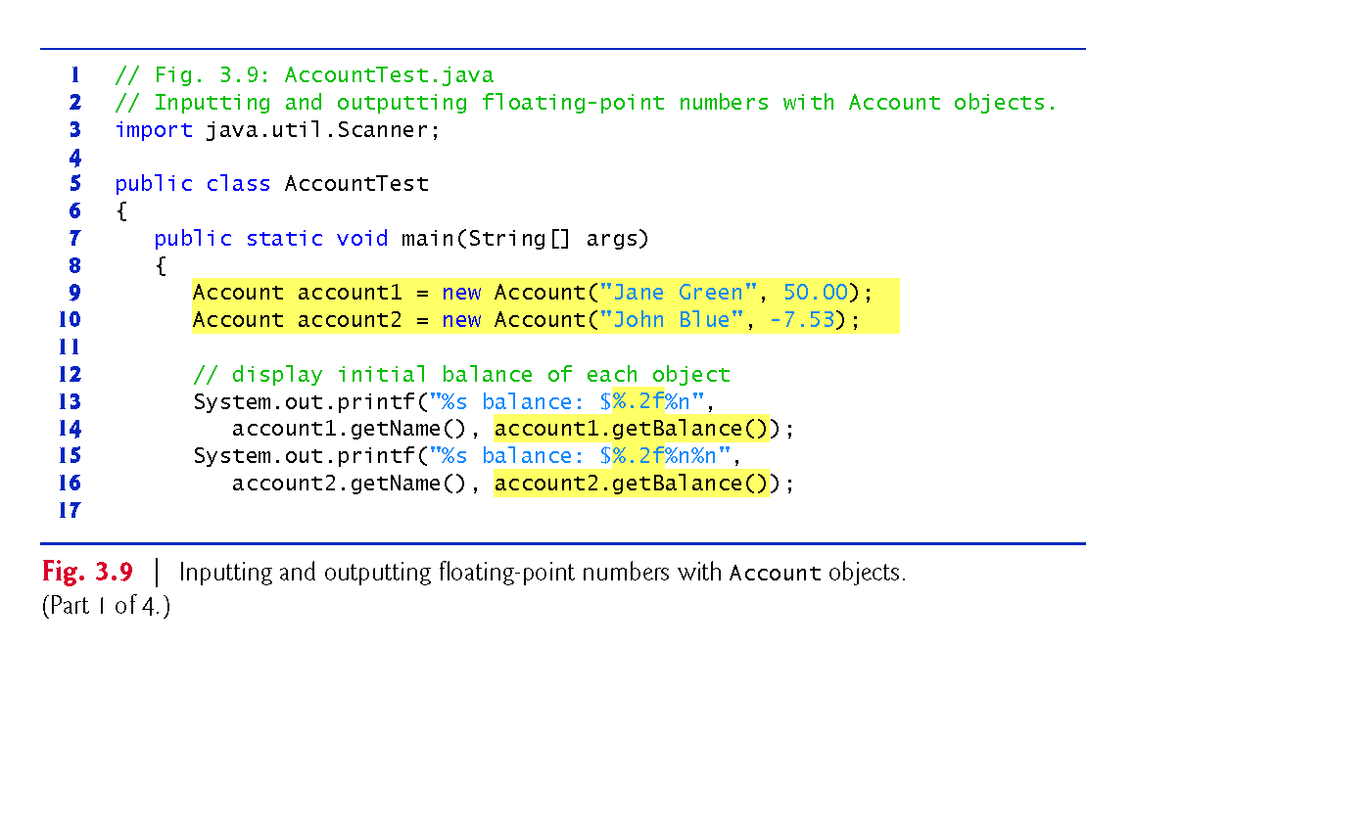
AccountTest Class to Use Class Account

Slide 26
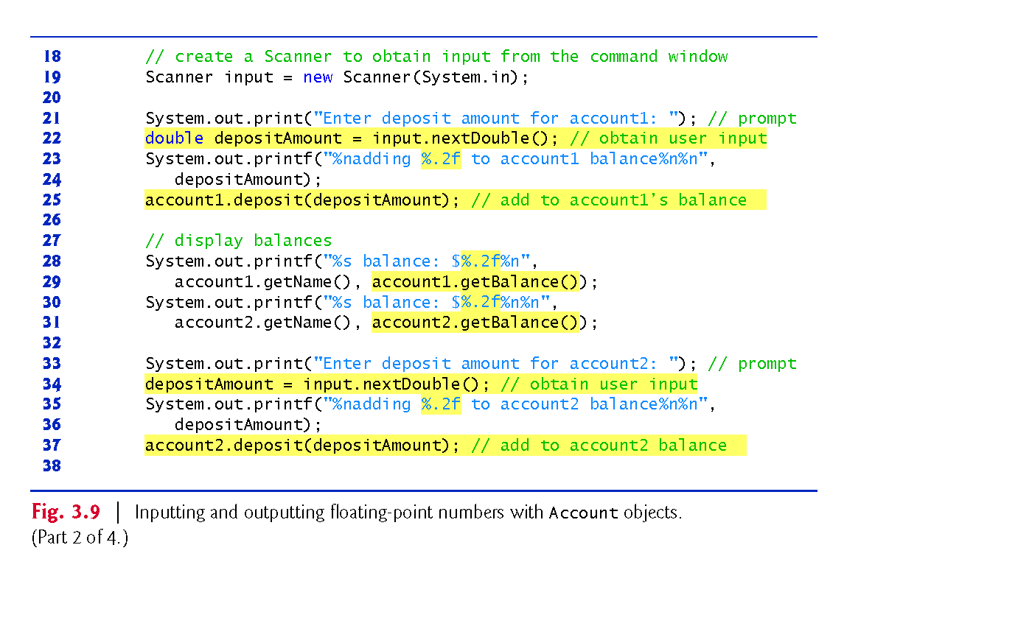

Slide 27
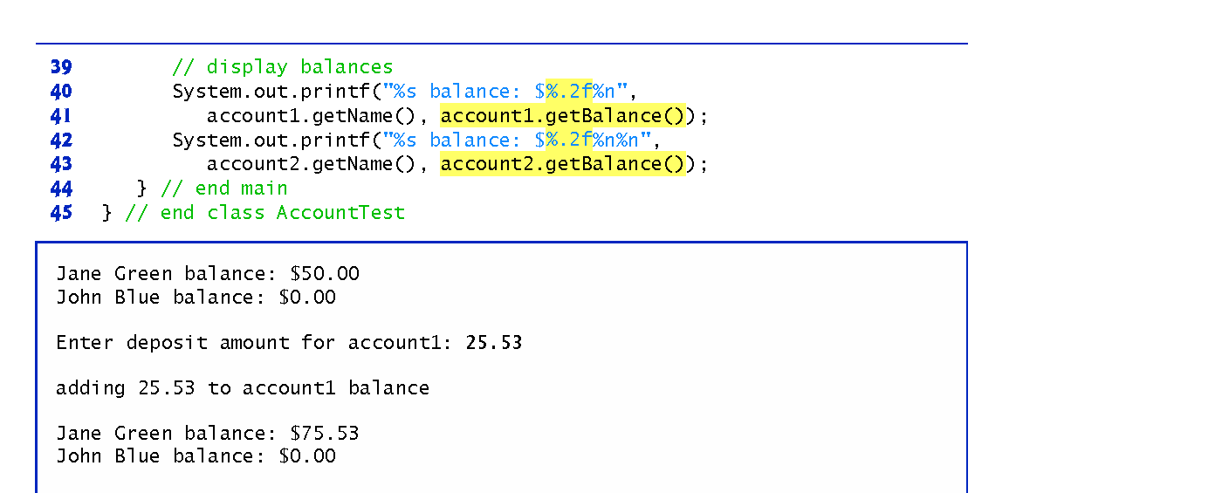
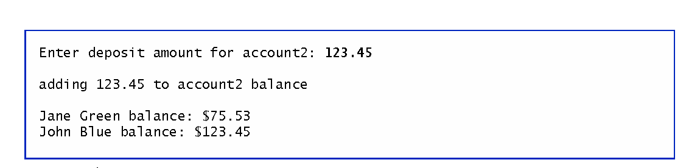

Slide 28
OOP Concepts: Encapsulation (Data hiding)

Slide 29
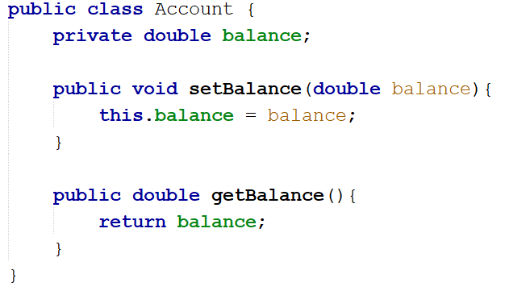
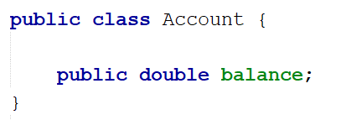
Encapsulation: An example
Encapsulation
applied

Slide 30
Encapsulation
Why do we create methods to access variables, if we can access them directly?
Answer: security issue.
'private' variables can only be accessed in the class. It's as if they were invisible out of the scope of the class / object.
Using set() and get() methods, A class can have total control over what is stored in its attributes

Slide 31
Set and Get: For example
Suppose you must create an application for a bank, which will limit the number of withdrawals from a customer.
The client’s balance value will be stored in the variable 'balance'. If you give full access to this variable, the client could use uncontrollably services of the bank. Right?

Slide 32
Set and Get: For example
int counter=-1;
public void setBalance(double amount){
if (amount <= balance && counter++ <= 3){ balance -= amount; }
else{ System.out.println("You have reached the daily limit"); }
}
However, we can create a method in which, each withdrawals from a customer activates a counter:
We know we have a daily limit for withdrawal, suppose to be three. So let's limit the number of withdrawals:
So every time you take money, your balance decreases in 'value' and a counter (which is a class variable) is incremented. Impossible to escape from this method! Did you understand this beauty? The counter always runs!

Slide 33
Coding
Let’s go to Compiler

Slide 34
Lab Exercise 1
Task: Create an Account class using following class diagram
Account
-balance: double -ownerName: String
<<constructor>>Account( name: String, balance: double) +setOwnerName(name: String) +getOwnerName():String +add(amount: double) +withdraw(amount: double) +getBalance():double

Slide 35
Lab Exercise 2
You need to do the following modification in Account Class:
In order to withdraw money, there will be a set of conditions:
Set a password (for example 1234)
User will get a message: “Please enter the 4-digit pass:”
User must enter the pass using keyboard
If pass is true, the user will withdraw the money
If pass is wrong, the user will try again two more times.
If the pass is still wrong, the user will get another message:
“Your account has been blocked, please try again later”
Do them all in withdraw() Method

Slide 36
This is the end of lecture
“If you think you are worth what you know, you are very wrong. Your knowledge today does not have much value beyond a couple of years. Your value is what you can learn and how easily you can adapt to the changes this profession brings so often.” — Jose M. Aguilar

