Slide 1

Week 9 OOP Concepts: Polymorphism
Week 9
Ozacar Kasim, PhD | Assist. Prof. | Computer Engineering Department

Slide 2
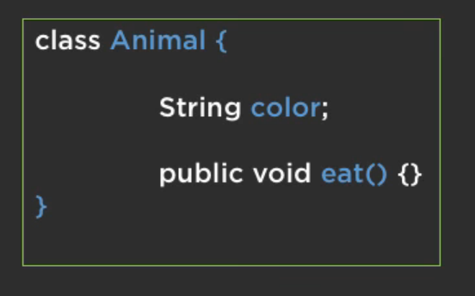


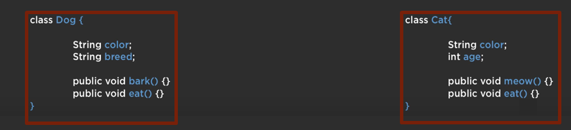
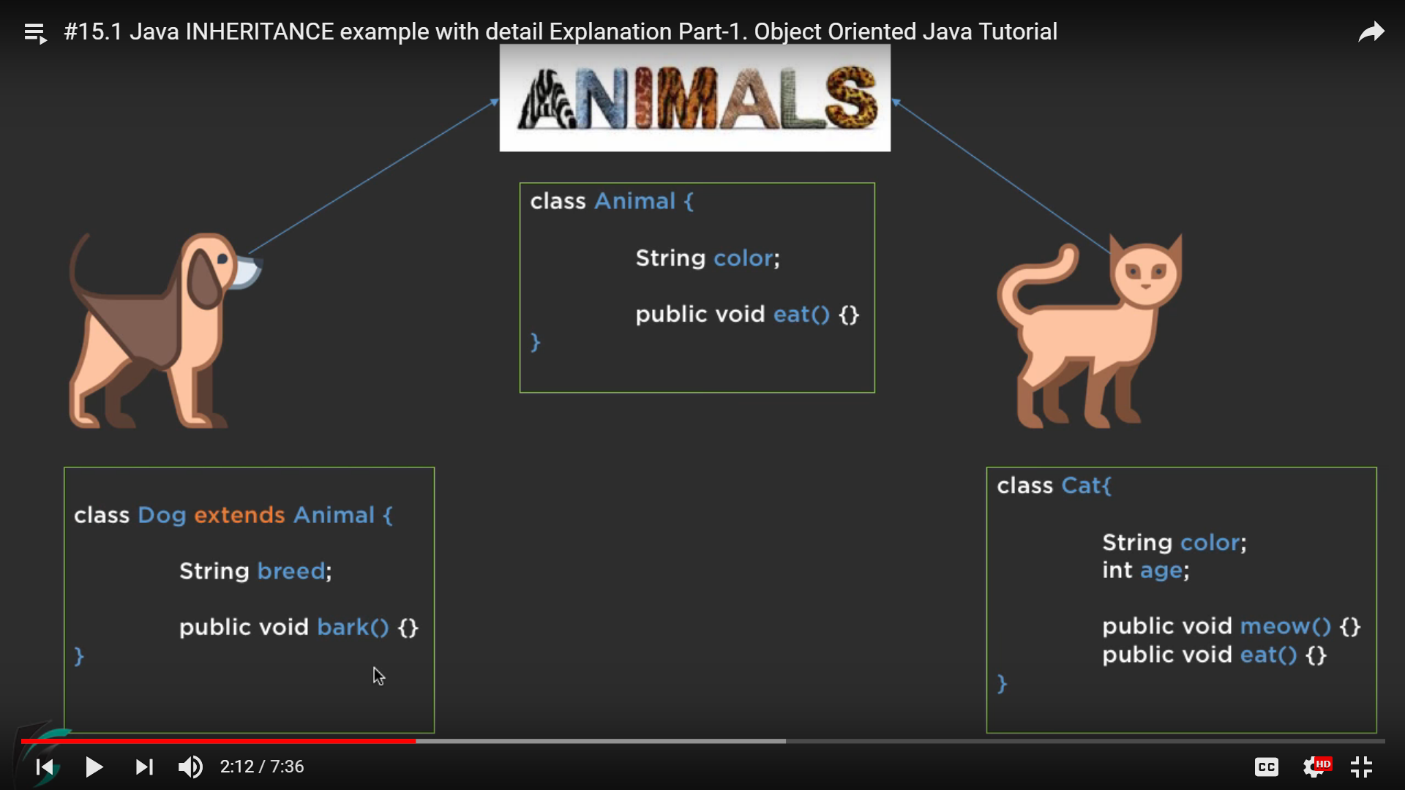
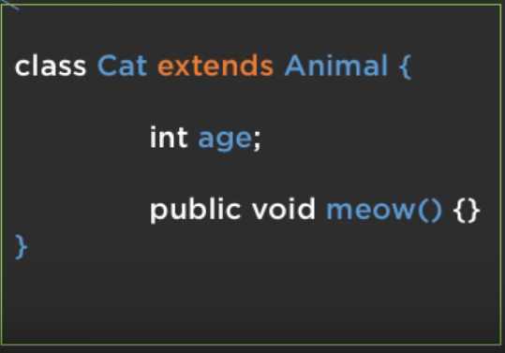
Inheritance
Week 8

Slide 3
Inheritance
Week 8
We use inheritance for two purposes:
Code Reusability
(Kod tekrarını engellemek)
2.Method Overriding

Slide 4
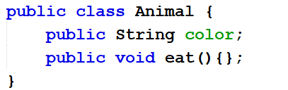
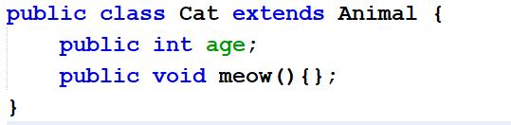
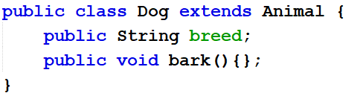
1-Code Reusability
Week 8
A Cat object have
color
age
meow()
eat()
A Dog object have
color
breed
bark()
eat()

Slide 5
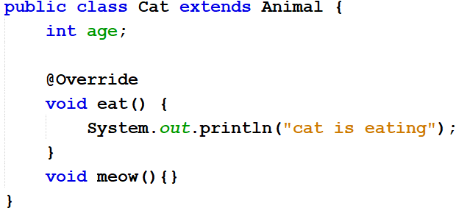
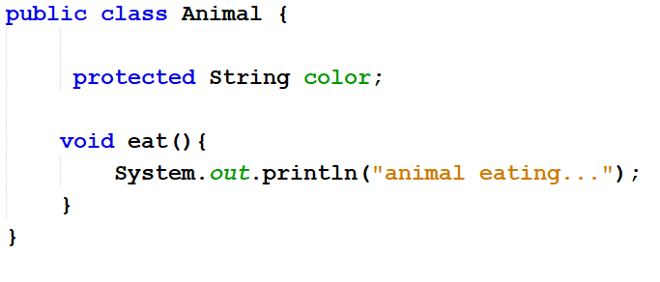
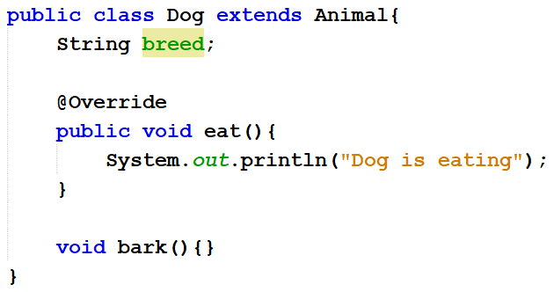
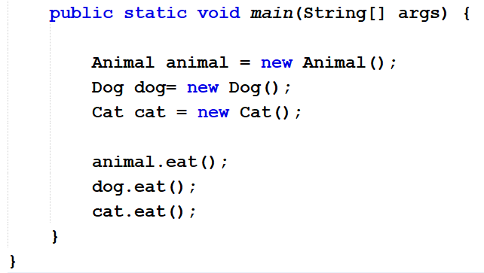
2. Method Overriding
Week 8
superclass
subclass
subclass
animal eating…
cat is eating
Dog is eating
Notes:
Elemanların tanımını değiştiriyoruz.

Slide 6
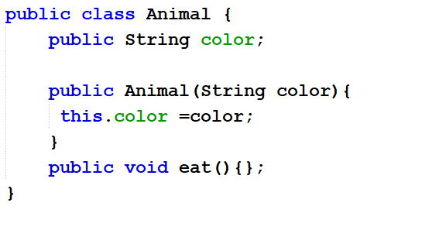
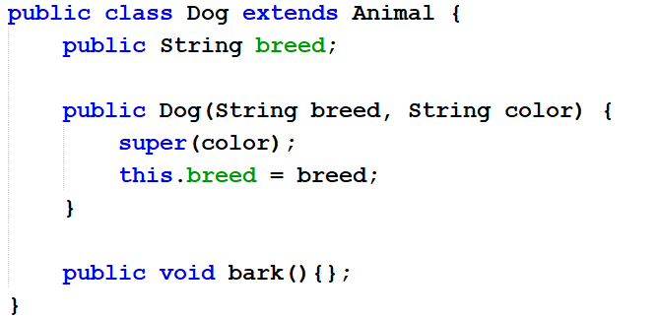
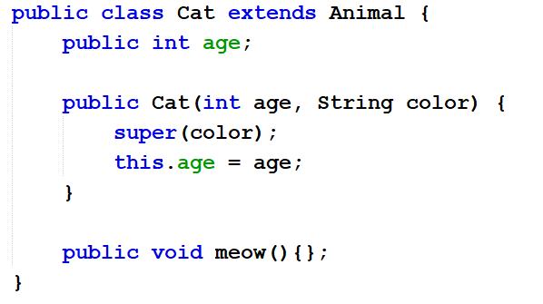
Inheritance with Constructor
Week 8
public Animal(String color){ this.color = color;
super(args); // call parent’s constructor super.attributeName // access parent’s attribute super.methodName(args); // access parent’s method
Usages
(just like this)

Slide 7
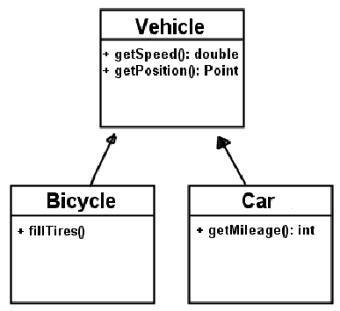
Protected & inheritance in UML & “is a”
Week 8
Protected
inheritance in UML
“is a” relationship
Public and private
We know them
protected:
visible to the current class, and all its child classes in any package
protected int age;
# for protected in UML
classes have inheritance relationships are connected by arrows
"Is-a" relationships is used for code reusability in OOP. public class Cat extends Animal { // ... }
a Cat object "is-a" Animal
therefore, it can do anything an Animal can do
Notes:
Ptorected: alt classsa her yerden erişilebilir. # ile kullanılır. Has a > sahiptir // is a >

Slide 8
Some Exercises: OUTPUT???
Week 8
class A {
public void method1() { System.out.println(“A1”); }
public void method3() { System.out.println(“A3”); }
}
class B extends A {
public void method2() { System.out.println(“B2”); }
public void method3() { System.out.println(“B3”); }
}
Class C {
public static void main(String[] args){
A a = new A();
B b = new B();
a.method1(); //A1
a.method2(); //HATA
a.method3(); //A3
b.method1();//A1
b.method2();//B2
b.method3();//B3
}
}

Slide 9
Week 9 OOP Concepts: Polymorphism
Week 9
Ozacar Kasim, PhD | Assist. Prof. | Computer Engineering Department

Slide 10
Table of Contents
Definition: Polymorphism
Types of Polymorphism
Polymorphism and Arrays
Object Type-casting
Exercises

Slide 11

Polymorphism?(çok biçimli, çok formlu)
Polymorphism (having multiple forms: poly + morph") is the characteristic of being able to assign a different meaning or usage to something.
In OOP, it allows an a variable, a method, or an object to have more than one form
Polymorphism is kind of a person who at the same time can have different characteristics
Mystique, a mutant character in X-men

Slide 12
Different Types of Polymorphism
Java supports 2 types of polymorphism:
Compile-time (Static)
Method overloading(metotun gövdesi aynı tipi değişebilir)
Run-time (Dynamic)
Method overriding

Slide 13
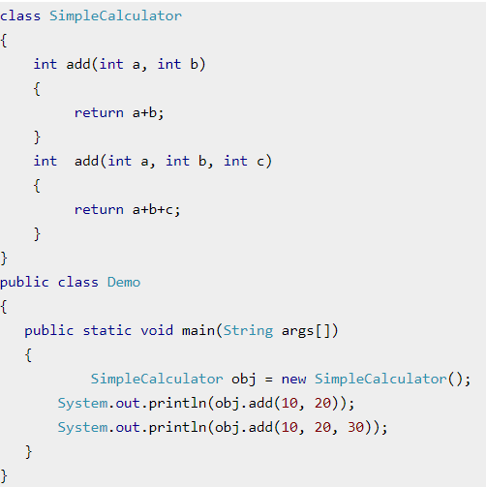
1-Compile-time Polymorphism
Example
Overloading is compile-time polymorphism where more than one methods share the same name with different parameters or signature and/or different return type.

Slide 14
2-Run-time Polymorphism
Example
Method Overriding is run time polymorphism having same method with same parameters or signature but associated in a class & its subclass.
superclass
subclass
Notes:
***Önemli olan bu. Ata classta metot yavru classta ifade edilir.

Slide 15
Polymorphism and arrays
Example: The problem we have is, we have 3 different classes (Cat, Dog, Horse) all with the same behavior: eat().
An array can be only one type, how can we store them all in an array?
TypeOfArray[] myArray = new TypeOfArray[]{cat, dog, horse};
Do we need 3 types of arrays?
That's the problem we can solve using polymorphism.
Using Polymorphism, we can deal with different sub classes as the same super class
Animal[] myArray = new Animal[]{cat, dog, horse};

Slide 16
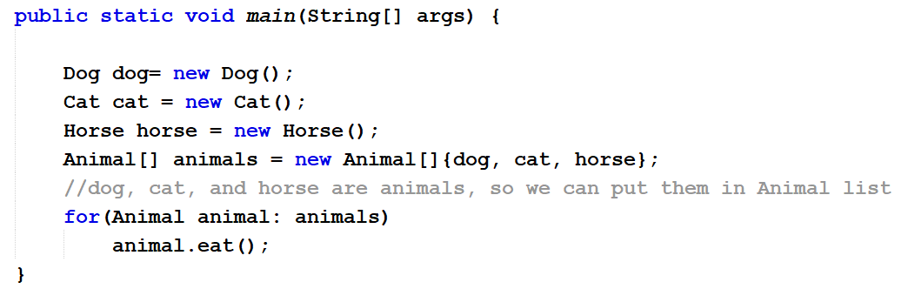
Polymorphism and arrays:Simple example
Let's create Dog, Horse, and Cat classes. And using an array, to call eat() foreach animal.

Slide 17
Object Type Casting: Upcasting & downcasting
converting one type to another type is known as type casting
Primitive type casting
double myDouble = 1.1;
int myInt = (int) myDouble; //we’re “turning” one type into another.
Reference type casting
Casting from a subclass to a superclass is called upcasting
Upcasting is closely related to inheritance
Cat cat = new Cat();
Animal animal = cat;
animal = (Animal) cat;
Casting from a superclass to a subclass is called downcasting
Animal animal = new Cat()
((Cat) animal).meow();
Upcasting narrows the list of methods and properties available to this object, and downcasting can extend it.

Slide 18
Some exercises: code that won't compile!!!
Not every Animal "is-a" Cat Cat cat = new Animal(); //wont compile
cannot call a Cat method on a variable of type Animal
(çalışmaz çünkü her hayvan kedi olmak zorunda değil.)
Animal a = new Cat();
a.eat(); //will compile
a.meow(); //wont compile, object a can only use Animal behaviors.
cannot use any Animal behavior on an Object variable Object o = new Animal(); o.eat(); // Object o does not have eat() o.meow(); // Object o does not have meow() either (çalışmaz)

Slide 19
Which method gets called?
Animal c = new Cat();
c.eat();
Will it call the eat method in
Cat Class?
Or
in Animal Class?(mevcut duruma göre değişir.)
Check this out!

Slide 20
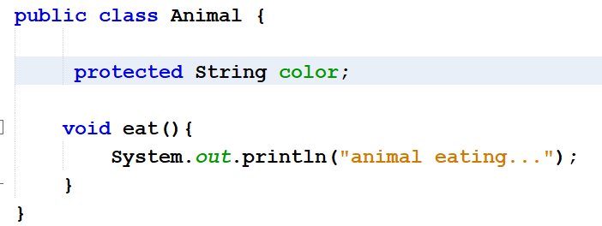
A problem
dummy implementations
subclass
subclass
What if we don’t want to implement a method in a super class?

Slide 21
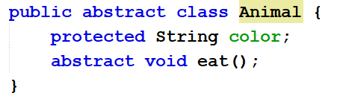
Abstract Classes
Using abstract class
An abstract class is a class that is declared abstract—it may or may not include abstract methods. Abstract classes cannot be instantiated, but they can be subclassed.
An abstract class can be used as a type of template for other classes. The abstract class will hold common functionality for subclasses.
Without abstract classes, you would have to provide dummy implementations of the methods you intend to override.
no body, no implementations
dummy implementations

Slide 22
Instance of
The java instance of operator is used to test whether the object is an instance of the specified type (class or subclass or interface).
It returns either true or false. If we apply the instanceof operator with any variable that has null value, it returns false.
class Simple1{
public static void main(String args[]){
Simple1 s=new Simple1();
System.out.println(s instanceof Simple1);//true
}
}

Slide 23
New Dog()
Animal animal3
New Cat()
New Horse()

Slide 24
A GOOD EXAMPLE: EMPLOYEE CLASSES

Slide 25
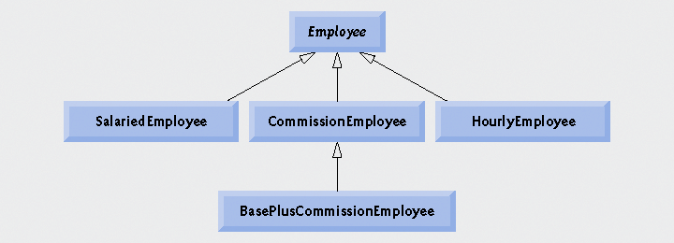
Employee hierarchy UML class diagram.

Slide 26
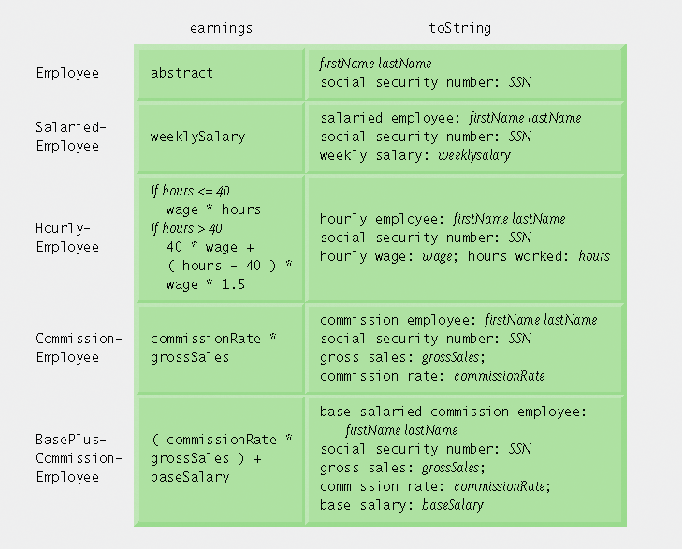
Polymorphic interface for the Employee hierarchy classes
earning()
toString()

Slide 27
Creating Abstract Superclass Employee
abstract superclass Employee
earning is declared abstract
No implementation can be given for earnings in the Employee abstract class
An array of Employee variables will store references to subclass objects
earning method calls from these variables will call the appropriate version of the earnings method

Slide 28
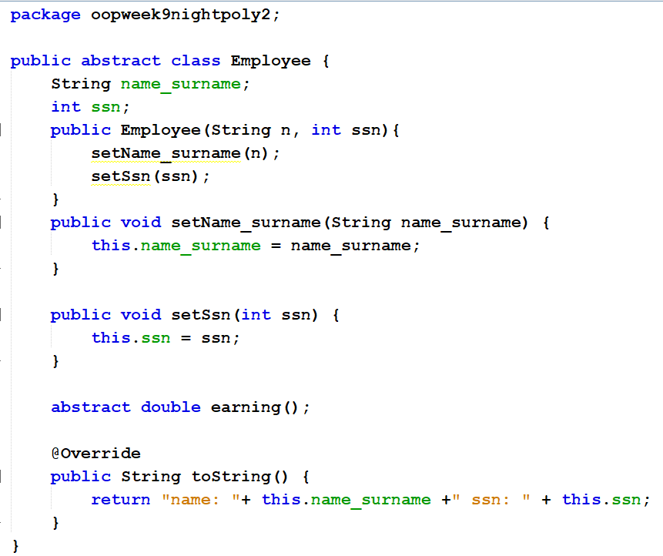
Employee.java
You cannot create an instance from Employee, because it is an abstract class
But you can create an instance from its subclasses

Slide 29
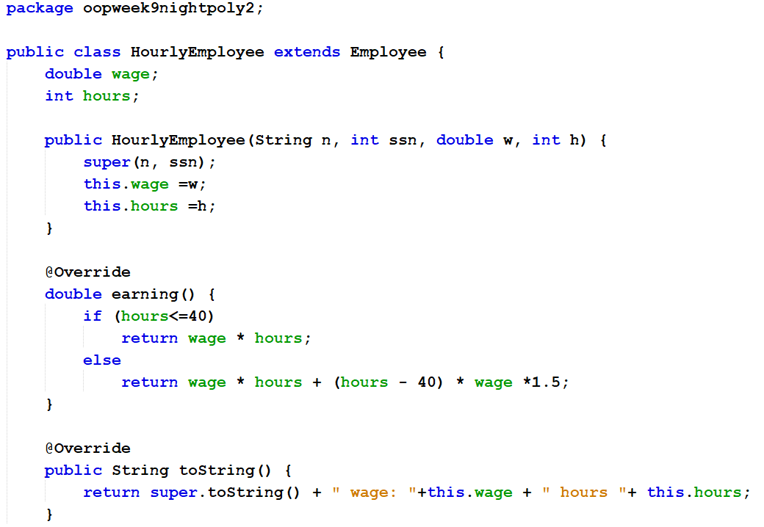
HourlyEmployee.java
HourlyEmployee class extends Employee.

Slide 30
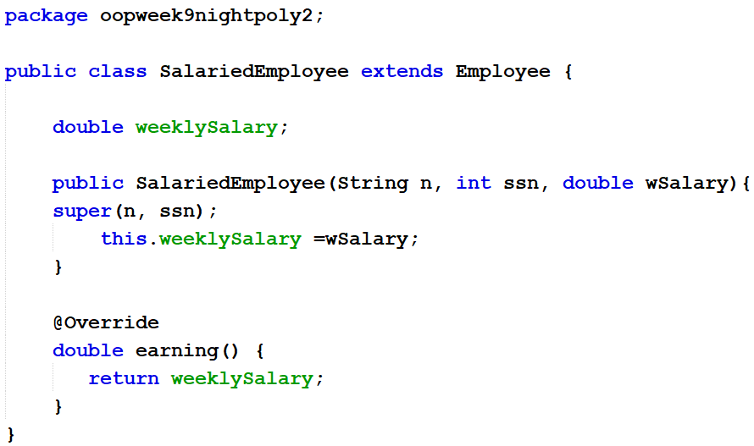
SalariedEmployee.java
SalariedEmployee class extends Employee.

Slide 31
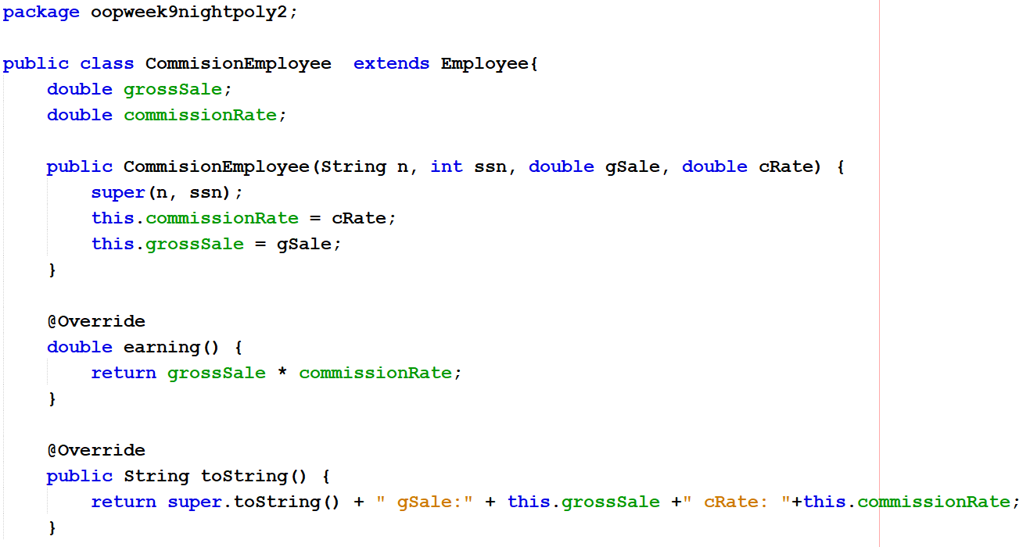
CommissionEmployee.java
CommissionEmployee class extends Employee.

Slide 32
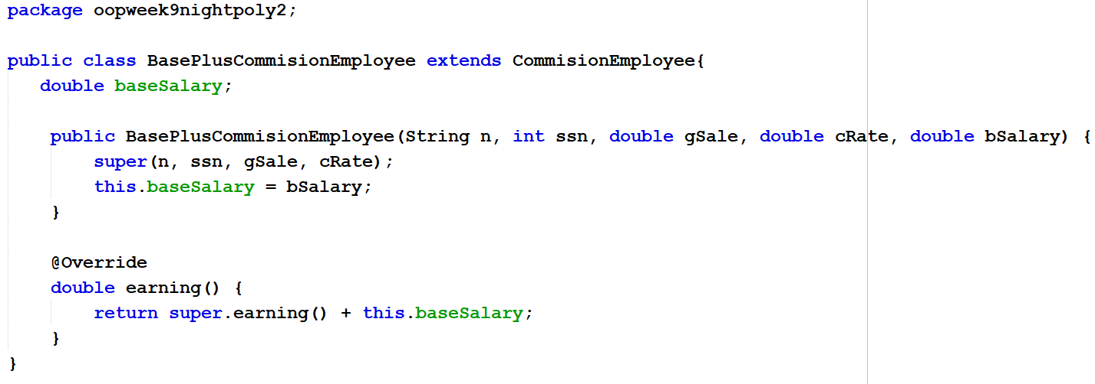
BasePlusCommissionEmployee.java
BasePlusCommissionEmployee class extends CommissionEmployee.

Slide 33
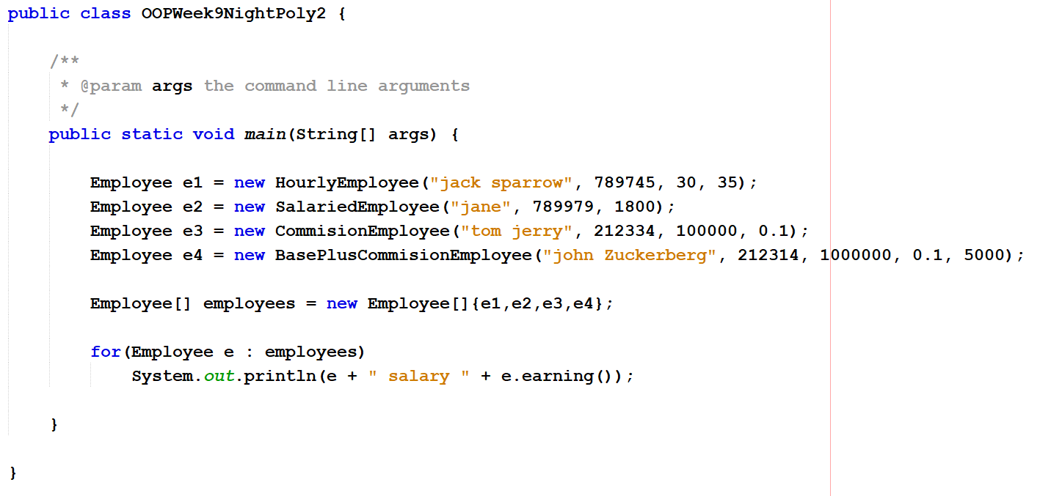
MainClassTest.java
MainClassTest {

Slide 34
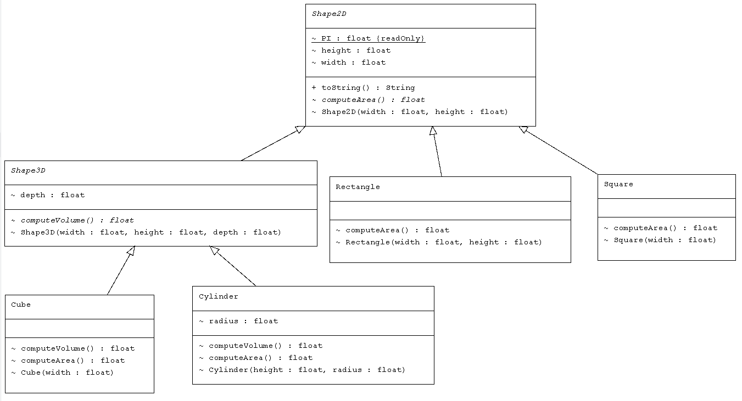
LAB Exercise

Slide 35
LECTURE IS OVER
Any questions?

