Slide 1

Week 10 - Interfaces: Abstraction, Multiple inheritance
Ozacar Kasim, PhD | Assist. Prof. | Computer Engineering Department

Slide 2

Polymorphism?
Week 9
Polymorphism allows a variable, a method, or an object to have more than one form

Slide 3
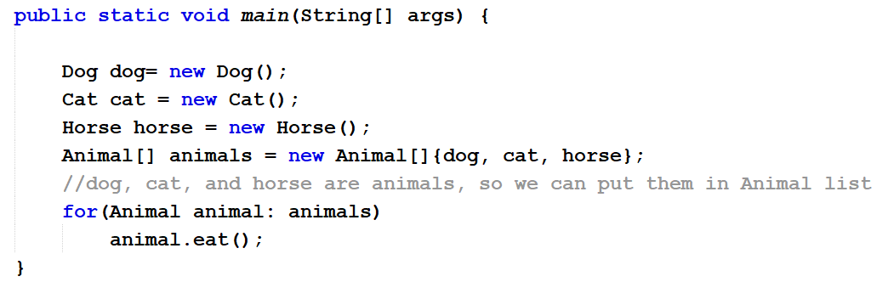
Polymorphism and arrays
Week 9
Scenario: We have 3 different classes (Cat, Dog, Horse, all extends Animal), and we want to put them all in an array. (Note that an array can have one single type)
Using Polymorphism, we can deal with different sub classes as the same super class
Animal[] myArray = new Animal[]{cat, dog, horse};

Slide 4
Typecasting
Week 9
Reference type casting
Casting from a subclass to a superclass is called upcasting
Cat cat = new Cat(); // class Cat extends Animal
Animal animal = (Animal) cat;
Casting from a superclass to a subclass is called downcasting
Animal animal = new Cat()
((Cat) animal).meow(); // extends the method available to Cat object
Upcasting narrows methods and attributes available to this object,
Downcasting extends methods and attributes available to this object

Slide 5
Animal
String color
eat();
Cat
age;
eat();
meuw();
Cat cat = new Cat();
Animal a = cat;
a.eat();
a.meuw();
((Cat)a).meuw();
a = new Dog();
((Dog)a).bark();
((Cat)a).meuw();
Dog
Breed;
eat();
bark();
Week 9

Slide 6
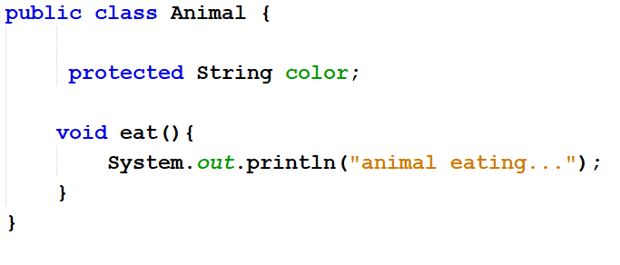
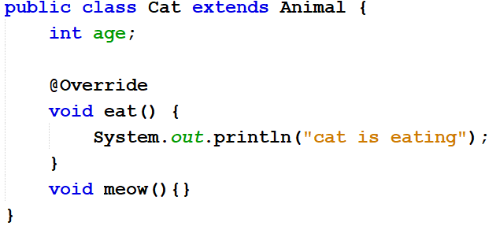
Exercises: Followings will compile? Run?
Week 9
Cat cat = new Animal(); //??
Animal a = new Cat();
a.meow(); //??
((Cat)a).meow(); //??
Object o = new Animal();
o.eat(); //??
o.meow(); //??
((Animal)o).eat(); //??
((Animal)o).meow(); //??
((Cat)o).eat(); //?? (*)
((Cat)o).meuw(); //??
* It is legal to cast a reference to the wrong subtype;
However, this will compile but crash when the program runs

Slide 7
Week 10 - Interfaces: Abstraction, Multiple inheritance
Ozacar Kasim, PhD | Assist. Prof. | Computer Engineering Department

Slide 8
Interfaces: Definition
An interface is like an abstract class that is intended to be used as a common base to access a number of similarly-behaving objects.
An interface is a contract an implementing class needs to respect
interface contains behaviors that a class implements. (Contract)
Methods in an interface are by-default public. (Contract)

Slide 9
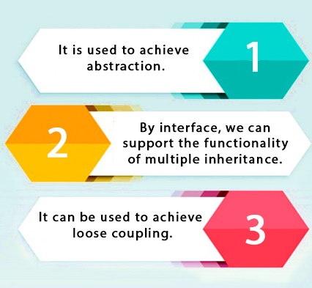
Interfaces : Introduction
There are mainly three reasons to use interface. Using interface we can:
achieve abstraction.
support the functionality of multiple inheritance.
achieve loose coupling.

Slide 10
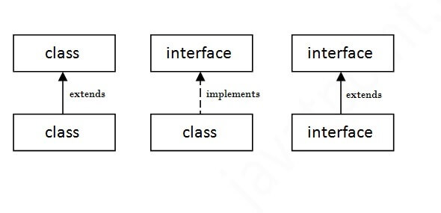
Relationship between classes and interfaces
We already know this!

Slide 11
Interfaces: Syntax and Structure
An interface is created with the following syntax:
An interface can extend other interfaces with the following syntax:
modifier interface InterfaceID {
//constants
//abstract method
}
modifier interface interfaceID extends interface1, .., interfaceN {
//constants
//abstract method, (After Java 8.0 static and default methods)
}
It provides total abstraction which means
all the methods in an interface are declared with the empty body,
and all the attributes are public, static and final by default.
A class that implements an interface must implement all the methods declared in the interface.

Slide 12
Interfaces: More …
Interfaces are like abstract classes (we will compare).
An interface is not extended by a class; it is implemented by a class. But, one interface can extend another one.
An interface does not contain any constructors.
A class can implement any number of interfaces. (multiple inheritance)
Interfaces cannot be instantiated. (like abstract classes)
You can use interface as a data type for variables. (Like classes)
Interfaces can contain only abstract methods and constants.

Slide 13
Interface vs. abstract class
 | Interface | Abstract class
Variable (attribute) | Only constants | Constants and variable data
Methods (behaviour) | No implementation allowed (no abstract modifier necessary) | Abstract or concrete
Interface | Abstract class
A subclass can implement many interfaces | A subclass can inherit only one class
Can extend numerous interfaces | Can implement numerous interfaces
Cannot extend a class | Extends one class

Slide 14
Interface usages

Slide 15
1.Abstraction
1
Abstract classes vs. Abstraction
Abstract classes are used for inheritance, which is more heavily used to achieve code reuse
Abstraction enables large systems to be built without increasing the complexity of code and understanding.
In other words, abstraction is a process where you show only “relevant” data and “hide” unnecessary details of an object from the user. We do abstraction when deciding what to implement.
We achieved abstraction using abstract classes and interfaces.

Slide 16
Example
1
Salary<<interface>>
CalculateSalary() declaration
Employee<<abstract>>
CalculateSalary() declaration
name;
wage;
Employee<<abstract>>
name;
wage;
FullTimeEmployee
PartTimeEmployee
PartTimeEmployee
FullTimeEmployee
CalculateSalary()
CalculateSalary()
hours;
CalculateSalary() declaration
CalculateSalary() declaration
hours;
Abstraction using Abstract classes
Abstraction using Abstract classes and Interfaces

Slide 17
2.Multiple inheritance
2
Multiple inheritance of implementations is not allowed in Java.
However, Classes can inherit multiple interfaces.
The advantage of multiple inheritance is that it allows a class to inherit the functionality of more than one base class
thus allowing for modeling of complex relationships.
public interface A {
void a();
}
public interface B {
void b();
}
public class Test implements A, B {
public void a() {}
public void b() {}
}

Slide 18
Example for Multiple inheritance
ColorPrintBehaviour
FaxBehaviour
ScanBehaviour
ColoredPrint();
Fax();
Scan();
Print();
Printer
Canon Professional
Print()
ColoredPrint()
Fax()
Scan()
Canon Office
Print()
Fax()
Scan()
Canon Basic
Print()
Scan()

Slide 19
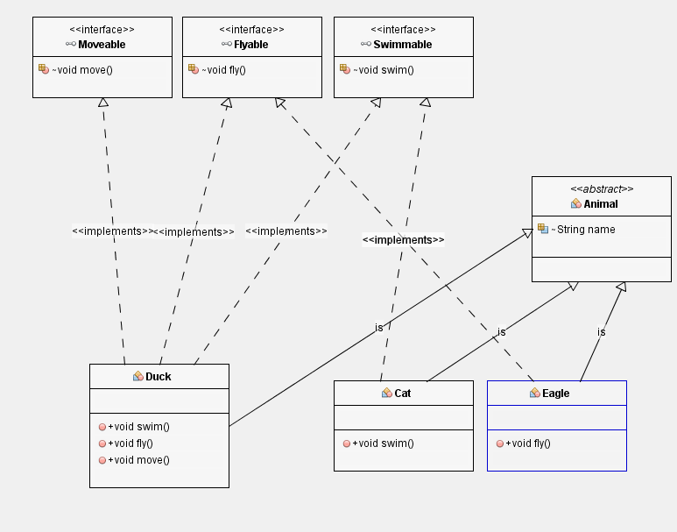
EXERCISE

Slide 20

Loosely coupling?
The Hat is "loosely coupled" to the body.
This means you can easily take the hat off without making any changes to the person/body.
When you can do that then you have "loose coupling".
In short, loosely coupling makes code easier to change.
if you want to change the skin, you would also HAVE TO change the design of your body as well because the two are joined - they are “tightly coupled”
loose coupling means that you need to know less of the used code. Thus using interfaces provides a part of that.
The Hat is "loosely coupled“ to the body.

Slide 21

MVC is a loosely coupled
Loose coupling is simply writing software in such a way that all your classes can work independently without relying on each other. MVC is a loosely coupled
Model - Contains your classes and business logic
View - Displays the application UI based on the model data
Controller - Respond to an oncoming URL request and select the appropriate view

