Slide 1
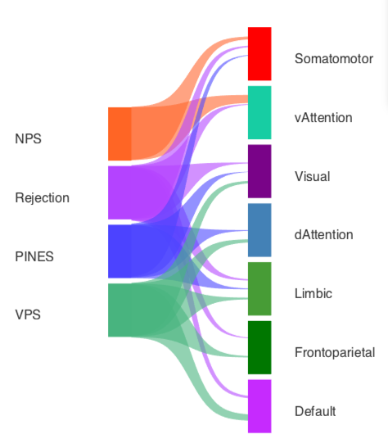
Quick start: Check out
riverplot_example_npsplus_bucknerlab.m

Slide 2
load_image_set.m
Get fmri_data objects and names
riverplot_example_npsplus_bucknerlab.m
image_similarity_plot.m
Get an association matrix and names
LAYER DRAWING
riverplot_draw_layer.m
Draw a layer (column) of rectangles
riverplot_reorder_matrix.m
Re-organize the rows for display
RIBBON DRAWING
riverplot_rect.m
Draw a rectangle, with defined coordinates for use by other functions
riverplot_ribbon_matrix.m
Plot the ribbons showing associations
riverplot_ribbon.m
Plot a ribbon, with some control features
riverplot_layer_names.m
Add names and show them on plot
riverplot_plot_ribbon.m
Plot a ribbon
riverplot_set_ribbon_property.m
Show names
riverplot_toggle_lines.m
Turn off/on the ribbon edges
riverplot_line.m
Define the lines bounding the ribbon curves
DISPLAY CONTROL

