Slide 1
NCS by condition
Feb 2023 for slides

Slide 2
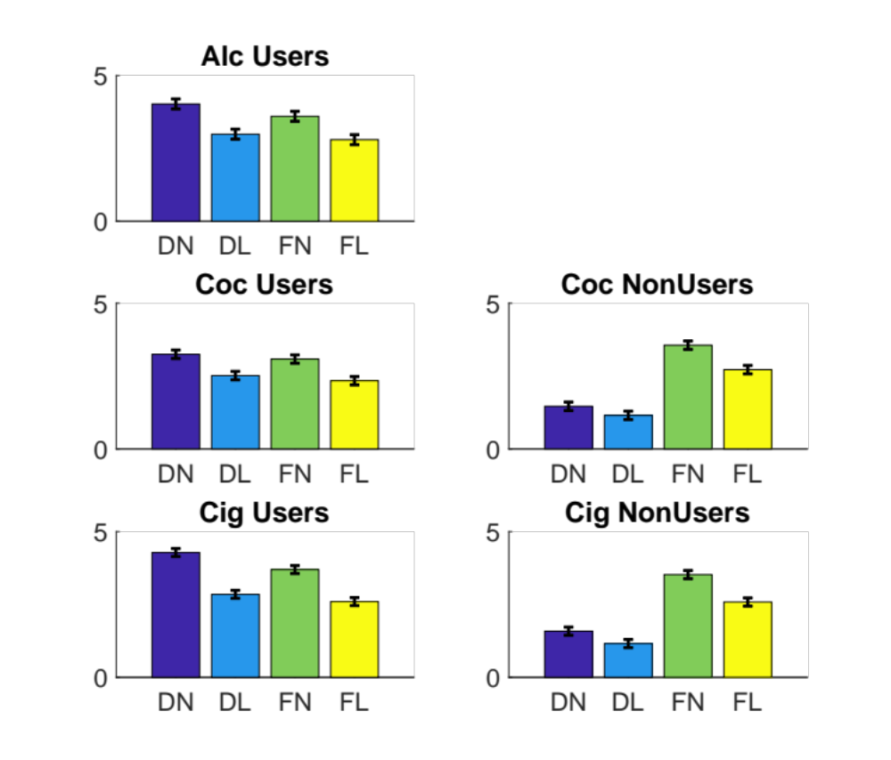
Craving self-report by condition and group
USERS
NON-USERS
Rating
Rating
DN = Drug NOW
DL = Drug LATER
FN = Food NOW
FL = Food LATER
Rating

Slide 3
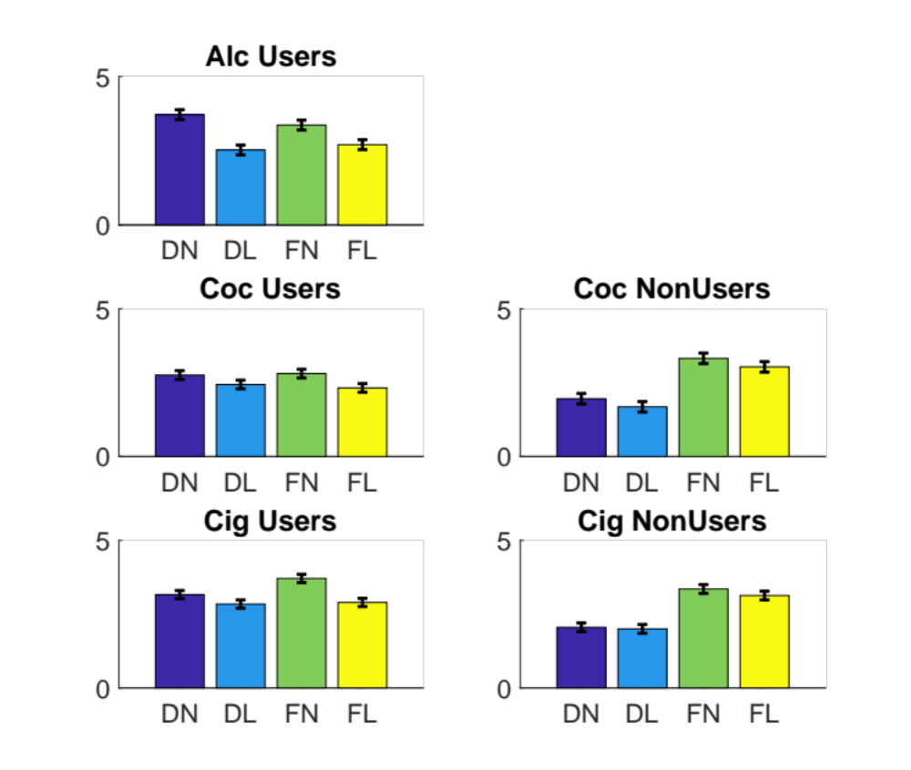
Pattern expression by condition and group
USERS
NON-USERS
NCS
NCS
DN = Drug NOW
DL = Drug LATER
FN = Food NOW
FL = Food LATER
NCS

