Slide 1
Effect size estimation pathway
Estimate unbiased ‘brain decoding’ effect sizes for a set of contrasts
Use:
Evaluate/benchmark a dataset or analysis pathway using two-alternative-forced-choice SVM classification to decode conditions from brain activity in new individual participants
specif_contrasts
brainomics_build_design_matrix.m
specif_model
onsets2fmridesign
X
Image data:
preprocessed_fMRI_bold.nii.gz
brainomics_1st_level_analysis
brainomics_reload_objects
condition_data_objects
Brainomics_condition_objects.mat
Legend
HTML Report Generation
brainomics_publish_svm_effect_size
Custom scripts
X
brainnomics_run_paired_SVM.m
canlab_run_paired_SVM
brainomics_reload_objects
Canlab Core functions
Key variables
brainnomics_run_paired_SVM.m
Analysis performance metrics:
SVM classification effect size (d)
Files
HTML Report saved in results/

Slide 2
condition_data_objects
brainomics_load_contrast_objects
brainomics_build_design_matrix.m
X
specif_contrasts
Image data:
specif_model
preprocessed_fMRI_bold.nii.gz
brainomics_1st_level_analysis
onsets2fmridesign
condition_data_objects
beta_maps
contrast_maps
con_data_objects
X
brainnomics_run_paired_SVM.m
canlab_run_paired_SVM
Analysis performance metrics:
SVM classification effect size (d)

Slide 3




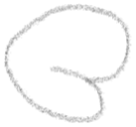



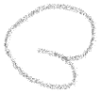








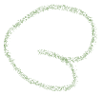






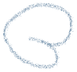

4-D neuroimaging data
fmri_data()
Data: obj.dat
voxels
Space: obj.volInfo
images
+ other metadata

Slide 4
